Slide 1
How to Raise Children to Become Wise, Responsible, Godly Adults
Training Your Child to Obey
Dealing with Rebellion
Training in Righteousness
Aiming for the Heart

Slide 2
Aiming for the Heart
We are often prone to judge others by what they say or how they behave outwardly.
Although what we say and do, is important in one sense, the true measure of who we are, as God sees it, is who we are in our innermost being (“heart”):
the LORD sees not as man sees: man looks on the outward appearance, but the LORD looks on the heart. (1Sam 16:7)
The Lord says: "These people come near to me with their mouth and honor me with their lips, but their hearts are far from me. (Isa 29:13a NIV)

Slide 3
Aiming for the Heart
In other words, the real you is who you are in your heart (inner thoughts and desires). All behavior flows out of the heart:
The good person out of the good treasure of his heart produces good, and the evil person out of his evil treasure produces evil, for out of the abundance of the heart his mouth speaks. (Luke 6:45)….
For from within, out of the heart of man, come evil thoughts, sexual immorality, theft, murder, adultery, coveting, wickedness, deceit, sensuality, envy, slander, pride, foolishness. (Mark 7:21)

Slide 4
Aiming for the Heart
Because we are unable to directly see what is going on in another person’s heart, we can easily be deceived by them as to why they’re behaving the way they are.
For example, someone may say one thing but be thinking another:
Do not eat the bread of a selfish man, Or desire his delicacies; For as he thinks within himself, so he is. He says to you, "Eat and drink!" But his heart is not with you. You will vomit up the morsel you have eaten, And waste your compliments. (Proverbs 23:6-8 NAS)
Or someone may “put on a show” of good behavior so that you will think well of them:
Beware of practicing your righteousness before other people in order to be seen by them…. (Mat 6:1)

Slide 5
Aiming for the Heart
In dealing with our kids, as in dealing with others, we can see what they do and say, but we can’t always know for sure what they’re thinking.
As parents you do need to address your children’s outward behavior.
But ultimately (as much as possible) you need to become aware of and address what’s going on in the heart of your child:
What they’re thinking
How they are reasoning
What they believe about God and the world around them
What are the motives and desires that are driving their behavior.

Slide 6
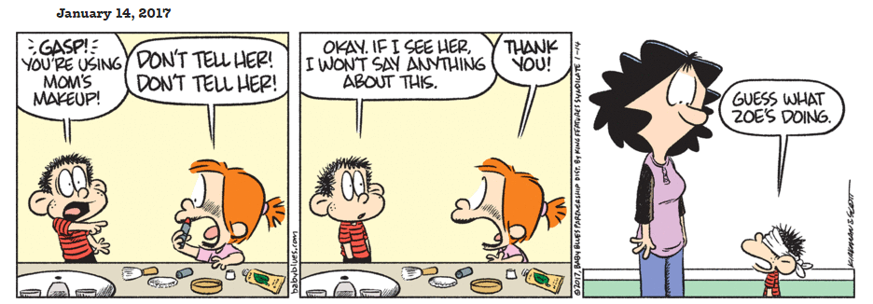
Aiming for the Heart
In the short term, if you don’t figure out how your kids think about things and what “makes them tick”, you will have a hard time motivating them and getting them to follow the “spirit of the law” rather than just the “letter of the law”.

Slide 7
Aiming for the Heart
In the long term, if you just work on getting your kids to outwardly do what you tell them to do and never work on reaching their heart, you may one day come to the horrifying realization that they don’t really buy into many of your most cherished values – including even the gospel itself!

Slide 8
Aiming for the Heart
Become a student of each of your kids:
If you have more than one kid, do everything you can to spend individual time with them on a regular basis.
Study their personality traits.
Notice the unique ways that God has gifted each of your kids.
Learn what kinds of things really motivate them and what kind of things really bother them.

Slide 9
Aiming for the Heart
Become a student of each of your kids:
When your kids are talking, really listen to them (you will need to teach them how to wait for you to acknowledge them before they start talking):
Listen to how they word things
Listen to their tone of voice.
Try to understand where they’re coming from – even if you don’t like what they’re telling you.
Take an interest in what’s going on in their life and in their minds – ask a lot of questions.

Slide 10
Aiming for the Heart
How to influence your child’s heart:
Talk to them about the things you believe and explain to them in detail why you believe them.
Expose them to other sources that re-enforce what you’re telling them so that they’re hearing it in more than one way from more than one person.
As you explain things to them, stop frequently and ask for feedback. Get them to respond to what you’re saying.
If they question your view resist the urge to be offended. Try instead to work through it with them.

Slide 11
Aiming for the Heart
How to influence your child’s heart:
Try to arrange things in such a way that you have extended periods of time to have casual conversations with each of your kids. For example:
Long walks or long trips sitting in the car together
Getting up early or staying up late at night.
Every opportunity you get, relate the things that are going on in their life or things they see going on around them back to a biblical worldview and the gospel.

Slide 12
Aiming for the Heart
The ultimate goal in shaping your child’s heart:
That they will see their need for the gospel and embrace it
That they will see God and His Word as the ultimate authority in life – even above your authority
That they will fear the Lord and want to please him above all

Slide 13
Odds and Ends That Are Left as We Finish This Class on Biblical Parenting
Special Considerations in Training Older Kids (Teenagers and Above)
Dealing With Your Kids as Adults
How to Be a Good Grandparent
Learning to Work Well Together With Your Spouse in Raising Your Kids
Going Through a Series of Fictitious Examples

