Slide 2
Review
When Muslims do a pilgrimage to Mecca what are they going to visit?
The Grand Mosque and a black building it surrounds called the Kaaba – which contains “the black stone”.
Why was Allah unwilling to forgive Muhammad’s parents when he interceded for them after their death?
They were guilty of shirk – the unforgivable sin.
According to the Hadith, 40 days after someone is conceived, an angel comes and writes a certain number of things that will happen to that person. What are those things?
Whether they will be male or female,
Whether they’re going to be successful or not,
The day of their death,
Whether they’re going to heaven or hell.

Slide 3
Review
Can a Muslim have any assurance that he is going to paradise when he dies?
No – there are people who do the deeds of the people of paradise their entire life, they’re righteous people, until they are a “hands breadth” from entering into paradise and then what is written of them overcomes them and they go to hell fire.
Describe the difference in the Quran between the Meccan surahs and the Medinan surahs and tell why there is a difference.
In the Meccan Surahs, where Muhammad is not in power, there is a lot of pleading for tolerance and religious freedom.
But in Medinan Surahs, written while Muhammad is in power and the head of the Islamic armies – there is much more of an emphasis on the use of the sword and fighting.
What did the third caliph, Uthman, do with copies of the Quran that didn’t agree with what he thought they should say – and why is this a problem?
He burned them
We no longer have access to all the manuscript evidence.

Slide 4
Islamic Conquests
https://islamandwesterncivilisation.com/posts/islam-a-religion-of-peace/historical-reality-muslim-conquests/

Slide 5
Islamic Conquests
After Muhammad’s death in 632, many Arabian tribes rebelled against his successor Abu Bakr, who ruled as caliph from AD 632 to 634 (Muslims refer to the period of a particular caliph’s rule as his caliphate).
Abu Bakr spent much of his brief caliphate subduing the rebellion.
But under the next caliph Omar (634-44), the Muslim armies came streaming out of Arabia, and the Islamic conquest of the Byzantine Empire began.
In AD 635, the Muslims besieged and captured Damascus.
In AD 637 they took Jerusalem.
In AD 638, Antioch, Caesarea, and 17 other cities along the Syrian coast fell to Muslim forces.
By AD 639 they had conquered the whole of Syria.
In AD 640 Muslim troops invaded Egypt;
In AD 641 Alexandria fell.
* Needham, Nick. 2,000 Years of Christ's Power Vol. 2: The Middle Ages

Slide 6
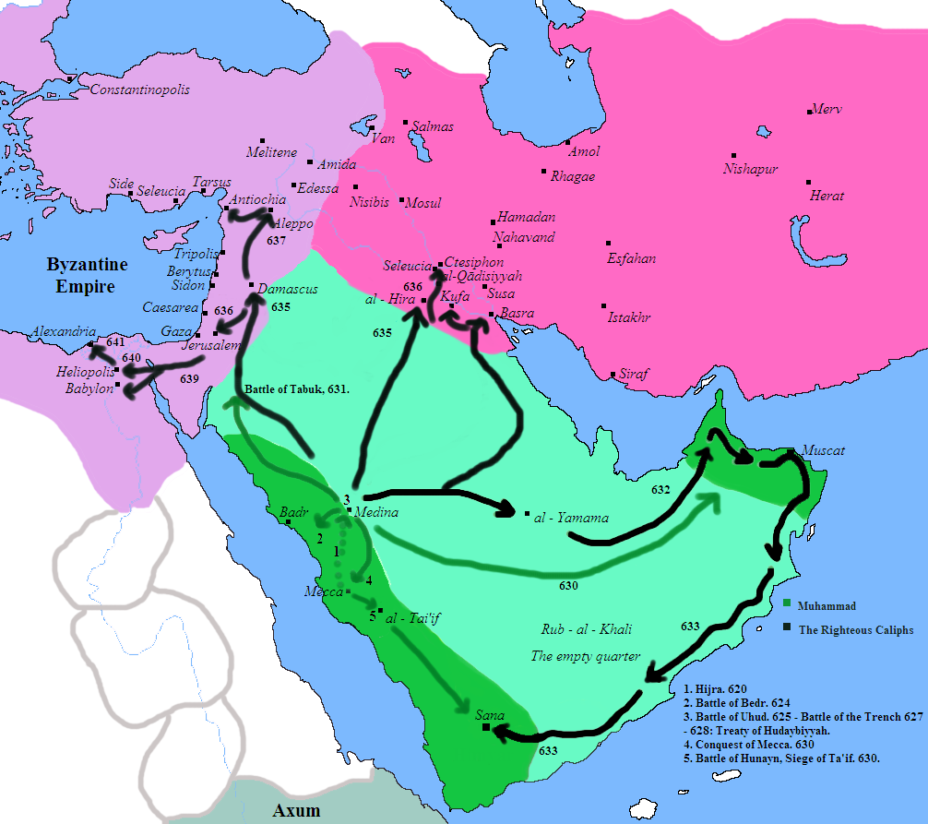
Islamic Conquests
https://en.wikipedia.org/wiki/Early_Muslim_conquests#/media/File:Muslim_Conquest.PNG

Slide 7
Islamic Conquests
Next, the Muslims turned their attention to destroying what was left of the Byzantine Empire, whose frontiers they had rolled back into Asia Minor.
Muslim fleets captured or laid waste many of the Mediterranean islands, such as Cyprus (AD 648).
By AD 651, the southern part of Asia Minor was under Muslim control. So too was most of Armenia.
The Muslims inflicted a crushing naval defeat on the Byzantines in AD 655 at the battle of Phoenix (off the southern coast of Asia Minor).
By the early 8th century, Muslim conquests in the east brought Afghanistan and northern India under Muslim control.
* Needham, Nick. 2,000 Years of Christ's Power Vol. 2: The Middle Ages

Slide 8
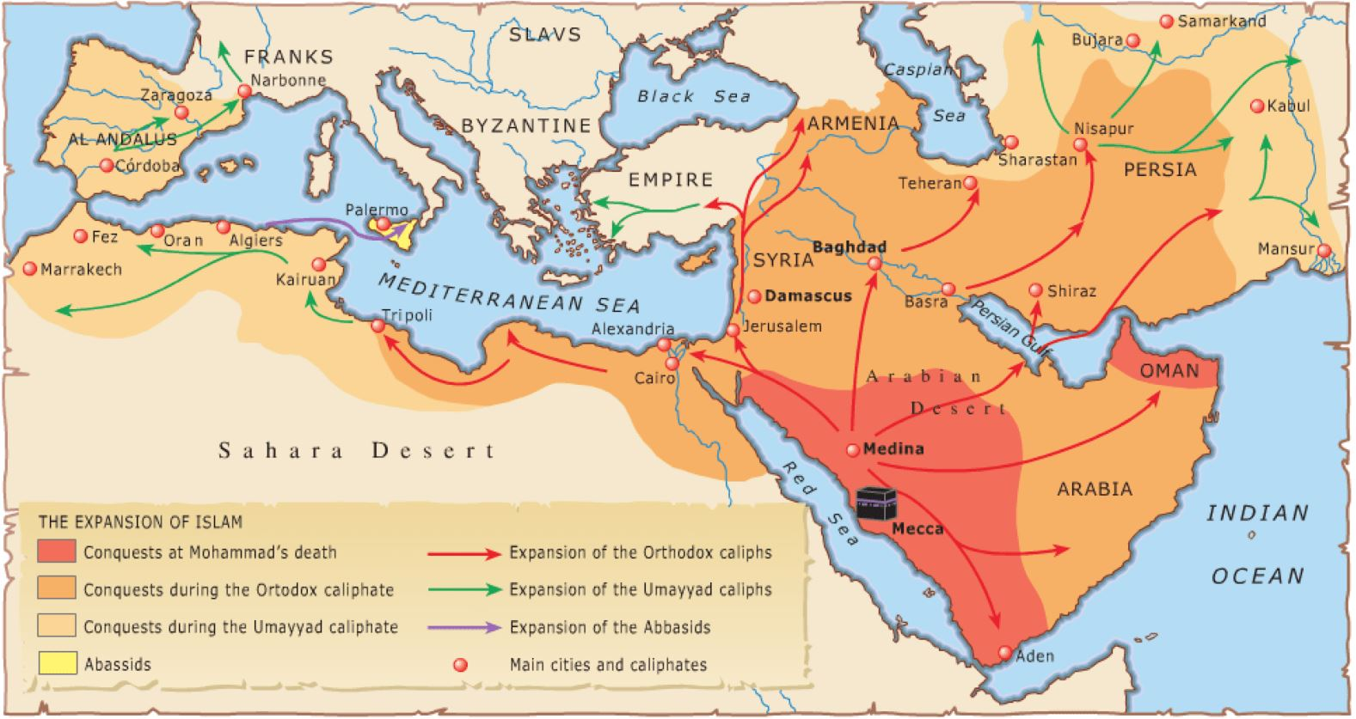
Islamic Expansion in the Middle Ages
https://i1.wp.com/slife.org/wp-content/uploads/Islam-and-Its-Arabian-Context.png?fit=1600%2C902&ssl=1

Slide 9
Islamic Conquests
Finally, under their fifth caliph Muawiyah (AD 661-80), the Muslim forces on land and sea gambled all their strength in a supreme effort to capture Constantinople itself.
The siege lasted five cruel years (AD 673-78).
However, for the first time, the Muslims met with total failure and defeat.
A recently invented Byzantine secret weapon called “Greek fire” ravaged their armies and ships (it was a chemical mixture which burned furiously when it came in contact with water).
The defenders of Constantinople hurled Greek fire at the besieging Muslim army and navy, with horrifically destructive effect.
* Needham, Nick. 2,000 Years of Christ's Power Vol. 2: The Middle Ages

Slide 10
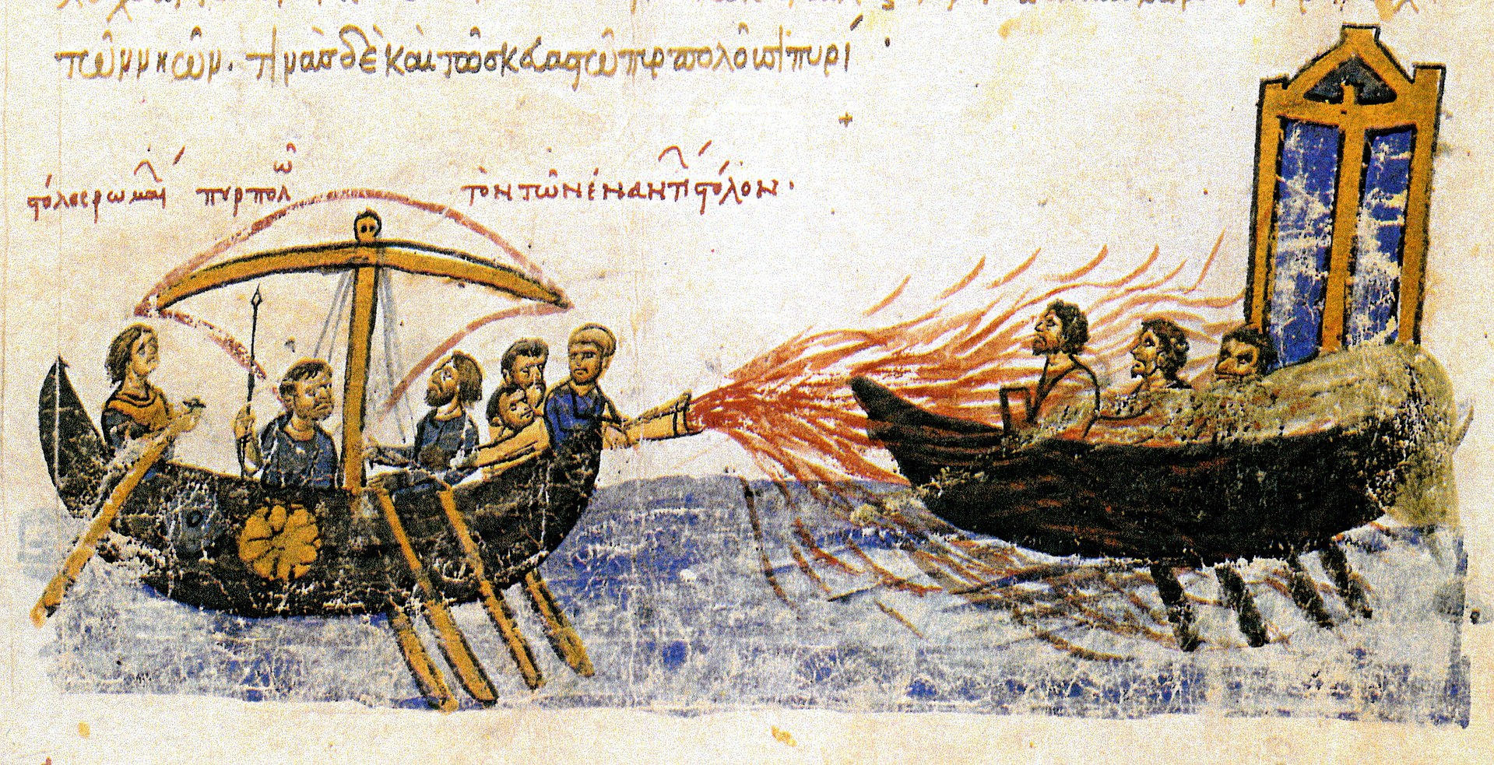
Greek Fire
12th Century Illustration by John Skylitzes
https://en.wikipedia.org/wiki/Greek_fire#/media/File:Greekfire-madridskylitzes1.jpg

Slide 11
Islamic Conquests
Greek fire became the “nuclear bomb” of medieval warfare – devastating, irresistible, and terrifying. Then a storm off the coast of Pamphylia smashed the Muslim fleet.
Finally, the great Byzantine Emperor Constantine IV (AD 668-85) wiped out the Muslim army at the Battle of Syllaeum in AD 678.
In AD 679, Constantine IV and caliph Muawiyah ceased hostilities and officially recognized each other’s territory.
* Needham, Nick. 2,000 Years of Christ's Power Vol. 2: The Middle Ages

Slide 12
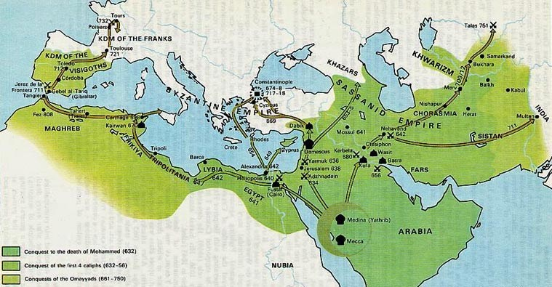
Islamic Expansion in the Middle Ages
https://i3.wp.com/iranpoliticsclub.net/maps/images/109%20Muslim%20Conquest%20632-750%20Map.jpg

Slide 13
Islamic Conquests
In the West, Muslim armies swept on from Egypt into North-West Africa.
Here they encountered strong resistance from the Berber people. It took the Muslims 50 years of savage fighting to subdue the Berbers, who then embraced the new faith themselves and became strict and zealous Muslims.
In AD 711, an Islamic Berber army crossed over from Africa into Visigothic Spain, and by AD 718 had conquered almost the whole of it – the northern coastlands alone remained under Visigothic Christian control.
* Needham, Nick. 2,000 Years of Christ's Power Vol. 2: The Middle Ages

Slide 14
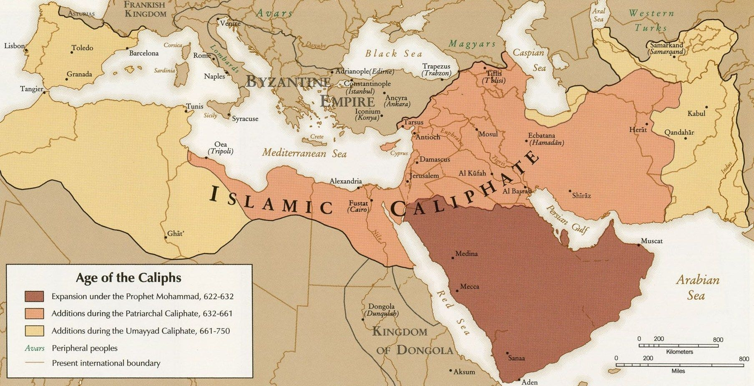
Islamic Expansion in the Middle Ages
https://collections.leventhalmap.org/search/commonwealth:q524n615z

Slide 15
Islamic Conquests
The Muslims then pushed on into France.
At Tours, in north-west France, they were met by a Frankish Catholic army.
Here in AD 732, the Muslim general Abd-er Rahman fought one of the decisive battles of world history against the Frankish general Charles Martel (Martel is French for “hammer”).
The Battle of Tours was a decisive victory for Charles Martel and the Franks; it permanently halted the Western progress of the Islamic Empire.
* Needham, Nick. 2,000 Years of Christ's Power Vol. 2: The Middle Ages

Slide 16
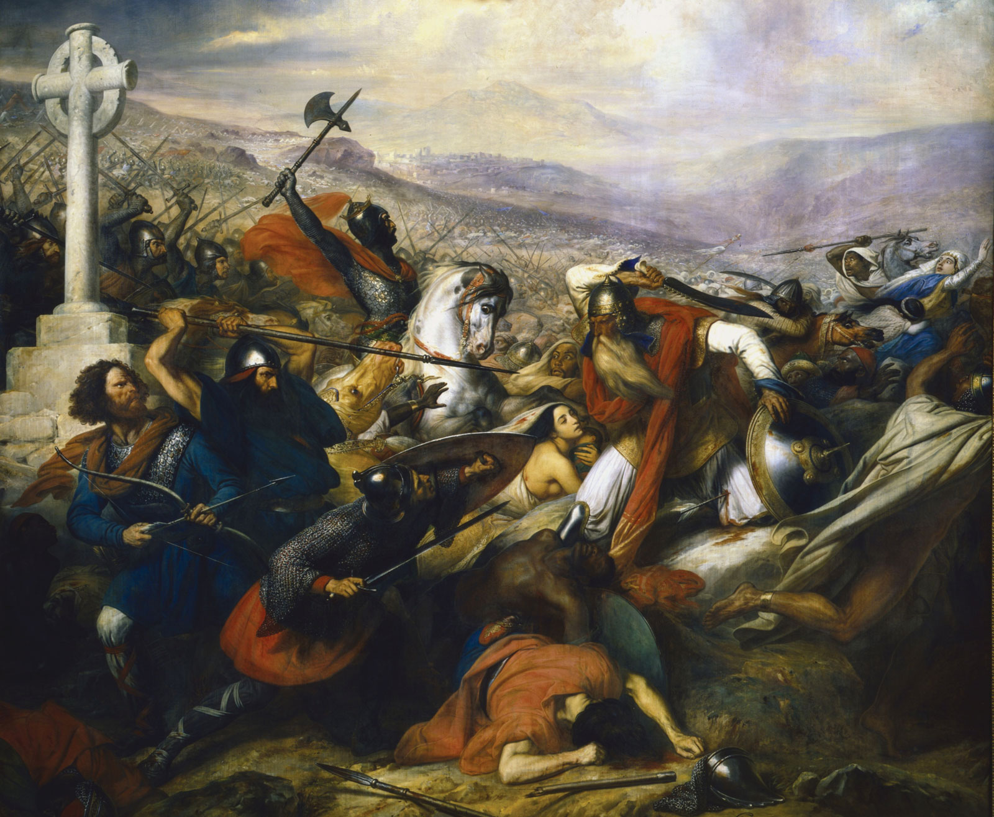
The Battle of Tours
19th Century Painting by Charles de Steuben
https://en.wikipedia.org/wiki/Charles_de_Steuben#/media/File:Steuben_-_Bataille_de_Poitiers.png

Slide 17
Islamic Expansion in the Middle Ages
https://i3.wp.com/iranpoliticsclub.net/maps/images/109%20Muslim%20Conquest%20632-750%20Map.jpg

Slide 18
Islamic Conquests
The Franks forced the Muslims back into Spain, and there they stayed for the next 700 years.
After centuries of struggle between Christians and Muslims in the Iberian peninsula, the great Spanish Catholic king, Ferdinand of Castile and Aragon, finally expelled the last Muslims of Spain back into North Africa in 1492.
This Christian-Muslim conflict in Spain, with the eventual triumph of the Christians, is known as the Reconquista (the “Reconquest”).
* Needham, Nick. 2,000 Years of Christ's Power Vol. 2: The Middle Ages

Slide 19
Islamic Dissention
The unity of the Islamic Empire was at first impressive, but it did not last.
Religious dissension arose after the murder of Othman, the third caliph, in AD 656. Muslims divided into two parties.
One party argued that the leadership of the Empire must be hereditary within the family of Muhammad, through Ali and his relatives (Ali was Muhammad’s cousin and had married Muhammad’s daughter Fatima, so that his children were Muhammad’s grandchildren).
This group was known as the Shiat Ali, “the party of Ali” – or the Shias, as they came to be called.
Shias held that a living leader (an imam), chosen by God from among Muhammad’s family, was essential to the right guidance of the Islamic community.
* Needham, Nick. 2,000 Years of Christ's Power Vol. 2: The Middle Ages

Slide 20
Islamic Dissention
The unity of the Islamic Empire was at first impressive, but it did not last.
Religious dissension arose after the murder of Othman, the third caliph, in AD 656. Muslims divided into two parties.
By contrast, the other party believed that the nation’s elders should freely elect each new caliph (or that the caliph should himself appoint his own successor), and that the caliph did not need to belong to Muhammad’s family.
This party was called the Sunnis.
They held that the sunna (the authentic hadith concerning Muhammad) was more important than a living leader for the guidance of the faithful.
* Needham, Nick. 2,000 Years of Christ's Power Vol. 2: The Middle Ages

Slide 21
Islamic Dissention
The Shias and Sunnis plunged the Islamic Empire into its first taste of civil war.
The Sunnis massacred Ali’s family, but the Shia party survived the disaster.
These fierce internal conflicts created a permanent religious division in the Islamic world between Sunni and Shia Muslims.
Shias were always in a small minority (between 10-15%), but their influence was concentrated in one region, Persia (present-day Iran), which became the great Shia stronghold.
* Needham, Nick. 2,000 Years of Christ's Power Vol. 2: The Middle Ages

Slide 22
Islamic Dissention
in AD 756, Muslim Spain seceded from the rest of the Islamic Empire, weakening the Empire’s political unity.
In the 9th century, Shia Persia became effectively independent from the caliphs who ruled in Baghdad. So did Morocco, Tunisia, and Libya in North-West Africa.
In the 10th century, Egypt also seceded and became an independent Muslim kingdom.
This political and territorial break-up of Islam paved the way for the Western Catholic conquest of the Middle East by the Crusaders in the 11th century.
* Needham, Nick. 2,000 Years of Christ's Power Vol. 2: The Middle Ages

Slide 23
Life for the Church under Islamic Rule
https://en.wikipedia.org/wiki/Christianity_in_the_Ottoman_Empire#/media/File:Gennadios.jpg

Slide 24
https://www.hopehelps.org/volunteer-appreciation-week-2018/

Slide 25
Class Discussion Time
https://www.weareteachers.com/moving-beyond-classroom-discussions/

Slide 26
*Class Discussion Time
Because we have the advantage of hindsight, many times as we look back over historical events we can identify times where, in the providence of God, a seemingly minor event significantly changed the course of history.
Of the historical events that we looked at this morning, do you see any that you would identify as being in this category? If so, which one(s)?
We know that all of the events of human history are under God’s control and will ultimately bring Him glory.
Do you find it difficult to see how something as terrible as the centuries long expansion of the Islam could bring glory to God? How might it do so?
Do you have a topic or question that you would like to see us to discuss?

