Slide 1
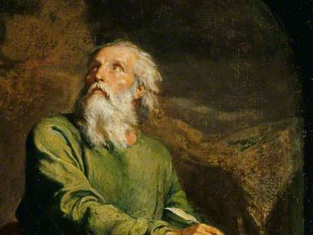
Highlights From the Book of Isaiah
To Download this lesson go to:
http://www.purifiedbyfaith.com/Isaiah/Isaiah.htm
https://www.wikiart.org/en/ernest-meissonier/isaiah

Slide 2
Outline of the Book of Isaiah
Isaiah’s Warning of Judgment on Israel (1-39)
Judgement and Hope for Jerusalem (1-12)
Judgement and Hope for the Nations (13-27)
True Deliverance Is Found, Not in Egypt, But in the Lord (28-35)
The Lessons of History (36-39)
The Deliverance of Jerusalem from Assyria (36-37)
Hezekiah’s Sickness and Recovery (38)
A Visit From the Envoys of Babylon (39)
The Promise of Future Hope in the New Jerusalem (40-66)

Slide 3
The Deliverance of Jerusalem from Assyria (36-37)
This section unfolds as follows:
The Assyrian Chief Adviser Addresses Hezekiah Though His Envoys (36:1-10)
The Assyrian Chief Adviser Appeals to the People of Jerusalem Sitting on the Wall (36:11-20)
Reactions to the Assyrian Ultimatum (36:21-37:7)
The King of Assyria’s Letter to Hezekiah (37:8-13)
Hezekiah’s Prayer (37:14-20)
The LORD’s Response to the Prayer of Hezekiah (37:21-35)
The LORD Destroys the Assyrian Army (37:36-38)
Oswalt, John . Isaiah (The NIV Application Commentary) (pp. 398-399).

Slide 4
The King of Assyria’s Letter to Hezekiah (37:8-13)
The chief adviser had failed to bring about an easy surrender on the part of Hezekiah and the city of Jerusalem.
But before Sennacherib could send his whole army against Jerusalem, a major threat loomed up from the south.
To counter that menace, Sennacherib had to take away the troops that he had already sent against the Jerusalem.
But lest Hezekiah and his people think they were safe from Assyria’s threats, Sennacherib sent a warning letter to Hezekiah, implying that he would return soon.
His letter contained no new arguments, beyond what had already been threatened by the chief adviser.
But it did remind Hezekiah of how dangerous his situation remained.
Mackay, John L. – A Study Commentary on Isaiah Volume I: Chapters 1-39 (p.731)

Slide 5
The King of Assyria’s Letter to Hezekiah (37:8-13)
^{37:8} When the chief adviser heard the king of Assyria had departed from Lachish, he left and went to Libnah, where the king was campaigning. ⁹ The king heard that King Tirhakah, [the Cushite king of Egypt], was marching out to fight him. He again sent messengers to Hezekiah, ordering them: ¹⁰ “Tell King Hezekiah of Judah this: ‘Don’t let your God in whom you trust mislead you when he says, “Jerusalem will not be handed over to the king of Assyria.” ¹¹ Certainly you have heard how the kings of Assyria have annihilated all lands. Do you really think you will be rescued? ¹² Were the nations whom my predecessors destroyed—the nations of Gozan, Haran, Rezeph, and the people of Eden in Telassar—rescued by their gods? ¹³ Where is the king of Hamath or the king of Arpad or the kings of Lair, Sepharvaim, Hena, and Ivvah?’”

Slide 6
^{37:8} When the chief adviser heard the king of Assyria had departed from Lachish, he left and went to Libnah, where the king was campaigning.
The unspoken assumption here is that Hezekiah had refused to surrender to Sennacherib’s spokesman, the “chief adviser”.
So, the “chief adviser” left Jerusalem to deliver Hezekiah’s response to Sennacherib, who had just finished capturing the city of “Lachish” and was now attacking the city of “Libnah”, seven miles to the north.
It was common practice for the Assyrian army to capture a fortified city like Lachish first and then seize the weaker cities around it.
Wegner, Paul D. – Isaiah An Introduction and Commentary - Tyndale OT Commentaries

Slide 7
^{37:9a} The king heard that King Tirhakah, [the Cushite king of Egypt], was marching out to fight him.
In 701 BC, while Sennacherib was leading an attack against the city of Libnah, he received a report that “King Tirhakah, [the Cushite king of Egypt]” and his army were headed north, with the intention of attacking him.
We know from history that “King Tirhakah” didn’t actually become “king” until eleven years later: at which time he reigned from 690-664 BC.
Tirhakah’s father, Shebitku, who was the Cushite king at the time, sent his son “Tirhakah” as commander of the army to fight against Sennacherib.
“Tirhakah” is referred to here as “king” simply because he later became king and that’s how later readers of this account would have known him.
Wegner, Paul D. – Isaiah An Introduction and Commentary - Tyndale OT Commentaries

Slide 8
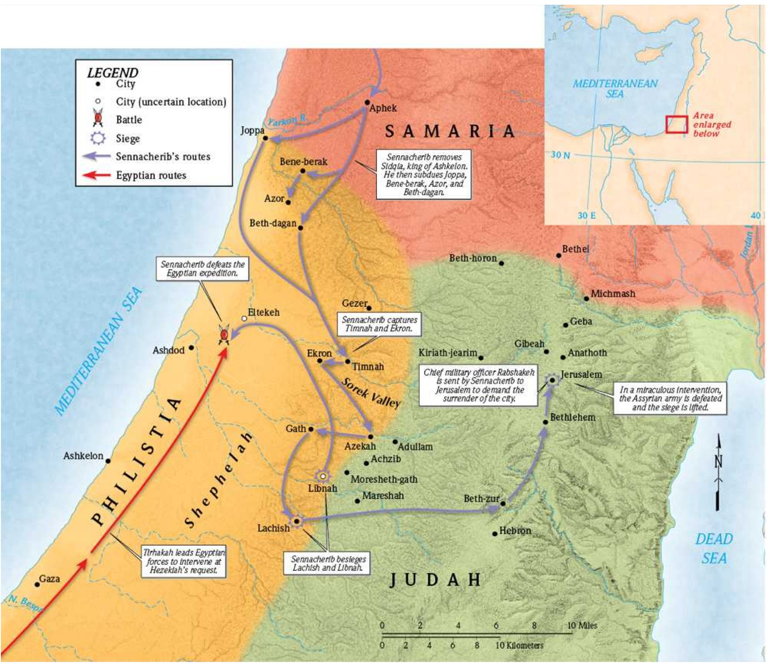
Sennacherib’s Route to Jerusalem
Ultimate Bible Atlas © 2020 by Holman Bible Publishers,
CSB Bibles by Holman. Ultimate Bible Atlas (Ultimate Guide) (Kindle Location 313). B&H Publishing Group. Kindle Edition.

Slide 9
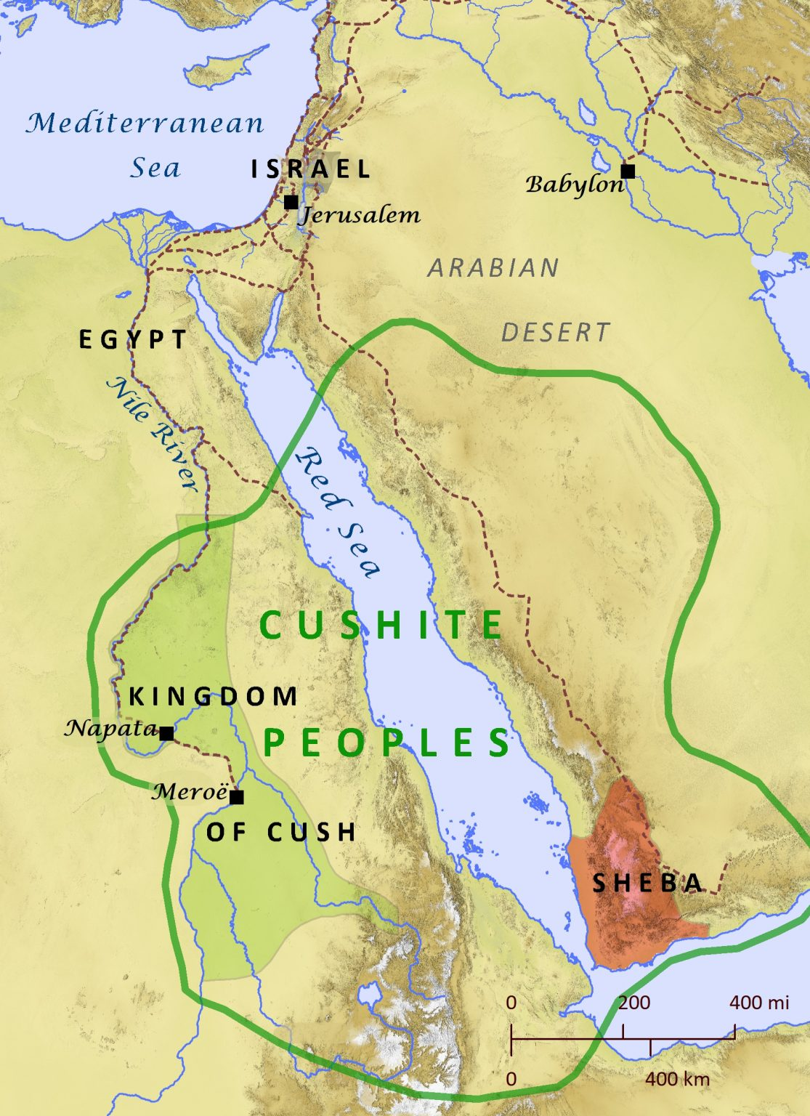
Kingdom of Cush (כּוּשׁ)
https://biblemapper.com/blog/index.php/2020/01/23/sheba/

Slide 10
^{37:9b} He again sent messengers to Hezekiah, ordering them: ¹⁰ “Tell King Hezekiah of Judah this: ‘Don’t let your God in whom you trust mislead you when he says, “Jerusalem will not be handed over to the king of Assyria.”
Before heading off to do battle with the Egyptian forces, Sennacherib sent a message to Hezekiah.
Unlike the chief adviser’s message, which was an attack upon Hezekiah, Sennacherib’s message was an attack upon the LORD himself.
In the chief adviser’s message it was Hezekiah who was deceiving the people.
Now it’s the LORD who is misleading Hezekiah!
At this point, the purpose is not to discredit Hezekiah in the eyes of the people, but to discredit the LORD in the eyes of Hezekiah.
Notice too that Sennacherib finally acknowledges Hezekiah’s title as “King” – something which the chief adviser had refused to do when speaking to the people.
Oswalt, John N.. The Book of Isaiah, Chapters 1–39 (The NIC on the OT) (p. 650).

Slide 11
^{37:11} Certainly you have heard how the kings of Assyria have annihilated all lands. Do you really think you will be rescued?
By saying “Certainly you have heard…” Sennacherib reminds Hezekiah of information that was in the public domain and seemingly incontestable.
For nearly fifty years the Assyrians had been extending their control over Mesopotamia and the Middle East and had “annihilated” all who opposed them.
The Assyrians had enjoyed almost total success in their ruthless policy of exterminating the opposition.
So it seems ridiculous for Hezekiah to think that he would be the exception and “be rescued”.
Mackay, John L. – A Study Commentary on Isaiah Volume I: Chapters 1-39 (p.734)

Slide 12
^{37:12} Were the nations whom my predecessors destroyed – the nations of Gozan, Haran, Rezeph, and the people of Eden in Telassar – rescued by their gods?
He then lists specific city-states that had surrendered to Assyrian kings who preceded Sennacherib (including his own father, Sargon II) – the nations of:
“Gozan”
“Haran”
“Rezeph”
“the people of Eden in Telassar”.
The point of this verse is that the gods of these nations could not protect their cities from the great and powerful Assyrians.
So what makes Hezekiah think that his God can rescue his city from the Assyrians?
Wegner, Paul D. – Isaiah An Introduction and Commentary - Tyndale OT Commentaries

Slide 13
^{37:13} Where is the king of Hamath or the king of Arpad or the kings of Lair, Sepharvaim, Hena, and Ivvah?’”
He then personalizes the message for King Hezekiah by asking the whereabouts of the kings he had defeated: “Where is the king of Hamath or the king of Arpad or the kings of Lair, Sepharvaim, Hena, and Ivvah?”
Of the cities we can identify, their kings were either killed or captured and the cities themselves destroyed.
Hezekiah would probably have been familiar with these Assyrian conquests.
Wegner, Paul D. – Isaiah An Introduction and Commentary - Tyndale OT Commentaries

Slide 14
Hezekiah’s Prayer (37:14-20)
^{37:14} Hezekiah took the letter from the messengers and read it. Then Hezekiah went up to the LORD’s temple and spread it out before the LORD. ¹⁵ Hezekiah prayed before the LORD: ¹⁶ “O LORD of Heaven’s Armies, O God of Israel, who is enthroned on the cherubim! You alone are God over all the kingdoms of the earth. You made the sky and the earth. ¹⁷ Pay attention, LORD, and hear! Open your eyes, LORD, and observe! Listen to this entire message Sennacherib sent and how he taunts the living God! ¹⁸ It is true, LORD, that the kings of Assyria have destroyed all the nations and their lands. ¹⁹ They have burned the gods of the nations, for they are not really gods, but only the product of human hands manufactured from wood and stone. That is why the Assyrians could destroy them. ²⁰ Now, O LORD our God, rescue us from his power, so all the kingdoms of the earth may know that you alone are the LORD.”

Slide 15
^{37:14} Hezekiah took the letter from the messengers and read it. Then Hezekiah went up to the LORD’s temple and spread it out before the LORD.
It now becomes apparent that Sennacherib had commissioned his messengers to deliver his massage orally and also give Hezekiah a written copy of what was said.
There is no mention here of torn clothes or sackcloth (in contrast to 37:1), and it would seem that the king was less despondent than he had been previously.
However it was clear that his troubles had not ended.
And so he again goes up to the “temple” (cf. 37:1) to seek the LORD’s assistance.
Mackay, John L. – A Study Commentary on Isaiah Volume I: Chapters 1-39 (p.736)

Slide 16
^{37:14} Hezekiah took the letter from the messengers and read it. Then Hezekiah went up to the LORD’s temple and spread it out before the LORD.
We don’t know exactly how Hezekiah “spread [the letter] out before the LORD”
But one thing we do know – this was not an attempt on the part of Hezekiah to inform God of something that he didn’t already know.
Instead, it was an obvious gesture to show that he was committing the matter and its resolution to the LORD.
Hezekiah knew he was incapable of coping with the challenge, and in faith he awaited God’s response.
In this, his conduct contrasts sharply with that of his father, Ahaz:
But Ahaz responded, “I don’t want to ask; I don’t want to put the Lord to a test.” (Isaiah 7:12)
Mackay, John L. – A Study Commentary on Isaiah Volume I: Chapters 1-39 (p.736)

Slide 17
^{37:15} Hezekiah prayed before the LORD: ¹⁶ “O LORD of Heaven’s Armies, O God of Israel, who is enthroned on the cherubim! You alone are God over all the kingdoms of the earth. You made the sky and the earth.
Hezekiah’s approach to the LORD is not based on arguments that would portray him as somehow worthy of being helped.
He begins with adoration of the LORD as he wonders anew at the privilege he enjoys of being able to be in covenant relationship with such a God.
The title “LORD of Heaven’s Armies” points to the majesty and immense power of God, who has every being under his control.
The mention of “Hosts” or “Armies”, was of particular relevance when facing the might of the Assyrian armies.
Mackay, John L. – A Study Commentary on Isaiah Volume I: Chapters 1-39 (p.737)

Slide 18
^{37:15} Hezekiah prayed before the LORD: ¹⁶ “O LORD of Heaven’s Armies, O God of Israel, who is enthroned on the cherubim! You alone are God over all the kingdoms of the earth. You made the sky and the earth.
As “God of Israel”, the LORD, the God of the covenant, had been pleased to enter into a special relationship with his chosen people, represented now by the remaining southern kingdom of Judah.
On the basis of God’s sovereign commitment, his people may come with confidence, knowing that he will have compassion on them (cf. Zech 10:6)
But even so, the fact that the LORD was “enthroned on the cherubim” (cf. 1 Sam 4:4; Ps 80:1) warned against presumption.
For although the LORD had graciously condescended to be present in the temple at the center of the nation, he was still guarded by “the cherubim”.
These winged celestial beings are the throne attendants of God (Ezek 10:1ff) – two of whom were represented in gold above the ark of the covenant (Ex 25:18-20)
Mackay, John L. – A Study Commentary on Isaiah Volume I: Chapters 1-39 (p.737)

Slide 19
^{37:15} Hezekiah prayed before the LORD: ¹⁶ “O LORD of Heaven’s Armies, O God of Israel, who is enthroned on the cherubim! You alone are God over all the kingdoms of the earth. You made the sky and the earth.
The LORD “alone” is God; he is unique; none can rival him.
What is more, his authority is not limited to one nation, but he rules “all the kingdoms of the earth” – and that includes their kings.
His universal dominion is the result of his being the Creator of all (cf. 40:22-23).
In faith Hezekiah had grasped these grand truths which were not understood by Assyria and her leaders.
Mackay, John L. – A Study Commentary on Isaiah Volume I: Chapters 1-39 (p.737)

Slide 20
^{37:17} Pay attention, LORD, and hear! Open your eyes, LORD, and observe! Listen to this entire message Sennacherib sent and how he taunts the living God!
Here Hezekiah addresses the LORD using five imperatives in rapid succession:
“Pay attention”
“Hear”
“Open your eyes”
“Observe”
“Listen to this… message Sennacherib sent”
But he doesn’t give the actual petition of his prayer until verse 20!
Here he is presenting a complaint with great persistence, using language similar to the plea of Solomon’s inaugural prayer where he says: “Now, my God, may you be attentive and responsive to the prayers offered in this place” (2 Chr 6:40)
Mackay, John L. – A Study Commentary on Isaiah Volume I: Chapters 1-39 (p.738)

Slide 21
^{37:17} Pay attention, LORD, and hear! Open your eyes, LORD, and observe! Listen to this entire message Sennacherib sent and how he taunts the living God!
In the mind of Hezekiah, there seemed to be a gross discrepancy between what he knew of the LORD’s character and the situation that currently prevailed.
It seemed impossible that the LORD could tolerate the words of Sennacherib, and yet the LORD had done nothing to about it.
How could the LORD endure such blasphemous statements uttered against his name? (cf. 37:4)
An idol would not be able to react against such ridicule, but the LORD is no idol – he is “the living God”!
Mackay, John L. – A Study Commentary on Isaiah Volume I: Chapters 1-39 (p.738)

Slide 22
^{37:18} It is true, LORD, that the kings of Assyria have destroyed all the nations and their lands. ¹⁹ They have burned the gods of the nations, for they are not really gods, but only the product of human hands manufactured from wood and stone. That is why the Assyrians could destroy them.
Hezekiah concedes that the Assyrian kings have had great military success against “all the nations and their lands. ”
In their campaigns they had ravaged “nations” far and wide and had demonstrated their power over other “gods” by burning their idols.
However, that was not really a problem because those gods were “not really gods”, but merely “the product of human hands”.
Mackay, John L. – A Study Commentary on Isaiah Volume I: Chapters 1-39 (pp.738-739)

Slide 23
^{37:18} It is true, LORD, that the kings of Assyria have destroyed all the nations and their lands. ¹⁹ They have burned the gods of the nations, for they are not really gods, but only the product of human hands manufactured from wood and stone. That is why the Assyrians could destroy them.
The worshippers of those pagan nations might claim that their objects of worship were inhabited by some divine power or force.
But the eye of faith could see nothing other than a material idol which could be destroyed with no consequence.
Though he doesn’t come right out and say it, Hezekiah is aghast at the idea that the Assyrians might be permitted to pillage and devastate the land of the people who worshipped not an idol, but the one true and living God.
Surely that could not be allowed to happen!
Mackay, John L. – A Study Commentary on Isaiah Volume I: Chapters 1-39 (pp.738-739)

Slide 24
^{37:20} Now, O LORD our God, rescue us from his power, so all the kingdoms of the earth may know that you alone are the LORD.”
“Now” introduces the conclusion of Hezekiah’s argument and (finally) the actual petition of his prayer: “rescue us! ”.
As leader of the LORD’s people he looks to God to fulfill his word and rescue his people from danger.
The king acknowledges that they are powerless to go against the superior force possessed by their enemy.
But at the same time he recognizes the ability of God to intervene effectively.
Mackay, John L. – A Study Commentary on Isaiah Volume I: Chapters 1-39 (p.739)

Slide 25
^{37:20} Now, O LORD our God, rescue us from his power, so all the kingdoms of the earth may know that you alone are the LORD.”
He ends here with the affirmation with which he began his prayer: the uniqueness of the LORD, “alone”.
He who is the one true Deity who could stop the Assyrians and avert the disaster currently faced by his people.
If he did so, then there would be compelling grounds for universal recognition of the LORD’s uniqueness throughout “all the kingdoms of the earth”.
The ultimate aim of Hezekiah’s prayer was not the deliverance of his people, but that through that deliverance the LORD would receive glory.
Mackay, John L. – A Study Commentary on Isaiah Volume I: Chapters 1-39 (p.739)

Slide 26
Next Time
I plan to look at the LORD’s response to the prayer of Hezekiah (Isaiah 37:21-35) and the destruction of the Assyrian army (Isaiah 37:36-38).

Slide 27
Class Discussion Time
https://www.weareteachers.com/moving-beyond-classroom-discussions/

Slide 28
Class Discussion Time
In his prayer, Hezekiah doesn’t just ask for what he wants – he makes an argument as to why it would be appropriate for God to do what he is asking.
Spurgeon once observed that:
The ancient saints were given with Job, to ordering their cause before God. As a petitioner coming into court does not come there without thought to state his case on the spur of the moment, but enters into the audience chamber with his suit well prepared, having also learned how he ought to behave himself in the presence of the great one to whom he is appealing, so it is well to approach the seat of the King of Kings as much as possible with premeditation and preparation, knowing what we are about, where we are standing, and what it is which we desire to obtain. ("Effective Prayer," Gospel Mission, p. 4)

Slide 29
Class Discussion Time
Spurgeon then gives an example from his own personal experience. He says:
The best prayers I have ever heard in our prayer meetings have been those which have been fullest of argument. Sometimes my soul has been fairly melted down where I have listened to the brethren who have come before God feeling the mercy to be really needed, and that they must have it, for they first pleaded with God to give it for this reason, and then for a second, and then for a third and then for a fourth and a fifth until they have awakened the fervency of the entire assembly. ("Effective Prayer," p. 10)
Is this a practice that you think might be good to incorporate into our own prayers?

Slide 30
Class Discussion Time
The ability to reason logically is a great gift. But our logic is only as good as the premises upon which that logic is built.
Sennacherib’s reasoning was very logical. Other nations had thought their gods would save them, but over and over the Assyrians had shown the trust that those nations had in their gods was misplaced.
Therefore he assumes that Hezekiah’s God would not be able to save him. But that’s where he gets it wrong because he has a wrong premise: God is not like “other gods”.
Hezekiah was being tested as to the strength of his trust in the LORD. As the Psalm says: “in God I trust; I am not afraid. What can mere men do to me?” (Ps 56:11).
The same response of trust in God and his word is called for in every clash with worldly thinking. Faith endures by refusing to cower before worldly wisdom and might by seeing him who is invisible.
Can you think of a modern situation where we might be called upon to have such faith?

