Slide 1
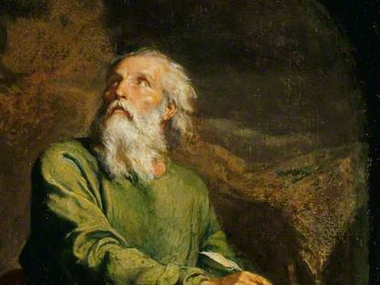
Highlights From the Book of Isaiah
To Download this lesson go to:
http://www.purifiedbyfaith.com/Isaiah/Isaiah.htm
https://www.wikiart.org/en/ernest-meissonier/isaiah

Slide 2
The Future Vindication of God on the World Stage (45:14-25)
We have now reached one of the grandest moments in the book.
Cyrus fades into the background and the whole scene is dominated by the uniqueness and glory of the one who has chosen to use him.
This magnificent poem develops the thought introduced in Isaiah 45:6 – “I do this so people will recognize from east to west that there is no God but me; I am the LORD, I have no peer. ”
Cyrus’s mission will demonstrate this fact, and one day people everywhere will acknowledge it.
There are two speeches by the LORD in this passage, and two short responses by Isaiah.
Webb, Barry G.. The Message of Isaiah (The Bible Speaks Today Series) (p. 185).

Slide 3
The LORD Speaks (45:14)
^{45:14} This is what the LORD says: “The profit of Egypt and the revenue of Ethiopia, along with the Sabeans, those tall men, will be brought to you and become yours. They will walk behind you, coming along in chains. They will bow down to you and pray to you: ‘Truly God is with you; he has no peer; there is no other God!’”

Slide 4
The LORD Speaks (45:14)
This first speech is addressed to Jerusalem, as indicated by use of the feminine singular pronoun “you” (in the previous verse Isaiah has just referred to “my city”, a feminine noun).
In a larger sense, Jerusalem in this passage represents the people of God.
And the astounding assertion of this speech is that the people of God will rule the world!
Webb, Barry G.. The Message of Isaiah (The Bible Speaks Today Series) (p. 185).

Slide 5
The LORD Speaks (45:14)
Verse 14 tells us that the rich agricultural products of the Nile valley and other merchandise of “Egypt” and “Ethiopia” will flow into Jerusalem.
Likewise, the tall “Sabeans” will come like prisoners in a victory parade, confessing that there is no God but the one who reigns in Jerusalem.
Like the magi who came to worship Jesus, they represent all that is remote and exotic in heathendom.
Egypt, on the other hand, represents everything that is cultured and rich.
Webb, Barry G.. The Message of Isaiah (The Bible Speaks Today Series) (p. 185).

Slide 6
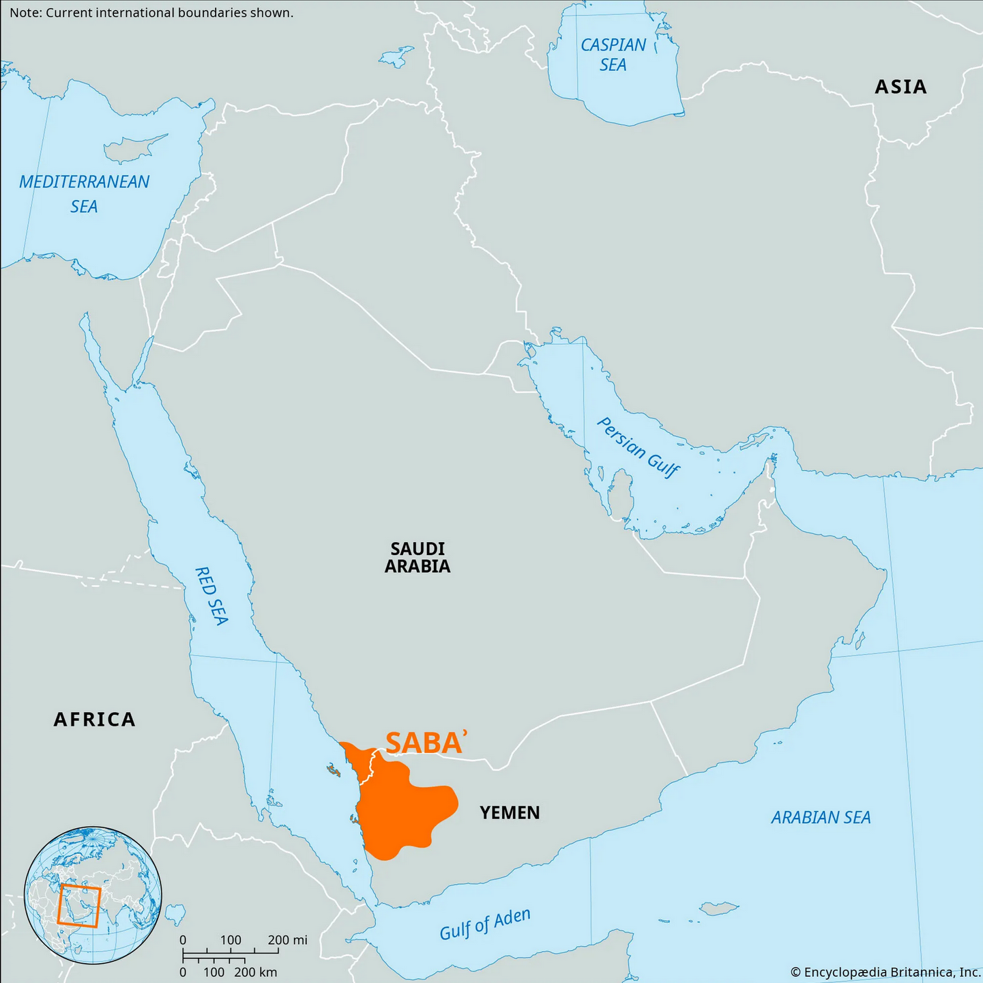
Nations Mentioned in Isaiah 45:14
https://www.jesuswalk.com/isaiah/maps/cush-egypt-1317x1500x300.jpg
https://www.britannica.com/place/Saba-ancient-kingdom-Arabia

Slide 7
The LORD Speaks (45:14)
And although the imagery is commercial and military, what is ultimately in view is a conquest that is intensely spiritual in nature, the final triumph of the truth about God. ¹
There will be genuine recognition of the unique status of Jerusalem, in that these nations “bow down” in deference before her.²
“pray to you” is a term used elsewhere of supplication to a god (cf. 44:17). ²
¹ Webb, Barry G.. The Message of Isaiah (The Bible Speaks Today Series) (p. 185).
² Mackay, John L. – A Study Commentary on Isaiah Volume 2: Chapters 40-66 – pp. 177–178.

Slide 8
The LORD Speaks (45:14)
But here it describes the nations’ request to Jerusalem to be permitted to be associated with her because of the unique way in which God has acted in determining the fortunes of his people and in being present with them in the holy city.
There is an unequivocal confession of the absolute and sole deity of the LORD, similar to the confession of the man Paul describes in 1 Cor 14:25: …he will fall down with his face to the ground and worship God, declaring, “God is really among you”.
Mackay, John L. – A Study Commentary on Isaiah Volume 2: Chapters 40-66 – pp. 177–178.

Slide 9
Isaiah Responds to What the LORD Has Said (45:15–17)
^{45:15} Yes, you are a God who keeps hidden, O God of Israel, deliverer! ¹⁶ They will all be ashamed and embarrassed; those who fashion idols will all be humiliated. ¹⁷ Israel will be delivered once and for all by the LORD; you will never again be ashamed or humiliated.

Slide 10
Isaiah Responds to What the LORD Has Said (45:15–17)
Isaiah’s response is like a gasp of amazement at the seeming audacity of what God has just proclaimed!
No one who saw the captives from Judah struggling to rebuild their shattered lives in Babylon would have ever guessed their significance.
They were not a nation – scarcely even the remnant of one, since all their national institutions had been destroyed.
God’s purposes, for the present, were “hidden” in them, but would one day become visible.
Then the tables will be completely turned.
Idolaters, presently so powerful, will be “ashamed and embarrassed”, while God’s people, presently weak and insignificant, will be “delivered once and for all by the LORD”.
Webb, Barry G.. The Message of Isaiah (The Bible Speaks Today Series) (pp. 185-186).

Slide 11
Isaiah Responds to What the LORD Has Said (45:15–17)
Jesus later made the same point in his teaching about the kingdom of God: It is like a treasure in a field (Mat 13:44), or yeast in flour (Mat 13:33), “hidden” from view, but destined to eventually dwarf everything else into insignificance.
As he says in Mat 5:5 – “Blessed are the meek [i.e. God’s people], for they will inherit the earth. ”
Or as Paul put it, “Or do you not know that the saints will judge the world? ” (1Co 6:2)
It is something we do well to remember in our own day, when we might be tempted to lose heart at the “hiddenness” of God.
Things are not always as they seem!
Webb, Barry G.. The Message of Isaiah (The Bible Speaks Today Series) (pp. 185-186).

Slide 12
The LORD Speaks Again (45:18-24a)
^{45:18} For this is what the LORD says, the one who created the sky— he is the true God, the one who formed the earth and made it; he established it, he did not create it without order, he formed it to be inhabited: “I am the LORD, I have no peer. ¹⁹ I have not spoken in secret, in some hidden place. I did not tell Jacob’s descendants, ‘Seek me in vain!’ I am the LORD, the one who speaks honestly, who makes reliable announcements.

Slide 13
The LORD Speaks Again (45:18-24a)
^{45:20} Gather together and come! Approach together, you refugees from the nations. Those who carry wooden idols know nothing, those who pray to a god that cannot deliver. ²¹ Tell me! Present the evidence! Let them consult with one another. Who predicted this in the past? Who announced it beforehand? Was it not I, the LORD? I have no peer, there is no God but me, a God who vindicates and delivers; there is none but me. ²² Turn to me so you can be delivered, all you who live in the earth’s remote regions! For I am God, and I have no peer.

Slide 14
The LORD Speaks Again (45:18-24a)
^{45:23} “I solemnly make this oath – what I say is true and reliable: ‘Surely every knee will bow to me, every tongue will solemnly affirm; ²⁴ they will say about me, “Yes, the LORD is a powerful deliverer.”’”

Slide 15
The LORD Speaks Again (45:18-24a)
The LORD, the creator of the heavens and earth, has had a purpose for all of creation from the very beginning: “he did not create it without order, he formed it to be inhabited”.
He stresses the fact that creation was “created”, “formed”, “made” and “established” by him.
He therefore has a right to declare its purpose (“he formed it to be inhabited”).
To make clear that no one else has this right, he again declares that there is no other god; he alone is the LORD.
God did not perform any of his actions “in secret , in some hidden place”, but openly so that all nations might see that LORD “speaks honestly” and “makes reliable announcements”.
Wegner, Paul D. – Isaiah An Introduction and Commentary – Tyndale OT Commentaries

Slide 16
The LORD Speaks Again (45:18-24a)
God gathers up the “refugees” (i.e. those who have survived the Persian onslaught) from all the nations who still cling to the worthless idols that cannot save them.
The next verse (v. 21) proclaims how futile it is to carry around “wooden idols” that “know nothing”, and “cannot deliver”.
By contrast, there is great wisdom in trusting the LORD – he declared his intentions long ago and his plans will all be fulfilled.
God then asks the rhetorical question “Who predicted this in the past? ” [i.e. Israel’s deliverance; see v. 17] “Who announced it beforehand? ”
He answers his own question, declaring that he is the one who foretold this deliverance which has now transpired.
The LORD has proven that he has “no peer, there is no God but [him]”, that he is indeed “a God who vindicates and delivers”.
Wegner, Paul D. – Isaiah An Introduction and Commentary – Tyndale OT Commentaries

Slide 17
The LORD Speaks Again (45:18-24a)
He then addresses all people everywhere (“all you who live in the earth’s remote regions! ”), urging them to “turn” to him (i.e. in belief) and “be delivered” (i.e. saved), for he is the only true God.
In this major step into a new age, even Gentiles can “turn” to the LORD.
In the strongest words possible the LORD says, “I solemnly make this oath – what I say is true and reliable”.
The LORD confirms that one day “every knee will bow ” to him and “every tongue will solemnly affirm” that “the LORD is a powerful deliverer”.
If the nations will examine what the LORD has said in the past, they will clearly see that the LORD keeps his word.
As a result, all people will have to acknowledge that he is the only true God and it is only in the LORD that we can find true deliverance.
Wegner, Paul D. – Isaiah An Introduction and Commentary – Tyndale OT Commentaries

Slide 18
Isaiah Again Responds to What the LORD Has Said (45:24b-25)
^{45:24b} All who are angry at him will cower before him. ²⁵ All the descendants of Israel will be vindicated by the LORD and will boast in him.

Slide 19
Isaiah Again Responds to What the LORD Has Said (45:24b-25)
Isaiah’s final response clarifies who will acquiesce to the LORD: “All who are angry at him will cower before him. ”.
They will be forced to acknowledge that he is the true God – even if they don’t accept him as their spiritual deliverer.
Salvation is not, therefore, universal, but only for those who turn to the LORD in faith and repentance.
However, “all the descendants of Israel ”, meaning true Israel, those who have trusted in the LORD, “will be vindicated”.
They too will see and acknowledge that he is the one true God and they will “boast” about their sovereign God who has delivered them.
Wegner, Paul D. – Isaiah An Introduction and Commentary – Tyndale OT Commentaries

Slide 20
Isaiah Again Responds to What the LORD Has Said (45:24b-25)
God’s people will at last be a light to the nations.
They too will now see that this amazing, all-powerful God has delivered them.
Even though only the believing remnant cared enough about serving God to take advantage of this deliverance from Babylon – the offer was open to all the exiled Israelites.
The remnant’s physical deliverance is a picture of their spiritual deliverance as they chose to step out in faith to return and rebuild Jerusalem and the temple so that they could offer the sacrifices God required.
Wegner, Paul D. – Isaiah An Introduction and Commentary – Tyndale OT Commentaries

Slide 21
Paul’s Use of Isaiah 45:23 in Romans 14:11 and Philippians 2:10-11

Slide 22
^{Isaiah 45:23} “I solemnly make this oath— what I say is true and reliable: ‘Surely every knee will bow to me, every tongue will solemnly affirm; ²⁴ they will say about me, “Yes, the LORD is a powerful deliverer.”’” (NET)
^{Romans 14:10} But you who eat vegetables only – why do you judge your brother or sister? And you who eat everything – why do you despise your brother or sister? For we will all stand before the judgment seat of God. ¹¹ For it is written, “As I live, says the Lord, every knee will bow to me, and every tongue will give praise to God.” ¹² Therefore, each of us will give an account of himself to God. (NET)
^{Philippians 2:9} …God highly exalted [Jesus] and gave him the name that is above every name, ¹⁰ so that at the name of Jesus every knee will bow – in heaven and on earth and under the earth – ¹¹ and every tongue confess that Jesus Christ is Lord to the glory of God the Father. (NET)

Slide 23
Paul’s Use of Isaiah 45:23 in Romans 14:11
The Apostle Paul cites Isaiah 45:23 in a section of the book of Romans (14:1-15:13) where he makes a lengthy plea for two groups of believers in the Roman church to welcome and accept one another.
Paul identifies these two groups in the Roman church as:
Those who are “weak in the faith” (14:1)
Those who are “strong” in the faith (15:1)
As we read through the text, we see three issues over which these two groups disagree:
The “strong” eat all kinds of food while the “weak” eat only vegetables (14:2)
The “strong” make no distinction between days while the “weak” value some days more than others (14:5)
The “strong” drink wine while the “weak” abstain (14:21 cf. 14:17)

Slide 24
Paul’s Use of Isaiah 45:23 in Romans 14:11
As Paul addresses these two groups, it becomes clear that the issues over which they differ are not sin issues, but issues of personal conviction and/or preference.
It is important for us to notice that when dealing with an issue that involves sinful behavior, Paul does not counsel believers to “welcome and accept” one another as he does here.
Instead he councils them to confront the sinning party, and if they are unwilling to repent, to disassociate from them and put them out of the church (1 Cor 5), which Jesus also taught (Mat 18:15ff).

Slide 25
Paul’s Use of Isaiah 45:23 in Romans 14:11
Throughout the course of this section of Romans Paul addresses many aspects of this division that existed within the Roman church and gives many reasons why the rivalry between these two groups must cease immediately.
In verse 10, Paul tells them “For we will all stand before the judgment seat of God.”
He then supports this idea by citing Isaiah 43:23 which says that “every knee will bow… to God” – not to one another.
In other words, unless God has rendered a clear judgment in his word that what a fellow believer is doing (or not doing) is sinful, we have no right to judge or condemn him.
God is his judge and therefore he answers to God alone – not you!.

Slide 26
Paul’s Use of Isaiah 45:23 in Romans 14:11
Notice this is very similar to what the Apostle Paul wrote to the Corinthian church (who had a similar dispute in their church concerning eating of foods that had been sacrificed to idols – see 1 Cor 8-10):
So then, do not judge anything before the time. Wait until the Lord comes. He will bring to light the hidden things of darkness and reveal the motives of hearts. Then each will receive recognition from God… learn ‘not to go beyond what is written,’ so that none of you will be puffed up. (1Cor 4:5-6)

Slide 27
Paul’s Use of Isaiah 45:23 in Philippians 2:10-11
A citation of Isaiah 45:23 can be found in the book of Philippians near the end of what is thought to be an ancient historic hymn of praise to Christ (sometimes referred to as the Carmen Christi) that is cited by the Apostle Paul in Phil 2:5-11.
In verse 5-8 the Philippians are encouraged to imitate the mindset of Christ as the one who, as God, “emptied himself by taking on the form of a slave” and was “obedient to the point of death– even death on a cross!”.
In verses 9-11 a description is given of the reward which Jesus received because of his obedience: “God highly exalted him..”.

Slide 28
Paul’s Use of Isaiah 45:23 in Philippians 2:10-11
Paul then continues: “and gave him the name that is above every name”.
He doesn’t yet tell us what “the name” is but saves it for the climax in verse 11.
The purpose of Christ’s exaltation is “so that at the name of Jesus every knee will bow –”
“in heaven” – angels (including archangels) and, of course all redeemed human beings who have departed
“on earth” – all human beings on the earth
“under the earth” – all the damned in hell, both human beings and evil angels

Slide 29
Paul’s Use of Isaiah 45:23 in Philippians 2:10-11
Finally, Paul arrives at the climax which he has been building up to and tells us “the name” which has been given to Jesus: “and every tongue [will] confess that Jesus Christ is Lord to the glory of God the Father.”
Note that in the Hebrew of Isaiah 45:23, the name of “Lord” which Paul here ascribes to Jesus is none other than Yahweh, the holy name of God himself!
And so we see that the one who “existed in the form of God [and] did not regard equality with God as something to be grasped” (Phil 2:6) is, in his final exaltation, acknowledged to be LORD (Yahweh) by every class of created intelligent beings!

Slide 30
Next Time
I plan to look at another one of the “servant” passages in Isaiah 49:1-13. This one talks about: “The Mission of the LORD’s Servant”.
There are at least three New Testament passages that give citations from this section of Isaiah.

Slide 31
Class Discussion Time
Do you find it comforting to be reminded that though:
God’s influence in the world seems “hidden” as ungodliness and rebellion are breaking out all around us
The glorious blessings that we have been given, as the people of God, is not recognized for the most part in our modern society
There is coming a day when:
Our trust in God will be vindicated
Those who have given themselves over to the idolatrous beliefs and practices of our day will be ashamed of what they have done.
There is coming a day of reckoning – a day when “at the name of Jesus every knee will bow – in heaven and on earth and under the earth – and every tongue confess that Jesus Christ is LORD to the glory of God the Father”!

Slide 32
Class Discussion Time
There seems to be a lot of confusion in the church today about when we should judge and when we shouldn’t.
On one hand, we have churches welcoming members who are living in open sin because, after all, “we’re not supposed to judge” – even though the scriptures are clear that we are supposed to “judge those inside” the church who are living in open unrepentant sin (1Cor 5:12) by putting them out of the church (Mat 18:15-17)
On the other hand we sometimes see church members who “go beyond what is written” and try to impose additional rules and standards on other believers that are not clearly commanded in the scriptures.
Can you think of any examples where you have seen this kind of behavior in a Christian church?

