Slide 1
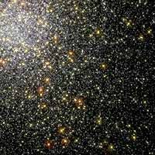
Creation versus Evolution
A Closer Look

Slide 2
Did God really say . . .
(Genesis 3:1)

Slide 3
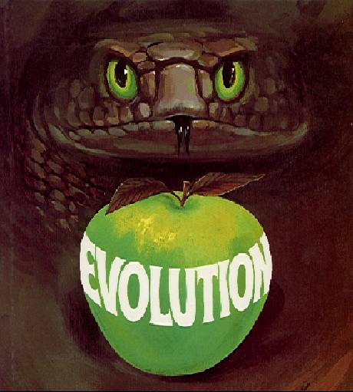
Did God really say . . .
That He made the heavens and the earth and all that is in them in six ordinary days and then rested on the seventh? (Genesis 1:1 - 2:4; Exodus 20:8-11)
That He made the earth before He made the stars? (Genesis 1:1 cf. 1:14-19), and He made plants before He made the sun? (Genesis 1:11-13 cf. 1:14-19)
That He directly made the first plants and animals - and made them to reproduce “according to their kind”? (Genesis 1:11,12,21,24,25)

Slide 4
Did God really say . . .
That He made the men of every nation from just one man (Adam) whom He created directly from the dust of the ground and one woman whom He created from Adam’s rib? (Genesis 1:26-28; 2:7, 18, 20-25; Acts 17:26)
That before the first man Adam sinned, there was no suffering or death in the world like there is today? (Genesis 3:16-20; Romans 5:12, 8:18-23)
That some men in ancient times lived in excess of 900 years? (Genesis 5:5,8,11,14,20,27)
That God once judged the whole world by sending a flood that covered every mountain on earth? (Genesis 6:1-8:22; Luke 17:26-27; 2Peter 2:5)

Slide 5
Introduction
Premise Assumed in this Course:
  The Bible is God’s Word and therefore, when interpreted correctly, is completely reliable, accurate, and true.
Bible Translation:
  All of the scriptures quoted in this material are from the ESV translation unless otherwise noted.

Slide 6
Introduction
My Approach to this Subject - I believe it is important to make distinctions between things that are:
  Category A: Known with (near) certainty
  Category B: Highly probable
  Category C: Possible, but not certain

Slide 7
Introduction
All the material taught in this class can be found on my web site: http://www.purifiedbyfaith.com
You are invited to make additional notes, though it should not be necessary for the most part.

Slide 8
Outline
Introduction
Genesis 1
  Creation 101
    Reading and observations from the text of Genesis 1
  Evolution 101
    Uses of the Word “Evolution”
    Scientific Objections to Evolution
    Natural Selection
    Beneficial Mutations?

Slide 9
Outline
Genesis 1 (continued)
  A Biblical Critique of Three Incorrect Views of Creation
    Theistic Evolution
    The Gap Theory
    The Day-Age (Progressive Creation) Theory

Slide 10
Outline
Genesis 2
  The Supposed Conflict Between Genesis 1 and 2
  Did Man Descend from Adam or Apes?
Genesis 3
  The Fall and Its Implications
Genesis 4
  Where Did Cain Get His Wife?
  What Happened to the Dinosaurs?

Slide 11
Outline
Genesis 5 and 11
  The Age of the Human Race - A Look at the Biblical Genealogies
  The Age of the Earth - A Look at Dating Methods
  The Age of the Universe – How Do We See Light From Distant Stars?
Genesis 6-9
  The Genesis Flood – Noah and the Ark

Slide 12
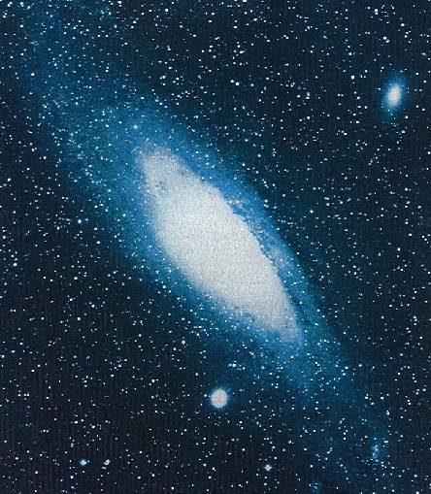
Creation 101

Slide 13

Genesis 1:1-5 – Day One
Genesis 1:1-5 - In the beginning, God created the heavens and the earth. ² The earth was without form and void, and darkness was over the face of the deep. And the Spirit of God was hovering over the face of the waters. ³ And God said, “Let there be light,” and there was light. ⁴ And God saw that the light was good. And God separated the light from the darkness. ⁵ God called the light Day, and the darkness he called Night. And there was evening and there was morning, the first day.

Slide 14
Genesis 1:6-8 – Day Two
Genesis 1:6-8 - And God said, “Let there be an expanse in the midst of the waters, and let it separate the waters from the waters.” ⁷ And God made the expanse and separated the waters that were under the expanse from the waters that were above the expanse. And it was so. ⁸ And God called the expanse Heaven. And there was evening and there was morning, the second day.

Slide 15
Genesis 1:9-13 – Day Three
Genesis 1:9-13 And God said, “Let the waters under the heavens be gathered together into one place, and let the dry land appear.” And it was so. ¹⁰ God called the dry land Earth, and the waters that were gathered together he called Seas. And God saw that it was good. ¹¹ And God said, “Let the earth sprout vegetation, plants yielding seed, and fruit trees bearing fruit in which is their seed, each according to its kind, on the earth.” And it was so. ¹² The earth brought forth vegetation, plants yielding seed according to their own kinds, and trees bearing fruit in which is their seed, each according to its kind. And God saw that it was good. ¹³ And there was evening and there was morning, the third day.

Slide 16
Genesis 1:14-19 – Day Four
Genesis 1:14-19 - And God said, “Let there be lights in the expanse of the heavens to separate the day from the night. And let them be for signs and for seasons, and for days and years, ¹⁵ and let them be lights in the expanse of the heavens to give light upon the earth.” And it was so. ¹⁶ And God made the two great lights-- the greater light to rule the day and the lesser light to rule the night-- and the stars. ¹⁷ And God set them in the expanse of the heavens to give light on the earth, ¹⁸ to rule over the day and over the night, and to separate the light from the darkness. And God saw that it was good. ¹⁹ And there was evening and there was morning, the fourth day.

Slide 17
Genesis 1:20-23 – Day Five
Genesis 1:20-23 - And God said, “Let the waters swarm with swarms of living creatures, and let birds fly above the earth across the expanse of the heavens.” ²¹ So God created the great sea creatures and every living creature that moves, with which the waters swarm, according to their kinds, and every winged bird according to its kind. And God saw that it was good. ²² And God blessed them, saying, “Be fruitful and multiply and fill the waters in the seas, and let birds multiply on the earth.” ²³ And there was evening and there was morning, the fifth day.

Slide 18
Genesis 1:24-31 – Day Six
Genesis 1:24-27 - And God said, “Let the earth bring forth living creatures according to their kinds-- livestock and creeping things and beasts of the earth according to their kinds.” And it was so. ²⁵ And God made the beasts of the earth according to their kinds and the livestock according to their kinds, and everything that creeps on the ground according to its kind. And God saw that it was good. ²⁶ Then God said, “Let us make man in our image, after our likeness. And let them have dominion over the fish of the sea and over the birds of the heavens and over the livestock and over all the earth and over every creeping thing that creeps on the earth.” ²⁷ So God created man in his own image, in the image of God he created him; male and female he created them.

Slide 19
Genesis 1:24-31 – Day Six
Genesis 1:28-31 ²⁸ And God blessed them. And God said to them, “Be fruitful and multiply and fill the earth and subdue it, and have dominion over the fish of the sea and over the birds of the heavens and over every living thing that moves on the earth.” ²⁹ And God said, “Behold, I have given you every plant yielding seed that is on the face of all the earth, and every tree with seed in its fruit. You shall have them for food. ³⁰ And to every beast of the earth and to every bird of the heavens and to everything that creeps on the earth, everything that has the breath of life, I have given every green plant for food.” And it was so. ³¹ And God saw everything that he had made, and behold, it was very good. And there was evening and there was morning, the sixth day.

Slide 20

Genesis 2:1-4 – Day Seven
DAY 7
(2 : 1-4)
REST
Genesis 2:1-2 - Thus the heavens and the earth were finished, and all the host of them. ² And on the seventh day God finished his work that he had done, and he rested on the seventh day from all his work that he had done.

Slide 21
Some Observations on Genesis Chapter One
The Bible always assumes and never argues for God’s existence. In other places the Bible teaches that God has made Himself known to all men “in the things that have been made” (the creation) and therefore those who deny His existence are fools who wickedly suppress that knowledge and are without excuse.
  Romans 1:18-20 - The wrath of God is revealed from heaven against all ungodliness and unrighteousness of men, who by their unrighteousness suppress the truth. For what can be known about God is plain to them, because God has shown it to them. For his invisible attributes, namely, his eternal power and divine nature, have been clearly perceived, ever since the creation of the world, in the things that have been made. So they are without excuse.
  Psalm 53:1 - The fool says in his heart, "There is no God.”

Slide 22
Some Observations on Genesis Chapter One
God could have made everything in an instant, but instead He took six days.
God created the entire universe out of nothing
  Genesis 1:1 - In the beginning, God created (Hebrew: bara) the heavens and the earth.
  Hebrews 11:3 - By faith we understand that the universe was created by the word of God, so that what is seen was not made out of things that are visible.

Slide 23
Some Observations on Genesis Chapter One
As God creates, He speaks things into existence
  Gen 1:3 - And God said, "Let there be light," and there was light.
  Gen 1:9 - And God said, "Let the waters under the heavens be gathered together into one place, and let the dry land appear." And it was so.
  Gen 1:11 - And God said, "Let the earth sprout vegetation, plants yielding seed, and fruit trees bearing fruit in which is their seed, each according to its kind, on the earth." And it was so.
  Psalm 33:6-9 - By the word of the LORD were the heavens made . . . He spoke, and it came to be; He commanded, and it stood firm.

Slide 24
Some Observations on Genesis Chapter One
God created light before He created the sun, moon or stars (vs.3 cf. vs. 14-18)
God directly created each of the various kinds of living things and caused them to reproduce after their “own kind” (vs. 11-12, 21, 24-25)
Man was created in God's image (vs.26-27)
In the original creation man and animals ate only vegetables (vs.29-30)
Over and over, God declared His creation to be "good" (vs. 4,10,12,18,21,25,31)

Slide 25
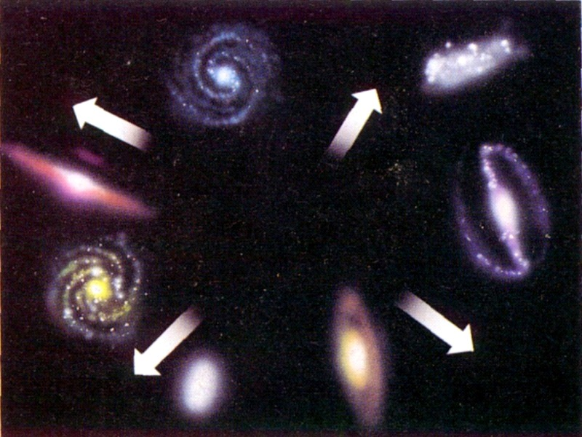
Evolution 101
In the Beginning the Cosmos Created Itself . . .
Big Bang!

Slide 26
The word “evolution” is used to describe at least four different ideas, only one of which is scientific.

Slide 27
Science - Systematized knowledge derived from observation, study, etc.
Webster’s Dictionary

Slide 28
“Evolution” is used to describe at least four different ideas, only one of which is scientific.
Cosmic evolution - the universe (stars, planets, and earth) came from a Big Bang

Slide 29
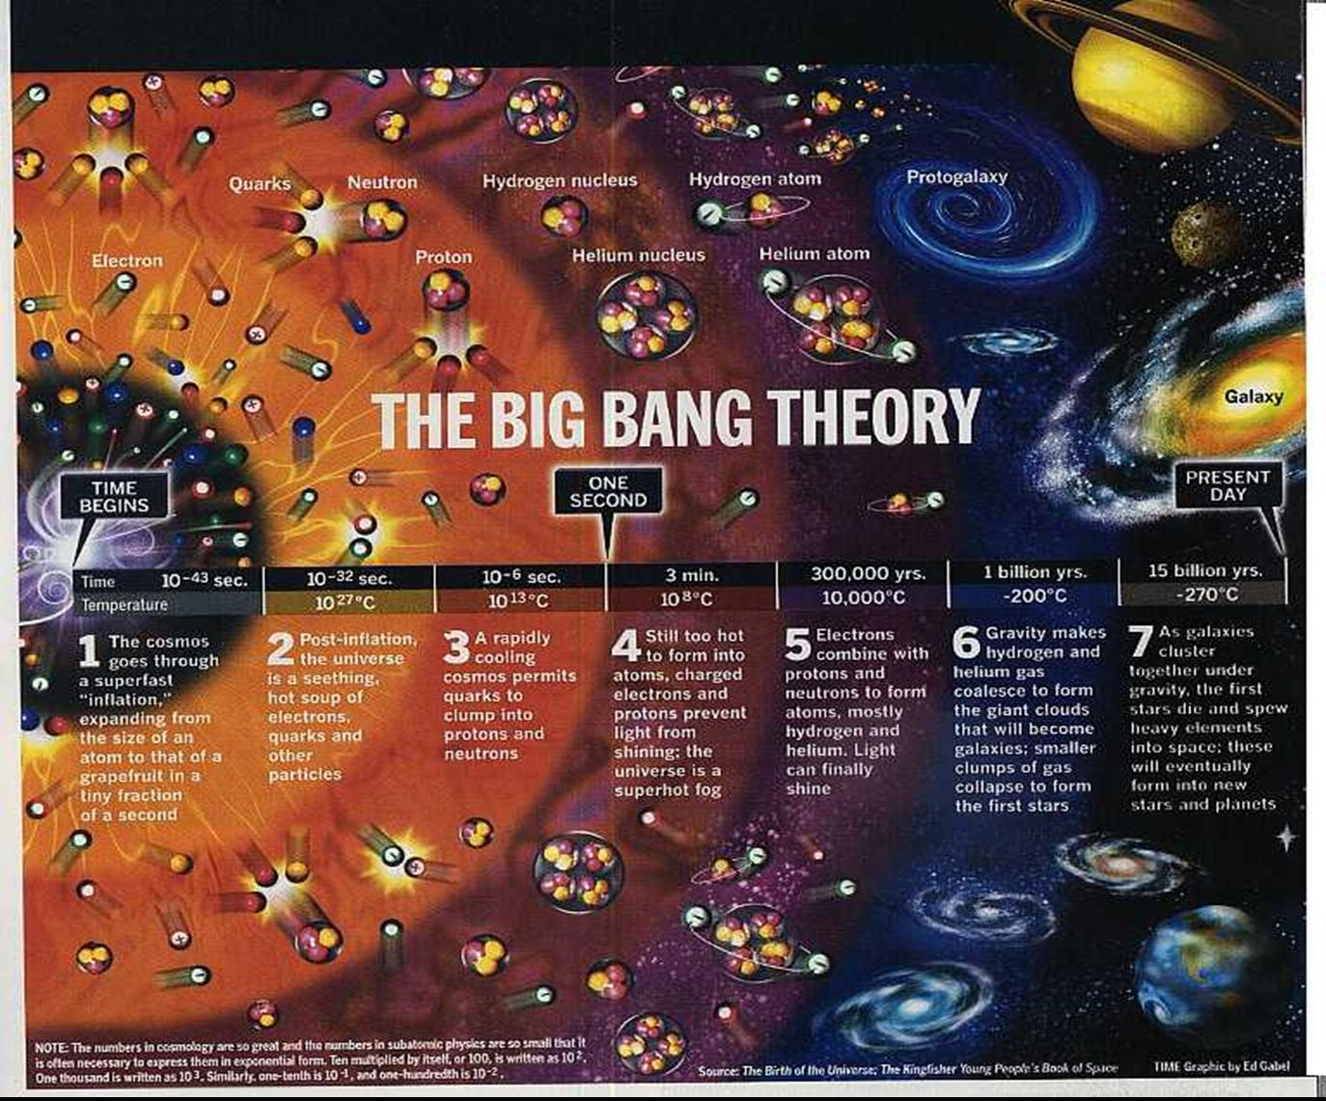

Slide 30
“Evolution” is used to describe at least four different ideas, only one of which is scientific.
Cosmic evolution - the universe (stars, planets, and earth) came from a Big Bang
Organic evolution - The first living cell came from non-living chemicals .

Slide 31
“Evolution” is used to describe at least four different ideas, only one of which is scientific.
Cosmic evolution - the universe (stars, planets, and earth) came from a Big Bang
Organic evolution - The first living cell came from non-living chemicals
“Goo-to-You” evolution - All living things evolved over millions of generations from a single living cell.

Slide 32
Evolution Teaches That All Living Things Evolved From a Single Cell

Slide 33
“Evolution” is used to describe at least four different ideas, only one of which is scientific.
Cosmic evolution - the universe (stars, planets, and earth) came from a Big Bang
Organic evolution - The first living cell came from non-living chemicals .
“Goo-to-You” evolution - All living things evolved over millions of generations from a single living cell.
Religious
4. Variation Within a Kind - Variations and changes occur within each “kind” of animal or plant. Some refer to this as “Micro-evolution”. This is the only kind of “evolution” that has ever been observed.

Slide 34

Rat poison

Slide 35
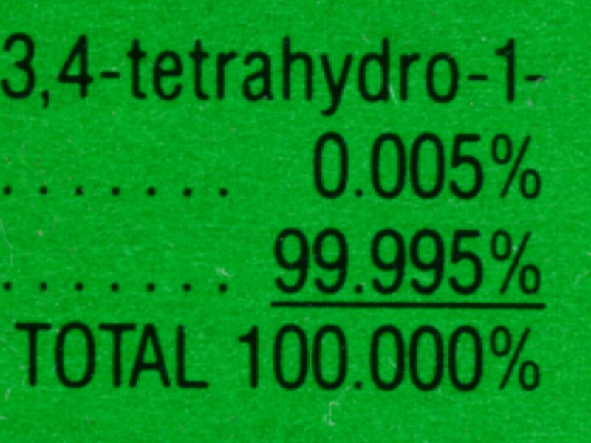
Rat poison
Poison
Good Food

Slide 36
Creation and Evolution
Two Irreconcilable Religious Views
Evolution
Creation
The universe is either eternal or it brought itself into existence.
Only God is self-existent and eternal.
Present reality consists only of that which is observable.
There is a whole realm of reality that cannot be seen.
The order and beauty that we observe in the universe around us is the result of impersonal random forces acting without purpose. over long periods of time.
The order and beauty that we observe in the universe around us is the creation of an all-knowing, all-powerful God who purposefully designed and created it for our benefit and ultimately for His own glory.
Life came from non-life by impersonal random processes acting over long periods of time.
God created life.

Slide 37
Creation and Evolution
Two Irreconcilable Religious Views
Evolution
Creation
All life as we know it descended from a common primitive ancestor.
God directly created each kind of living thing and caused each living thing to reproduce “after its own kind”.
Man is just another kind of animal and has no more significance than an ant or an elephant.
Man was made in the “image of God” and is special.
The universe is evolving into a better place.
The universe started off “good” but was corrupted by sin.
The earth and the universe is billions of years old, life is millions of years old.
The heavens and the earth and all that is in them were created in six regular days, thousands (not millions or billions) of years ago.

Slide 38
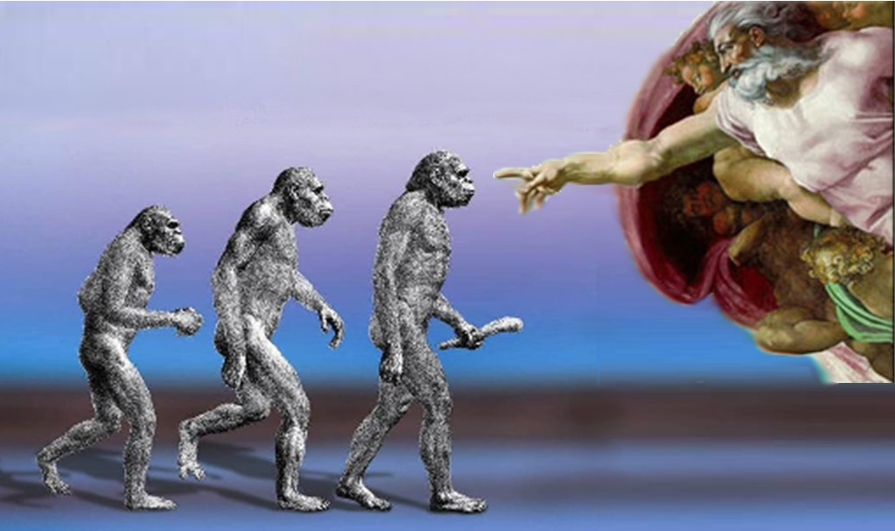
What about
Theistic Evolution?

Slide 39
What about Theistic Evolution?
Why couldn’t God have used evolutionary processes to create the universe?
The story of evolution was made up as a way of explaining how the Universe got here without God.
If God did in fact use evolutionary processes (as described by the theory of evolution) to create the universe, what that means is that God knowingly told us many untrue things in the biblical creation account!
Contrary to what many would have you believe, there are huge scientific problems with the theory of evolution.

Slide 40
Scientific Objections to Cosmic Evolution*
* The universe (stars, planets, and earth) came from a Big Bang

Slide 41
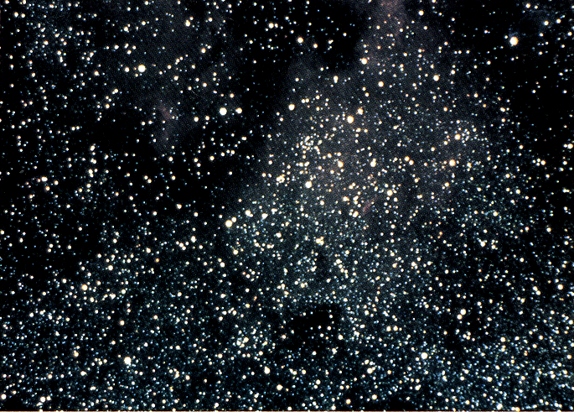
Some Evolutionists say that the Universe came from nothing!

Slide 42
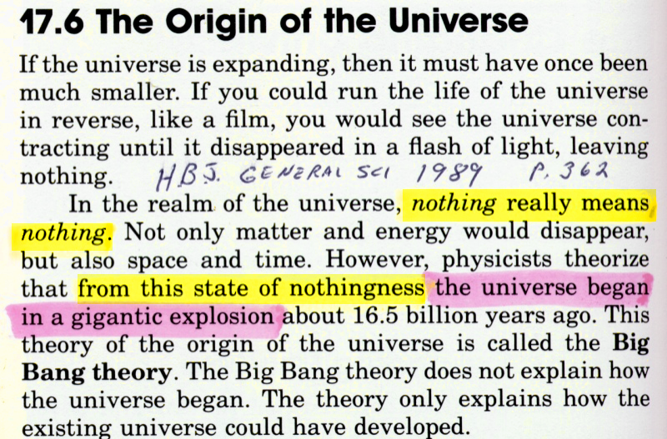
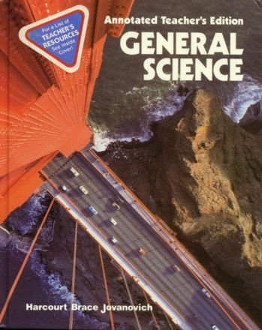
HBJ General Science, 1989, p. 362

Slide 43
Something from Nothing?
The idea that something came from nothing is a philosophical absurdity!
It is also a violation of the First Law of Thermodynamics, which tells us that: “Energy can neither be created nor destroyed”

Slide 44
Some Evolutionists say that the Universe has always been here!

Slide 45
Has The Universe Always Been Here?
The universe as we know it cannot be infinitely old.
The reason? Because according to the Second Law of Thermodynamics, the universe is running down or “wearing out”.
Second Law of Thermodynamics (more formally stated): “in all energy exchanges, if no energy enters or leaves the system, the potential energy of the state will always be less than that of the initial state.”

Slide 46

The Second Law of Thermodynamics:
Everything tends toward disorder

Slide 47

The Second Law of Thermodynamics:
Everything tends toward disorder

Slide 48
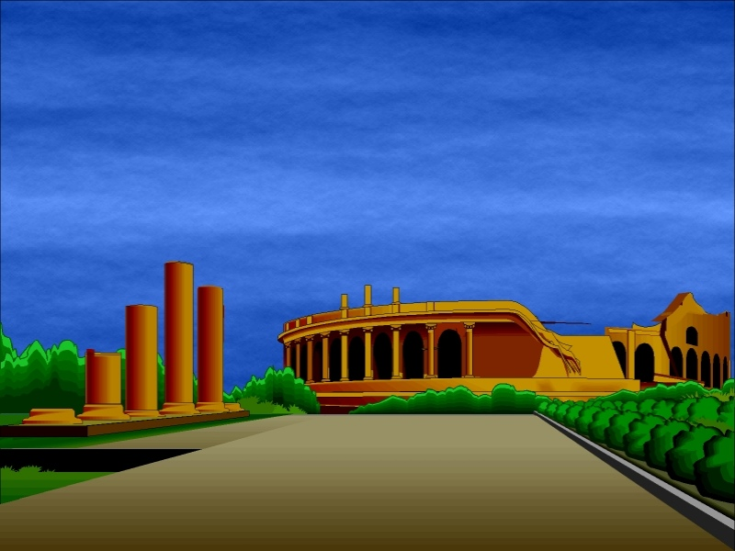
The Second Law of Thermodynamics:
Everything tends toward disorder

Slide 49
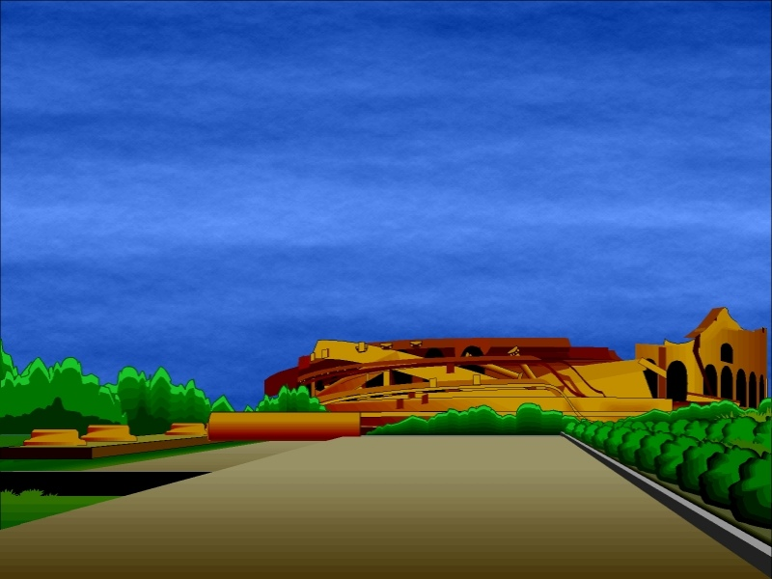
The Second Law of Thermodynamics:
Everything tends toward disorder

Slide 50
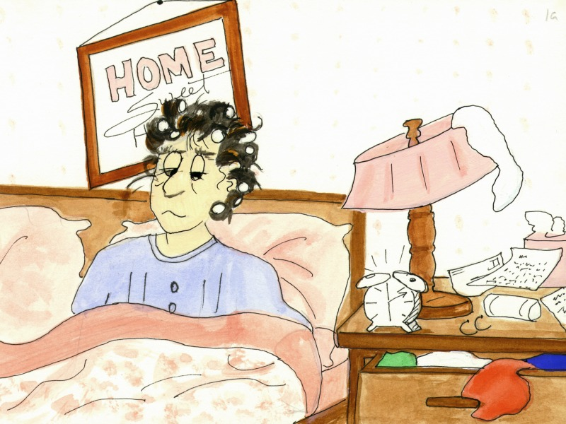
Housewife waking up

Slide 51
Hebrews 1:10-11
(cf. Psalm 102:25-26)
You, Lord, laid the foundation of the earth in the beginning, and the heavens are the work of your hands; they will perish, but you remain; they will all wear out like a garment…

Slide 52
Scientific Objections to Organic Evolution*
* The first living cell came from non-living chemicals.

Slide 53
Scientific Objections to
Organic Evolution
  The simplest organism capable of independent life, the karyote bacterial cell, is a masterpiece of miniaturized complexity which makes a spaceship seem rather low-tech . . . that a living organism emerged by chance from a pre-biotic soup is about as likely as that a tornado sweeping through a junkyard might assemble a Boeing 747 . . . Chance assembly is just a naturalistic way of saying “miracle”. (Darwin on Trial, p.105-106)

Slide 54
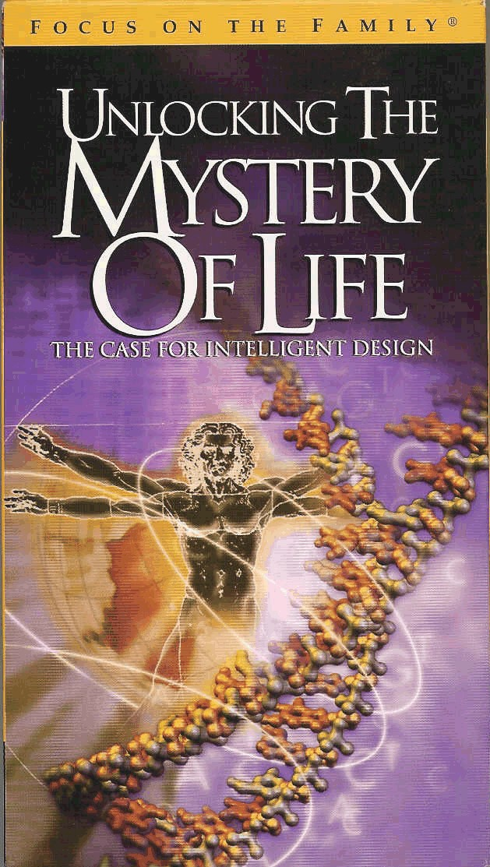
Unlocking the Mystery of Life
The Case for Intelligent Design
Available from Focus on the Family

Slide 55
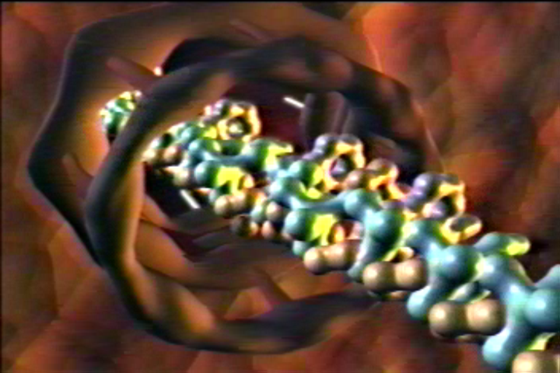
The Production of Protein Within a Cell
A brief segment from the video “Unlocking the Mystery of Life”

Slide 56


Slide 57
Scientific Objections to
“Goo-to-You” Evolution*
* All living things evolved over millions of generations from a single living cell.

Slide 58
Scientific Objections to
“Goo-to-You” Evolution
  Gaps in the Fossil Record
    Evolutionists claim that the layers of rocks containing the fossils of dead plants and animals found throughout the world were laid down over millions of years and therefore provide us with a record of what the plants and animals that lived in the past looked like.
    Evolutionists also claim that living things gradually evolved over those millions of years from a single cell to the complex forms of life we see today.

Slide 59
Scientific Objections to
“Goo-to-You” Evolution
  Gaps in the Fossil Record
    So if evolution is true, we should expect to see evidence in the fossil record of living things gradually transitioning from one kind of living thing to another.
    But we don’t see this! Instead there are gaps throughout the fossil record with new kinds of organisms appearing suddenly and with very few, if any, intermediate links.

Slide 60
Scientific Objections to
“Goo-to-You” Evolution
  Gaps in the Fossil Record
    Darwin said that the absence of such intermediates was the “most obvious and serious objection’ against his theory. One hundred and twenty years later, Dr. David Raup, head of one of the great museums in America, said that the situation concerning missing links ‘hasn’t changed much’ and that ‘we have even fewer examples of evolutionary transition than we had in Darwin’s time”. *
*Carl Wieland, Stones and Bones, 1994, p. 17-18

Slide 61
Scientific Objections to
“Goo-to-You” Evolution
  Gaps in the Fossil Record
    Some evolutionists claim there are some – maybe a handful of such in-between fossil types. Other leading experts say there are none. (Stones and Bones, p.14)
    But if evolution is true, there should be millions of in-between forms. Where are they?

Slide 62
Scientific Objections to
“Goo-to-You” Evolution
  Similar Structures Do Not Prove Ancestry
    One of the primary “evidences” that evolutionists offer to “prove” their theory is the similarity of living things.
    They assume that if two living things have similar characteristics they must be closely related.
    But this is an unproven assumption!

Slide 63

Life Science, Holt, Rinehart, Winston, 2001, p.156

Slide 64
Scientific Objections to
“Goo-to-You” Evolution
  Similar Structures Do Not Prove Ancestry
    Similarities between living things may instead show that living things have a common designer. After all, one would expect a similar design for a similar structure or purpose from the hand of the same Designer.

Slide 65
Scientific Objections to
“Goo-to-You” Evolution
  We Don’t See Evolution Happening*
    Living things do change. But we know that every living thing contains a set of instructions, like a blueprint or a recipe that specifies whether it will be an amoeba or a horse, for example.
    This information is written on a long molecule called DNA.
*Information on “We Don’t See Evolution Happening” slides taken from Carl Wieland’s booklet, Stones and Bones, 1994, p. 17-18

Slide 66
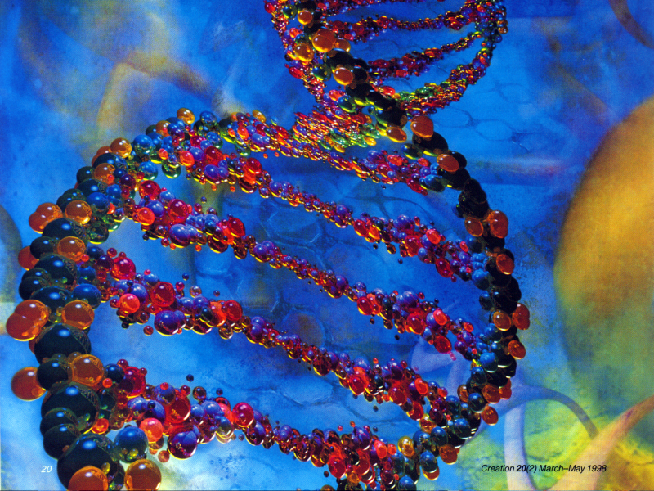

Slide 67
Scientific Objections to
“Goo-to-You” Evolution
  We Don’t See Evolution Happening*
    Evolution teaches that (over millions of years) a comparatively simple creature , like the one celled amoeba, has become a much more complicated one, like a horse.
    But amoebas clearly do not contain as much information as a horse. They don’t have instructions specifying how to make eyes, blood, brains, hooves, muscles, etc.

Slide 68
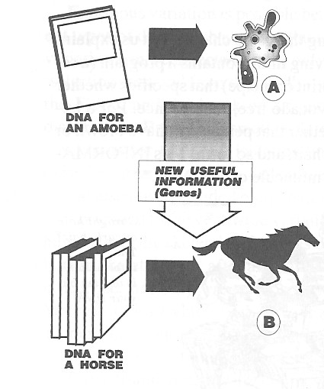
Real evolution requires huge increases in DNA information (symbolized here as books)

Slide 69
Scientific Objections to
“Goo-to-You” Evolution
  We Don’t See Evolution Happening*
    So for an amoeba to evolve into a horse would require an increase in information. Information coding for new structures, new functions – new useful complexity.
    If we saw those sorts of information-increasing changes happening, even if only a few, this could reasonably be used to help support the argument that fish may indeed evolve into philosophers!

Slide 70
Scientific Objections to
“Goo-to-You” Evolution
  We Don’t See Evolution Happening*
    But the changes that we observe in living things today do not involve increasing information.
    Instead, we see that when living things reproduce, they pass on either the same or less information, not more.
    Therefore the changes that we see are heading in the wrong direction for evolution to occur!

Slide 71

What About Natural Selection?

Slide 72
Natural Selection is not the same as Evolution*
*Information on “Natural Selection is not the same as Evolution” slides taken from Carl Wieland’s booklet, Stones and Bones, 1994, p. 18-20

Slide 73
Natural Selection is not the same as Evolution*
Just as someone who breeds dogs (or anything else) can only work with the genetic information that is already there, so it is with the process of natural selection.
In fact, starting with a short breed of dogs no amount of breeding and selection will produce a tall variety of dogs, because some of the “tall” information has been lost in that population.

Slide 74
Natural Selection is not the same as Evolution*
In the same way, “nature” can “select” animals with a physical trait that is beneficial in a given environment, by allowing it to survive longer and pass that trait on to others.
But natural selection cannot create any new information within a population of animals, it can only select from the traits that are already there.

Slide 75
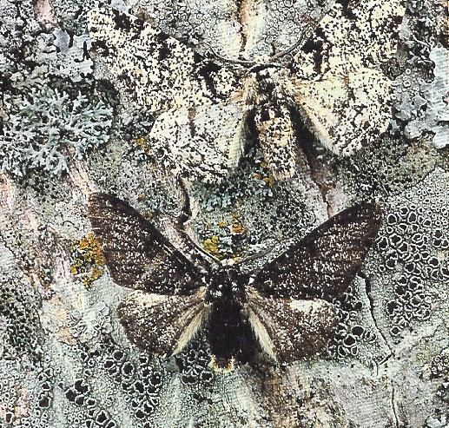
What About Beneficial Mutations?*
*Information on “Beneficial Mutations?” slides taken from Carl Wieland’s booklet, Stones and Bones, 1994, p. 21-22

Slide 76
Beneficial Mutations?
When the genetic code within the gene of a living thing is corrupted or damaged, this is known as a mutation.
If a mutation is passed on to the offspring of a living thing it can result in the offspring having a characteristic that is not found within the genetic code of either of its parent(s).
Because mutations are the result of random damage, they are almost never beneficial, but harmful – much like the accidental splattering of ink on the page of a book is not very likely to improve what is written there!

Slide 77
Beneficial Mutations?
Evolutionists know that mutations are overwhelmingly harmful but their belief system demands that there must have been beneficial mutations on occasion.
There are, in fact, a tiny handful of mutations known which make it easier for an organism to survive in a given environment:
  Eyeless fish in caves survive better as they are not prone to eye disease/injury
  Wingless beetles do better on a windy rock in the sea because they are less likely to be blown away and drowned.

Slide 78
Beneficial Mutations?
But the loss of eyes or the loss of information necessary to manufacture wings is a defect - a crippling of a previously functional piece of machinery.
Such changes, though “beneficial” in a purely survival sense, are not an example of increases in information - new coding for new functions, new useful structures.
It’s no use turning to insecticide resistance in insects - in almost every case the information for resistance was there in a few individuals in the population before man began to spray.

Slide 79
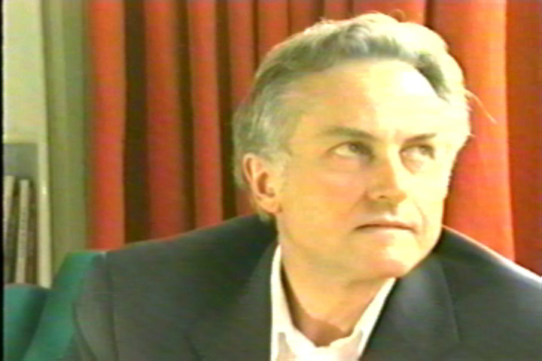
Professor Dawkins
Leading Evolutionist
“Professor Dawkins, can you give an example of a genetic mutation or an evolutionary process which can be seen to increase the information in the genome?”
Brief excerpt from the video “From a Frog to a Prince”

Slide 80
Peppered Moths –
The Rest of the Story

Slide 81
Peppered Moths –
The Rest of the Story*
The textbook story of England’s famous peppered moths goes like this:
  The moths come in light and dark forms.
  Pollution from the Industrial Revolution darkened the tree trunks.
  The lighter moths which had been well camouflaged against the light background now stood out and so birds more readily ate them.
  Therefore the proportion of the dark moths increased dramatically.
  Later, pollution was cleaned up, and the light moth became predominant again.
*Information on “Peppered Moths – the Rest of the Story” slides taken from Creation ex nihilo magazine, June-August 1999, p. 56

Slide 82
Peppered Moths –
The Rest of the Story
When the story of the peppered moths first came out, evolutionists were very enthusiastic about it.
H.B. Kettlewell who performed most of the classic experiments, said that if Darwin had seen the peppered moth experiment, “He would have witnessed the consummation and confirmation of his life’s work.”

Slide 83
Peppered Moths –
The Rest of the Story
Note: Even as it stands, the peppered moth story only shows an increase or decrease of an existing characteristic within the moth population caused by natural selection.
There were both dark moths and light moths before, during and after the Industrial Revolution that darkened the tree trunks. No new traits appeared; no new information was added to the moth population.
Therefore the peppered moth story does not show the kind of increase in information that is necessary for amoeba-to-man evolution to occur.

Slide 84
Peppered Moths –
The Rest of the Story
But as it turns out, this classic story is full of holes anyway:
  Peppered moths don’t even rest on tree trunks during the day - the latest story is that they rest on the leaves in the tops of the trees, but no one really knows for sure!
  The moths filmed being eaten by the birds were laboratory-bred ones placed onto tree trunks by Kettlewell!
  And all those still photos of moths on tree trunks? One paper described how it was done – dead moths were glued to the tree. University of Massachusetts biologist Theodore Sargent helped glue moths onto trees for a NOVA documentary. He says textbooks and films have featured “a lot of fraudulent photographs.”

Slide 85
Peppered Moths –
The Rest of the Story
University of Chicago evolutionary biologist Jerry Coyne agrees that the peppered moth story, which was “the prize horse in our stable”, has to be thrown out
He says the realization gave him the same feeling as when he found out that Santa Clause wasn’t real!
Regrettably, hundreds of millions of students have once more been indoctrinated with “proof of evolution” which is riddled with error, fraud and half-truths.

Slide 86
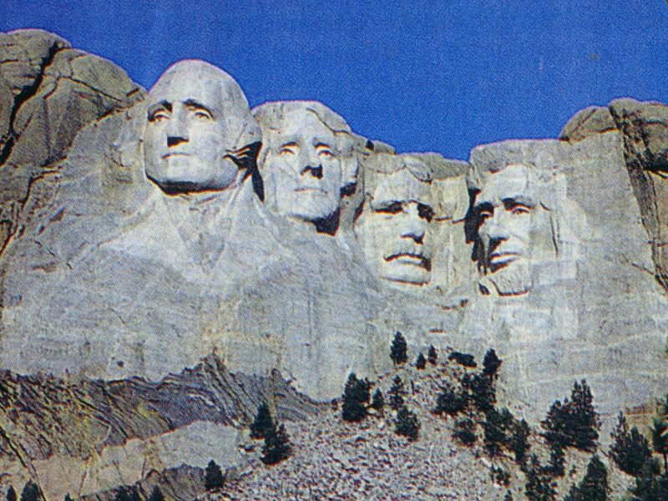
Mount Rushmore (find)

Slide 87
Romans 1:20
Since the creation of the world God's invisible qualities . . . have been clearly seen, being understood from what has been made, so that men are without excuse.

