Slide 1
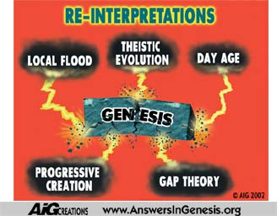

Slide 2
Twisted Views of Creation
Evolutionary scientists claim that the earth is 4½ billion years old.
Christians who hear this claim sometimes try to reinterpret the Bible so as to accommodate these long ages (rather than question the evolutionists’ claim).
In the process they end up twisting the clear teaching of the scriptures.
The three most common views held by Christians who try to read long ages into the Bible are:
  Theistic Evolution: God used Evolution.
  The “Gap” Theory: There is a time “gap” between Genesis 1:1 and Genesis 1:2.
  The Day-Age (“Progressive Creationist”) View: The “days” of Genesis 1 are indefinitely long ages.

Slide 3
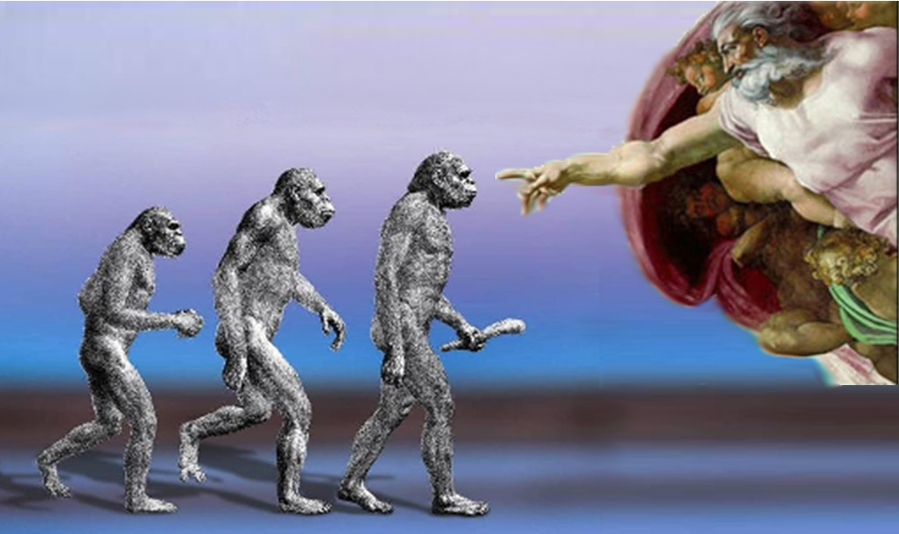
Theistic Evolution

Slide 4
Biblical Problems With Theistic Evolution
The Bible says that when God created the universe and all that is in it, His words caused an immediate response:
  Gen 1:3 - And God said, "Let there be light," and there was light.
  Gen 1:9 - And God said, "Let the waters under the heavens be gathered together into one place, and let the dry land appear." And it was so.
  Gen 1:11 - And God said, "Let the earth sprout vegetation, plants yielding seed, and fruit trees bearing fruit in which is their seed, each according to its kind, on the earth." And it was so.
  Psalm 33:6-9 - By the word of the LORD were the heavens made . . . He spoke, and it came to be; He commanded, and it stood firm.
. . . not a gradual evolutionary process.

Slide 5
Biblical Problems With Theistic Evolution
The Bible says that God directly created each kind of plant and animal during the six days of creation and designed them to produce offspring belonging to the same “kind”
  Genesis 1:11 – And God said, “Let the earth sprout vegetation, plants yielding seed, and fruit trees bearing fruit in which is their seed, each according to its kind, on the earth.”
  Genesis 1:25 - And God made the beasts of the earth according to their kinds and the livestock according to their kinds, and everything that creeps on the ground according to its kind.
. . . not a single one celled organism that gradually evolved into the various kinds of living things over millions of years.

Slide 6
Biblical Problems With Theistic Evolution
The Bible says that God’s creation was good when He first made it. . .
  Genesis 1:11-12 - And God made the beasts of the earth … and the livestock… and everything that creeps on the ground… And God saw that it was good. (compare vss. 10 ,12, 18, 21, and 25)
  Genesis 1:31 – And God saw everything that he had made, and behold, it was very good.
. . . it did not require millions of years of death, disease, struggle, and “survival of the fittest” for higher life forms to evolve.

Slide 7
Biblical Problems With Theistic Evolution
The Bible says that God made Adam directly from the dust of the ground and Eve directly from Adam’s rib . . .
  Genesis 2:7 – then the LORD God formed the man of dust from the ground and breathed into his nostrils the breath of life, and the man became a living creature.
  Genesis 2:21-23 - So the LORD God caused a deep sleep to fall upon the man, and while he slept took one of his ribs and closed up its place with flesh. And the rib that the LORD God had taken from the man he made into a woman and brought her to the man. Then the man said, "This at last is bone of my bones and flesh of my flesh; she shall be called Woman, because she was taken out of Man.”
. . . not from an evolved species of ape-like creatures.

Slide 8
Biblical Problems With Theistic Evolution
The Bible says that God made the universe and all that is in it in six ordinary days. . .
  Exodus 20:11 - For in six days the LORD made heaven and earth, the sea, and all that is in them…
. . . Not 13.5 billion years.

Slide 9
The Gap Theory
Picture taken from The Greatest Book on Dispensational Truth by Clarence Larkin

Slide 10
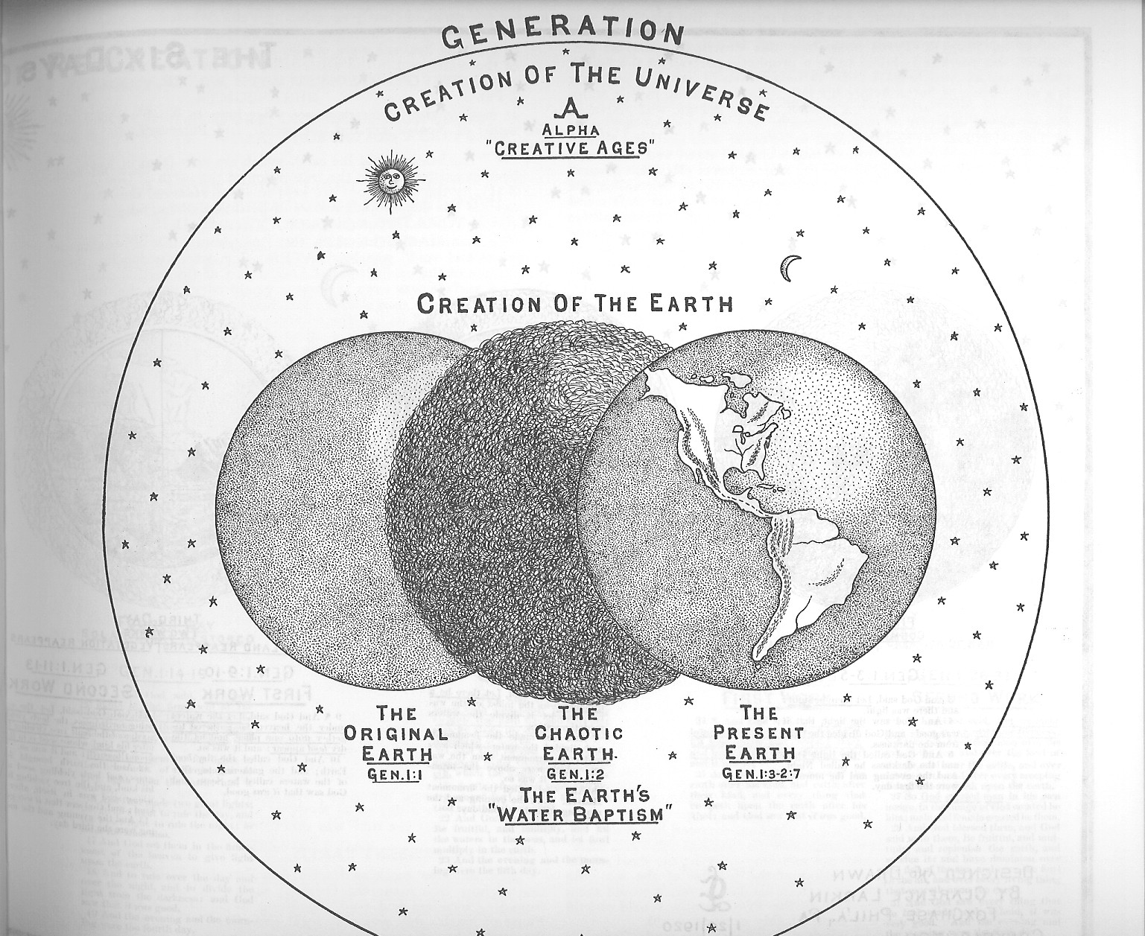
The “Gap” Theory
Genesis 1:1 - In the beginning God created the heavens and the earth.
Then
  God created Satan, angels, other creatures (including dinosaurs) that lived on the earth
  Satan and his angels rebelled against God
  God put down the rebellion and judged the earth so that . . .
Genesis 1:2 - The earth was without form and void, and darkness was over the face of the deep.

Slide 11
A Brief History of the Gap Theory*
1814 - Dr. Thomas Chalmers of Edinburgh University first proposed the Gap Theory.
  By imagining a gap between Genesis 1:1 and 1:2, Dr. Chalmers thought he could accommodate the long periods of time that the geologists of his day were claiming the earth had existed - while continuing to hold to a “literal” interpretation of (the rest of) the creation account.
1917 - The Scofield Reference Bible popularized the Gap Theory by describing it in a footnote on Genesis 1.
  Probably no reference Bible has ever been as broadly distributed in the English speaking world.
  Unfortunately, the inclusion of this footnote led many to believe that the Bible itself teaches the Gap Theory.
*Taken from Unformed and Unfilled by Weston W. Fields, p.40-43

Slide 12
Objections to the “Gap” Theory
No Scriptural Support
  The view is a result of reading something into Genesis 1:1-2 that is not there.
  There is no other scriptural support for the view
God Made Everything in Six Days
  Exodus 20:11 - For in six days the LORD made heaven and earth, the sea, and all that is in them…

Slide 13
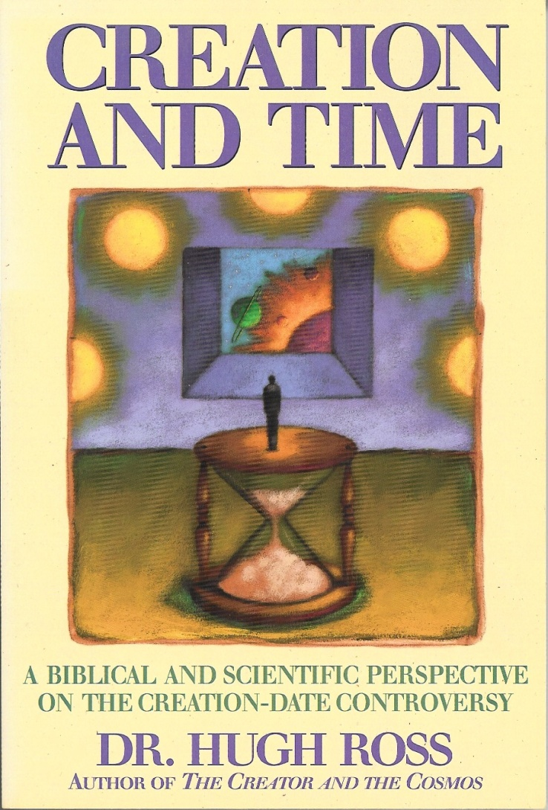
The Day-Age (“Progressive Creationist”) View

Slide 14
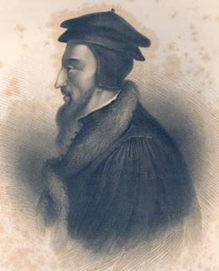
Interpreting the "Days" of Genesis 1
In John Calvin's Day (1509 - 1564)

Slide 15
Interpreting the "Days" of Genesis 1
In John Calvin's Day (1509 - 1564)
Apparently in John Calvin's day it was popular among theologians to assume the "days" in Genesis 1 occurred in a “moment” because they couldn't imagine God needed to take any longer than that to make things! John Calvin argued against this in his commentary on Gen 1:5:
  Genesis 1:5 - God called the light "day," and the darkness he called "night." And there was evening, and there was morning-- the first day.
  Here the error of those is manifestly refuted who maintain that the world was made in a moment…Let us rather conclude that God Himself took the space of six days, for the purpose of accommodating his works to the capacity of men.
John Calvin, Calvin's Commentaries, Volume I, p.78,

Slide 16
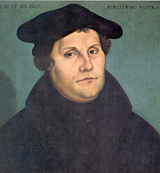
Interpreting the "Days" of Genesis 1
In Martin Luther’s Day (1483-1546)

Slide 17
Interpreting the "Days" of Genesis 1
In Martin Luther’s Day (1483-1546)
Martin Luther encountered a encountered a similar error: people in his day were saying that the six days of creation only took one day, since it wouldn’t have taken God any longer than that to create everything. In response to this error, Luther had this to say:
How long did the work of Creation take? When Moses writes that God created heaven and earth and whatever is in them in six days, then let this period continue to have been six days, and do not venture to devise any comment according to which six days were one day. But, if you cannot understand how this could have been done in six days, then grant the Holy Spirit the honor of being more learned than you are. For you are to deal with Scripture in such a way that you bear in mind that God Himself says what is written. But since God is speaking, it is not fitting for you wantonly to turn His Word in the direction you wish to go.
What Martin Luther Says: A Practical In-Home Anthology for the Active, p. 1523.

Slide 18

Interpreting the "Days" of Genesis 1 in Modern Times
It is apparent that the most straightforward understanding of the Genesis record, without regard to all the hermeneutical considerations suggested by science, is that God created heaven and earth in six solar days . . . (emphasis added) (Dr. Pattle P.T. Pun)
It cannot be denied ... that the almost universal view of the Christian world until the eighteenth century was that the earth was only a few thousand years old. Not until the development of modern scientific investigation of the earth itself would this view be called into question within the church (emphasis added) (Davis A. Young, 1982)
So the old earth advocates seem to me to have the greater weight of scientific evidence on their side, and it seems the weight of scientific evidence is increasing yearly. On the other hand, the interpretations of Genesis 1 presented by the old earth advocates, while possible, do not seem as natural to the sense of the text (emphasis added). (Wayne Grudem, Systematic Theology, 1994, p.307)
What are these men using to determine the meaning of the word “day” in Genesis 1?

Slide 19
The Day-Age (“Progressive Creationist”) View
Supposed “Biblical” Support for This View:
Yom (the Hebrew word for “day”) sometimes means an “indefinite period of time”.
Too Many events on the Sixth Day

Slide 20
So how do we decide what the word “day” means in Genesis 1?
Determining the Meaning of the word “day” in a Particular Text

Slide 21
Determining the Meaning of yom in a Particular Text
Since yom (the Hebrew word for “day) can mean any one of a number of things:
  “Daylight” as Contrasted With Nighttime
  A Period of 24 Hours
  A Period of Unspecified Duration
  A Point of Time or a Moment
  A Year - (when used in the plural)
When examining a particular text where the word “day” is used, we must look for clues in the immediate context in order to determine which meaning of the word “day” was intended by the writer.
Can you identify the uses of the English word “day” below?
  In my father’s day, he would go to bed early Sunday evening and rise early in the morning of the following day, and spend the next six days traveling, during the day, to cross the whole country.

Slide 22
What clues do we find for the meaning of the word “day” in Genesis 1?

Slide 23
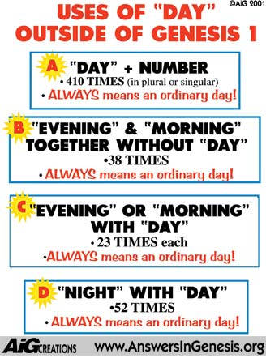

Slide 24
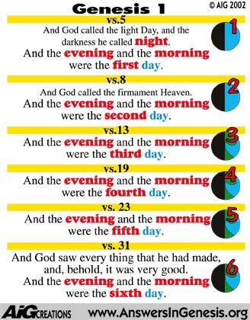

Slide 25
The Days of Genesis Are Ordinary 24-Hour Days
What else could God say to convey the idea that the days of creation were literal days? He used the only terms available to communicate that idea. There was a word, on the other hand, which Moses could have used to signify ages, or vast periods of time. He could have used the word dor [cf. Joel 2:2] which has that very meaning. But instead he used the word “day”, and we think the reason he did is very obvious to the unbiased reader: He wanted to tell his readers that all of creation took place in six literal 24 hour days! (Weston W. Fields, Unformed and Unfilled, 1976, p. 177-178)
If . . . the word ‘day’ in these chapters does not mean a period of twenty-four hours, the interpretation of Scripture is hopeless (Marcus Dods, Expositor’s Bible, T. & T. Clark: Edinburgh, 1888, p.4)

Slide 26
Too Many Events on the Sixth Day?
Those who believe the days of Genesis 1 were long ages sometimes try to prove their view by saying that the events that took place on the sixth day had to have taken longer than 24 hours – so if the sixth day is longer than 24 hours, maybe the other days of creation were long periods of time also.
But did the events that took place on day six really have to take longer than 24 hours?

Slide 27
The "Many" Events of Day Six*
God created all the animals.
God formed man from the dust of the ground.
God put Adam in the garden to till it and keep it.
God gave Adam directions regarding the tree of the Knowledge of Good and Evil.
God brought the animals to man for them to be named.
There was no helper found for Adam that was fit for him.
God caused a deep sleep to fall upon Adam and created the Woman from Adam’s rib.
*Taken from Wayne Grudem’s Systematic Theology, p.294

Slide 28
How long did it take Adam to name the animals?*
Genesis 2:19-20 – Now out of the ground the LORD God had formed every beast of the field and every bird of the heavens and brought them to the man to see what he would call them…The man gave names to all livestock and to the birds of the heavens and to every beast of the field.
It was only those animals in closest proximity ... to man that were actually brought to him these included the birds of the air, the cattle, and the beasts of the field, which were evidently the smaller wild animals that would live near human habitations.
Those not included were the fish of the sea, creeping things, and the beasts of the earth, which … were those wild animals living at a considerable distance from man and his cultivated fields.
*Information excerpted from Henry Morris, The Genesis Record, comments on Genesis 2:19, p. 97

Slide 29
How long did it take Adam to name the animals?
We have no way of knowing exactly how many "kinds" of animals appeared before Adam, but clearly not such a large number as to be incapable of examination within a few hours at most.
It is not unreasonable to suggest that Adam could note and name about ten kinds each minute, so that in, say five hours, about three thousand kinds could be identified. Clearly this number seems more than adequate to meet the needs of the case.
*Information excerpted from Henry Morris, The Genesis Record, comments on Genesis 2:19, p. 97

Slide 30
Long Days Don’t Solve the Problem
Even if we interpret the days of Genesis 1 as long periods of time, the Biblical account still cannot be made to accommodate modern evolutionary timetables.
Genesis Says:
Secular Science Says:
Earth (1st day) before the sun and stars (4th day)
Sun and stars before the earth
Light (1st day) before the sun (4th day)
Sun, the earth’s first light
Land vegetation (3rd day) before sun (4th day)
Sun before land vegetation
Plants (3rd day) before insects (included in “creeping things” - 6th day)
Insects before flowering plants. Few flowering plants could survive without insects for pollination.
Fruit trees (3rd day) before fish (5th day)
Fish before fruit trees

Slide 31
Long Days Don’t Solve the Problem (Continued)
Genesis Says:
Secular Science Says:
Birds and fish created at the same time (5th day)
Fish came millions of years before Birds
Fish (5th day) before insects (included in “creeping things” - 6th day)
Insects before fish
Birds (5th day) before land reptiles (6th day)
Reptiles before birds
Birds (5th day) before insects (included in “creeping things” - 6th day)
Insects before birds
Marine mammals (5th day) before land mammals (6th day)
Land mammals before marine mammals

Slide 32
John 3:12
If I have told you earthly things and you do not believe, how can you believe if I tell you heavenly things?

