Slide 1

Genesis 2 - The Creation of Man
The Supposed Conflict Between Genesis 1 and 2
Did Man Descend from Adam or Apes?

Slide 2
Genesis 2:4ff – The “Generations” of the Heavens and the Earth
These are the generations [or – “This is the account” (NET, NIV)] of the heavens and the earth when they were created, in the day that the LORD God made the earth and the heavens.
The word translated “generations” is a Hebrew word (TOLEDOTH) that is used several times in the book of Genesis.
In all the other places, TOLEDOTH is used to introduce the descendants that come from a person - Adam (5:1), Noah (6:9, 10:1), Shem (11:10), Terah (11:27), etc. - and to give a more detailed account of what that person and their descendants did.
Here TOLEDOTH is used to introduce a more detailed account of what happened after God created the heavens and the earth.

Slide 3
Genesis 2:5-9 – God Prepares a Garden for Man
When no bush of the field was yet in the land and no small plant of the field had yet sprung up -- for the LORD God had not caused it to rain on the land, and there was no man to work the ground…

Slide 4
Genesis 2:5-9 – God Prepares a Garden for Man
When no bush of the field was yet [or – “had yet grown” (NET)] in the land and no small plant of the field had yet sprung up [or – “sprouted” (NET)] -- for the LORD God had not caused it to rain on the land, and there was no man to work the ground…
Keil and Delitzsch give the following clarification on this passage in their commentary on Genesis: We must not understand the words as meaning that there was neither shrub nor herb before the rain… or before the creation of man and so draw the conclusion that the creation of plants occurred… after… the creation of man, in direct contradiction to chapter 1:11-12… The growing of shrubs and sprouting of herbs is… the natural development of plants as it has steadily proceeded ever since the creation. This was dependent on upon rain and human culture; their creation was not.

Slide 5
Genesis 2:5-9 – God Prepares a Garden for Man
When no bush of the field was yet [or – “had yet grown” (NET)] in the land and no small plant of the field had yet sprung up [or – “sprouted” (NET)] -- for the LORD God had not caused it to rain on the land, and there was no man to work the ground,
⁶ and a mist was going up from the land and was watering the whole face of the ground-- ⁷ then the LORD God formed the man of dust from the ground and breathed into his nostrils the breath of life, and the man became a living creature.
Job 36:27-29 – For [God] draws up the drops of water; they distill his mist [same Hebrew word as Gen. 2:6] in rain, which the skies pour down and drop on mankind abundantly. Can anyone understand the spreading of the clouds, the thunderings of his pavilion?

Slide 6
Genesis 2:5-9 – God Prepares a Garden for Man
⁸ And the LORD God planted [or – “had planted”(NIV)] a garden in Eden, in the east, and there he put the man whom he had formed. ⁹ And out of the ground the LORD God made to spring up every tree that is pleasant to the sight and good for food. The tree of life was in the midst of the garden, and the tree of the knowledge of good and evil.

Slide 7
Genesis 2:10-14 – The Rivers in the Garden
A river flowed out of Eden to water the garden, and there it divided and became four rivers. ¹¹ The name of the first is the Pishon. It is the one that flowed around the whole land of Havilah, where there is gold. ¹² And the gold of that land is good; bdellium and onyx stone are there. ¹³ The name of the second river is the Gihon. It is the one that flowed around the whole land of Cush. ¹⁴ And the name of the third river is the Tigris, which flows east of Assyria. And the fourth river is the Euphrates

Slide 8
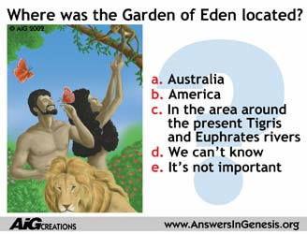

Slide 9
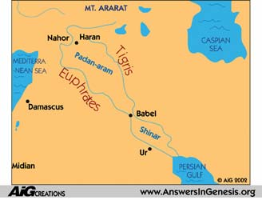

Slide 10
Genesis 2:15-20 – God’s First Interaction with Adam
The LORD God took the man and put him in the garden of Eden to work it and keep it. ¹⁶ And the LORD God commanded the man, saying, “You may surely eat of every tree of the garden, ¹⁷ but of the tree of the knowledge of good and evil you shall not eat, for in the day that you eat of it you shall surely die.” ¹⁸ Then the LORD God said, “It is not good that the man should be alone; I will make him a helper fit for him.” ¹⁹ Now out of the ground the LORD God had formed every beast of the field and every bird of the heavens and brought them to the man to see what he would call them. And whatever the man called every living creature, that was its name. ²⁰ The man gave names to all livestock and to the birds of the heavens and to every beast of the field. But for Adam there was not found a helper fit for him.

Slide 11
Genesis 2:21-25 – God Makes a Companion for Adam
So the LORD God caused a deep sleep to fall upon the man, and while he slept took one of his ribs and closed up its place with flesh. ²² And the rib that the LORD God had taken from the man he made into a woman and brought her to the man. ²³ Then the man said, "This at last is bone of my bones and flesh of my flesh; she shall be called Woman, because she was taken out of Man." ²⁴ Therefore a man shall leave his father and his mother and hold fast to his wife, and they shall become one flesh. ²⁵ And the man and his wife were both naked and were not ashamed.

Slide 12
The Supposed Conflict Between Genesis 1 and 2
Genesis chapter 1 gives a broad overview of the six days of creation, laid out in chronological order.
Genesis chapter 2 briefly recaps some of the creation events mentioned in chapter 1, but focuses primarily on God’s creation of, and provision for, Adam, giving more detail.
Because there is some repetition between the two chapters and some of the events are mentioned in a different order in chapter 2 (than in chapter 1), skeptics have tried to claim that Genesis has “two contradictory creation accounts”.
But of course this is not the case at all!

Slide 13
The Supposed Conflict Between Genesis 1 and 2
Sequence of Genesis 1 | (Alleged) Sequence of Genesis 2
1. Creation of Plants (1:11-12) | 1. Creation of Man (2:7)
2. Creation of Animals (1:24-25) | 2. Creation of Plants (2:8-9)
3. Creation of Man (1:26-27) | 3. Creation of Animals (2:19)

Slide 14
Hebrew Style of Writing
An Example from 1 Kings 6-7
Tell the Whole Story:
1 Kings 6:1-37 | Tells us how Solomon built the temple
1 Kings 6:38 | Tells us that Solomon finished the temple
1 Kings 7:1-12 | Tells us about Solomon's next project (his palace)
Then Revisit Some of the Details:
1 Kings 7:13-51 | Goes back and tells about one of the craftsman that Solomon hired to work on the temple and gives the details of what he made

Slide 15
Comparison of Genesis 1 and 2
Tell the Whole Story:
Genesis 1 - Gives a Sequential Overview of the Creation Week:
Day 1 – Light
Day 2 – Water and Sky
Day 3 – Land and Vegetation
Day 4 – Luminaries (Sun, Moon , and Stars)
Day 5 – Birds and Fish
Day 6 – Beasts and Man
Day 7 – Rest

Slide 16
Comparison of Genesis 1 and 2
Then Revisit Some of the Details:
Genesis 2 - Gives the Events of the Creation Week As They Relate To Adam:
vs.4 - The creation of the heavens and the earth
vs.5 - Points out that prior to the sprouting and growth of the plants that God placed in the garden:
  God had not yet caused it to rain on the earth.
  God had not yet created man to cultivate and care for plants.
vs.6 – Describes the hydrologic cycle that God set up to water the plants on an ongoing basis.

Slide 17
Comparison of Genesis 1 and 2
Then Revisit Some of the Details:
Genesis 2 - Gives the Events of the Creation Week As They Relate To Adam:
vs.7 - The formation of Adam from the dust of the ground
vs.8-9 - The garden of Eden which God “had planted” (NIV) for the man
vs.10-14 - The rivers that ran through the garden of Eden and the natural resources found there

Slide 18
Comparison of Genesis 1 and 2
Then Revisit Some of the Details:
Genesis 2 - Gives the Events of the Creation Week As They Relate To Adam:
vs.15-18 - The commands and responsibilities given to Adam
vs.19-20 – Adam names the animals which God “had formed”
vs.21ff - The forming of the woman as a companion for Adam

Slide 19

Did Man Descend from Adam or Apes?

Slide 20
Did Man Descend from Adam or Apes?
The Biblical Answer:
Genesis 2:7 – Then the LORD God formed the man of dust from the ground and breathed into his nostrils the breath of life, and the man became a living creature.
Genesis 2:21-23 – So the LORD God caused a deep sleep to fall upon the man, and while he slept took one of his ribs and closed up its place with flesh. ²² And the rib that the LORD God had taken from the man he made into a woman and brought her to the man. ²³ Then the man said, “This at last is bone of my bones and flesh of my flesh; she shall be called Woman, because she was taken out of Man.”

Slide 21
Did Man Descend from Adam or Apes?
The Biblical Answer:
1 Corinthians 11:8-9 – For man was not made from woman, but woman from man. ⁹ Neither was man created for woman, but woman for man.
Acts 17:26 – And [God] made from one man every nation of mankind to live on all the face of the earth, having determined allotted periods and the boundaries of their dwelling place…
Romans 5:12 – Therefore, just as sin came into the world through one man, and death through sin, and so death spread to all men because all sinned--

Slide 22

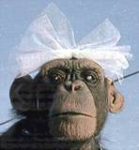
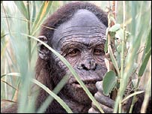
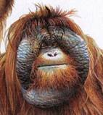
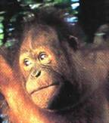

Two Contrasting Views
The Bible teaches that God created man
Evolution begins with the assumption that man has evolved from ape-like creatures
So God created man in his own image, in the image of God created he him; male and female
Genesis 1:27
Pick your relative

Slide 23
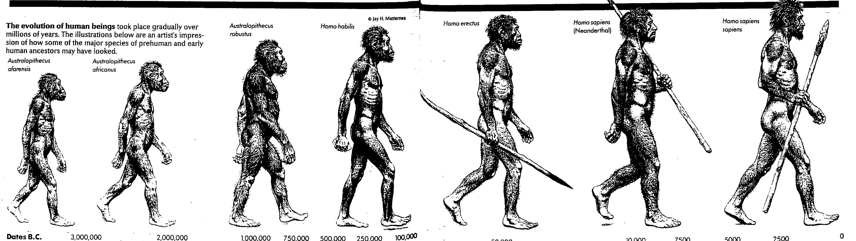
The Evolution of Man According to the 1996 World Book Encyclopedia
Of course the specifics of the evolutionary theories are always changing. . .

Slide 24
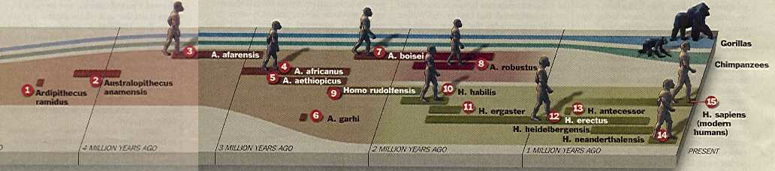
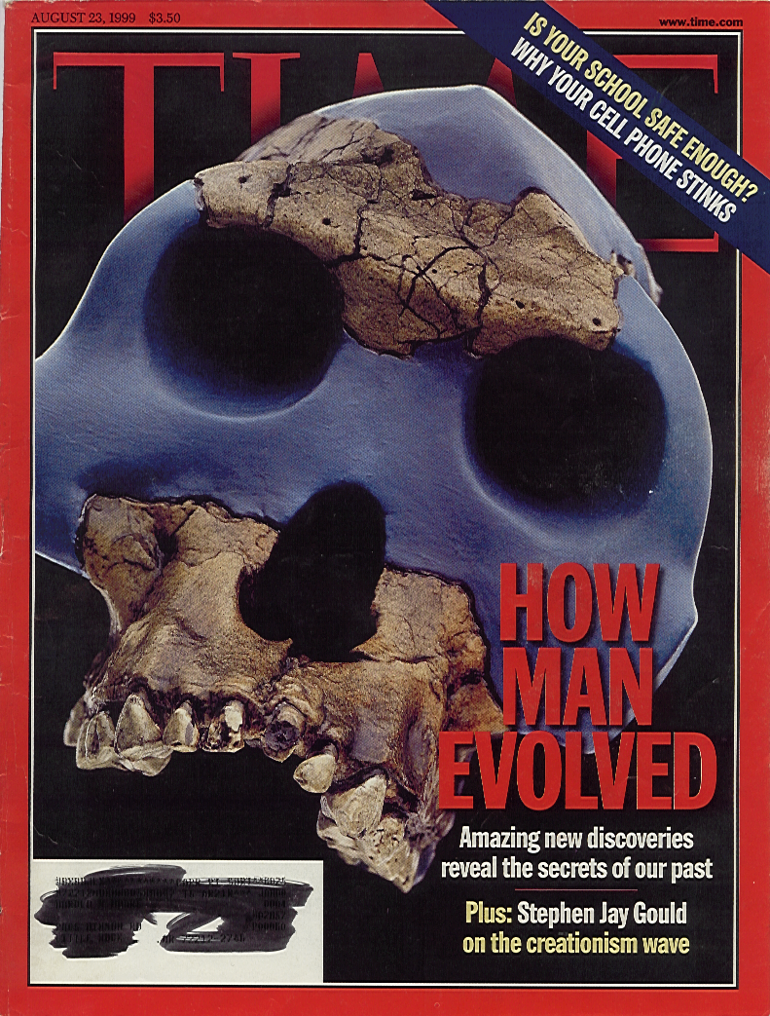
For example, according to Time magazine (Aug 1999):
“The path from proto-apes to modern humans is commonly seen as a succession of new and improved species taking the place of worn out evolutionary clunkers. It’s a satisfying, if slightly chauvinistic tale, but experts in human evolution have known for years that it is dead wrong. . .”
Time Magazine, August 23, 1999, p.51 (emphasis added)

Slide 25

But though the details may change. . .
Miller and Levine, Biology, 2000, p. 757.
“. . . all [evolutionary] researchers agree on certain basic facts. We know, for example, that humans evolved from ancestors we share with other living primates such as chimpanzees and apes.”

Slide 26
The Evolutionary Approach to Man’s Origins
Evolutionists begin with a preconceived bias that man evolved from ape-like creatures millions of years ago.
From this starting point:
  Evolutionists “build their case” - often using faulty or insufficient evidence and often ignoring evidence to the contrary.
  Evolutionists then create misleading stories, pictures, models, videos, etc. in newspapers, magazines, textbooks, museums, documentaries etc. in order to promote their evolutionary views

Slide 27
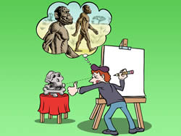
Evolutionary Stories
Examples of where the evolutionary approach has led to some rather embarrassing results

Slide 28
Ramapithecus
Discovered in India in 1932
Consisted of part of a fossilized jaw and a few teeth
Some famous experts declared that these fossils proved that this creature was on its way to becoming human
Summarized from The Amazing Story of Creation by Dr. Duane Gish, 1990, pp.77-85

Slide 29
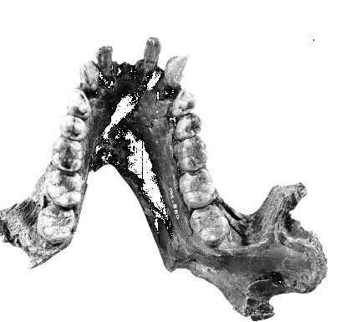
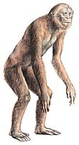
Ramapithecus
1930s
What they found
What they drew
http://answersingenesis.org/home/area/overheads/TOC.asp
Notes:
Pithecos = Greek for ape
Discovered in 1930s: jaw fragments and teeth

Slide 30
Ramapithecus
What they said:
  “Ramapithecus is ideally structured to be an ancestor of hominids. If he isn't, we don't have anything else that is.”
  Time Magazine (Nov. 7, 1977)
http://answersingenesis.org/home/area/overheads/TOC.asp

Slide 31
Ramapithecus
As it turns out:
  In 1970 a baboon living in Ethiopia was discovered with the same dental structure as that of the Ramapithecus fossil.
  As a result, evolutionists no longer try to claim that Ramapithecus is a human ancestor.
http://answersingenesis.org/home/area/overheads/TOC.asp

Slide 32
Nebraska Man
Discovered in western Nebraska In 1922
Consisted of a single tooth!
Was shown to one of America’s foremost fossil experts, Dr. Henry Fairfield Osborn, professor at Columbia University.
Dr. Osborn and other experts declared that the tooth had certain characteristics intermediate between ape and man
Summarized from The Amazing Story of Creation by Dr. Duane Gish, 1990, pp.77-85

Slide 33

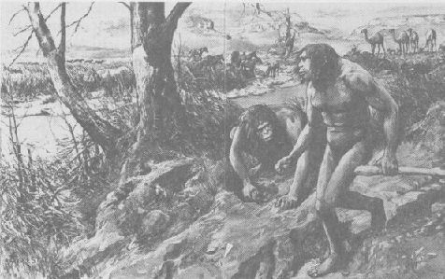
Nebraska Man
1922
What they found
What they drew
Illustrated London News, 160:942-4
Notes:
Pithecos = Greek for ape
Discovered in 1930s: jaw fragments and teeth

Slide 34
Nebraska Man
As it turns out the tooth on which Nebraska man was built was the tooth of an extinct pig!
Summarized from The Amazing Story of Creation by Dr. Duane Gish, 1990, pp.77-85

Slide 35
The Evolution of Man According to the 1996 World Book Encyclopedia

Slide 36
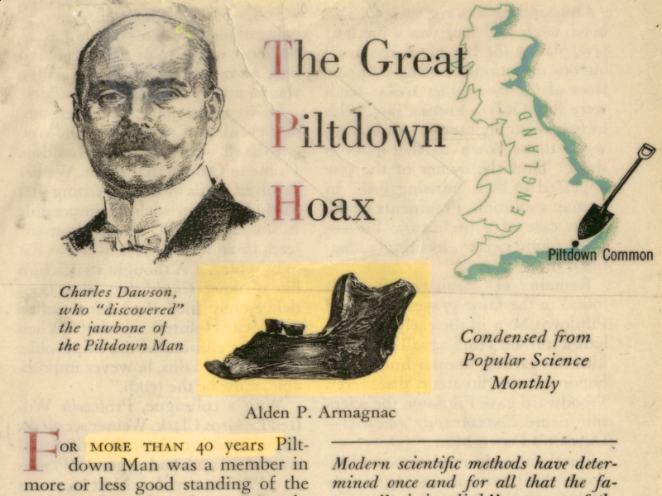
October 1956 Reader’s Digest reprint of April 1956 Popular Science article

Slide 37
Piltdown Man
In 1912, Charles Dawson, a lawyer and amateur fossil hunter, discovered a few fragments of a jawbone and pieces of a skull in a gravel pit near Piltdown, England.
Summarized from The Amazing Story of Creation by Dr. Duane Gish, 1990, p.79

Slide 38
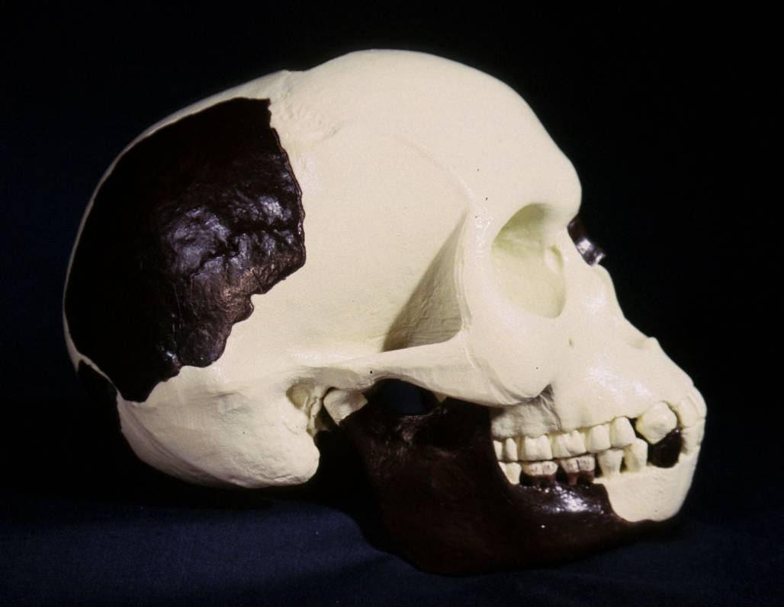
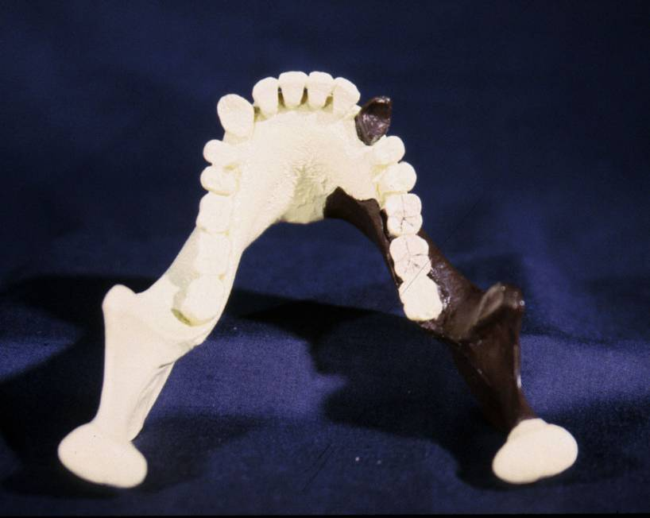
Piltdown Man
Segment of lower ape-like jaw
Segment of human skull

Slide 39
Piltdown Man
In 1912, Charles Dawson, a lawyer and amateur fossil hunter, discovered a few fragments of a jawbone and pieces of a skull in a gravel pit near Piltdown, England.
The jawbone appeared to be quite ape-like, but the teeth and skull appeared to be quite human-like.
Dawson and the English scientists with whom he consulted declared that these fossils were from a creature intermediate between ape and man that existed 500,000 years ago.
In 1925, Piltdown Man was used as one of the evidences of human evolution (from apes) in the famous Scopes Trial.
Summarized from The Amazing Story of Creation by Dr. Duane Gish, 1990, p.79

Slide 40
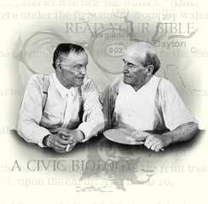
Piltdown Man
Used as Evidence in the Famous Scopes Trial

Slide 41
Piltdown Man
Used as Evidence in the Famous Scopes Trial*
“Anthropologists accept evolution as the most satisfactory explanation of the observed facts relating to the universe, to our world and all life on it… [The anthropologist] has selected a series of points for observation [on the human body]… These observations… are so definite that given a single skull or skeleton it is possible to tell with considerable certainty the age, sex and race of the individual… The skeletons tell much of man’s history… how he walked, how he held his head and many other details of his life.”
*Quotations are from the testimony of Fay-Cooper Cole at the Scopes trial (1925) quoted in D-Day at Dayton, Jerry R. Tompkins, 1965, pp.169-173

Slide 42
Piltdown Man
Used as Evidence in the Famous Scopes Trial*
“It does appear . . . that both man and other primates have a common [ancestor] . . .If this is true, then we might hope to find in ancient strata of the rocks some evidences of the earlier forms of men, who might more closely approach the common ancestor. This is exactly the case. . .[A find was made] near Piltdown in Sussex, England. This [find] consisted of the crushed skull of a woman and a jaw which can scarcely be distinguished from that of a chimpanzee… The skull is exceedingly thick and its capacity much less than that of a modern man, but is distinctly human, while as indicated, the jaw approaches that of an anthropoid [ape].”
*Quotations from the testimony of Fay-Cooper Cole at the Scopes trial (1925) quoted in D-Day at Dayton, Jerry R. Tompkins, 1965, pp.169-173

Slide 43
In 1953, 28 years after the famous Scopes trial, Piltdown Man was shown to be a hoax!*
As it turns out:
  The “fossil” bones had been planted in the gravel pit.
  The jawbone was from an ape.
  The skull was that of a modern human.
  The teeth had been filed to make them look human like instead of apelike.
  The bones had been treated with chemicals to make them look old.
The Piltdown hoax fooled scientific “experts” for more than 40 years!
*Summarized from Reader’s Digest, “The Great Piltdown Hoax”, Alden P. Armagnac, 1956, pp.179-185

Slide 44
Summary of “Facts”
Ramapithecus …….. Ape
Nebraska Man …….. Pig
Piltdown Man ……… Hoax
What about the dates?
In each case the date (age) was completely WRONG!

Slide 45
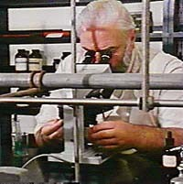
Note: “Expert” scientists can sometimes be fooled by hoaxes today!

Slide 46
A Modern Hoax
National Geographic
November 1999

Slide 47
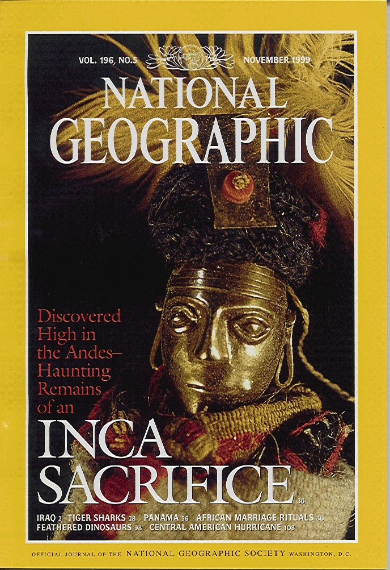
A Modern Hoax
In the November, 1999, National Geographic published a 10 page article with color pictures in which they stated that clear evidence had been found which proved that dinosaurs had evolved into birds! They wrote:
“It’s a missing link between terrestrial dinosaurs and birds that could actually fly” (p.100)
“We can now say that birds are theropods [a type of dinosaur] just as confidently as we say that humans are mammals” (p.105)

Slide 48
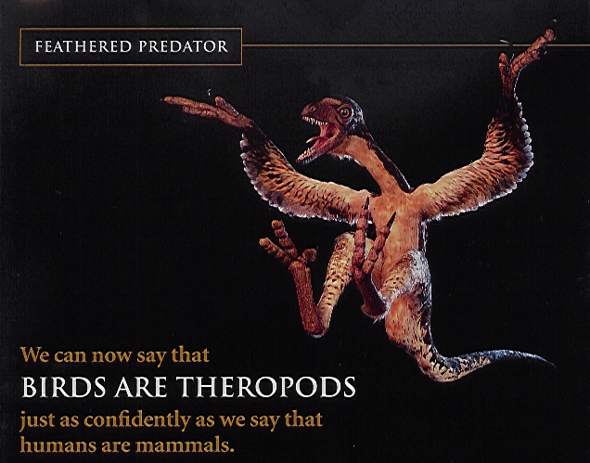

Slide 49
A Modern Hoax
“Then came the bad news. The discovery was phony. An opportunistic Chinese farmer, finding several sets of old bones in a shed, managed to rearrange them in such a manner that he was later able to persuade a buyer that one tail structure from some large but unidentifiable fowl belonged at the back end of an apparently legitimate dinosaur. That’s all it took to convince some pretty high powered scientists that this remarkable animal was once covered with feathers instead of scales, and that it had been airborne” (World, February 19, 2000 issue, p.18)

Slide 50
A Modern Hoax
In March, 2000, National Geographic published a retraction of its earlier article (in small print in the magazine’s obscure, had-to-find “Forum” section):
  “After observing a new feathered dromaeosaur . . . And comparing it with the fossil known as Archaeoraptor, I have concluded that Archaeoraptor is a composite . . . A dromaeosaur tail and a bird body [Letter from Xu Xing] . . . Xu Xing is one of the scientists who originally examined Archaeoraptor.”

Slide 51

What is the Evidence for Human Evolution?
http://www.answersingenesis.org/articles/wow/did-humans-really-evolve

Slide 52
What is the Evidence for Human Evolution?
Outside of what God tells us in the Bible, fossils are the only historical evidence we have that can prove whether or not man evolved from apes.
In order to prove that ancient apes evolved into humans, evolutionists would have to find fossil evidence of a series of apes who were on their way to becoming human – i.e. a series of ape-men.
These ape-man fossils would have a mix of both human and ape characteristics – the earlier fossils having more apelike characteristics, that later fossils having more human characteristics.

Slide 53
Human vs. Ape Anatomy
Key Areas of Comparison:
  Skulls
  Jaws and Teeth
  Rib Cage
  Pelvis
  Knee Joint
  Hands (and sometimes wrists)
  Feet

Slide 54
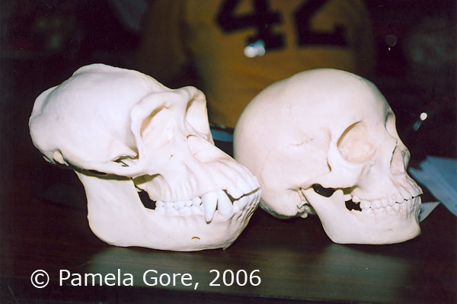
Skulls
Bony Eye Ridge
Smaller Brain Capacity
Protruding Lower Jaw
Notes:
The human skull is easily distinguished from all living apes, though there are, of course, similarities.
The part of the skull that houses the brain is large in humans because of their relatively large brain compared to apes.
The size of the normal adult human brain varies considerably. These differences in size in the human brain do not correlate with intelligence.
Adult apes have brains that are generally smaller than even the smallest of adult human brains and, of course, are not even remotely comparable in intelligence.
Perhaps the best way to distinguish an ape skull from a human skull is to examine it from a side view:
The face of the human is nearly vertical, while that of the ape slopes forward from its upper face to its chin.
The bony socket of the eye (the orbit) of an ape is obscured by its broad flat upper face. Humans, on the other hand, have a more curved upper face and forehead, clearly revealing the orbit of the eye from a side view.

Slide 55
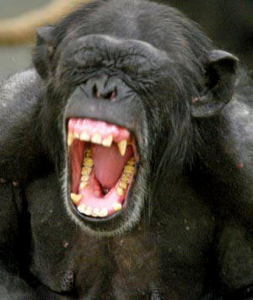
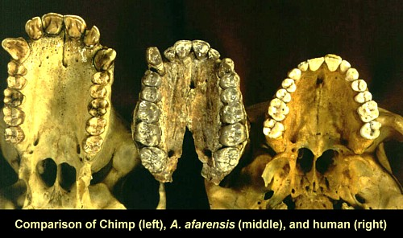
Jaws and Teeth
U-Shaped
Large Canines
Notes:
The problem in declaring a fossil ape to be a human ancestor (i.e., a hominid) on the basis of certain humanlike features of the teeth is that some living apes have these same features and they are not considered to be ancestors of man.
Some species of modern baboons, for example, have relatively small canines and incisors and relatively large molars.
While most apes do have thin enamel, some apes such as the orangutans have relatively thick enamel.
Clearly, teeth tell us more about an animal’s diet and feeding habits than its supposed evolution. Nonetheless, thick enamel is one of the most commonly cited criteria for declaring an ape fossil to be a hominid.

Slide 56
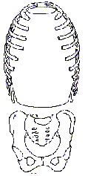
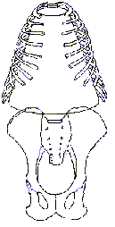
Rib Cage
Ape ribs are conical shaped
Human ribs are barrel-like
Human
Ape
Circular barrel-like
Conical shape

Slide 57
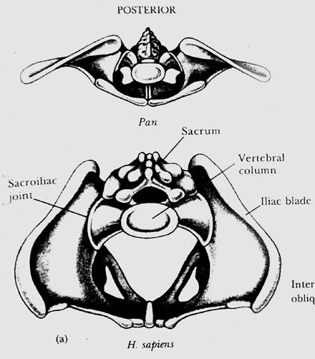
Pelvis
Chimp
Human

Slide 58
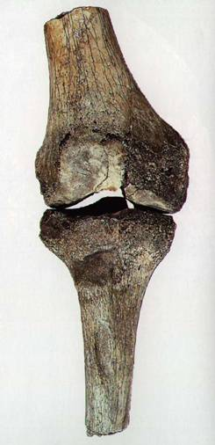
Knee Joint
Carrying angle (valgus)
  Human = 9°
  Gorilla = 0°
  Chimp = 0°
Orangutan = 9°
Spider monkey = 9°
Notes:
The most eagerly sought-after evidence in fossil hominids is any anatomical feature that might suggest bipedality (the ability to walk on two legs). Since humans walk on two legs, any evidence of bipedality in fossil apes is considered by evolutionists to be compelling evidence for human ancestry. But we should bear in mind that the way an ape walks on two legs is entirely different from the way man walks on two legs. The distinctive human gait requires the complex integration of many skeletal and muscular features in our hips, legs and feet. Thus, evolutionists closely examine the hipbones (pelvis), thighbones (femur), leg bones (tibia and fibula) and foot bones of fossil apes in an effort to detect any anatomical features that might suggest bipedality.
Evolutionists are particularly interested in the angle at which the femur and the tibia meet at the knee (called the carrying angle). Humans are able to keep their weight over their feet while walking because their femurs converge toward the knees, forming a carrying angle of approximately 9 degrees with the tibia (in other words, we’re sort of knock-kneed). In contrast, chimps and gorillas have widely separated straight legs with a carrying angle of essentially 0 degrees. These animals manage to keep their weight over their feet when walking by swinging their body from side to side in the familiar “ape walk.”
Evolutionists assume that fossil apes with a high carrying angle (humanlike) were bipedal and thus evolving into man. Certain australopithecines (an apelike creature) are considered to have walked like us and thus to be our ancestors largely because they had a high carrying angle. But high carrying angles are not confined to humans-they are also found on some modern apes that walk gracefully on tree limbs and only clumsily on the ground.
Living apes with a high carrying angle (values comparable to man) include such apes as the orangutan and spider monkey-both adept tree climbers and capable of only an apelike bipedal gait on the ground. The point is that there are living tree-dwelling apes and monkeys with some of the same anatomical features that evolutionists consider to be definitive evidence for bipedality, yet none of these animals walks like man and no one suggests they are our ancestors or descendants.

Slide 59
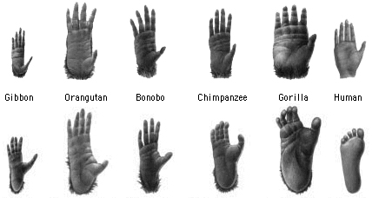
Hands and Feet

Slide 60
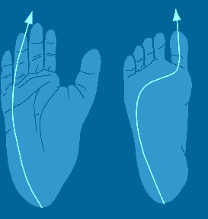
Footprints
Human
Ape

Slide 61
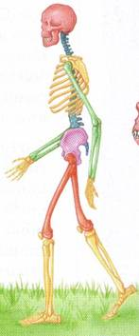
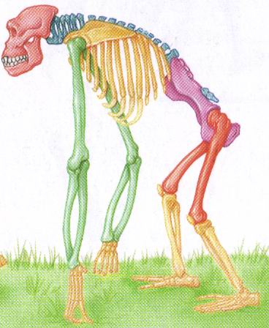
Skeleton
Notes:
All these deal with being bipedal
FINE BALANCE: Requires a fine sense of balance. The inner ear has a network of fluid-filled canals which contain sensors which are sensitive to movement and gravity. The sensors consist of fine hairs which send out signals to indicate direction and speed. Humans have a more complex inner ear design than apes
FLAT FACE: So their eyes have a field of view which extends down to the ground in front of the feet.
UPRIGHT SKULL: the position at which the spinal cord enters the skull. In humans it is located at the bottom of the skull. This means the most natural position for the head is looking forward in the upright position.
STRAIGHT BACK: This is ideal for upright posture because the torso and head are directly above the hips in the standing position. Apes have a curved back.
FULLY EXTENDABLE FEMUR BONES: When looking from the front humans have femur bones which are angled inwards as they come down from the hip. This has the effect of making the knees and feet closer together. Having feet closer together keeps the feet nearly under the center of the body and gives stability during walking and running. During walking and running the body is supported by one leg at any instant and so the body can topple over if the legs are not right under the body. If the feet were not close together then the body would be thrown from side to side
FULLY EXTENDABLE KNEE JOINTS:
VERY LONG LEGS: The length of human legs is about half the total body. This makes it possible to walk and run for long distances with relative ease. In contrast, apes are only about a third.
ARCHED FEET: The human foot is arched between the ball of the foot and the toes. The foot has around 26 bones and many muscles and ligaments, tendons and nerves so the foot can flex between the heel and the ball. The arched structure of the foot makes it easy for a person to press down on the ball for the foot which is important for balance and control. This ability is also important for movements such as standing on tiptoe, running and turning. It also helps absorb shocks during walking and running. In contrast the feet and hands of apes are like hands suited for grasping.
STRONG BIG TOES: This feature is important for walking and running. For each step, the final push from the ground comes from the big toe. In order to propel the body forwards in a controlled manner, the big toe must be very strong. Apes have a toe designed for grasping. They cannot make a firm push from their big toe.

Slide 62
Only Three Ways to Make an “Apeman” *
Knowing from Scripture that God didn’t create any ape-men, there are only three ways for the evolutionist to create one:
  Combining Men and Apes - Combine ape fossil bones with human fossil bones and declare the two to be one individual-a real “ape-man.” (e.g. “Piltdown Man”)
  Making Man Out of Apes - Emphasize certain humanlike qualities of fossilized ape bones, and with imagination upgrade apes to be more humanlike.
  Making Apes Out of Man - Emphasize certain apelike qualities of fossilized human bones, and with imagination downgrade humans to be more apelike.
These three approaches account for all of the attempts by evolutionists to fill the unbridgeable gap between apes and men with fossil apemen.
* http://www.answersingenesis.org/articles/wow/did-humans-really-evolve

Slide 63
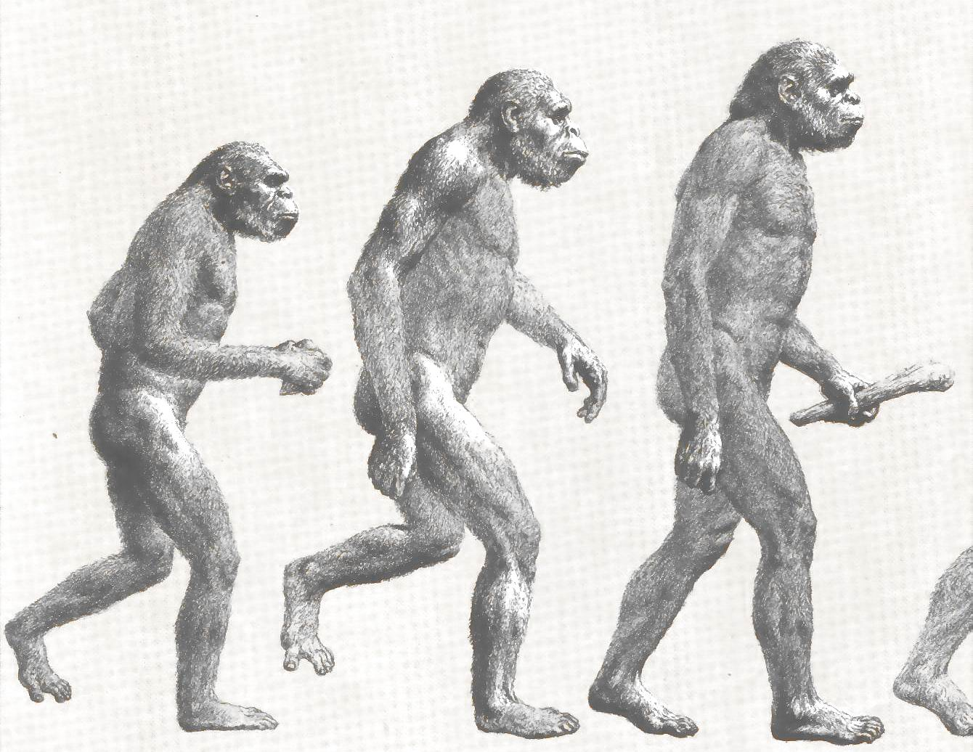
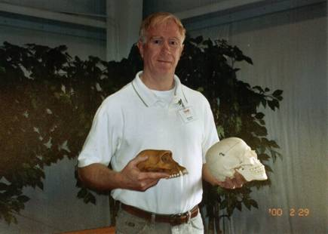
Making Man Out of Apes
Lucy and the Australopithecines

Slide 64
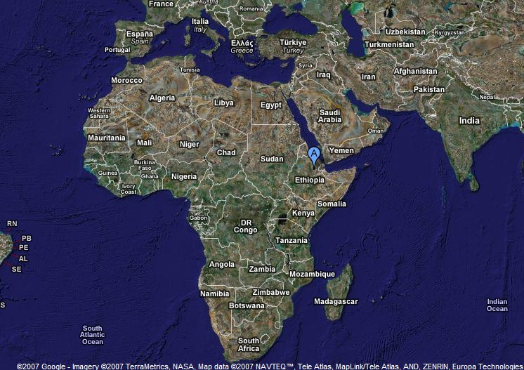
Lucy (Australopithecus afarensis)
In 1974, Dr. Donald Johanson, an American anthropologist, discovered the fossilized skeletal remains (about 40%) of an extinct ape species in the Afar Depression of Ethiopia.
It was later classified as an Australopithecus afarensis and was given the nickname “Lucy”.
Evolutionists claim it is 3.5 million years old

Slide 65
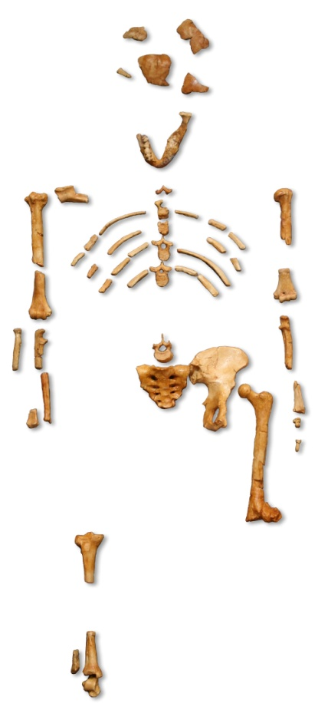
Lucy
(Australopithecus afarensis)

Slide 66
Lucy (Australopithecus afarensis)
In 1974, Dr. Donald Johanson, an American anthropologist, discovered the fossilized skeletal remains (about 40%) of an extinct ape species in the Afar Depression of Ethiopia.
It was later classified as an Australopithecus afarensis and was given the nickname “Lucy”.
Evolutionists claim it is 3.5 million years old
All the parts of Lucy’s anatomy that they actually found are ape-like – none of them resemble the bones of a human.

Slide 67
Lucy’s Brain Size is Apelike
““Although brain organization is more important than brain size alone, the significant gap between the cranial capacities of the largest australopithecine and the smallest human, fossil or living, has not been bridged.” (Marvin Lubenow in Bones of Contention, 1992 ,p.168)

Slide 68
Lucy’s Jaw and Teeth are Apelike
http://www.nwcreation.net/riddle/FactsAboutApemenwithGospel_files/frame.htm
Notes:
The problem in declaring a fossil ape to be a human ancestor (i.e., a hominid) on the basis of certain humanlike features of the teeth is that some living apes have these same features and they are not considered to be ancestors of man.
Some species of modern baboons, for example, have relatively small canines and incisors and relatively large molars.
While most apes do have thin enamel, some apes such as the orangutans have relatively thick enamel.
Clearly, teeth tell us more about an animal’s diet and feeding habits than its supposed evolution. Nonetheless, thick enamel is one of the most commonly cited criteria for declaring an ape fossil to be a hominid.

Slide 69
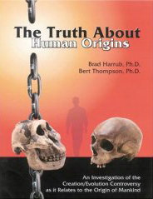
Lucy’s Rib Cage is Apelike
“In Lucy’s case, her ribs are conical, like those found in apes.”
Brad Harrub (Ph.D. Anatomy and Neurobiology) and Bert Thompson (Ph.D. Microbiology), The Truth About Human Origins, 2003, p. 47.

Slide 70
Lucy’s Pelvis is Apelike
“The marked resemblance of AL 288-1 (Lucy) to the chimpanzee is equally obvious…” (J. Stern & R. Sussman, American Journal of Physical Anthropology, 1983, pp. 291 & 292)
Stern and Sussman go on to say that even though they believe Lucy walked upright, because of the shape of Lucy’s pelvis they believe her method of standing was more like that of a chimp than a human.
http://www.nwcreation.net/riddle/FactsAboutApemenwithGospel_files/frame.htm

Slide 71
Lucy and the Australopithecines
Long arms identical to chimpanzees
Upper leg bone is similar to chimpanzees
Legs were very ape-like
Hands were similar to pygmy chimpanzee
Feet were long and curved
No similarity in appearance to humans
And yet, according to evolutionists, Lucy and the Australopithecines were on their way to becoming human!
Why do they make this claim?
http://www.nwcreation.net/riddle/FactsAboutApemenwithGospel_files/frame.htm

Slide 72
Evolutionists Begin With a
Preconceived Bias. . .
Commenting on the facial reconstruction of the Australopithecus afarensis,(Lucy’s family) artist John Gurche told National Geographic:
“I wanted to get a human soul into this ape-like face, to indicate something about where he was headed.” (John Gurche, artist, National Geographic, March, 1996 p. 109).
http://www.icr.org/article/5306/

Slide 73
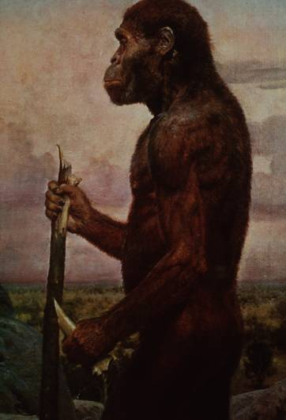
Evolutionists then create misleading stories, pictures, models, etc. . .
Artistic conception
Australopithecus
africanus
What do you notice about this picture?
Note the contemplative gaze, human hands and use of tools.
http://www.nwcreation.net/riddle/FactsAboutApemenwithGospel_files/frame.htm

Slide 74
Lucy – What They Found:
http://www.nwcreation.net/riddle/FactsAboutApemenwithGospel_files/frame.htm
Notes:
Picture of Lucy from: Biology: Understanding Life Third Edition, 2000

Slide 75
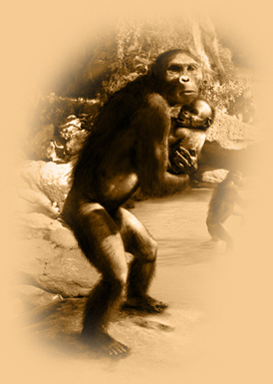
Lucy – What They Drew:
http://lucyexhibition.com/life-in-lucys-time.aspx
Notes:
Picture of Lucy from: Biology: Understanding Life Third Edition, 2000

Slide 76
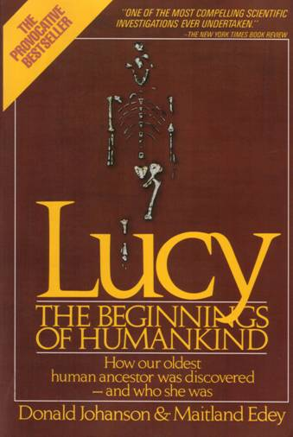
Lucy – What They Said:
Note: Lucy is our ancestor

Slide 77
Lucy: What They Modeled:
Exhibit at the St. Louis Zoo
http://www.nwcreation.net/riddle/FactsAboutApemenwithGospel_files/frame.htm

Slide 78
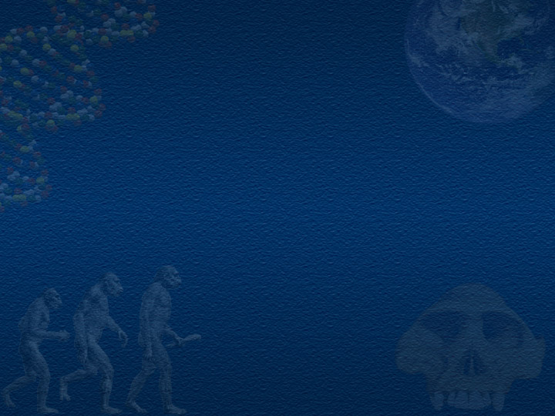
And If the Evidence Doesn’t Fit…
No problem!
The evolutionists just make it fit!

Slide 79
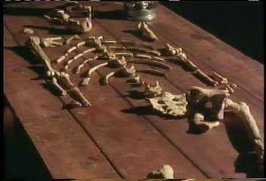
Example: Lucy’s pelvis is “wrong” because it is very ape-like
PBS Nova Series; In Search of Human Origins
episode one 1994 (Dr. Owen Lovejoy)
Notes:
C. Owen Lovejoy is Chairman of Anthropology at Kent State University

Slide 80
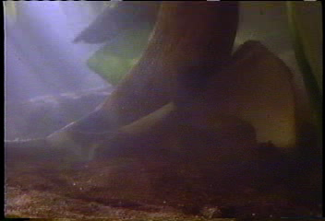
“Fixing” Lucy with a power saw!
PBS Nova Series; In Search of Human Origins
episode one 1994 (Dr. Owen Lovejoy)

Slide 81
Romans 1:22,25
Claiming to be wise, they became fools . . . they exchanged the truth about God for a lie and worshiped and served the creature rather than the Creator. . .

Slide 82
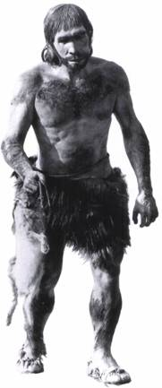
Making humans more ape-like
Neanderthals
http://dsc.discovery.com/convergence/cavemen/evolve/evolve.html

Slide 83
Neandertals*
Neandertal man was first discovered in 1856 by workmen digging in a limestone cave in the Neander valley near Dusseldorf, Germany.
The fossil bones were examined by an anatomist (professor Schaafhausen) who concluded that they were human.
At first, not much attention was given to these finds, but with the publication of Darwin’s Origin of Species in 1859, the search began for the imagined “apelike ancestors” of man.
Darwinians argued that Neandertal man was an apelike creature, while many critical of Darwin (like the great anatomist Rudolph Virchow) argued that Neandertals were human in every respect, though some appeared to be suffering from rickets or arthritis.
* http://www.answersingenesis.org/articles/wow/did-humans-really-evolve

Slide 84
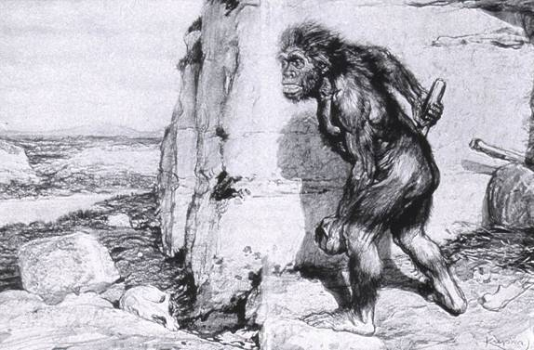
Neandertals
Original Drawing of Neandertal
http://www.nwcreation.net/riddle/FactsAboutApemenwithGospel_files/frame.htm

Slide 85
Neandertals*
Over 300 Neandertal specimens have now been found scattered throughout most of the world, including Belgium, China, Central and North Africa, Iraq, the Czech republic, Hungary, Greece, northwestern Europe, and the Middle East.
This race of men was characterized by prominent eyebrow ridges (like modern Australian Aborigines), a low forehead, a long narrow skull, a protruding upper jaw and a strong lower jaw with a short chin.
They were deep-chested, large-boned individuals with a powerful build.
It should be emphasized, however, that none of these features fall outside the range of normal human anatomy.
Interestingly, the brain size (based on cranial capacity) of Neandertal man was actually larger than average for that of modern man, though this is rarely emphasized.
* http://www.answersingenesis.org/articles/wow/did-humans-really-evolve

Slide 86
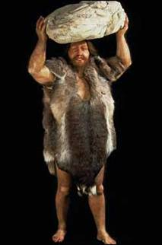
Neandertal Anatomy
Thick brow
Stocky body build
Short extremities
http://www.nwcreation.net/riddle/FactsAboutApemenwithGospel_files/frame.htm

Slide 87
Neandertals*
In addition to the fact that their bodies are consistent with those of modern humans, there is also a great deal of cultural evidence that Neanderthals are fully human:
  They buried their dead and had elaborate funeral customs that included arranging the body and covering it with flowers.
  They made a variety of stone tools and worked with skins and leather.
  A wood flute was recently discovered among Neanderthal remains.
  There is even evidence that suggests that he engaged in medical care.
  Some Neanderthal specimens show evidence of survival to old age despite numerous wounds, broken bones, blindness and disease.
* http://www.answersingenesis.org/articles/wow/did-humans-really-evolve

Slide 88
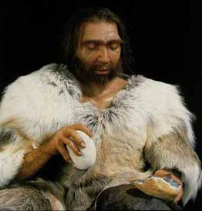
Conclusion About Neandertals
Protruding brow ridge
Stocky body build and short extremities
Isolated population of people
Lived in a cold, harsh climate
100% human
Neandertal man, reconstructed from a skull found in La Chapelle-aux-Saints, France
http://www.nwcreation.net/riddle/FactsAboutApemenwithGospel_files/frame.htm

Slide 89
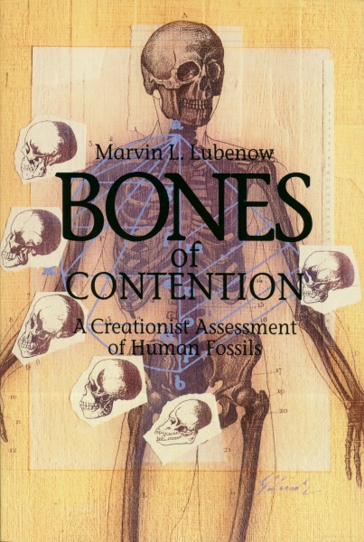
A Creationist Response to the Evolutionary View of Human Origins
As Given by Marvin Lubenow in Bones of Contention, 1992

Slide 90

Humans Did Not Evolve From Apes*
“There are fossils that are indistinguishable from modern humans that extend all the way back to 4.5 million years on the evolutionary time scale.” (p.169)
“As far back as the human fossil record goes the human body has remained substantially the same and has not evolved from something else.” (p.140)
*Marvin Lubenow in Bones of Contention, 1992

Slide 91
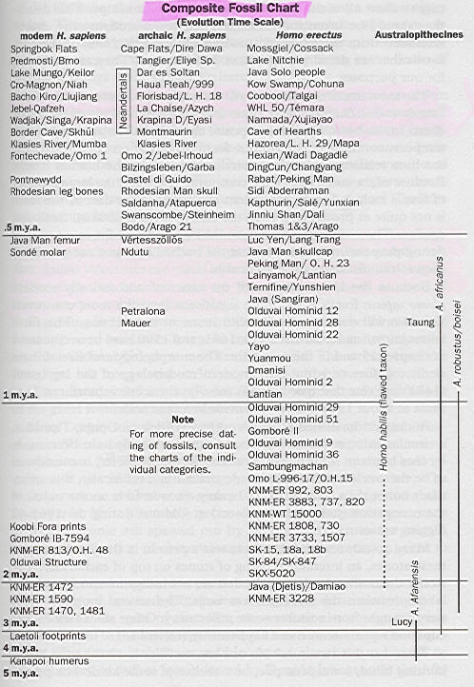
Chart of Ape/Man Fossil Evidence
As Given by Marvin Lubenow in Bones of Contention, 1992, p.171

Slide 92
Man is NOT Just Another Kind of Animal
“Most eight-year-olds can write an understandable letter to their grandparents describing a trip to the zoo, or can move to a foreign country and learn any other language in the world, and we think it entirely normal. But no animal will ever write such a letter to its grandparents, or give the past, present, and future of even one French verb, or read a detective story and understand it, or understand the meaning of even one verse from the Bible. Human children do all these things quite readily, and in so doing they show themselves so far superior to the whole animal kingdom that we wonder why people have sometimes thought that we are merely another kind of animal.”
(Wayne Grudem, Systematic Theology, pp. 446-447)

Slide 93
Psalm 139:14
I praise you, for I am fearfully and wonderfully made. Wonderful are your works; my soul knows it very well.

