Slide 1
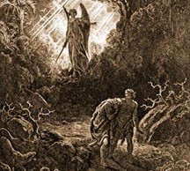
Genesis 3-4
The Fall and Its Implications
Where Did Cain Get His Wife?
What Happened to the Dinosaurs?

Slide 2
Genesis 3:1-5 – The Temptation
Now the serpent was more crafty than any other beast of the field that the LORD God had made. He said to the woman, “Did God actually say, 'You shall not eat of any tree in the garden’?” ² And the woman said to the serpent, "We may eat of the fruit of the trees in the garden, ³ but God said, ‘You shall not eat of the fruit of the tree that is in the midst of the garden, neither shall you touch it, lest you die.’” ⁴ But the serpent said to the woman, "You will not surely die. ⁵ For God knows that when you eat of it your eyes will be opened, and you will be like God, knowing good and evil.”

Slide 3
Genesis 3:6-8 – The Sin
So when the woman saw that the tree was good for food, and that it was a delight to the eyes, and that the tree was to be desired to make one wise, she took of its fruit and ate, and she also gave some to her husband who was with her, and he ate. ⁷ Then the eyes of both were opened, and they knew that they were naked. And they sewed fig leaves together and made themselves loincloths. ⁸ And they heard the sound of the LORD God walking in the garden in the cool of the day, and the man and his wife hid themselves from the presence of the LORD God among the trees of the garden.

Slide 4
Genesis 3:9-13 – “Passing the Buck”
But the LORD God called to the man and said to him, “Where are you?” ¹⁰ And he said, "I heard the sound of you in the garden, and I was afraid, because I was naked, and I hid myself." ¹¹ He said, “Who told you that you were naked? Have you eaten of the tree of which I commanded you not to eat?” ¹² The man said, “The woman whom you gave to be with me, she gave me fruit of the tree, and I ate.” ¹³ Then the LORD God said to the woman, “What is this that you have done?” The woman said, “The serpent deceived me, and I ate.”

Slide 5
Genesis 3:14-15 – The Serpent is Cursed
The LORD God said to the serpent, “Because you have done this, cursed are you above all livestock and above all beasts of the field; on your belly you shall go, and dust you shall eat all the days of your life. ¹⁵ I will put enmity between you and the woman, and between your offspring and her offspring; he shall bruise your head, and you shall bruise his heel.”

Slide 6
Genesis 3:16-19 – Consequences of the Fall on Man and Woman
To the woman he said, “I will surely multiply your pain in childbearing; in pain you shall bring forth children. Your desire shall be for your husband, and he shall rule over you.” ¹⁷ And to Adam he said, “Because you have listened to the voice of your wife and have eaten of the tree of which I commanded you, ‘You shall not eat of it,’ cursed is the ground because of you; in pain you shall eat of it all the days of your life; ¹⁸ thorns and thistles it shall bring forth for you; and you shall eat the plants of the field. ¹⁹ By the sweat of your face you shall eat bread, till you return to the ground, for out of it you were taken; for you are dust, and to dust you shall return.”

Slide 7
Genesis 3:20-24 – The Aftermath
The man called his wife's name Eve, because she was the mother of all living. ²¹ And the LORD God made for Adam and for his wife garments of skins and clothed them. ²² Then the LORD God said, "Behold, the man has become like one of us in knowing good and evil. Now, lest he reach out his hand and take also of the tree of life and eat, and live forever-- " ²³ therefore the LORD God sent him out from the garden of Eden to work the ground from which he was taken. ²⁴ He drove out the man, and at the east of the garden of Eden he placed the cherubim and a flaming sword that turned every way to guard the way to the tree of life.

Slide 9
The Extent of the Curse
Romans 5:12 – Therefore, just as sin came into the world through one man, and death through sin, and so death spread to all men because all sinned--
1 Corinthians 15:22 – For as in Adam all die, so also in Christ shall all be made alive.

Slide 10
The Extent of the Curse
Romans 8:19-22 – For the creation waits with eager longing for the revealing of the sons of God. ²⁰ For the creation was subjected to futility, not willingly, but because of him [God] who subjected it, in hope ²¹ that the creation itself will be set free [in the new heavens and new earth] from its bondage to corruption and obtain the freedom of the glory of the children of God. ²² For we know that the whole creation has been groaning together in the pains of childbirth until now.

Slide 11
Genesis 4:1-2 – The Birth of Cain and Abel
¹ Now Adam knew Eve his wife, and she conceived and bore Cain, saying, "I have gotten a man with the help of the LORD." ² And again, she bore his brother Abel. Now Abel was a keeper of sheep, and Cain a worker of the ground.

Slide 12
Genesis 4:3-7 – Cain and Abel Interact With the Lord
³ In the course of time Cain brought to the LORD an offering of the fruit of the ground, ⁴ and Abel also brought of the firstborn of his flock and of their fat portions. And the LORD had regard for Abel and his offering, ⁵ but for Cain and his offering he had no regard. So Cain was very angry, and his face fell. ⁶ The LORD said to Cain, "Why are you angry, and why has your face fallen? ⁷ If you do well, will you not be accepted? And if you do not do well, sin is crouching at the door. Its desire is for you, but you must rule over it.”

Slide 13
Genesis 4:8-12 – The First Murder
Cain spoke to Abel his brother. And when they were in the field, Cain rose up against his brother Abel and killed him. ⁹ Then the LORD said to Cain, "Where is Abel your brother?" He said, "I do not know; am I my brother's keeper?" ¹⁰ And the LORD said, "What have you done? The voice of your brother's blood is crying to me from the ground. ¹¹ And now you are cursed from the ground, which has opened its mouth to receive your brother's blood from your hand. ¹² When you work the ground, it shall no longer yield to you its strength. You shall be a fugitive and a wanderer on the earth.”

Slide 14
Genesis 4:13-15 – Cain’s Response to His Punishment
Cain said to the LORD, "My punishment is greater than I can bear. ¹⁴ Behold, you have driven me today away from the ground, and from your face I shall be hidden. I shall be a fugitive and a wanderer on the earth, and whoever finds me will kill me." ¹⁵ Then the LORD said to him, "Not so! If anyone kills Cain, vengeance shall be taken on him sevenfold." And the LORD put a mark on Cain, lest any who found him should attack him.

Slide 15
Genesis 4:16-18 – Cain’s Offspring
Then Cain went away from the presence of the LORD and settled in the land of Nod, east of Eden. ¹⁷ Cain knew his wife, and she conceived and bore Enoch. When he built a city, he called the name of the city after the name of his son, Enoch. ¹⁸ To Enoch was born Irad, and Irad fathered Mehujael, and Mehujael fathered Methushael, and Methushael fathered Lamech

Slide 16
Genesis 4:19-24 – Lamech
And Lamech took two wives. The name of the one was Adah, and the name of the other Zillah. ²⁰ Adah bore Jabal; he was the father of those who dwell in tents and have livestock. ²¹ His brother's name was Jubal; he was the father of all those who play the lyre and pipe. ²² Zillah also bore Tubal-cain; he was the forger of all instruments of bronze and iron. The sister of Tubal-cain was Naamah. ²³ Lamech said to his wives: "Adah and Zillah, hear my voice; you wives of Lamech, listen to what I say: I have killed a man for wounding me, a young man for striking me. ²⁴ If Cain's revenge is sevenfold, then Lamech's is seventy-sevenfold."

Slide 17
Genesis 4:25-26 – The Birth of Seth
And Adam knew his wife again, and she bore a son and called his name Seth, for she said, "God has appointed for me another offspring instead of Abel, for Cain killed him." ²⁶ To Seth also a son was born, and he called his name Enosh. At that time people began to call upon the name of the LORD.

Slide 18
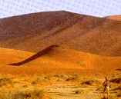
Where Did Cain Get His Wife?

Slide 19
Where Did Cain Get His Wife?
Adam’s Sons Married Adam’s Daughters
Logically this has to be the case:
Adam and Eve Were the First Human Couple
Genesis 2:7,18 – the LORD God formed the man of dust from the ground and breathed into his nostrils the breath of life, and the man became a living creature …Then the LORD God said, “It is not good that the man should be alone; I will make him a helper fit for him.”
1 Corinthians 15:45 – Thus it is written, “The first man Adam became a living being”

Slide 20
Where Did Cain Get His Wife?
All Other Human Beings Come From Adam and Eve
Acts 17:26a – And he made from one man [Adam] every nation of mankind to live on all the face of the earth…
Genesis 3:20 – The man called his wife's name Eve [which means “life-giver”], because she was the mother of all living.

Slide 21
Where Did Cain Get His Wife?
Adam Had “Other Sons and Daughters”
Genesis 5:4 – The days of Adam after he fathered Seth were 800 years; and he had other sons and daughters.
Therefore Adam’s Sons (e.g. Cain) Would Have to Have Married Adam’s Daughters - There was no one else around to marry!

Slide 22
Objections to View That Brothers Married Sisters in Adam’s Day:
Objection #1: The Bible forbids family intermarriage.
Leviticus 18:9 – Do not have sexual relations with your sister, either your father's daughter or your mother's daughter, whether she was born in the same home or elsewhere.
Response:
The laws against incest were not given until the time of Moses around 1400 BC.

Slide 23
Objections to View That Brothers Married Sisters in Adam’s Day:
Objection #2: It would have caused physical problems in the offspring.
Response:
Family intermarriage sometimes results in deformed children in modern times
But Family intermarriage does not seem to have caused such problems in ancient times

Slide 24
What Happened to the Dinosaurs?
T-Rex Attack on Triceratops

Slide 25
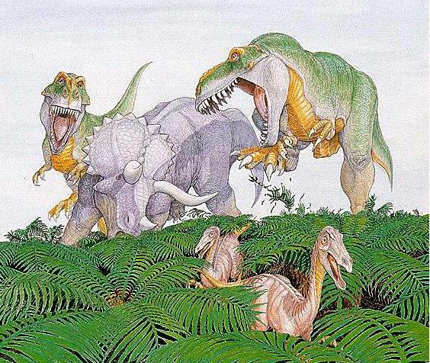
The Discovery of Dinosaurs
Dinosaur fossils were first discovered in the early 1800s
The term "dinosaur", which means "terrible lizard", was coined in 1841 by the famous paleontologist, Sir Richard Owen.
Since these early finds, more than 1,000 different sites containing dinosaur fossils have been uncovered around the world
From 1870 into the early 1900s, two men dominated the search for dinosaurs in the western United States:
Othniel Charles Marsh and
Edward Drinker Cope.

Slide 26
Places Where Dinosaur Fossils Have Been Found

Slide 27
Evolutionary Theory on Dinosaurs
Evolutionists believe that dinosaurs "evolved" about 230 million years ago and then died out about 65 million years ago.
Evolutionists are uncertain as to why dinosaurs went extinct.

Slide 28
Supposed Dinosaur Evolution

Slide 29
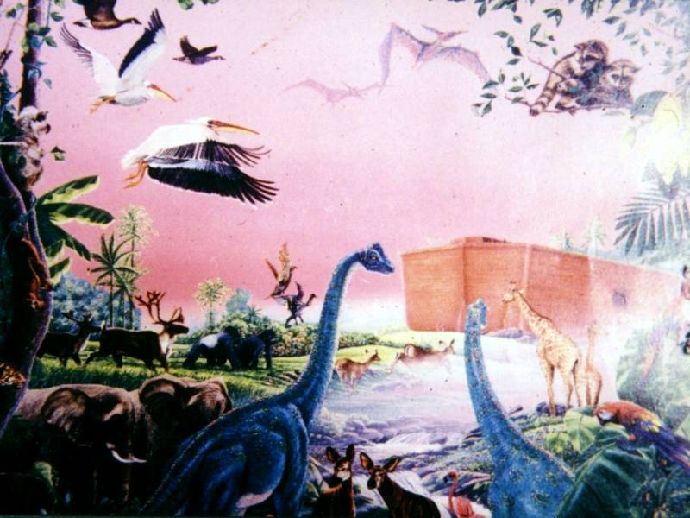
Biblical Perspective on Dinosaurs

Slide 30
Biblical Perspective on Dinosaurs
Dinosaurs would have been included in the animals created on the fifth and sixth days of creation.
If the dinosaurs lived until the time of Noah's flood . . .
Many dinosaurs would have perished in the flood - leaving numerous fossils.
Dinosaurs would have been among those animals that God preserved on the ark.
The apparent extinction of dinosaurs today would have taken place after the flood - perhaps due to changing conditions on the earth.

Slide 31
Evidence That Dinosaurs and Man Coexisted
Ancient Legends
Possible Biblical References
Behemoth (Job 40)
Leviathan (Job 41)
Present Day Examples?

Slide 32
Ancient Legends May Show That Man Co-Existed With Dinosaurs*
Just as nearly every culture of the world has flood stories similar to the account given in Genesis 6-9, many different cultures also have dragon legends.
China - China has always been renowned for its dragon stories. Dragons have always been prominent on Chinese pottery, embroidery and carvings.
England - England has its story of St. George, who slew a dragon that lived in a cave.
Ireland - In the tenth century, an Irishman wrote of his encounter with what appears to have been a Stegosaurus.
Italy - A well-known naturalist of the time, Ulysses Aldrovandus, recorded an encounter between a peasant named Baptista and a dragon whose description fits that of the dinosaur Tanystropheus. The encounter was on May 13, 1572 near Bologna in Italy, and the peasant killed the dragon.
*Examples given by Ham, Snelling, and Wieland, The Answers Book - Answers to the 12 most-asked questions on Genesis and Creation/Evolution, pp.21-39

Slide 33
Ancient Legends May Show That Man Co-Existed With Dinosaurs*
Just as nearly every culture of the world has flood stories similar to the account given in Genesis 6-9, many different cultures also have dragon legends.
Ancient Sumeria - There is a Sumerian story dating back to 3,000 BC that tells of a hero named Gilgamesh who, when he went to a remote forest, encountered a huge dragon which he slew, cutting off its head as a trophy.
India - When Alexander the Great and his soldiers marched into India, they found that the Indians worshipped huge hissing reptiles that they kept in caves.
Europe - In the 1500s, a European scientific book Historia Animalum, listed several animals as still being alive that we would classify as dinosaurs.
*Examples given by Ham, Snelling, and Wieland, The Answers Book - Answers to the 12 most-asked questions on Genesis and Creation/Evolution, pp.21-39

Slide 34
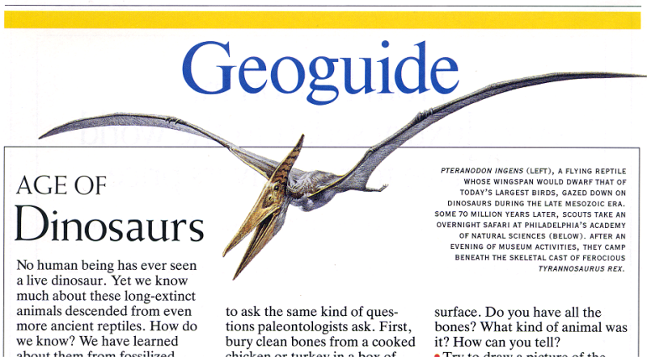
“No human being has ever seen a live dinosaur.”
National Geographic Jan. 1993
Then why did they draw them, carve them, and write about them?

Slide 35
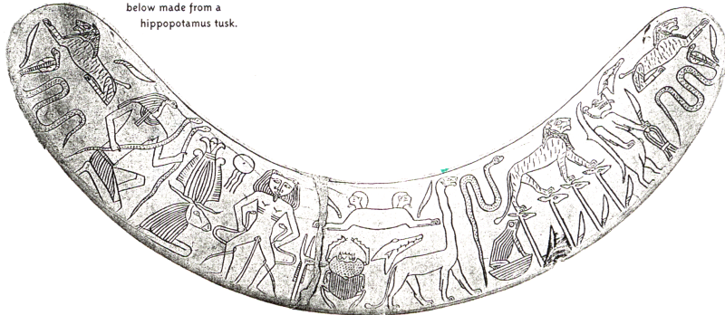
Long necked creature found on hippo tusk “magic wand” in tomb of Inherka.
12th century BC in Egypt.

Slide 36

Russian medallion

Slide 37
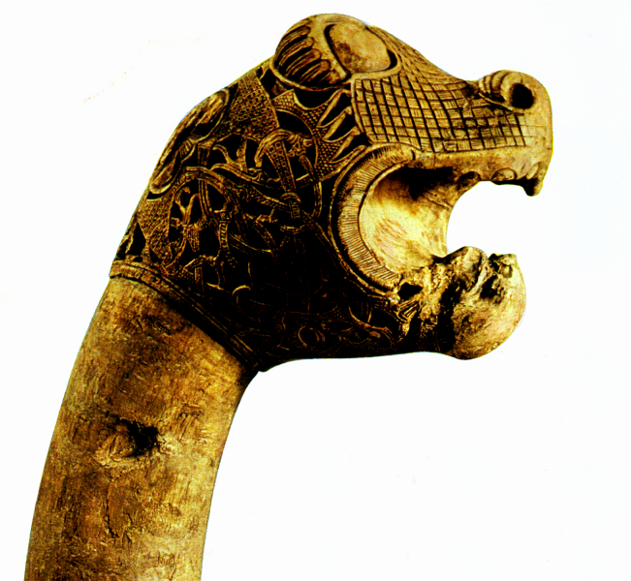
Viking ships often had a dragon head. 1000 A.D. The Vikings p.17

Slide 38
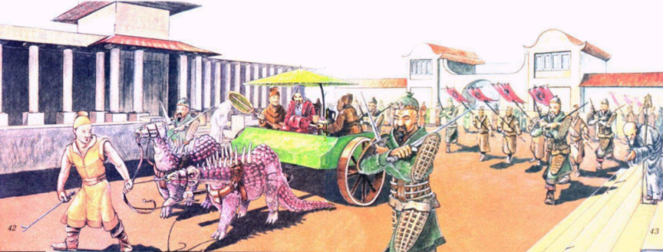
Marco Polo lived in China for 17 yrs. around 1271 A.D. and reported that the emperor raised dragons to pull his chariots in parades.

Slide 39
In 1611 the emperor appointed the post of a “Royal Drago Feeder.” Books even tell of Chinese families raising dragons to use their blood for medicines and highly prizing their eggs. (DeVisser, Marinus Willem, The Dragon in China & Japan, 1969.)

Slide 40
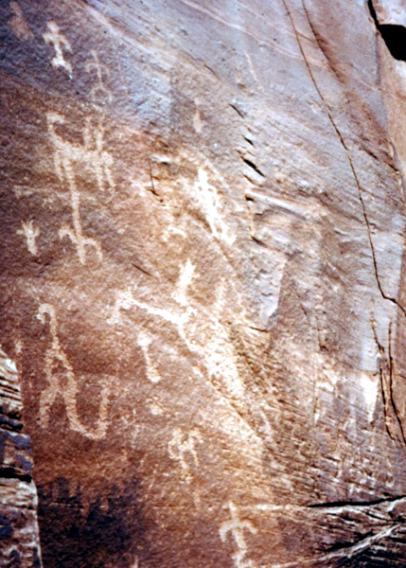
Indian pictograph, from the Grand Canyon.
Found in the Havasupai canyon in Grand Canyon.
photo taken by
Dr. DeLancy
719 S. Main St. Perkasie, PA 18944
His widow has the originals.

Slide 41
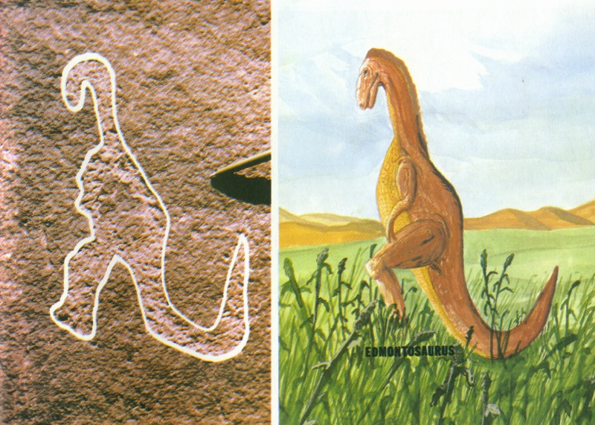
carving compared to dinosaur (great dinosaur mystery)

Slide 42
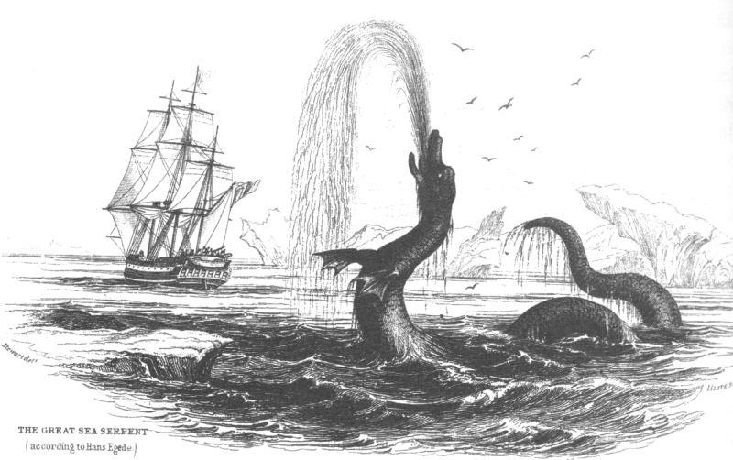
sea monster and sailing ship “””
Hans Egede, Missionary to Greenland, drew this sketch of the “sea monster” he saw off the coast of Greenland in 1734.
S.M. McAllister 205-773-7823 is a living descendant.

Slide 43
Ancient Legends May Show That Man Co-Existed With Dinosaurs
If the accounts given in ancient histories of dragons are really descriptions of encounters of men with (what we would classify as) dinosaurs, then there is quite a bit of evidence that man and dinosaurs coexisted!

Slide 44
Evidence That Dinosaurs and Man Coexisted Possible Biblical References
Behemoth (Job 40)
Leviathan (Job 41)
Sea Monsters?

Slide 45
Behemoth?
Look at the behemoth, which I made along with you and which feeds on grass like an ox. What strength he has in his loins, what power in the muscles of his belly! His tail sways like a cedar; the sinews of his thighs are close-knit. His bones are tubes of bronze, his limbs like rods of iron. He ranks first among the works of God, yet his Maker can approach him with his sword. The hills bring him their produce, and all the wild animals play nearby. Under the lotus plants he lies, hidden among the reeds in the marsh. The lotuses conceal him in their shadow; the poplars by the stream surround him. When the river rages, he is not alarmed; he is secure, though the Jordan should surge against his mouth. Can anyone capture him by the eyes, or trap him and pierce his nose? Job 40:15-24 (NIV)
Brown-Driver-Briggs Hebrew Dictionary:
Perhaps an extinct dinosaur; a Diplodocus or Brachiosaurus, exact meaning unknown

Slide 46
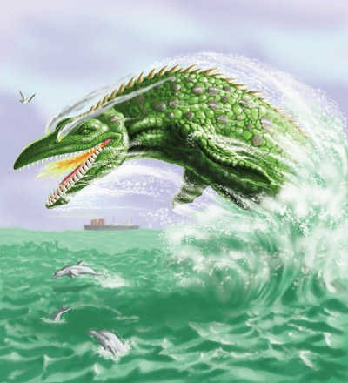
Leviathan?

Slide 47
Leviathan - Job 41:1-34 (NIV)
"Can you pull in the leviathan with a fishhook or tie down his tongue with a rope? ² Can you put a cord through his nose or pierce his jaw with a hook? ³ Will he keep begging you for mercy? Will he speak to you with gentle words? ⁴ Will he make an agreement with you for you to take him as your slave for life? ⁵ Can you make a pet of him like a bird or put him on a leash for your girls? ⁶ Will traders barter for him? Will they divide him up among the merchants? ⁷ Can you fill his hide with harpoons or his head with fishing spears? ⁸ If you lay a hand on him, you will remember the struggle and never do it again! ⁹ Any hope of subduing him is false; the mere sight of him is overpowering.

Slide 48
Leviathan - Job 41:1-34 (NIV)
¹⁰ No one is fierce enough to rouse him. Who then is able to stand against me? ¹¹ Who has a claim against me that I must pay? Everything under heaven belongs to me. ¹² I will not fail to speak of his limbs, his strength and his graceful form. ¹³ Who can strip off his outer coat? Who would approach him with a bridle? ¹⁴ Who dares open the doors of his mouth, ringed about with his fearsome teeth? ¹⁵ His back has rows of shields tightly sealed together; ¹⁶ each is so close to the next that no air can pass between. ¹⁷ They are joined fast to one another; they cling together and cannot be parted.

Slide 49
Leviathan - Job 41:1-34 (NIV)
¹⁸ His snorting throws out flashes of light; his eyes are like the rays of dawn. ¹⁹ Firebrands stream from his mouth; sparks of fire shoot out. ²⁰ Smoke pours from his nostrils as from a boiling pot over a fire of reeds. ²¹ His breath sets coals ablaze, and flames dart from his mouth. ²² Strength resides in his neck; dismay goes before him. ²³ The folds of his flesh are tightly joined; they are firm and immovable. ²⁴ His chest is hard as rock, hard as a lower millstone. ²⁵ When he rises up, the mighty are terrified; they retreat before his thrashing. ²⁶ The sword that reaches him has no effect, nor does the spear or the dart or the javelin.

Slide 50
Leviathan - Job 41:1-34 (NIV)
²⁷ Iron he treats like straw and bronze like rotten wood. ²⁸ Arrows do not make him flee; slingstones are like chaff to him. ²⁹ A club seems to him but a piece of straw; he laughs at the rattling of the lance. ³⁰ His undersides are jagged potsherds, leaving a trail in the mud like a threshing sledge. ³¹ He makes the depths churn like a boiling caldron and stirs up the sea like a pot of ointment. ³² Behind him he leaves a glistening wake; one would think the deep had white hair. ³³ Nothing on earth is his equal-- a creature without fear. ³⁴ He looks down on all that are haughty; he is king over all that are proud.

Slide 51
Leviathan
Brown-Driver-Briggs Hebrew Dictionary:
Leviathan, sea monster, dragon
Large aquatic animal
Perhaps the extinct dinosaur, plesiosaurus, exact meaning unknown

Slide 52

Sea Monsters?

Slide 53
Sea Monsters? Dragons?
You divided the sea by your might; you broke the heads of the sea monsters on the waters. (Psalm 74:13)
Praise the LORD from the earth, Sea monsters and all deeps; (Psalm 148:7 - NAS)
In that day the LORD with his hard and great and strong sword will punish Leviathan the fleeing serpent, Leviathan the twisting serpent, and he will slay the dragon that is in the sea. (Isaiah 27:1 )

Slide 54
Sea Monsters? Dragons?
Brown-Driver-Briggs Hebrew Dictionary:
Hebrew: tanniyn
Dragon, serpent, sea monster
Dragon or dinosaur
Sea or river monster
Serpent, venomous snake

Slide 55
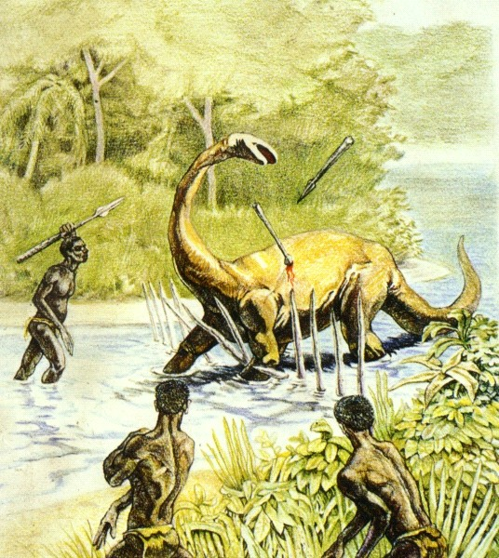
Present Day Examples?

Slide 56
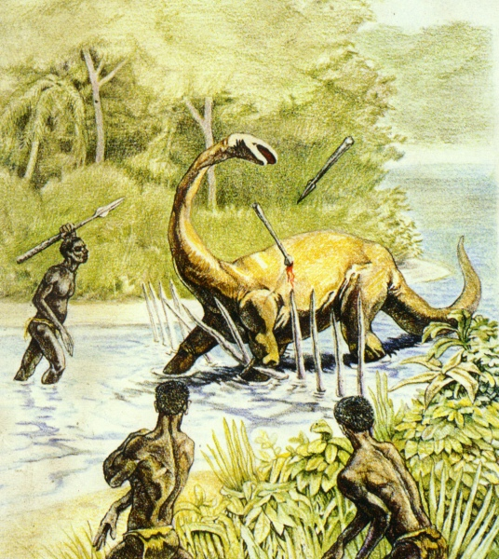
Evidence That Dinosaurs and Man Coexisted Present Day Examples?
42 year veteran missionary, Eugene Thomas had two pygmies in his church in Congo, Africa that claimed to have killed a Mokele-Mbembe in 1959.

Slide 57
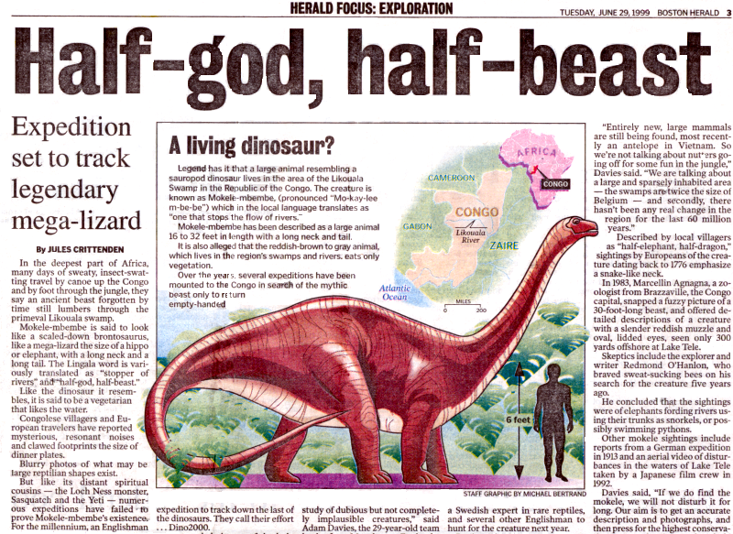
Evidence That Dinosaurs and Man Coexisted Present Day Examples?

