Slide 1

Genesis 5 (and 11) Issues Related to Time and Dating
How Old is the Human Race?
The Genealogies of Genesis 5 and 11
Supposed Objections to Interpreting the Genealogies Literally
How Old is the Earth?
Radioactive Dating Methods
Scientific Proofs for a Young Earth
How Old is the Universe?
How Do We See Light From Distant Stars in a Young Universe?
Did the Universe Evolve?

Slide 2

Genesis 5 – The Line of Adam
This is the book of the generations of Adam. When God created man, he made him in the likeness of God. ² Male and female he created them, and he blessed them and named them Man when they were created.
³ When Adam had lived 130 years, he fathered a son in his own likeness, after his image, and named him Seth. ⁴ The days of Adam after he fathered Seth were 800 years; and he had other sons and daughters. ⁵ Thus all the days that Adam lived were 930 years, and he died.

Slide 3
Genesis 5 – The Line of Adam
When Seth had lived 105 years, he fathered Enosh. ⁷ Seth lived after he fathered Enosh 807 years and had other sons and daughters. ⁸ Thus all the days of Seth were 912 years, and he died.
⁹ When Enosh had lived 90 years, he fathered Kenan. ¹⁰ Enosh lived after he fathered Kenan 815 years and had other sons and daughters. ¹¹ Thus all the days of Enosh were 905 years, and he died.
¹² When Kenan had lived 70 years, he fathered Mahalalel. ¹³ Kenan lived after he fathered Mahalalel 840 years and had other sons and daughters. ¹⁴ Thus all the days of Kenan were 910 years, and he died.
¹⁵ When Mahalalel had lived 65 years, he fathered Jared. ¹⁶ Mahalalel lived after he fathered Jared 830 years and had other sons and daughters. ¹⁷ Thus all the days of Mahalalel were 895 years, and he died.

Slide 4
Genesis 5 – The Line of Adam
¹⁸ When Jared had lived 162 years he fathered Enoch. ¹⁹ Jared lived after he fathered Enoch 800 years and had other sons and daughters. ²⁰ Thus all the days of Jared were 962 years, and he died.
²¹ When Enoch had lived 65 years, he fathered Methuselah. ²² Enoch walked with God after he fathered Methuselah 300 years and had other sons and daughters. ²³ Thus all the days of Enoch were 365 years. ²⁴ Enoch walked with God, and he was not, for God took him.
²⁵ When Methuselah had lived 187 years, he fathered Lamech. ²⁶ Methuselah lived after he fathered Lamech 782 years and had other sons and daughters. ²⁷ Thus all the days of Methuselah were 969 years, and he died.

Slide 5
Genesis 5 – The Line of Adam
²⁸ When Lamech had lived 182 years, he fathered a son ²⁹ and called his name Noah, saying, "Out of the ground that the LORD has cursed, this one shall bring us relief from our work and from the painful toil of our hands." ³⁰ Lamech lived after he fathered Noah 595 years and had other sons and daughters. ³¹ Thus all the days of Lamech were 777 years, and he died.
³² After Noah was 500 years old, Noah fathered Shem, Ham, and Japheth.

Slide 6
Genesis 11 – The Line of Shem
These are the generations of Shem. When Shem was 100 years old, he fathered Arpachshad two years after the flood. ¹¹ And Shem lived after he fathered Arpachshad 500 years and had other sons and daughters.
¹² When Arpachshad had lived 35 years, he fathered Shelah. ¹³ And Arpachshad lived after he fathered Shelah 403 years and had other sons and daughters.
¹⁴ When Shelah had lived 30 years, he fathered Eber. ¹⁵ And Shelah lived after he fathered Eber 403 years and had other sons and daughters.
¹⁶ When Eber had lived 34 years, he fathered Peleg. ¹⁷ And Eber lived after he fathered Peleg 430 years and had other sons and daughters.

Slide 7
Genesis 11 – The Line of Shem
¹⁸ When Peleg had lived 30 years, he fathered Reu. ¹⁹ And Peleg lived after he fathered Reu 209 years and had other sons and daughters.
²⁰ When Reu had lived 32 years, he fathered Serug. ²¹ And Reu lived after he fathered Serug 207 years and had other sons and daughters.
²² When Serug had lived 30 years, he fathered Nahor. ²³ And Serug lived after he fathered Nahor 200 years and had other sons and daughters.
²⁴ When Nahor had lived 29 years, he fathered Terah. ²⁵ And Nahor lived after he fathered Terah 119 years and had other sons and daughters.
²⁶ When Terah had lived 70 years, he fathered Abram, Nahor, and Haran.

Slide 8
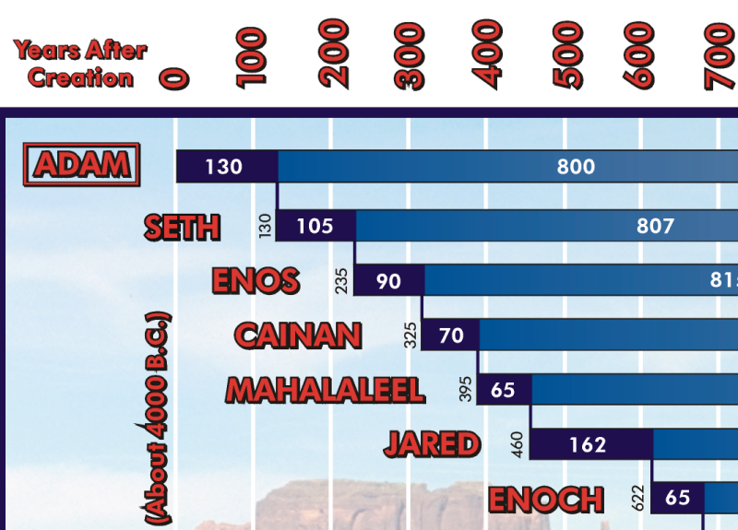
130+105+90+70+65+162+….=4000 B.C.
Last page of “seminar notebook” by Kent Hovind

Slide 9
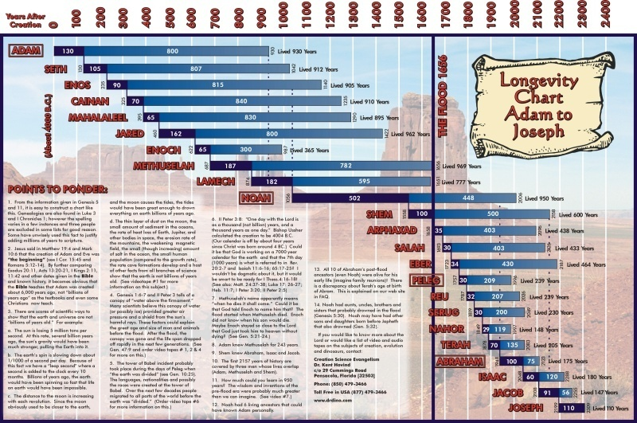
Last page of “seminar notebook” by Kent Hovind

Slide 10
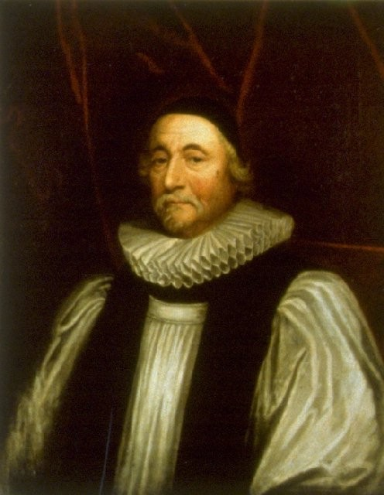
Archbishop James Ussher of Armagh
(1581-1656)

Slide 11
Archbishop Ussher’s Chronology of the Bible
Was originally compiled in 1650.
Was based on a literal interpretation of the genealogies of Genesis 5 and 11 in addition to other Biblical and historical data.
Gave a date of 4004 BC for the creation of the heavens and the earth and a date of 2348 BC for Noah's flood.
Was printed in the margins of the King James Bible for many years, beginning in the eighteenth century.
Is often criticized today for:
Attempting to be too precise
Interpreting the Bible too literally
Giving too young a date for the creation

Slide 12
Genealogical Data -- Genesis 5

Slide 13
Genealogical Data -- Genesis 11

Slide 14

Should We Opt for a Strict Literal Interpretation of the Genealogies of Genesis 5 and 11?

Slide 15
Should We Opt for a Strict Literal Interpretation of the Genealogies (of Genesis 5 and 11)?
Secular Objections:
Archeologists claim to have found civilizations preceding Ussher's Date for Creation.
Archeologists claim to have found civilizations existing during Ussher's date for the Flood
Some Things to Think About:
Archeology is far from being a precise science.
Archeological dating methods are far from certain.
Archeologists have often claimed that the Bible was wrong, only to discover later that the Bible was right after all.

Slide 16
Archeologists have often claimed that the Bible was wrong, only to discover later that the Bible was right after all.
Nelson Glueck, famous Jewish archaeologist, spoke of what he called ‘the almost incredibly accurate historical memory of the Bible, and particularly so when it is fortified by archaeological fact.’ (Geisler, N.L. and Nix, W.E., A General Introduction to the Bible, Moody Press, Chicago, 1986)
William F. Albright, widely recognized as one of the great archaeologists, stated:
‘The excessive skepticism shown toward the Bible by important historical schools of the eighteenth and nineteenth centuries, certain phases of which still appear periodically, has been progressively discredited. Discovery after discovery has established the accuracy of innumerable details, and has brought increased recognition to the value of the Bible as a source of history.’ (McDowell, J., Evidence that Demands a Verdict, Vol. 1, Campus Crusade for Christ, San Bernadino, CA, 1972 )

Slide 17
Archeologists have often claimed that the Bible was wrong, only to discover later that the Bible was right after all.*
The Hittites were once thought to be a Biblical legend, until their capital and records were discovered at Bogazkoy, Turkey.
Many thought the Biblical references to Solomon's wealth were greatly exaggerated. Recovered records from the past show that wealth in antiquity was concentrated with the king and Solomon's prosperity was entirely feasible.
It was once claimed there was no Assyrian king named Sargon as recorded in Isaiah 20:1, because this name was not known in any other record. Then, Sargon's palace was discovered in Khorsabad, Iraq. The very event mentioned in Isaiah 20, his capture of Ashdod, was recorded on the palace walls. What is more, fragments of a stela memorializing the victory were found at Ashdod itself.
Another king who was in doubt was Belshazzar, king of Babylon, named in Daniel 5. The last king of Babylon was Nabonidus according to recorded history. Tablets were found showing that Belshazzar was Nabonidus' son who served as coregent in Babylon.
*Examples cited from http://www.christiananswers.net/q-abr/abr-a008.html

Slide 18
Should We Opt for a Strict Literal Interpretation of the Genealogies (of Genesis 5 and 11)?
Secular Objection:
The genealogies of other ancient cultures seem to suggest that those civilizations existed for more time than a literal interpretation of Genesis 5 and 11 would allow.
Something to Think About:
When faced with an irreconcilable conflict between the genealogies in the Bible and the genealogies of ancient heathen nations, which would you believe?

Slide 19
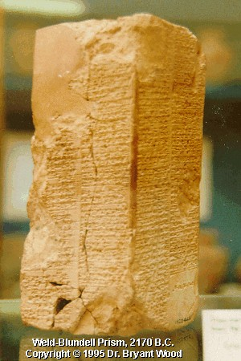
Ancient Pagan Chronologies

Slide 20
Berosus*
Berosus was a Babylonian historian who lived around 300 BC.
Basing his history on ancient pagan writings, Berosus named 10 long-lived kings who lived before "the Great Deluge occurred."
According to Berosus, these kings (supposedly) reigned from 10,000 to 60,000 years each!
*From Halley’s Bible Handbook, 1965 edition, p.71

Slide 21
Weld Prism and Nippur Tablets*
Ancient pagan inscriptions uncovered in recent times, such as the Weld Prism and Nippur Tablets, give a similar list to the one recorded by Berosus. The kings given in these inscriptions are listed below.
Chronology of Kings Given in Ancient Pagan Inscriptions:
Alulim Reigned at Eridu 28,000 years
Alalmar Reigned at Eridu 36,000 years
Emenluanna Reigned at Badgurgurru 43,000 years
Kichunna Reigned at Larsa 43,000 years
Enmengalanna Reigned at Badgurgurru 28,000 years
Dumuzi Reigned at Badgurgurru 36,000 years
Sibzianna Reigned at Larak 28,000 years
Emenduranna Reigned at Sippar 21,000 years
Uburratum Reigned at Shuruppak 18,000 years
Zinsuddu (Utnapishtim) 64,000 years
“Then the Flood overthrew the land.”
*From Halley’s Bible Handbook, 1965 edition, p.71

Slide 22
Ancient Pagan Chronologies
It seems that the ancient pagans tended to exaggerate when giving the chronologies of their ancient ancestors!
But, although they tended to exaggerate, it is interesting that the Babylonians, Egyptians, Hindus, Greeks and others all record that the earth’s earliest inhabitants lived for long periods of time.
This undoubtedly is because men in ancient times did in fact live for long periods of time.

Slide 23
Should We Opt for a Strict Literal Interpretation of the Genealogies (of Genesis 5 and 11)?
Supposed Biblical Objection:
Some Christians believe that there could be "gaps" (missing names) in the genealogies of Genesis 5 and 11 because:
In the Bible, “became the father of” can mean to become “the ancestor of”, rather than “the immediate father of” someone.
We see an example of this in the genealogy of Matthew 1:8 where it says that Jehoram was the father of Uzziah.
But we know from 2 Kings 8:25, 11:2, 14:1, and 2 Chronicles 26:1 that Jehoram was actually the great-great-grandfather of Uzziah!

Slide 24
Should We Opt for a Strict Literal Interpretation of the Genealogies (of Genesis 5 and 11)?
Some Things to Think About:
Unlike the chronologies of Matthew, Genesis 5 and 11 gives each patriarch's age at the birth of his son.
If the each age given is the patriarch's age at the birth of the descendant listed, then we can still add the years listed to arrive at a date for Adam's creation (even if there are "gaps").
What would be the purpose of listing each patriarch's age at the birth of his descendant if it is not for establishing an accurate chronology of early human history?

Slide 25
How Old is the Human Race?
If we interpret the genealogies in a straightforward, literal manner then the human race is about 6000 years old:
From Adam to the Abraham: 2,000 years
From Abraham to Christ: 2,000 years
From Christ to the Present: 2,000 years
Age of the Human Race: 6,000 years

Slide 26

How Old is the Earth?

Slide 27
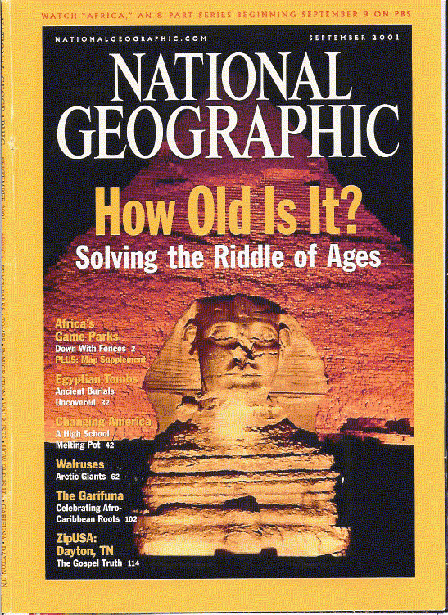

How Old is the Earth?
“The world’s oldest known rock was dated . . . at 4.03 billion years. The earth itself goes back 4.5 billion years.”
National Geographic, September 2001, p. 91

Slide 28
How Old is the Earth?
To those who believe in secular evolution, an old earth is considered essential -
“The secrets of evolution are death and time - the death of enormous numbers of life forms that were imperfectly adapted to the environment; and time for a long succession of small mutations that were by accident adaptive, time for the slow accumulation of patterns of favorable mutations [emphasis added].” (Carl Sagan , Cosmos, 1980, p.30)

Slide 29
How Old is the Earth?
To those who believe in secular evolution, an old earth is considered essential -
Time is in fact the hero of the plot . . . given so much time the ‘impossible’ becomes possible, the possible probable and the probable virtually certain. One has only to wait: time itself performs miracles [emphasis added]. (George Wald, “The Origin of Life,” Physics and the Chemistry of Life, 1955, p.12)

Slide 30
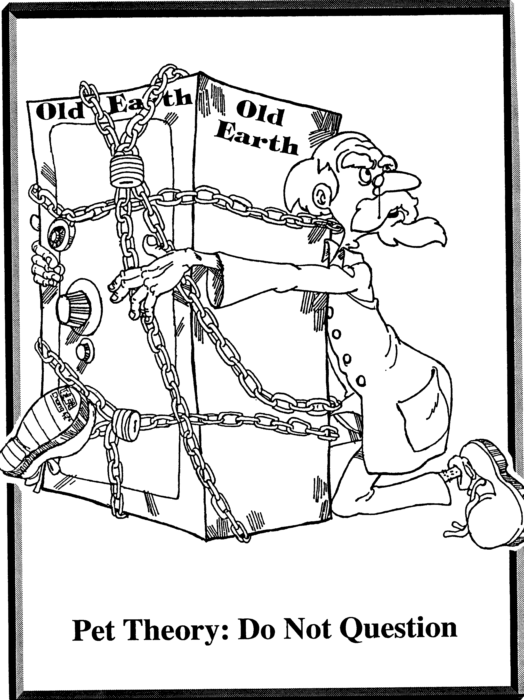

Slide 31
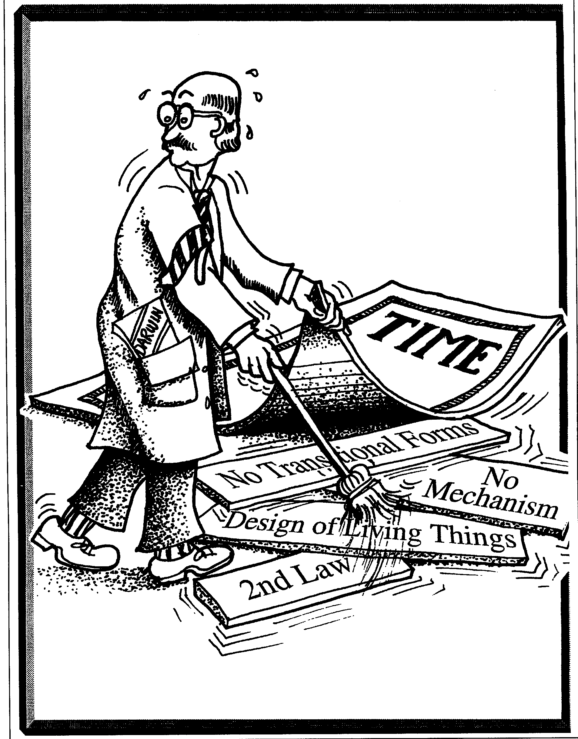

Slide 32
The Bible teaches that the earth is about 6000 years old
If we recognize that the “the heavens and the earth and all that is in them” were created in six ordinary days and we interpret the genealogies in a straightforward, literal manner then we have to conclude that the earth is about 6000 years old:
From Creation to the Abraham: 2,000 years
From Abraham to Christ: 2,000 years
From Christ to the Present: 2,000 years
Age of the Earth: 6,000 years

Slide 33
The Bible teaches that the earth is about 6000 years old
“Probably, so far as I know, there is no professor of Hebrew or Old Testament at any world-class university who does not believe that the writer(s) of Genesis 1-11 intended to convey to their readers the ideas that
Creation took place in a series of six days which were the same as the days of 24 hours we now experience
The figures contained in the Genesis genealogies provided by simple addition a chronology from the beginning of the world up to later stages in the biblical story . . .
Or, to put it negatively, the apologetic arguments which suppose the 'days' of creation to be long eras of time [and] the figures of years not to be chronological . . . are not taken seriously by any such professors, as far as I know.” [emphasis added]
(James Barr in a letter to David Watson, 1984. Barr is Professor of Hebrew Bible, Vanderbilt University, and former Reguis Professor of Hebrew, Oxford University, Oxford, England.)

Slide 34
How Can We Know How Old Something Is?

Slide 35
How Can We Know How Old Something Is?
A. First Hand Knowledge - We were there personally when it came into existence.
B. A Reliable Eyewitness - We have a reliable eyewitness account telling us when the item in question came into existence from someone who was there to see it.
C. A Reliable "Clock" - We have the current reading from a reliable "clock" that we are sure has been running since the time the object came into existence. And in order for us to determine the age of the item in question from this "clock" we need to know three things about the clock:
The Original Setting: What the clock read at the time that the item in question was created.
Runs at a Known Rate - That the clock has been running at a constant rate (or if the rate has changed, we must know exactly how it changed and when)
Has Never Been Changed - That the clock has never been changed or reset since the creation of the item in question (or if the clock has been changed, we must know exactly how it changed and when)

Slide 36
How Can We Know How Old Something Is?
A. First Hand Knowledge
B. A Reliable Eyewitness
C. A Reliable "Clock"
So how do we know how old the earth is?:
Option A - We weren’t there (Job 38:4).
Option B - Those who believe that the Bible is the Word of God and believe that Genesis 1 teaches the earth was made in six days and the genealogies are reliable - believe that they have option “B”: a reliable eyewitness account.
Option C - Those who do not accept Genesis as a reliable account of when God created the earth (either because they think that Genesis is not reliable on this point or they read long, indefinite periods time into the text of Genesis 1) must rely on option “C”. The “clock” most often chosen by secular scientists by which they arrive at such ancient dates for the age of the earth is the “clock” of radioactive decay.

Slide 37

Radioactive Dating Methods

Slide 38
How Radioactive Dating Works
A radioactive element (known as the "parent" element) gives off radiation at an (assumed) constant rate.
As this happens, the radioactive element turns into another (usually non-radioactive) element (known as the "daughter" element).
The time it takes for half of any parent element to turn into the daughter element is called the "half-life" of that element.
By measuring the amount of parent and daughter elements present in a rock, scientists (given certain assumptions) believe that they can determine the age of that rock.

Slide 39
Radioactive Dating Methods
Some examples of radioactive elements used in dating rocks are:
Parent-Daughter
Half Life
uranium-lead
4.5 billion years
potassium-argon
1.3 billion years
rubidium-strontium
4.7 billion years
Note: These radioactive dating methods can only be used on:
Igneous Rocks (formed by volcanic action)
Or Metamorphic Rocks (igneous rocks that have undergone change).
Not Sedimentary Rocks (rocks laid down as sediment by water).

Slide 40
Radioactive Decay
Parent element
Daughter element
Uranium
Decay
Lead
Potassium
Decay
Argon

Slide 41
Half-Life Illustration
4.5 billion years
1 half-life
9 billion years
2 half-lives
Time = 0
U-238
Pb-206
1/2
Pb-206
3/4
U-238
1/2
U-238
The above dating assumes that we know:
The original sample was 100% U-238
No contamination of the sample has taken place
The rate of radioactive decay has always been the same

Slide 42
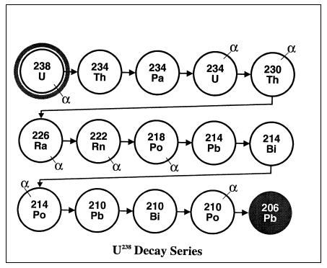

Slide 43
Apparent Problems with Radioactive Dating
Scientists often encounter examples in the real world that contradict their assumptions about the reliability of radioactive dating methods:
Scientists often get conflicting dates using different radioactive dating methods on the same rock. Obviously both dates can't be right!
Sometimes rocks that are thought to be much older than other rocks (because they are buried several layers under them) date much younger than the rocks found above them!
Often rocks that are known to be very young (because they come from recent volcanoes whose eruption date is known) give dates using radioactive dating methods that are very old and therefore known to be erroneous

Slide 44
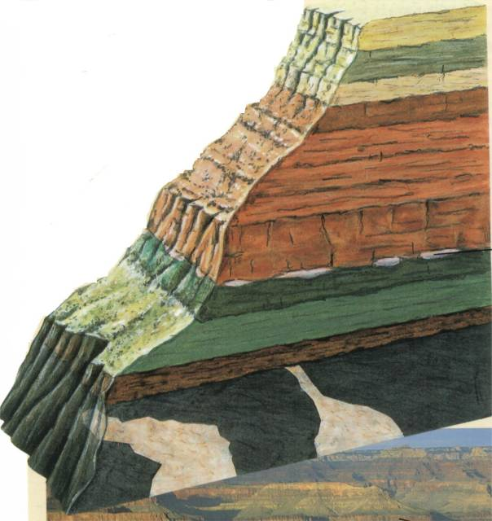
Basaltic rocks of Uinkaret Plateau (Grand Canyon)
six K-Ar model ages 0.01 to 17 million
five Rb-Sr model ages 1270 to 1390 million
one Rb-Sr isochron age 1340 million
one Pb-Pb isochron age 2600 million
Paleozoic
Precambrian
As documented by Steve Austin Ph.D., Grand Canyon - Monument to Catastrophe, 1994, p.126
Gardenas Basalt (Precambrian)
five K-Ar model ages 791 to 853 million
six Rb-Sr model ages 980 to 1100 million
one K-Ar isochron age 715 million
one Rb-Sr isochron age 1070 million

Slide 45

More Radioactive Dating Problems
Sunset Crater, Northern Arizona
Potassium-argon: 200,000 years old
Reality: AD 1065 (about a 1,000 years old)
Hualalai basalt, Hawaii
Various Methods: 140 million – 2.96 billion years old
Reality: AD 1801 (about 200 years old)
Above examples are documented by John Morris, Ph.D., The Young Earth, 1994, p.54-55
Notes:
Apollo 11 brought back some moon rocks. The rocks were dated using 4 different methods. The range between the oldest and youngest date was almost 4-billion years.
Apollo 16 brought back some moon rocks that were dated at 18-billion years. To fix the problem they subjected the rocks to acid to melt out the lead and then re-dated and got 4.5 billion years. (Science magazine Jan 30, 1973)
Sunset Crater in n. Arizona is known to be a recent volcano. Indian artefacts and relics are found within the rocks formed by the eruption. The volcano last erupted some 900 years ago. Two lava flows have been dated giving ages of 210,000 and 230,000.
Hualalai volcano in Hawaii Known to have erupted in 1800-1801 were dated with a variety of methods. 12 dates were taken which ranged from 140 million years to 2.96 billion years. The average date was 1.41 billion. There have been many explanations to explain these results away (as the lava rose, the older material from inside the earth rose with it, but they are unable to explain why such a variance in ages). If this is the explanation, then why could this not also be the case for other dates?
This does not disprove radioisotope dating, but it does demonstrate the tremendous inconsistency in the interpretation of the method.
The conventional K-Ar dating method was applied to the 1986 dacite flow from the new lava dome at Mount St. Helens, Washington. Porphyritic dacite which solidified on the surface of the lava dome in 1986 gives a whole rock K-Ar ‘age’ of 0.35 0.05 million years.
Steven A. Austin, “Excess Argon within Mineral Concentrates from the New Dacite lava Dome at Mount St. Helens Volcano, 1996

Slide 46
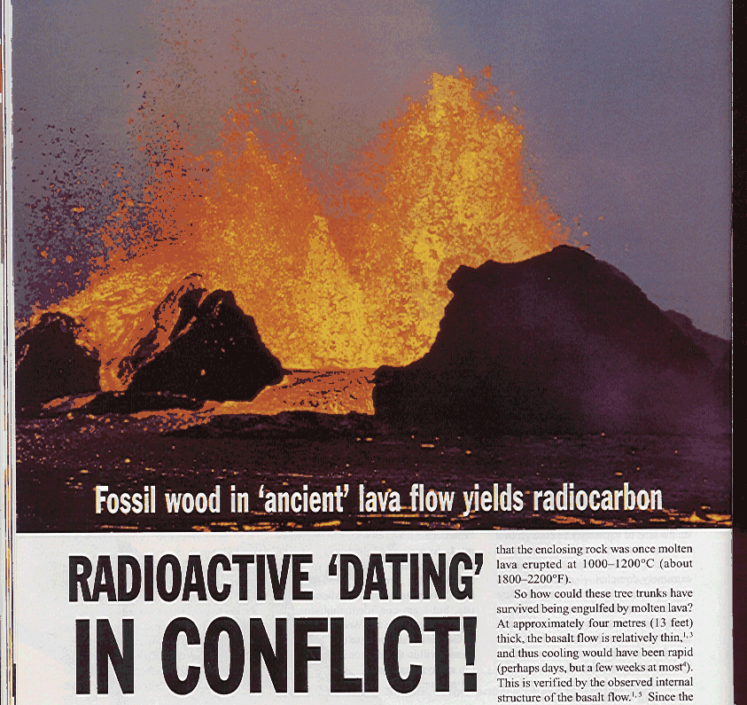

In 1993, several pieces of wood were found entombed in the bottom of a (cooled) lava flow in a coal mine in Australia. Parts of the wood were still intact! The various pieces of wood were carbon dated between 35 and 45 thousand years old. The lava enclosing the wood was dated (using K-Ar dating) at 36.7 ± 1.2 million years old!
Dr. Andrew Snelling, Creation ex nihilo, December 1997 - February 1998, Vol. 20 No. 1, p.24-27

Slide 47
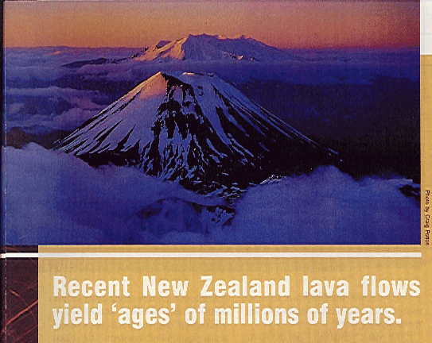

Rock from cooled lava flows known to have occurred between 1949 and 1975 were sent to several standard labs to be dated - without telling the labs where the rocks had come from or that the actual age of the rocks was already known. The labs (using K-Ar) dating returned results ranging from <0.27 million years old to 3.5 ± .2 million years old!
Dr. Andrew Snelling, Creation ex nihilo, December 1999 - February 2000, Vol. 22 No. 1, p.18-21

Slide 48
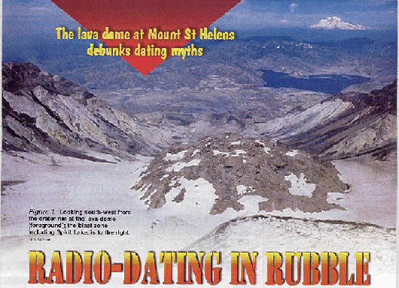
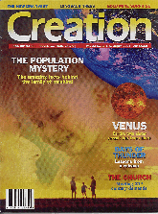
Rocks from the cooled lava dome of Mount St. Helens (which at the time were about 10 years old) were sent to a reputable lab to be dated - without telling the lab where the rocks had come from. The lab (using K-Ar) dating returned results ranging from
0.34 ± 0.06 million years old to
2.8 ± 0.6 million years old!
Keith Swensen, Creation, June - August 2001, Vol. 23 No. 3, p.23-25

Slide 49
Radioisotope Dating
Reliability and Consistency
If the dates aren’t right when we know the age of the rocks, how can we be sure they are correct when we don’t know the exact date of the rocks?

Slide 50
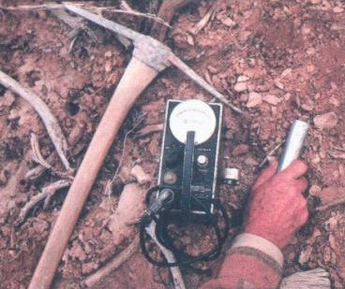
What about Carbon Dating?

Slide 51
Carbon-14 Dating
Some Basic Facts About Carbon Dating:
Carbon-14 dating can only be used on organic materials, not on rocks or even fossils
The half-life of C-14 is about 5,730 years
Scientists will usually not use Carbon-14 dating on anything that they consider to be older than 50,000 years

Slide 52
What is Carbon-14?
A normal carbon atom weighs 12 atomic mass units.

Slide 53
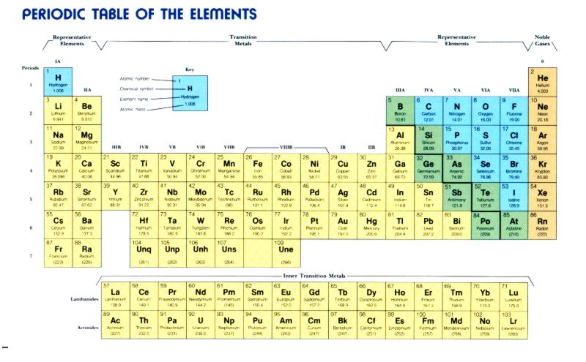

Slide 54
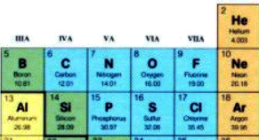
C
N
O
Carbon
Nitrogen
Oxygen
12.03
14.01
16.00

Slide 55
What is Carbon-14?
A normal carbon atom weighs 12 atomic mass units.
However, about one in every trillion carbon atoms (in earth’s atmosphere today) weighs 14 atomic units.
This carbon is called carbon-14.
It is also called radiocarbon because it is radioactive (but not dangerous).

Slide 56
How Carbon-14 Dating Works
When Nitrogen in the earth’s upper atmosphere is struck by cosmic radiation it turns into radioactive carbon (Carbon-14).
In this way, about 21 pounds of Nitrogen is converted each year into radiocarbon (carbon-14)
N14
C14

Slide 57
How Carbon-14 Dating Works
Most carbon-14 quickly combines with oxygen to form radioactive carbon dioxide, which then intermingles with regular carbon dioxide throughout the earth’s atmosphere.
O16
O16
O16
C12
C12
O16
C14
O16
O16
O16
O16
C12
C12
O16
O16

Slide 58
How Carbon-14 Dating Works
Plants use carbon dioxide. In doing this, plants absorb small amounts of radioactive carbon into their cells.
C12
O16
O16
C12
C12
C14
O16
O16
C12
O16
C12
O16
C14
O16
C12
O16
C12
O16
C12
O16

Slide 59
How Carbon-14 Dating Works
Animals eat plants. In doing this, animals absorb small amounts of radioactive carbon into their bodies.

Slide 60
How Carbon-14 Dating Works
When plants and animals die, they stop taking in radioactive carbon.

Slide 61
How Carbon-14 Dating Works
The radioactive carbon in a plant or animal will slowly decay back into nitrogen after the plant or animal dies.

Slide 62
Half-Life Illustration
5,730 years
1 half-life
11,460 years
2 half-lives
Time = 0
C-14
N-14
1/2
N-14
3/4
C-14
1/2
C-14

Slide 63
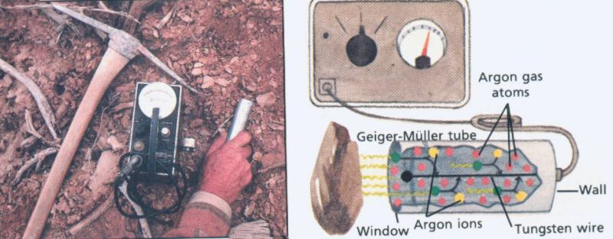
How Carbon-14 Dating Works
By measuring the amount of radioactive carbon left in a dead plant or animal (and by making certain assumptions) scientists believe that they can determine how long ago the plant or animal has died.

Slide 64
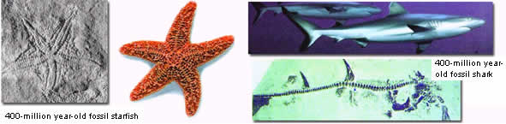
Determining the Starting Amount
When an organism is alive it is normally expected to have about the same ratio of C-12 to C-14 that exists in the atmosphere at the time it is living – which today is about 1-trillion to 1
Once the organism dies that ratio slowly begins to change as the C-14 in the dead organism decays.
I’m alive
I’m a fossil
Same ratio
Different ratio
Notes:
When an organism dies the ratio begins to change (the clock starts because the C-14 begins to decrease in the organism and the amount of C-12 stays the same)
The ratio difference is used to determine how much C-14 has decayed

Slide 65
How the C-12 / C-14 Ratio Works
Amount of stable C-12
Amount of unstable C-14
Ratio
Years Dead
# Half-lives
100 Trillion
100
1-T to 1
0
0
100 Trillion
50
2-T to 1
5,730
1
100 Trillion
25
4-T to 1
11,460
2
100 Trillion
12
8-T to 1
17,190
3
100 Trillion
6
16-T to 1
22,920
4
100 Trillion
3
32-T to 1
28,650
5

Slide 66
A Critical Assumption
Has the ratio of C-12 to C-14 in the earth’s atmosphere always been the same as it is today (1-trillion to 1)?
This is a key assumption
If this assumption is true then carbon-14 dating is a reliable dating method
If this assumption is false then carbon-14 dating is not a reliable dating method

Slide 67
Problems with the Assumptions of Carbon-14 Dating in Light of Biblical Teaching:
The Bible teaches that the earth was created about 6000 years ago. God might not have created the earth with the same ratio of carbon-14 to carbon-12 that exists today.
The Bible teaches that about 4,500 years ago there was a global flood. Conditions on the earth before, during, and after the flood might have had a dramatic effect on the ratio of carbon-14 to carbon-12.

Slide 68
Is Carbon Dating Reliable?
In addition to the assumptions made when using carbon dating, we see many examples where carbon dating is not reliable in dating living things that we know are not very old.

Slide 69

Living mollusk shells were carbon dated as being 2300 years old.
Science vol. 141, 1963 p. 634-637

Slide 70

A freshly killed seal was carbon dated as having died 1300 years ago!
Antarctic Journal
vol. 6 Sept-Oct.
1971 p. 211

Slide 71

Shells from living snails were carbon
dated as being 27,000 years old.
Science Vol. 224, 1984 p. 58-61

Slide 72
Problems With Carbon-14 Dating
The troubles of the radiocarbon dating method are undeniably deep and serious. Despite 35 years of technological refinement and better understanding, the underlying assumptions have been strongly challenged, and warnings are out that radiocarbon may soon find itself in a crisis situation. Continuing use of the method depends on a "fix-it-as-we-go" approach, allowing for contamination here, fractionation there, and calibration whenever possible. It should be no surprise, then, that fully half of the dates are rejected. The wonder is, surely, that the remaining half come to be accepted.
No matter how "useful" it is, though, the radiocarbon method is still not capable of yielding accurate and reliable results. There are gross discrepancies, the chronology is uneven and relative, and the accepted dates are actually selected dates.
Lee, Robert E. "Radiocarbon, Ages in Error, Anthropological Journal of Canada, Vol. 19, No. 3, 1981, pp. 9, 29 (Assistant Editor).

Slide 73
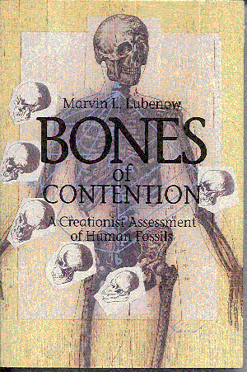
The Dating Game
A great illustration of the games evolutionists play when dating a particular rock or fossil can be seen in a sequence of events described by Marvin Lubenow in the appendix of his book, Bones of Contention, 1992

Slide 74

The Dating Game
Background: In 1972, Richard Leakey discovered a very modern looking skull in Kenya just east of Lake Turkana. At the time, fossils found in this area were considered about 2.9 million years old. Leakey’s discovery created a problem, because the theory of human evolution did not allow for a skull that looked so modern to be so old! The following chart gives a history of how the evolutionists ended up “solving” this problem. Notice how many different dates evolutionists can get for the same layer of rock!

Slide 75
Year
Dated by
Dating Method
Age Claimed
Comment
1969
Fitch and Miller
potassium-argon
212 to 230 million yrs. old
Original Dating of the rocks above the area where Leakey later found his skull.
1970
Fitch and Miller
potassium-argon
argon-argon
2.61 ± .26 million yrs. old
The original date conflicted with the dating of fossils in the area so they asked for new samples
1972
2.9 million yrs. old
Richard Leakey discovered a very modern looking skull.
1972
Vincent Maglio
fossils of pigs and elephants found in the area
2.61 million yrs. old
Confirmed Fitch and Miller’s date
1974
Brock and Isaac
paleomagnetism
2.7 to 3.0 million yrs. old
Based on samples below area tested by Fitch and Miller, thus confirming their dates
1974
Fitch and Miller
2.61 ± .26 million yrs. old
Published their revised study
1975
Basil Cooke
pig fossils in area
1.8 million yrs. old
Presented at a geology conference in London
1975
G. H. Curtis et al.
potassium-argon
1.82 million yrs. old
They challenged the validity of Fitch and Miller’s methodology
1976
Fitch and Miller
potassium-argon
argon-argon
2.4 million yrs. old
Re-tested both sets of rocks using more advanced techniques.
1976
Hurford et al.
fission-track dating
2.44 million yrs. old
1977
G.A. Wagner
fission-track dating
1.9 million yrs. old
Claimed that Hurford et al. used the wrong radioactive constant in their calculations
1980
Gleadow et al.
fission-track dating and potassium-argon
1.87 or 1.89 million yrs. old
1981
Ian McDougal
Argon-argon
1.88 million yrs. old
Published in Nature magazine
Today
1.9 million yrs. old
Leakey’s skull now fits the traditional evolutionary view

Slide 76
The Dating Game
“The pigs won. In the ten-year controversy over the dating of one of the most important human fossils ever discovered, the pigs won. The pigs won over the elephants. The pigs won over K-Ar dating. The pigs won over Ar-Ar dating. The pigs won over fission-track dating. They won over paleomagnetism. The pigs took it all. But in reality, it wasn't the pigs that won. It was evolution that won. In the dating game, evolution always wins.” (Lubenow, p.266)

Slide 77
Apparent versus Actual Age

Slide 78

God did not make two babies in the Garden of Eden and give them seeds to plant. The creation was mature.

Slide 79
Apparent vs. Actual Age
When God created the world, he created it with the appearance of age. For example:
The day after God made him, Adam probably looked 20 to 30 years old (when in reality he was one day old!)
When God made the first trees, they probably looked 50 to 100 years old, maybe older. They might have even had tree rings!
When God made the first rocks, they might have looked millions or perhaps billions of years old by today's "scientific" reckoning.

Slide 80
Apparent vs. Actual Age
Some people have a problem with the idea of God creating things with an apparent age because they think that it would be deceptive for God to do this. There are two responses to this objection:
If God is going to make something that is fully functioning and mature instantaneously, it would have to have an apparent age.
It is not deceptive for God to do this, because He tells us what He did. If we fail to believe God, then we deceive ourselves!

Slide 81
Scientific “Proofs” for a Young Earth

Slide 82
Scientific “Proofs” for a Young Earth
There are a number of scientific “proofs” that the earth is much younger than secular scientists now claim.
Secular scientists generally reject such proofs because they do not give the “correct” results.
Of course, like any other dating method (including the radioactive methods) these proofs are only as good as their assumptions. And it is on this basis that such proofs are often challenged - sometimes rightfully so.
It is interesting to note that prior to the advent of radioactive dating methods, such methods were often used to estimate the age of the earth.
Morris and Parker (What is Creation Science? Master Books, 1982, pp. 288-293) list 68 such proofs which, if we assume everything on the earth has always operated as it does today, yield a maximum age for the earth of anywhere from 140 years to 500,000,000 years!

Slide 83
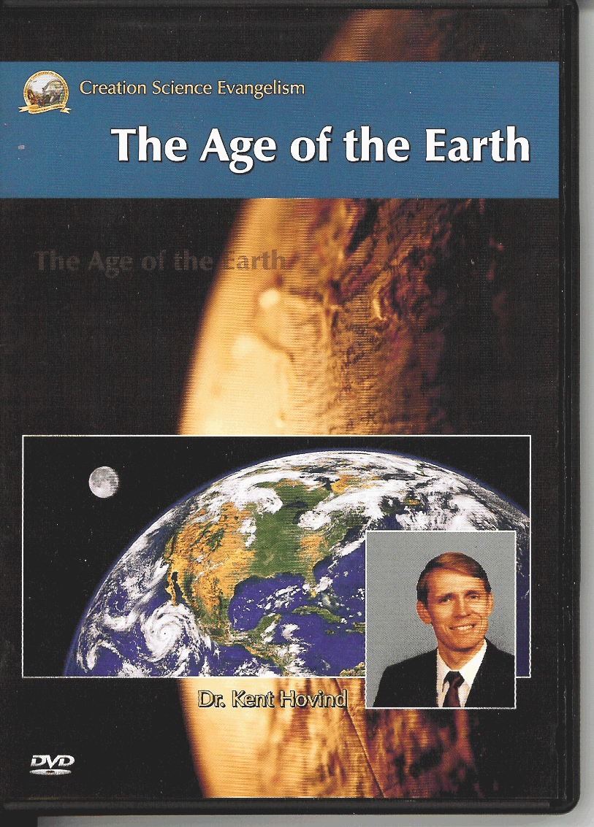
Scientific “Proofs” for a Young Earth

Slide 84
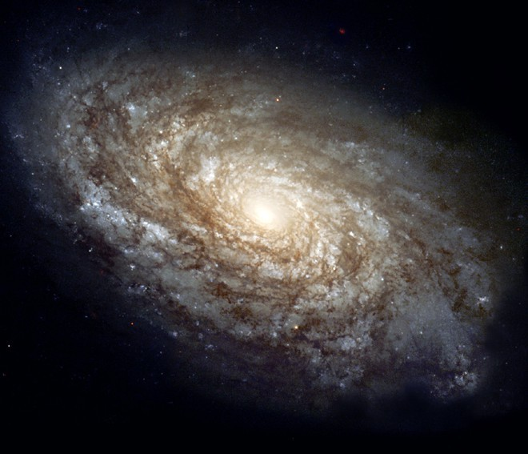
How Old is the Universe?

Slide 85


How Old is the Universe?
National Geographic, September 2001, p. 85

Slide 86
How Old is the Universe?
Those who believe in secular evolution generally believe that the universe is somewhere between 13 to 20 billion years old.
The Bible teaches that the universe, like the earth is thousands of years old

Slide 87
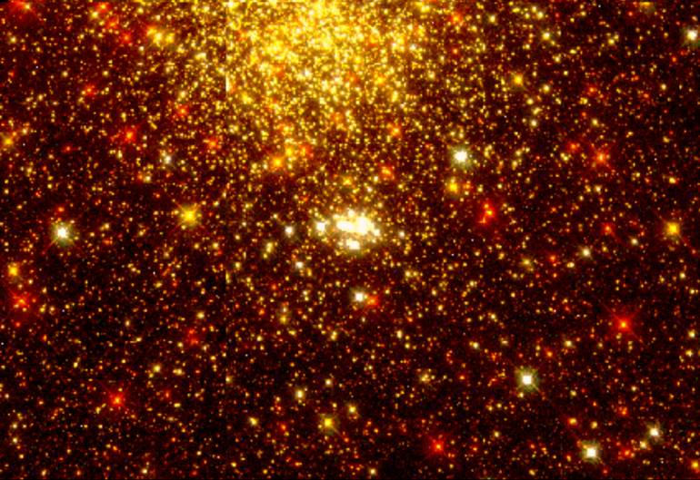
If the Universe is only thousands of years old, how can we see stars that are billions of light years away?

Slide 88
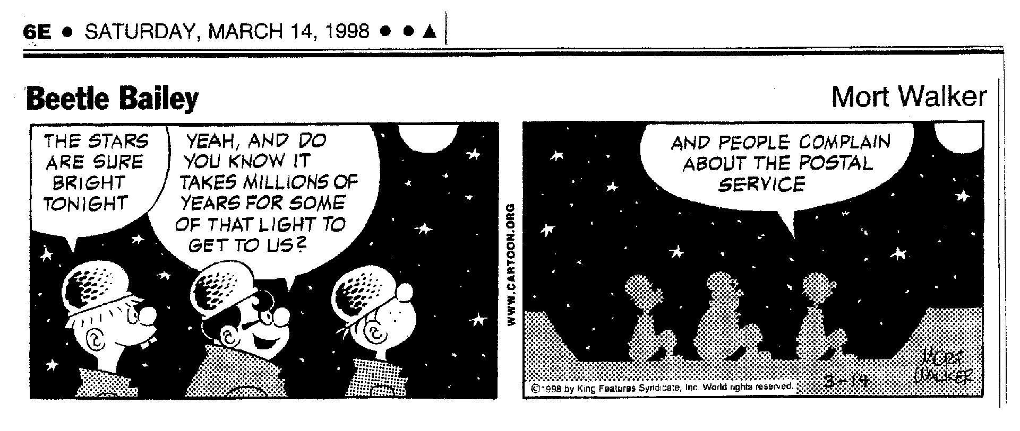

Slide 89
The “Problem”
Distant galaxies are extremely far away
Based on present understanding, it should take billions of years for light to travel from these galaxies to Earth
We see these galaxies
Therefore, we are told, the universe must be billions of years old

Slide 90
Solutions to Avoid (because they have BIG problems)
Claim: “Those distances are not real”
Problem: Operational science confirms the galaxies are indeed a great distance.
Problem: The Milky Way galaxy (our own galaxy) alone is about 80,000 light-years across.

Slide 91
Solutions to Avoid (because they have BIG problems)
Light in transit: The light was created already on its way
Problem: We would be seeing events that never happened (for example stars that blow up and form a supernova)

Slide 92
Two Possible Solutions Suggested by Creationists
Changes in the speed of light over time
Gravitational Time Dilation (based on Einstein's Theory of General Relativity)

Slide 93

Has the Speed of Light Changed?

Slide 94
Has the Speed of Light Changed?*
Creationist author Barry Setterfield went back and looked at the various measurements taken of the speed of light as they have been recorded historically (the first measurement being made in 1675).
Setterfield noticed that earlier measurements for the speed of light seemed to be consistently higher than later measurements.
In fact, when he then plotted these measurements on a graph he noticed that the speed of light seems to have been decreasing logarithmically over time – which would suggest that the speed of light was much greater in the past than it is today.
*Much of the information in this section was gleaned from Douglas F. Kelly, Creation and Change, 1997, pp.144-148

Slide 95
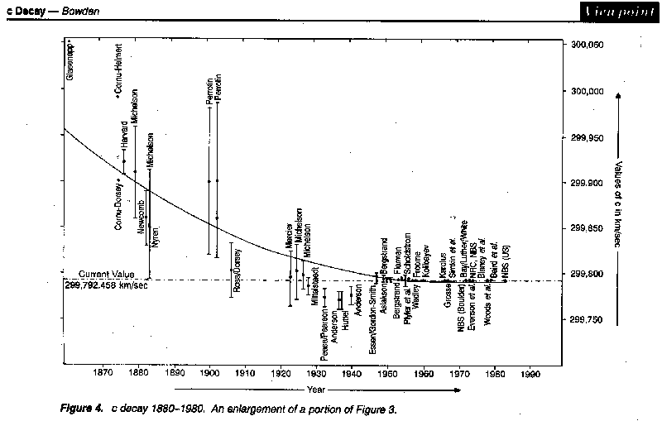
Speed of light has decayed. Creation Tech. Journal, June, 2000

Slide 96
Has the Speed of Light Changed?
Setterfield extended the curve formed by these historical measurements back in time and estimated that at the time of creation (around 4000 BC) the speed of light would have been 5 x 10¹¹ faster than it is today – making it possible for light to have reached the earth from the distant stars in time for Adam (and us) to see them.

Slide 97
Has the Speed of Light Changed?
When Setterfield and other creationists first presented the idea of the speed of light changing over time they were mocked by evolutionists for even suggesting the possibility (Creation ex nihilo, vol.22 no.1, December 1999 - February 2000, “’C’ the difference”, p.9)
But in recent years, because it has been discovered that a constant speed of light in the past creates problems for the big bang theory, some evolutionary scientists are beginning to suggest that maybe the speed of light was much faster in the past than it is today!

Slide 98
Has the Speed of Light Has Changed?
New Science Magazine: Call it heresy, but all the big cosmological problems will simply melt away, if you break one rule . . . The rule that says the speed of light never varies (“Is nothing sacred?”, July 24, 1999, p. 28)
The Sunday Times – UK: Einstein built his theory around the idea that the speed of light in a vacuum is a constant 670,615,000 mph (186,282 miles per second) and that nothing could go faster. New studies suggest, however, that this did not apply in the infancy of the universe, during and soon after the big bang, in which the universe exploded into existence 12 to 15 billion years ago (Jonathan Leake,“High-speed Light Casts Doubt on Einstein’s Laws”, December 24, 2000)

Slide 99
Has the Speed of Light Has Changed?
The New York Times: “New observations from the world’s biggest telescope indicate that one of nature’s supposedly immutable constants [the speed of light] has changed over the 15 billion-year history of the universe” (The Associated Press, “Study: Light Speed May Have Changed”, The New York Times, August 15, 2001)

Slide 100
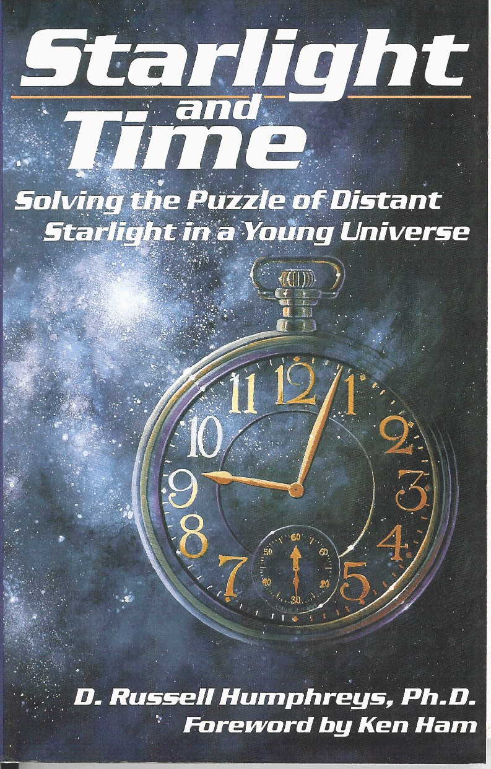
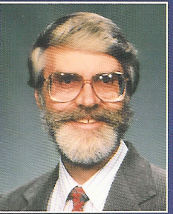
Dr. Russell Humphreys Model

Slide 101

According to Einstein’s Theory of Relativity Gravity Affects Time
Einstein’s Theory of General Relativity has shown that time can pass at different rates for different objects.
One of the things that affects the rate at which time passes is gravity.
According to Einstein, Clocks tick more slowly when they experience the strong gravitational force exerted by a massive object – the larger the gravitational force, the more slowly the clock within that gravitational force will tick.
We also know, that the closer an object gets to the center of a large mass, the more gravitational pull it will experience from that mass.

Slide 102
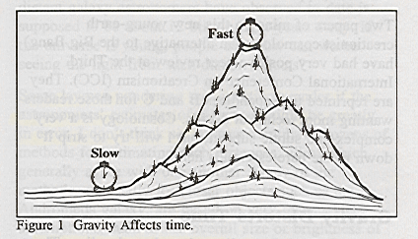
According to Einstein’s Theory of Relativity Gravity Affects Time
So for example, the atomic clock at the Royal observatory in Greenwich, England, ticks five microseconds per year slower than an identical clock at the National Bureau of Standards in Boulder, Colorado, both clocks being accurate to about one microsecond per year. The difference is exactly what general relativity predicts for the one-mile difference in altitude (Figure 1).
Dr. Russell Humphreys, Starlight and Time, 1994, pp.11-12

Slide 103
Starlight and Time: Solving the Puzzle of Distant Starlight in a Young Universe
Dr. Russell Humphreys has proposed that:
God initially created all the materials in the universe in a (relatively) small area (he suggests an area two light years in diameter) with the earth being near the center of that area.
God then “stretched out the heavens”, as He created the galaxies and stars.

Slide 104
Starlight and Time: Solving the Puzzle of Distant Starlight in a Young Universe
Isaiah 42:5 - This is what God the LORD says-- he who created the heavens and stretched them out…
Isaiah 45:12 - It is I who made the earth and created mankind upon it. My own hands stretched out the heavens; I marshaled their starry hosts.
(Cf. Job 9:8, Psalm 104:2, Isaiah 40:22, 42:5, 44:24, 45:12, 51:13, Jeremiah 10:12, 51:15, Zechariah 12:1)

Slide 105
Starlight and Time: Solving the Puzzle of Distant Starlight in a Young Universe
Humphreys suggests that because of the tremendous gravitational force generated by having the mass of the universe initially concentrated in a relatively small area (and then later stretched out as He made the stars), time would have passed more slowly on the earth which was near the center of the created universe, than it passed for the stars which were far away from the center.
Therefore, the stars and galaxies could have aged billions of years during the time that the earth aged 24 hours on the fourth day, giving time for the light from those stars to reach the earth where they could be seen by Adam.

Slide 106
Not just a problem for creation…
Even if all the Young Earth Creation models turn out to be wrong, light travel-time cannot be used to support the big bang with it’s billions of years because the big bang has a light travel-time problem of it’s own!

Slide 107
The Horizon Problem
The big bang theory requires that the different regions of the universe started with very different temperatures.
Today they all have almost the same temperature.
Yet there has not been enough time for these regions to exchange light in order to come to the same temperature.

Slide 108
Conclusions
There are several possible ways in which starlight can travel large distances in a short amount of time.
Therefore, the fact that the universe is large does not prove that it is billions of years old.
The big bang has a light travel-time problem also.

Slide 109
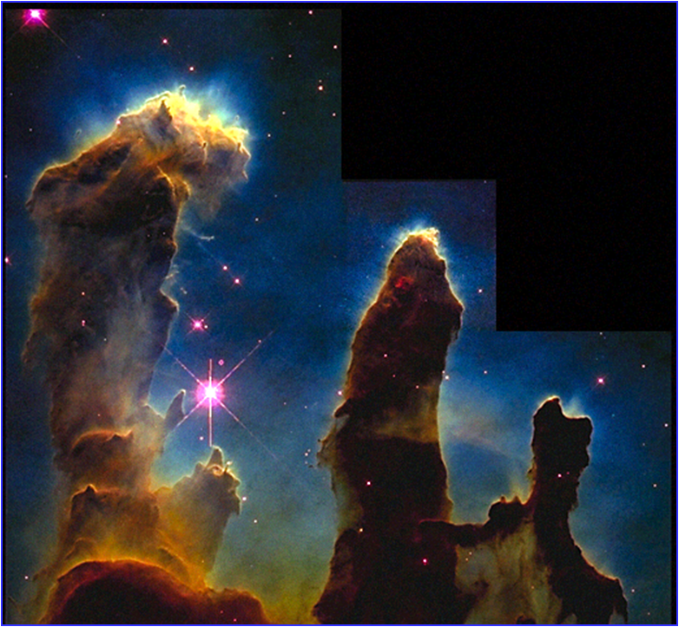
Did the Universe “Evolve”?
Scientific Problems With the “Big Bang”

Slide 110
Scientific Problems With the “Big Bang”
While some believe that light from distant stars presents a problem for young-earth creationists, evolutionists have their own problems explaining the universe!

Slide 111
Scientific Problems With the “Big Bang”
The biggest problem that evolutionists have is explaining where the material for the universe came from. The First Law of Thermodynamics states that matter/energy can neither be created nor destroyed (through natural means). So if there was no supernatural creation, where did all the matter and energy in the universe come from ?
And we know the universe has not always been here, because the Second Law of Thermodynamics states that the energy available for useful work always decreases over time. Therefore if the universe has always been here, it would have run out of usable energy by now.

Slide 112
Scientific Problems With the “Big Bang”
Evolutionists also have their own problems with light from distant stars: For example, there are some faraway galaxies whose light has traveled great distances and therefore (supposedly) shows what those galaxies looked like millions of years ago, and yet look just as old as nearby galaxies (Science News, March 7, 1981, “Most Distant Galaxies: Surprisingly Mature”, p.148).
Recently, distant galaxies have been observed by the Hubble Space Telescope whose age, based on calculations which assume the big bang occurred, exceeds the age of the universe! (Nature, June 13, 1996, “An Old Galaxy in a Young Universe”, pp.555-556)

Slide 113
Scientific Problems With the “Big Bang”
In order to explain the things that we observe in our universe, Evolutionists who believe in the big bang often have to make assumptions for which there is little or no evidence:
Big bang cosmologists routinely assume that there is at least ten times as much matter in the universe as what we can see! (George Smoot and Keay Davidson, Wrinkles in Time, 1993, p.12)
Some big bang cosmologists are now beginning to assume that the speed of light was many thousands of times faster when the big bang occurred than it is today. (Jonathan Leake,“High-speed Light Casts Doubt on Einstein’s Laws”, The Sunday Times - UK, December 24, 2000, www.Sunday-times.co.uk)

Slide 114
Scientific Problems With the “Big Bang”
Because there are so many conflicts between evolutionary theories and what we actually see as we observe the universe, evolutionists are often forced to abandon their theories of how the universe formed:
Observations only recently made possible by improvements in astronomical instrumentation have put theoretical models of the Universe under intense pressure. The standard ideas of the 1980s about the shape and history of the universe have now been abandoned … (Nature, June 25, 1998, “The End of the Old Model Universe”, p.741)

Slide 115
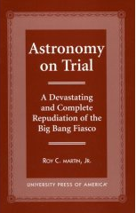
Scientific Problems With the “Big Bang”
“Astronomy, rather cosmology, is in trouble. It is, for the most part, beside itself. It has departed from the scientific method and its principles, and drifted into the bizarre; it has raised imaginative invention to an art form; and has shown a ready willingness to surrender or ignore fundamental laws, such as the second law of thermodynamics and the maximum speed of light, all for the apparent rationale of saving the status quo. Perhaps no ‘science’ is receiving more self-criticism, chest-beating, and self-doubt; none other seems so lost and misdirected; trapped in debilitating dogma.” (Roy C. Martin, Jr., Astronomy on Trial: A Devastating and Complete Repudiation of the Big Bang Fiasco, 1999, p. xv)

Slide 116
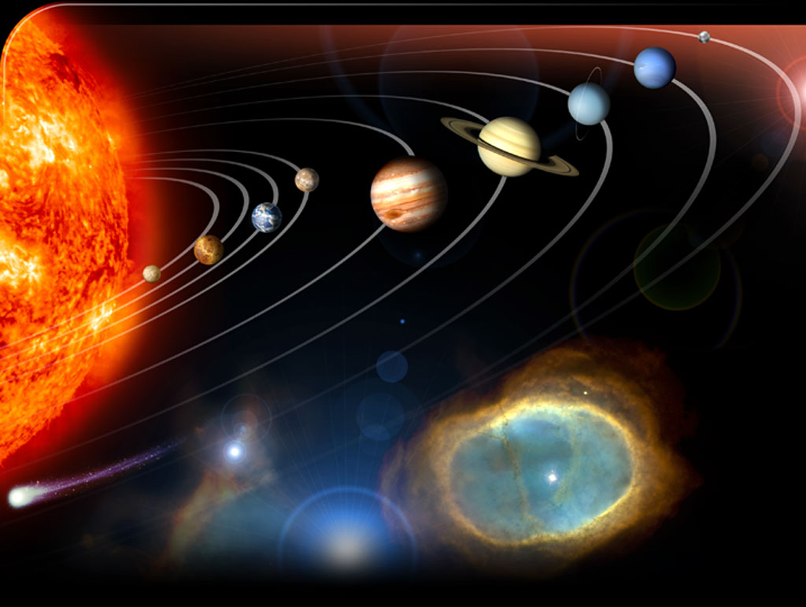
Problems With the Evolutionary View of Our Solar System

Slide 117
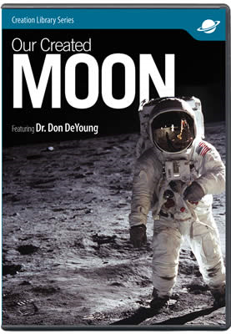

The Origin of the Moon?

Slide 118
The Origin of the Moon?
The problems that arise in trying to explain the origin of the moon from an evolutionary perspective, caused one expert to joke, “The best explanation [for the Moon] was observational error - the Moon does not exist.” (Nature, September 25, 1997, “It’s not easy to make the Moon”, p.327)

Slide 119
The Origin of the Moon?
But the moon does exist, and the best explanation for its existence is that God made it along with all the other heavenly bodies!

Slide 120
Nehemiah 9:6 - You alone are the LORD. You made the heavens, even the highest heavens, and all their starry host, the earth and all that is on it, the seas and all that is in them. You give life to everything, and the multitudes of heaven worship you.

Slide 121
Problems With the Evolutionary View of Our Solar System

Slide 122
Problems With the Evolutionary View of Our Solar System
Many undisputed observations contradict current theories on how the solar system evolved.
One theory says planets formed when a star, passing near our Sun, tore matter from the sun.
More popular theories hold that the solar system formed from a cloud of swirling gas, dust, or larger particles.
Either way, if the planets and moons in our solar system evolved from the same material, they should have many similarities.
After several decades of planetary exploration, this expectation is now recognized as false.

Slide 123
Problems With the Evolutionary View of Our Solar System
“The solar system used to be a simple place . . . But 30 years of planetary exploration have replaced that simple picture with a far more complex image . . . One of the early hopes of planetary exploration was that learning why other planets differ from Earth would feed directly into our understanding of our home planet . . . I wish it were not so, but I’m somewhat skeptical we’re going to learn an awful lot about earth by looking at other planetary bodies. The more that we look at different planets, the more each one seems to be unique” (Science, September 2, 1994, “The Solar System’s New Diversity”, p.1360)

Slide 124
Problems With the Evolutionary View of Our Solar System
Problems with evolutionary theories:
Backward-Spinning Planets - All planets should spin in the same direction, but Venus, Uranus, and Pluto rotate backwards.
Backward Orbits - All 72 moons in the solar system should orbit their planets in the same direction that the planets are rotating, but at least eight have backward orbits. Furthermore, Jupiter, Saturn, Uranus, and Neptune have moons orbiting in both directions!

Slide 125
Problems With the Evolutionary View of Our Solar System
Problems with evolutionary theories:
Tipped Orbits - The orbit of each of these 72 moons should lie in the equatorial plane of the planet it orbits, but many, including the Earth’s moon, are in highly inclined orbits.
Wrong Chemistry - Because about 98% of the Sun is hydrogen or helium, Earth, Mars, Venus, and Mercury should have similar compositions. Instead much less than 1% of these planets is hydrogen or helium.

Slide 126
Problems With the Evolutionary View of Our Solar System
Problems with evolutionary theories:
Angular Momentum - The Sun should have 700 times more angular momentum than all the planets combined. Instead, the planets have 50 times more angular momentum than the Sun.
Information for this section is documented by Walter Brown, In the Beginning - Compelling Evidence for Creation and the Flood, Seventh Edition, 2001, p.21

