Slide 1
The Flood

Slide 2

Genesis 6:1-4 – The Corruption of the Godly Line
When man began to multiply on the face of the land and daughters were born to them, ² the sons of God [cf. Hos. 1:10 where “Sons of the God” refers to believers] saw that the daughters of man were attractive. And they took as their wives any they chose. ³ Then the LORD said, "My Spirit shall not abide in man forever, for he is flesh: his days shall be 120 years." ⁴ The Nephilim [“giants” cf. Num 13:33] were on the earth in those days, and also afterward, when the sons of God came in to the daughters of man and they bore children to them. These were the mighty men who were of old, the men of renown.

Slide 3
Genesis 6:5-7 – The Lord Grieves Over the Wickedness of Man
⁵ The LORD saw that the wickedness of man was great in the earth, and that every intention of the thoughts of his heart was only evil continually. ⁶ And the LORD regretted that he had made man on the earth, and it grieved him to his heart. ⁷ So the LORD said, "I will blot out man whom I have created from the face of the land, man and animals and creeping things and birds of the heavens, for I am sorry that I have made them.”

Slide 4
Genesis 6:8-12 – Noah Stands in Contrast to Wicked Humanity
⁸ But Noah found favor in the eyes of the LORD. ⁹ These are the generations of Noah. Noah was a righteous man, blameless in his generation. Noah walked with God. ¹⁰ And Noah had three sons, Shem, Ham, and Japheth. ¹¹ Now the earth was corrupt in God's sight, and the earth was filled with violence. ¹² And God saw the earth, and behold, it was corrupt, for all flesh had corrupted their way on the earth.

Slide 5
Genesis 6:13-16 – God’s Instructions to Noah
¹³ And God said to Noah, "I have determined to make an end of all flesh, for the earth is filled with violence through them. Behold, I will destroy them with the earth. ¹⁴ Make yourself an ark of gopher wood. Make rooms in the ark, and cover it inside and out with pitch. ¹⁵ This is how you are to make it: the length of the ark 300 cubits, its breadth 50 cubits, and its height 30 cubits. ¹⁶ Make a roof for the ark, and finish it to a cubit above, and set the door of the ark in its side. Make it with lower, second, and third decks.

Slide 6
Genesis 6:17-22 – God’s Covenant To Preserve Noah in the Coming Judgment
¹⁷ For behold, I will bring a flood of waters upon the earth to destroy all flesh in which is the breath of life under heaven. Everything that is on the earth shall die. ¹⁸ But I will establish my covenant with you, and you shall come into the ark, you, your sons, your wife, and your sons' wives with you. ¹⁹ And of every living thing of all flesh, you shall bring two of every sort into the ark to keep them alive with you. They shall be male and female. ²⁰ Of the birds according to their kinds, and of the animals according to their kinds, of every creeping thing of the ground, according to its kind, two of every sort shall come in to you to keep them alive. ²¹ Also take with you every sort of food that is eaten, and store it up. It shall serve as food for you and for them." ²² Noah did this; he did all that God commanded him.

Slide 7

Answers in Genesis Presents:
Thinking Outside the Box

Slide 8
Genesis 7:1-5 – God’s Final Instructions to Noah
Then the LORD said to Noah, "Go into the ark, you and all your household, for I have seen that you are righteous before me in this generation. ² Take with you seven pairs of all clean animals, the male and his mate, and a pair of the animals that are not clean, the male and his mate, ³ and seven pairs of the birds of the heavens also, male and female, to keep their offspring alive on the face of all the earth. ⁴ For in seven days I will send rain on the earth forty days and forty nights, and every living thing that I have made I will blot out from the face of the ground." ⁵ And Noah did all that the LORD had commanded him.

Slide 9
Genesis 7:6-12 – The Flood Begins!
⁶ Noah was six hundred years old when the flood of waters came upon the earth. ⁷ And Noah and his sons and his wife and his sons' wives with him went into the ark to escape the waters of the flood. ⁸ Of clean animals, and of animals that are not clean, and of birds, and of everything that creeps on the ground, ⁹ two and two, male and female, went into the ark with Noah, as God had commanded Noah. ¹⁰ And after seven days the waters of the flood came upon the earth. ¹¹ In the six hundredth year of Noah's life, in the second month, on the seventeenth day of the month, on that day all the fountains of the great deep burst forth, and the windows of the heavens were opened. ¹² And rain fell upon the earth forty days and forty nights.

Slide 10
Genesis 7:13-16 – List of Those God Saved on the Ark
¹³ On the very same day Noah and his sons, Shem and Ham and Japheth, and Noah's wife and the three wives of his sons with them entered the ark, ¹⁴ they and every beast, according to its kind, and all the livestock according to their kinds, and every creeping thing that creeps on the earth, according to its kind, and every bird, according to its kind, every winged creature. ¹⁵ They went into the ark with Noah, two and two of all flesh in which there was the breath of life. ¹⁶ And those that entered, male and female of all flesh, went in as God had commanded him. And the LORD shut him in.

Slide 11
Genesis 7:17-20 – The Extent of the Flood
¹⁷ For forty days the flood kept coming on the earth, and as the waters increased they lifted the ark high above the earth. ¹⁸ The waters rose and increased greatly on the earth, and the ark floated on the surface of the water. ¹⁹ They rose greatly on the earth, and all the high mountains under the entire heavens were covered. ²⁰ The waters rose and covered the mountains to a depth of more than twenty feet.

Slide 12
Genesis 7:17-20 – The Extent of the Flood
¹⁷ The flood continued forty days on the earth. The waters increased and bore up the ark, and it rose high above the earth. ¹⁸ The waters prevailed and increased greatly on the earth, and the ark floated on the face of the waters. ¹⁹ And the waters prevailed so mightily on the earth that all the high mountains under the whole heaven were covered. ²⁰ The waters prevailed above the mountains, covering them fifteen cubits deep.

Slide 13
Genesis 7:21-24 – The Destruction Caused By the Flood
²¹ And all flesh died that moved on the earth, birds, livestock, beasts, all swarming creatures that swarm on the earth, and all mankind. ²² Everything on the dry land in whose nostrils was the breath of life died. ²³ He blotted out every living thing that was on the face of the ground, man and animals and creeping things and birds of the heavens. They were blotted out from the earth. Only Noah was left, and those who were with him in the ark. ²⁴ And the waters prevailed on the earth 150 days.

Slide 14
Genesis 8:1-4 – The Rain Stops and the Waters Begin to Recede
¹ But God remembered Noah and all the wild animals and the livestock that were with him in the ark, and he sent a wind over the earth, and the waters receded. ² Now the springs of the deep and the floodgates of the heavens had been closed, and the rain had stopped falling from the sky. ³ The water receded steadily from the earth. At the end of the hundred and fifty days the water had gone down, ⁴ and on the seventeenth day of the seventh month the ark came to rest on the mountains of Ararat.

Slide 15
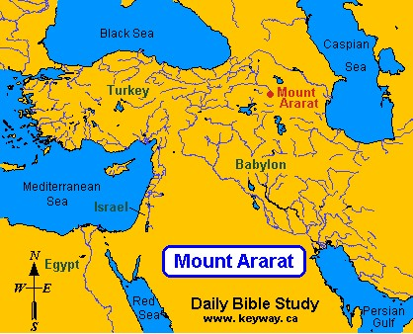
Gen 8:4 – “The Mountains of Ararat”

Slide 16
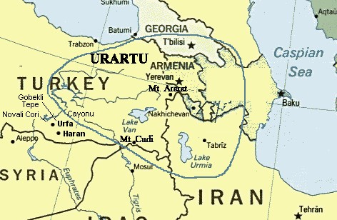
Gen 8:4 – “The Mountains of Ararat”

Slide 17
Time Periods of the Flood
* Date notation specifically mentioned in Scripture (All others derived)

Slide 18
Genesis 8:5-12 – The Waters Continue to Recede
⁵ The waters continued to recede until the tenth month, and on the first day of the tenth month the tops of the mountains became visible. ⁶ After forty days Noah opened the window he had made in the ark ⁷ and sent out a raven, and it kept flying back and forth until the water had dried up from the earth. ⁸ Then he sent out a dove to see if the water had receded from the surface of the ground. ⁹ But the dove could find no place to set its feet because there was water over all the surface of the earth; so it returned to Noah in the ark. He reached out his hand and took the dove and brought it back to himself in the ark. ¹⁰ He waited seven more days and again sent out the dove from the ark. ¹¹ When the dove returned to him in the evening, there in its beak was a freshly plucked olive leaf! Then Noah knew that the water had receded from the earth. ¹² He waited seven more days and sent the dove out again, but this time it did not return to him.

Slide 19
Genesis 8:13-19 – Noah Comes Out of the Ark
¹³ By the first day of the first month of Noah's six hundred and first year, the water had dried up from the earth. Noah then removed the covering from the ark and saw that the surface of the ground was dry. ¹⁴ By the twenty-seventh day of the second month the earth was completely dry. ¹⁵ Then God said to Noah, ¹⁶ "Come out of the ark, you and your wife and your sons and their wives. ¹⁷ Bring out every kind of living creature that is with you-- the birds, the animals, and all the creatures that move along the ground-- so they can multiply on the earth and be fruitful and increase in number upon it." ¹⁸ So Noah came out, together with his sons and his wife and his sons' wives. ¹⁹ All the animals and all the creatures that move along the ground and all the birds-- everything that moves on the earth-- came out of the ark, one kind after another.

Slide 20
Genesis 8:20-22 – God Determines Never to Flood the Entire Earth Again
²⁰ Then Noah built an altar to the LORD and, taking some of all the clean animals and clean birds, he sacrificed burnt offerings on it. ²¹ The LORD smelled the pleasing aroma and said in his heart: "Never again will I curse the ground because of man, even though every inclination of his heart is evil from childhood. And never again will I destroy all living creatures, as I have done. ²² "As long as the earth endures, seedtime and harvest, cold and heat, summer and winter, day and night will never cease."

Slide 21
Genesis 9:1-7 – God Gives Noah Instructions for the New World
Then God blessed Noah and his sons, saying to them, "Be fruitful and increase in number and fill the earth. ² The fear and dread of you will fall upon all the beasts of the earth and all the birds of the air, upon every creature that moves along the ground, and upon all the fish of the sea; they are given into your hands. ³ Everything that lives and moves will be food for you. Just as I gave you the green plants, I now give you everything. ⁴ "But you must not eat meat that has its lifeblood still in it. ⁵ And for your lifeblood I will surely demand an accounting. I will demand an accounting from every animal. And from each man, too, I will demand an accounting for the life of his fellow man. ⁶ "Whoever sheds the blood of man, by man shall his blood be shed; for in the image of God has God made man. ⁷ As for you, be fruitful and increase in number; multiply on the earth and increase upon it."

Slide 22
Genesis 9:8-11 – God Covenants With Noah Never Again to Destroy the Earth by Flood
⁸ Then God said to Noah and to his sons with him: ⁹ "I now establish my covenant with you and with your descendants after you ¹⁰ and with every living creature that was with you-- the birds, the livestock and all the wild animals, all those that came out of the ark with you-- every living creature on earth. ¹¹ I establish my covenant with you: Never again will all life be cut off by the waters of a flood; never again will there be a flood to destroy the earth."

Slide 23
Genesis 9:12-17 – God Gives the Rainbow as a Sign of His Covenant With Noah
¹² And God said, "This is the sign of the covenant I am making between me and you and every living creature with you, a covenant for all generations to come: ¹³ I have set my rainbow in the clouds, and it will be the sign of the covenant between me and the earth. ¹⁴ Whenever I bring clouds over the earth and the rainbow appears in the clouds, ¹⁵ I will remember my covenant between me and you and all living creatures of every kind. Never again will the waters become a flood to destroy all life. ¹⁶ Whenever the rainbow appears in the clouds, I will see it and remember the everlasting covenant between God and all living creatures of every kind on the earth.“ ¹⁷ So God said to Noah, "This is the sign of the covenant I have established between me and all life on the earth."

Slide 24
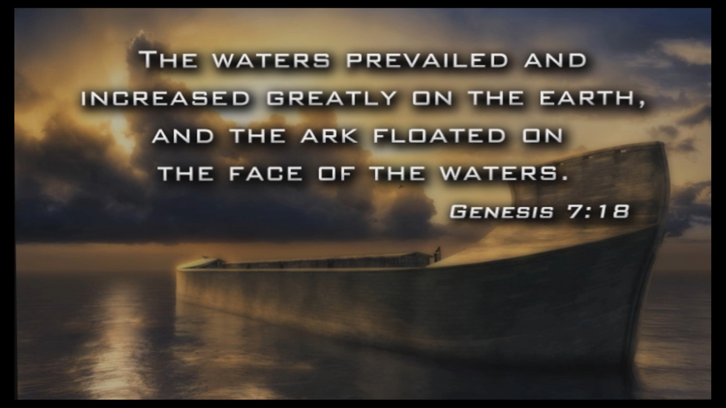
The Flood

Slide 25
Time Periods of the Flood
* Date notation specifically mentioned in Scripture (All others derived)

Slide 26
Time Periods of the Flood

Slide 27
The Bible Clearly Teaches That the Flood Was Universal and Global
Universal: Every Living, Breathing Creature was Destroyed by the Flood - with the exception of those creatures that were preserved on the ark with Noah, his three sons and their wives.
Note: The living things that were completely destroyed by the flood involved specifically those animals that lived on "dry land" and "breathed" (Gen.7:22). Animals that lived in the water (e.g. fish) could survive outside the ark, though, no doubt, in the turbulence of the flood, many fish died as well.
Global: Every High Mountain on the Face of the Earth Was Covered By the Waters of the Flood

Slide 28
The Flood Was Universal - Every Living, Breathing Creature was Destroyed by the Flood
Genesis 6:17-19 - For behold, I will bring a flood of waters upon the earth to destroy all flesh in which is the breath of life under heaven. Everything that is on the earth shall die. ¹⁸ But I will establish my covenant with you, and you shall come into the ark, you, your sons, your wife, and your sons' wives with you. ¹⁹ And of every living thing of all flesh, you shall bring two of every sort into the ark to keep them alive with you. They shall be male and female.

Slide 29
The Flood Was Universal - Every Living, Breathing Creature was Destroyed by the Flood
Genesis 7:21-23 - And all flesh died that moved on the earth, birds, livestock, beasts, all swarming creatures that swarm on the earth, and all mankind. ²² Everything on the dry land in whose nostrils was the breath of life died. ²³ He blotted out every living thing that was on the face of the ground, man and animals and creeping things and birds of the heavens. They were blotted out from the earth. Only Noah was left, and those who were with him in the ark.

Slide 30
The Flood Was Universal - Every Living, Breathing Creature was Destroyed by the Flood
Genesis 9:11,15 - I establish my covenant with you, that never again shall all flesh be cut off by the waters of the flood, and never again shall there be a flood to destroy the earth… I will remember my covenant that is between me and you and every living creature of all flesh. And the waters shall never again become a flood to destroy all flesh.

Slide 31
The Flood Was Universal - Every Living, Breathing Creature was Destroyed by the Flood
1 Peter 3:20 - …when God's patience waited in the days of Noah, while the ark was being prepared, in which a few, that is, eight persons, were brought safely through water.
2 Peter 2:5 - …[God] did not spare the ancient world, but preserved Noah, a herald of righteousness, with seven others, when he brought a flood upon the world of the ungodly;
2 Peter 3:6 - … the world that then existed was deluged with water and perished.

Slide 32
The Flood Was Global - Every High Mountain on the Face of the Earth Was Covered By the Waters of the Flood
Genesis 7:18-20 - The waters prevailed and increased greatly on the earth, and the ark floated on the face of the waters. ¹⁹ And the waters prevailed so mightily on the earth that all the high mountains under the whole heaven were covered. ²⁰ The waters prevailed above the mountains, covering them fifteen cubits deep.

Slide 33
The Flood Was Global - Every High Mountain on the Face of the Earth Was Covered By the Waters of the Flood
Psalm 104:5-9 - He set the earth on its foundations, so that it should never be moved. ⁶ You covered it with the deep as with a garment; the waters stood above the mountains. ⁷ At your rebuke they fled; at the sound of your thunder they took to flight. ⁸ The mountains rose, the valleys sank down to the place that you appointed for them. ⁹ You set a boundary that they may not pass, so that they might not again cover the earth.

Slide 34
The Flood Was Global - Every High Mountain on the Face of the Earth Was Covered By the Waters of the Flood
Isaiah 54:9 - This is like the days of Noah to me: as I swore that the waters of Noah should no more go over the earth, so I have sworn that I will not be angry with you, and will not rebuke you.

Slide 35
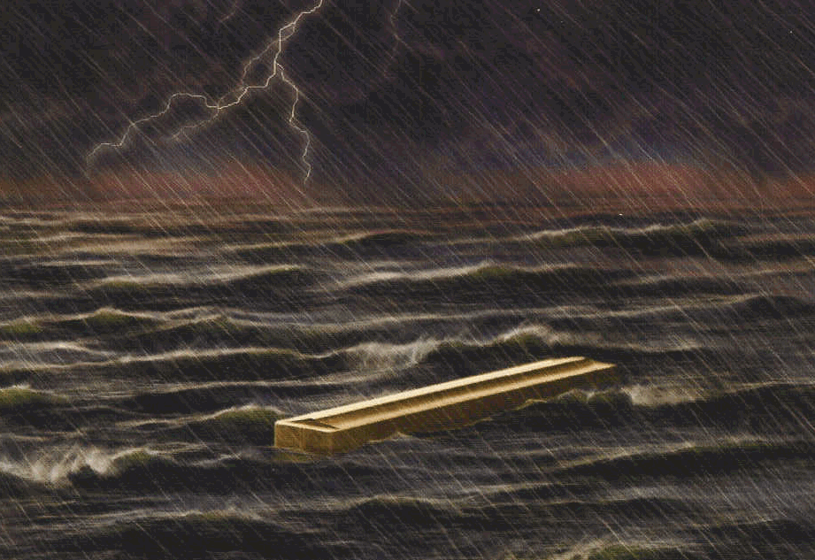
Where Did All the Water For the Flood Come From?

Slide 36
Where Did All the Water For the Flood Come From?
Genesis 7:11 - In the six hundredth year of Noah's life, in the second month, on the seventeenth day of the month, on that day all the fountains of the great deep burst forth, and the windows of the heavens were opened.
Two Sources:
1. The Fountains of the Great Deep
May Have Lasted For 150 days
Came from within the earth
Probably Involved a Great Deal of Volcanic Activity
2. The “Windows” of the Heavens
An Extraordinary Rain
Lasted for "40 days and 40 nights"

Slide 37
What Are the Fountains of the Deep?
Referred to twice in the flood account:
Genesis 7:11 – … the fountains of the great deep burst forth…
Genesis 8:2 - The fountains of the deep… were closed…
As best we can tell, the “fountains of the great deep” seem to be underground water sources that existed deep within the earth prior to the flood.
These springs are said to “burst forth” which seems to imply a violent release of the water as it breaks through the ground.
Note: Given the number of volcanic rocks that we see interspersed between the layers in the rocks laid down by the Flood – it seems likely that the bursting forth of these fountains involved an large number volcanic eruptions as well.
http://www.answersingenesis.org/home/area/answersbook /flood12.asp#2

Slide 38
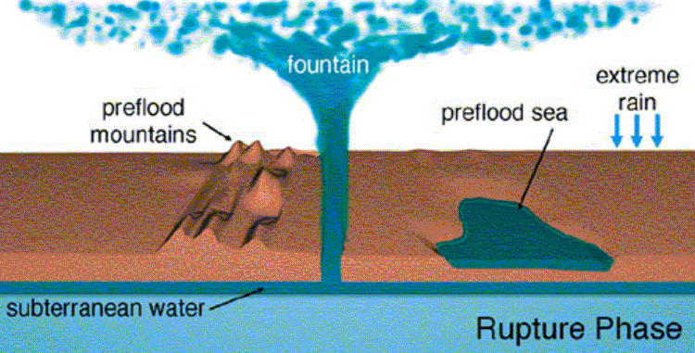
Fountains of the Deep Burst Forth?
Taken from Walt Brown, Ph.D., In the Beginning – Compelling Evidence for Creation and the Flood, 7th Edition, 2001, p.101
Available at www.creationscience.com

Slide 39
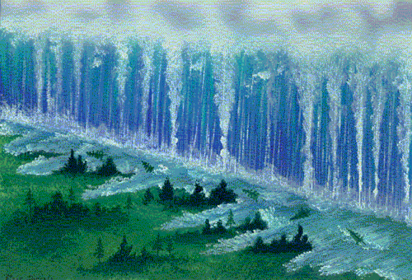
Springs (or Fountains) of the Deep Burst Forth?
Brown, In the Beginning, p.101

Slide 40
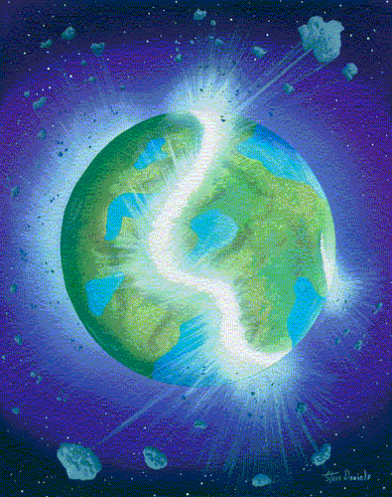
Springs (or Fountains) of the Deep Burst Forth?
Brown, In the Beginning, p.84

Slide 41
What are the Windows of the Heavens?
The other source of the waters for Noah's Flood was “the windows of the heavens.” Genesis 7:12 says that it rained for 40 days and 40 nights continuously.
Genesis 2:5 tells us that there was no rain before man was created. Because of this, some have suggested that there was no rainfall anywhere on the earth until the time of the Flood. However, the Bible does not actually say this, so we really don’t know for sure.
http://www.answersingenesis.org/home/area/answersbook/flood12.asp#2

Slide 42
What are the Windows of the Heavens?
The expression “windows of the heavens” is used twice in reference to the flood :
Genesis 7:11 – … the windows of the heavens were opened…
Genesis 8:2 - … the windows of the heavens were closed…
This expression is only used four other times in the Old Testament:
Twice in 2 Kings 7:2 and 19, referring to God's miraculous intervention in sending rain
Once in Isaiah 24:18 to refer to an outpouring of God’s judgment
Once in Malachi 3:10, where the phrase is used again of God intervening to pour out abundant blessings on his people
Here in Genesis, the expression seems to refer to an extraordinary rain poured out by God during the first 40 days of the flood.
http://www.answersingenesis.org/home/area/answersbook/flood12.asp#2

Slide 43
What was the water source for this extraordinary “windows of the heavens” rainfall?
“If all the water in our present atmosphere were suddenly precipitated, it would suffice to cover the ground to an average depth of less than two inches” (Whitcomb and Morris, The Genesis Flood, 1961, p.121)
So how was the rain able to continue falling for 40 days and nights during the flood?
One possibility is that God miraculously created water for the rain throughout the 40 days and nights.
But as Morris observes: “There is no question that God could have accomplished the entire event miraculously (say by special creation of the waters of the Flood and then by special ‘uncreation’ of them when it was over), but this would be unnecessary and therefore theologically unlikely” (Henry Morris, The Genesis Record, p.195)

Slide 44
The Water Canopy Theory?
In 1874, Isaac Vail (1840-1912) proposed (for the first time) a theory that has come to be known as the "Water Canopy Theory". (Walt Brown, In the Beginning, Seventh Edition, p.260)
This theory was later popularized by Whitcomb and Morris in their book The Genesis Flood (1961). (Brown, p.266)

Slide 45
The Water Canopy Theory?
Whitcomb and Morris have argued that, prior to the flood, the earth was surrounded by a "water canopy" and that God opened the floodgates of heaven by causing the water canopy to fall to the earth.
To support this idea they point to Genesis 1:6-8 where it says that on the second day of creation God separated the waters that were on the earth by an “expanse” (Hebrew: raqiya) or “firmament”.
Genesis 1:6-8 – And God said, "Let there be an expanse in the midst of the waters, and let it separate the waters from the waters." ⁷ And God made the expanse and separated the waters that were under the expanse from the waters that were above the expanse. And it was so. ⁸ And God called the expanse Heaven. And there was evening and there was morning, the second day.
They reason that “expanse” in this text refers to the atmosphere, because it says a few verses later that birds fly in the expanse (Genesis 1:20).

Slide 46
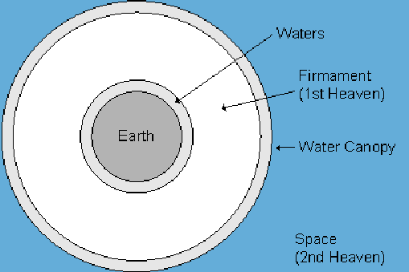
The Water Canopy Theory?
Thus they envision a literal blanket of water surrounding the earth (not to scale) :

Slide 47
Problems With the Canopy Theory
In recent years many traditional supporters of the Water Canopy Theory, such as Larry Vardiman (with ICR) have discovered a problem with the canopy theory: The “greenhouse effect” caused by a large water canopy would cause the surface of the earth to become intolerably hot!
Using computer models, Vardiman tried to solve the problem, but found that he had to drastically reduce the amount of water vapor in the canopy in order to make it work.
It seems that the maximum amount of water that could be held in such a canopy without causing things on the earth to get too hot would be the rain equivalent of about 6.5 feet of water.
Obviously such a reduced canopy would not significantly contribute to the 40 days and nights of rain at the beginning of the flood!
http://www.answersingenesis.org/home/area/answersbook/flood12.asp#2

Slide 48
Problems With the Canopy Theory
Many creation scientists are now either abandoning the water vapor canopy model or no longer see any need for such a concept, particularly if other reasonable mechanisms could have supplied the rain for the flood.
Information excerpted from: http://www.answersingenesis.org/home/area/answersbook/flood12.asp#2

Slide 49
So if there is no water canopy around the earth, what is Genesis 1:6-8 talking about?
Genesis 1:6-8 – And God said, "Let there be an expanse in the midst of the waters, and let it separate the waters from the waters." ⁷ And God made the expanse and separated the waters that were under the expanse from the waters that were above the expanse. And it was so. ⁸ And God called the expanse Heaven. And there was evening and there was morning, the second day.
Some other recent suggestions:
Walt Brown:
Expanse = the earth’s outer crust
Waters below the expanse = subterranean water
Waters above the expanse = surface waters (which became seas, lakes, etc. when the dry land appeared on day 3)
Dr. Russell Humphreys:
Expanse = interstellar space (the abode of the sun moon and stars – Genesis 1:17)
Waters below the expanse = surface waters on the earth (which became seas, lakes, etc. when the dry land appeared on day 3)
Waters above the expanse = water beyond the stars at the edge of the universe!

Slide 50
So if there is no water canopy around the earth, what is Genesis 1:6-8 talking about?
Genesis 1:6-8 – And God said, "Let there be an expanse in the midst of the waters, and let it separate the waters from the waters." ⁷ And God made the expanse and separated the waters that were under the expanse from the waters that were above the expanse. And it was so. ⁸ And God called the expanse Heaven. And there was evening and there was morning, the second day.
The Traditional View – Calvin (1554), Gill (1810), Keil and Delitzsch (1890?) and others:
Expanse = the atmosphere
Waters below the expanse = surface waters on the earth (which became seas, lakes, etc. when the dry land appeared on day 3)
Waters above the expanse = water stored in the clouds
While the other views of this passage are interesting and worthy of consideration, the traditional view seems to be the most straightforward and seems to have the least problems!

Slide 51
So if there is no water canopy around the earth, what was the water source for this extraordinary "floodgates of the heavens" rainfall?
The most reasonable suggestion seems to be that the water (along with rocks and mud) that burst forth from the fountains of the deep with incredibly violent force went far up into the atmosphere and fell back to the earth as rain.

Slide 52
Where Did All the Water Go After the Flood?

Slide 53
Where Did All the Water Go After the Flood?
Psalm 104:6 You covered [the earth] with the deep as with a garment; the waters stood above the mountains. ⁷ At your rebuke they fled; at the sound of your thunder they took to flight. ⁸ The mountains rose, the valleys sank down to the place that you appointed for them. ⁹ You set a boundary that they may not pass, so that they might not again cover the earth.
If this passage refers to the process that God used at the time of Noah’s flood, then it would seem to indicate that the bulk of the waters from the flood ended up in today's ocean basins.

Slide 54
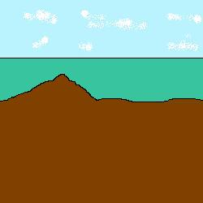
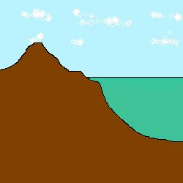
Where Did All the Water Go After the Flood?
Psalm 104:6 You covered [the earth] with the deep as with a garment; the waters stood above the mountains. ⁷ At your rebuke they fled; at the sound of your thunder they took to flight. ⁸ The mountains rose, the valleys sank down to the place that you appointed for them. ⁹ You set a boundary that they may not pass, so that they might not again cover the earth.

Slide 55
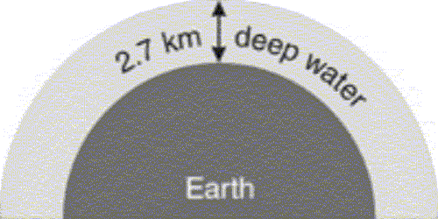
Where Did All the Water Go After the Flood?
Note: On our present earth, without mountains or sea basins, water would cover the whole earth to a depth of 2.7 km, or 1.7 miles (not to scale):
http://www.answersingenesis.org/home/area/answersbook/flood12.asp#2

Slide 56
Evidence of a Global Flood

Slide 57
Evidence of a Global Flood
As we look around our world, we find a great deal of evidence for the global flood talked about in scripture:
Large Sedimentary Deposits containing the fossilized remains of dead plants and animals – including fossils of sea creatures on top of the highest mountains!
Notes:
The deepest ocean is the Marianas Trench in the Pacific Ocean which is 36,201 feet (6.9 miles) below sea level.
The highest mountain is Mount Everest which is 29,028 feet (5.5 miles) above sea level.

Slide 58
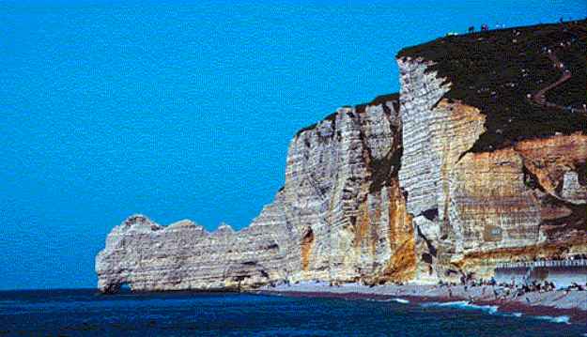
Normandy, France

Slide 59
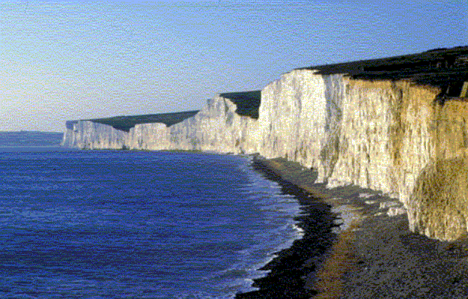
The White Cliffs of Dover, England

Slide 60
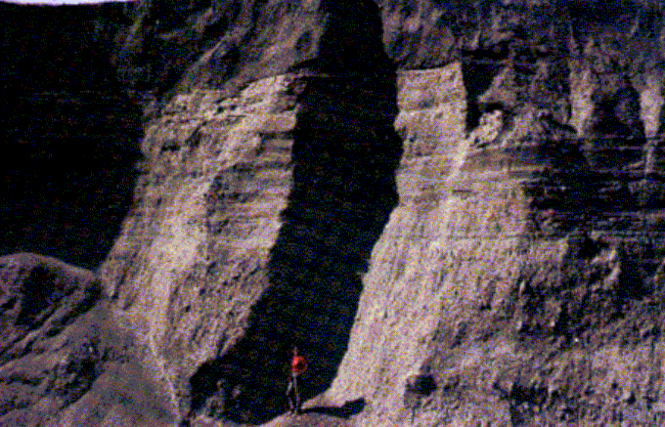
Mount Saint Helens Rock Layers Formed Rapidly
Evolutionists tell us that it takes millions of years for such rock layers to form - but the layers pictured above were produced within a matter of hours during the Mount Saint Helens volcano eruption on June 12, 1980.
(http://www.answersingenesis.org/docs/456.asp)

Slide 61
Evidence of a Global Flood
As we look around our world, we find a great deal of evidence for the global flood talked about in scripture:
Large Sedimentary Deposits containing the fossilized remains of dead plants and animals – including fossils of sea creatures on top of the highest mountains!
Large Canyons carved out by vast amounts water and mud as it ran rapidly back into the seas after the flood.
Notes:
The deepest ocean is the Marianas Trench in the Pacific Ocean which is 36,201 feet (6.9 miles) below sea level.
The highest mountain is Mount Everest which is 29,028 feet (5.5 miles) above sea level.

Slide 62
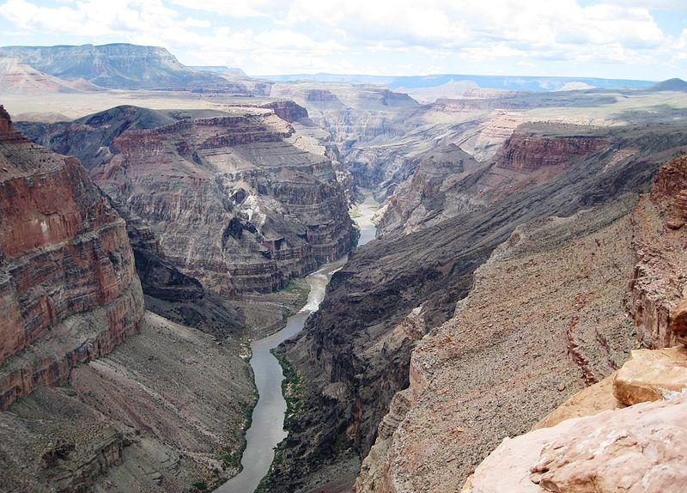
The Grand Canyon
Evolutionists tell us that it took millions of years for the river pictured above to carve out this canyon.

Slide 63
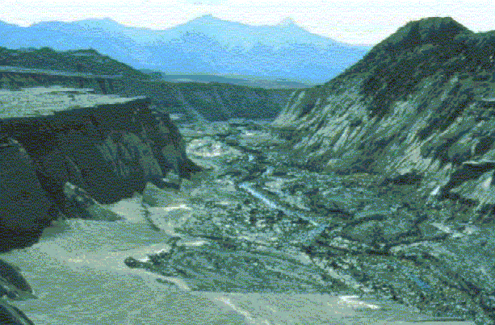
Mount Saint Helens Small Model of the Grand Canyon?
But the 100-foot-deep Engineer’s Canyon on the north fork of the Toutle River is like a small scale model of the Grand Canyon.
And it was carved very quickly by a catastrophic mud flow produced by one volcano eruption (Mt St Helens)
(http://www.answersingenesis.org/home/area/feedback/negative_31march2002.asp)

Slide 64
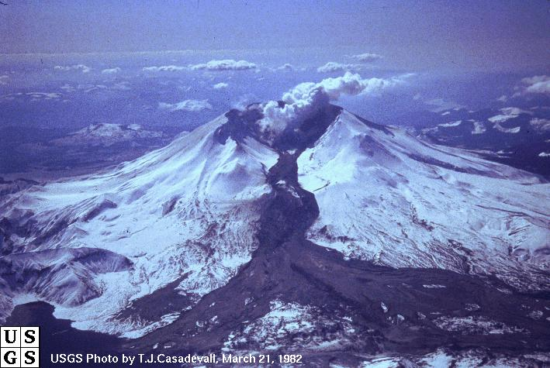
Mount Saint Helens – Mud Flow
A high altitude photo of the mud flow that carved Engineer’s Canyon on March 19, 1982

Slide 65
Evidence of a Global Flood
As we look around our world, we find a great deal of evidence for the global flood talked about in scripture:
Large Sedimentary Deposits containing the fossilized remains of dead plants and animals – including fossils of sea creatures on top of the highest mountains!
Large Canyons carved out by vast amounts water and mud as it ran rapidly back into the seas after the flood.
Flood Legends in Cultures Throughout the World
Notes:
The deepest ocean is the Marianas Trench in the Pacific Ocean which is 36,201 feet (6.9 miles) below sea level.
The highest mountain is Mount Everest which is 29,028 feet (5.5 miles) above sea level.

Slide 66
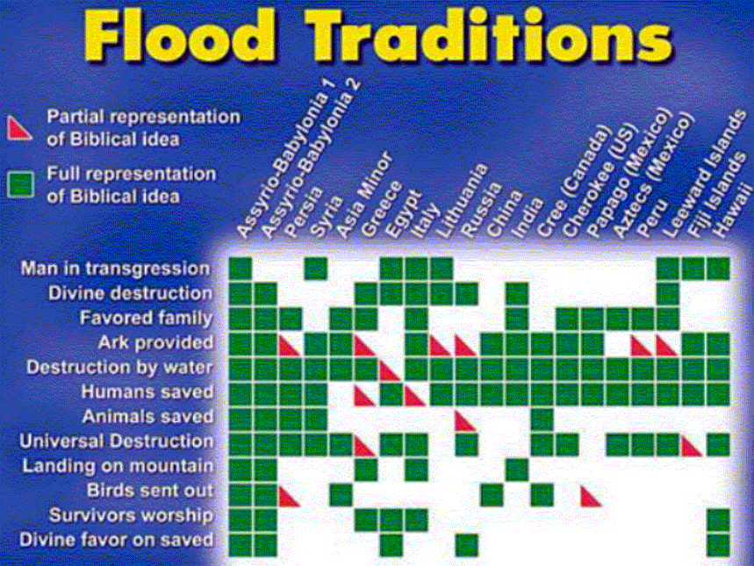
Flood Traditions
(http://www.answersingenesis.org/docs2004/0324ark.asp)

Slide 67
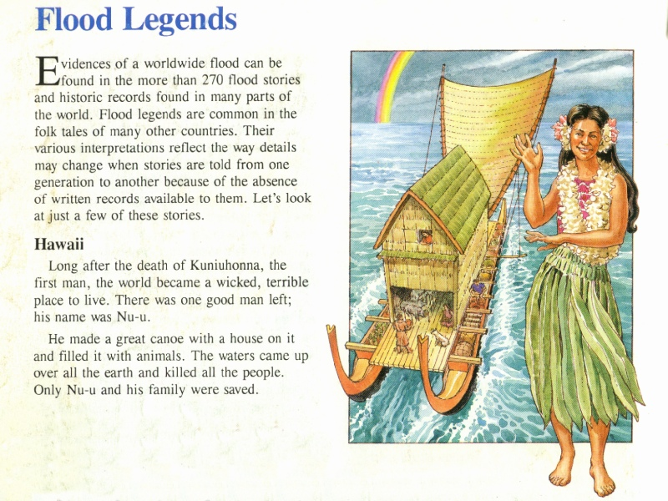
Flood legend one (red book)
Dinosaurs by Design by Duane Gish

Slide 68
Flood legend one (red book)
Hawaii
“Long after the death of Kuniuhonna, the first man, the world became a wicked terrible place to live. There was one good man left; his name was Nu-u.
He made a great canoe with a house on it and filled it with animals. The waters came up over all the earth and killed all the people. Only Nu-u and his family were saved.”

Slide 69
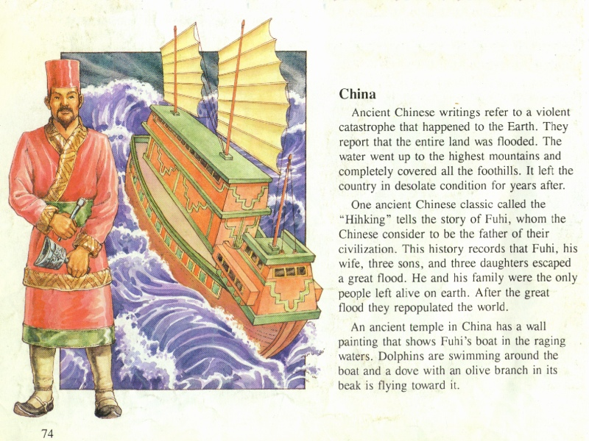
One ancient Chinese classic called the “Hihking” tells the story of Fuhi, whom the Chinese consider to be the father of their civilization

Slide 70
This history records that Fuhi, his wife, three sons and three daughters escaped a great flood. He and his family were the only people alive on earth.
After the great flood they repopulated the world.
Dinosaurs by Design by Duane Gish

Slide 71
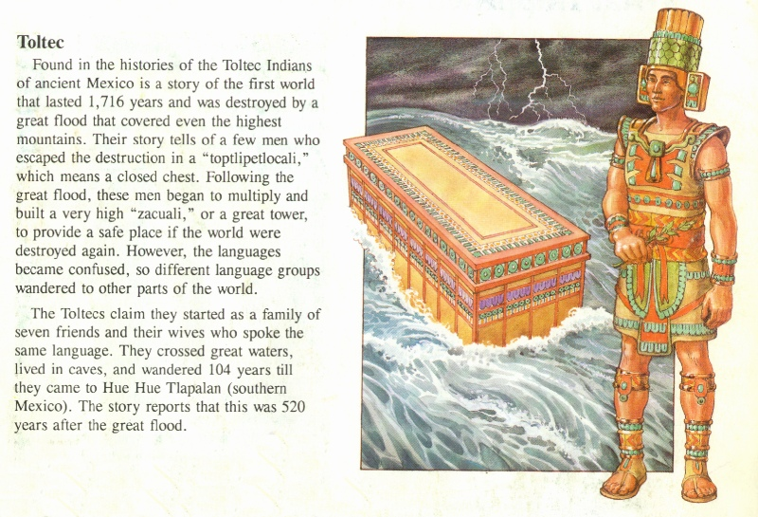
Flood legend three (red book)
The Toltec Indians
of ancient Mexico
said, “the first
world lasted 1716
years and was
destroyed by a
great flood.” Only
one family named
Coxcox survived.
Dinosaurs by Design by Duane Gish

Slide 72
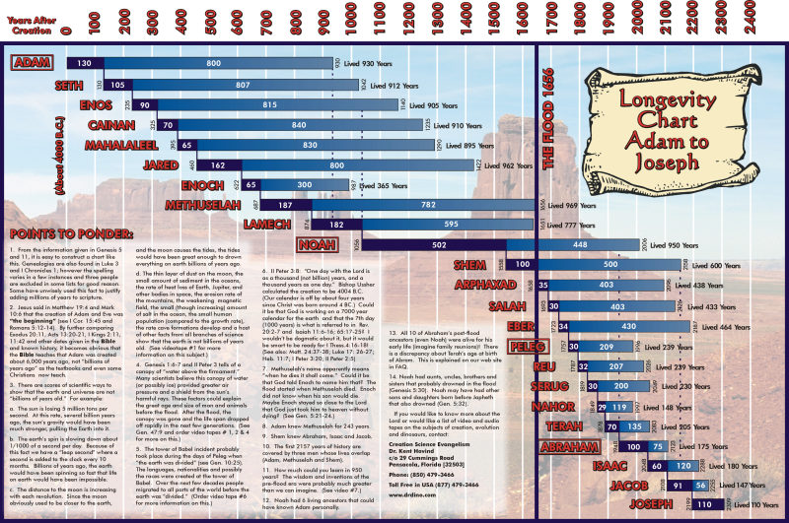
The Bible dates put the flood 1656 years after creation. The Toltec legend is only 60 years off! Not bad.

Slide 73
Questions That Are Often Asked About Noah and the Ark

Slide 74
How Did Noah Gather All the Animals To Go on the Ark?

Slide 75
How Did Noah Gather All the Animals To Go on the Ark?
How could Noah possibly go out and find two of every kind of animal?
How would he capture animals that were difficult to catch?
How could the animals that were in remote places (e.g. kangaroos and koalas in Australia, kiwis in New Zealand, etc.) get to the ark?

Slide 76
How Did Noah Gather All the Animals To Go on the Ark?
The first thing we have to remember about gathering the animals to the ark is that the animals came to Noah (under God's sovereign direction):
Genesis 6:20 - Of the birds according to their kinds, and of the animals according to their kinds, of every creeping thing of the ground, according to its kind, two of every sort shall come in to you to keep them alive.
Genesis 7:7-9 – And Noah and his sons and his wife and his sons' wives with him went into the ark to escape the waters of the flood. ⁸ Of clean animals, and of animals that are not clean, and of birds, and of everything that creeps on the ground, ⁹ two and two, male and female, went into the ark with Noah, as God had commanded Noah.

Slide 77
How Did Noah Gather All the Animals To Go on the Ark?
Also, the earth was undoubtedly much different before the flood than it is now. Some possible differences are:
Mountains may not have been as large prior to the flood – our large mountains may have been raised up after the flood to provide a place for the water to go.
There may have only been one continent before the flood (Genesis 1:9 says that the waters were gathered into one place – let the dry land appear)
There may not have been as much water on the earth. Much of the water from the flood may have come from out of the fountains of the deep - so there may not have been vast oceans prior to the flood.
Diverse animal kinds may not have been spread out much prior to the flood as they are today thus getting two of each kind of animal on the ark would not require animals to travel great distances.

Slide 78
How Could Noah Have Gotten All Those Animals to Fit on the Ark?

Slide 79
How Could Noah Have Gotten All Those Animals to Fit on the Ark?
To Answer This Question We Need to Know:
How big was the ark?
How many animals did Noah need to take on the ark?
How big were the animals that Noah took on the ark?

Slide 80
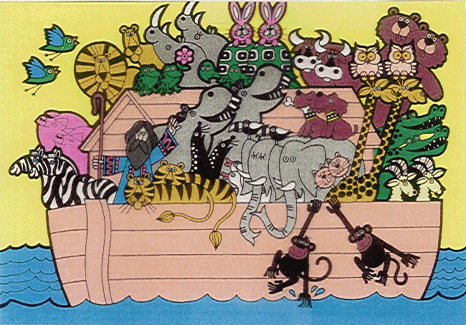
How big was the ark?
What some people picture:

Slide 81
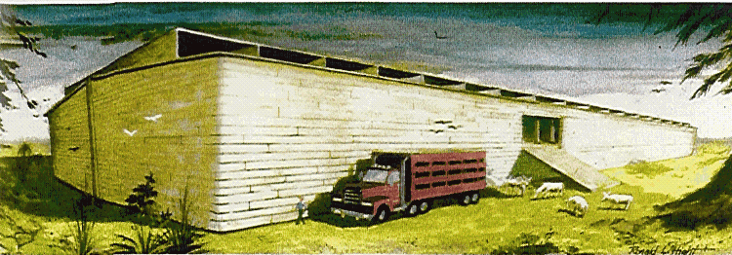
How big was the ark?
What the Bible teaches:

Slide 82
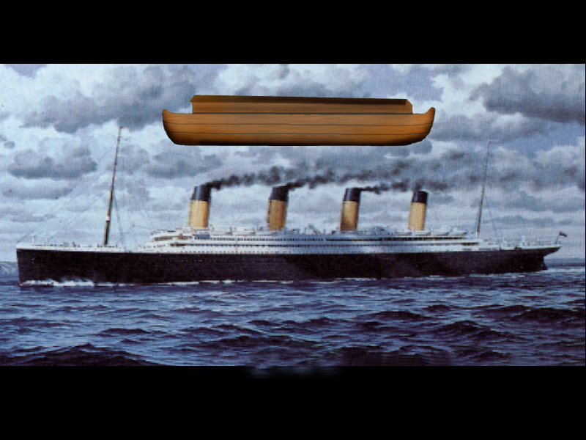
515 feet
882 feet
Noah’s ark compared to Titanic

Slide 83

Noah’s ark in a football stadium

Slide 84
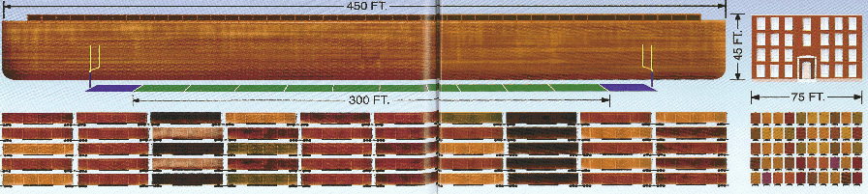
Noah’s Ark:
50% Longer Than a Football Field
About the Height a Four Story Building
Storage Capacity = 522 Standard Railroad Stock Cars

Slide 85
How many animals did Noah need to take on the ark?
Genesis 6:19 – And of every living thing of all flesh, you shall bring two of every sort into the ark to keep them alive with you. They shall be male and female.
Genesis 7:2 – Take with you seven pairs of all clean animals, the male and his mate, and a pair of the animals that are not clean, the male and his mate
Genesis 7:15 – They went into the ark with Noah, two and two of all flesh in which there was the breath of life.
Genesis 7:22 – Everything on the dry land in whose nostrils was the breath of life died

Slide 86
How many animals did Noah need to take on the ark?
Noah only had to keep breathing land animals on the ark.
Therefore Noah did not have to take any fish or sea creatures on the ark.
Noah only had to take select animals representing each created “kind”:
Seven of each “clean” kind (whether seven pairs or seven individuals is uncertain)
Two of each unclean
Depending on how “clean” animals were defined in Noah’s day, there may have been very few clean animals (there are only a couple of dozen clean animals as defined in Moses day).

Slide 87
A Possible List of Clean Animals in Moses Day
Animals (Deut. 14:4-6) | Insects (Lev. 11:21) | Birds (Encyclopaedia Judaica *)
antelope | cricket | domestic duck
deer | grasshopper | domestic goose
gazelle | katydid | hen
goat | locust | house sparrow
ibex |  | palm dove
mountain sheep |  | partridge
ox |  | peacock
roe deer |  | pheasant
sheep |  | pigeon
wild goat |  | quail
 |  | turtle dove
“You may eat any animal that has a split hoof divided in two and that chews the cud.” (Deut 14:6) |  | “Leviticus 11:13-19 lists 20 ‘unclean’ birds, and Deuteronomy 14:12-18 enumerates 21 … The Bible does not list ‘clean’ birds”.
*http://ej.kdsdev.com/sample-articles/article_view.php?sid=dietary-laws&p=7

Slide 88
How many animals did Noah need to take on the ark?
Noah only had to keep breathing land animals on the ark.
Therefore Noah did not have to take any fish or sea creatures on the ark.
Noah only had to take select animals representing each created “kind”:
Seven of each “clean” kind (whether seven pairs or seven individuals is uncertain)
Two of each unclean
Depending on how “clean” animals were defined in Noah’s day, there may have been very few clean animals (there are only a couple of dozen clean animals as defined in Moses day).
If this is the case the majority of animal kinds on the ark would be represented by one pair (rather than seven).

Slide 89
What is an animal “kind”?
Noah was instructed to take two (or seven) of each “kind” of land animal on board the ark .
Animals are of the same “kind” if they can procreate and therefore produce other animals of the same “kind” as themselves.
Thus by having a representative of each kind of animal on the ark, the earth could be repopulated after the flood with each of the different kinds of animals as they existed before the flood.
Genesis 6:20 – Of the birds according to their kinds, and of the animals according to their kinds, of every creeping thing of the ground, according to its kind, two of every sort shall come in to you to keep them alive

Slide 90

By observing the different kinds of living things in the world today, we can see that God built a great deal of variety and adaptability into each created kind!

Slide 91

While God has built great variety into each kind, God has also placed limits. God made all living things to produce “according to their kinds” (Genesis 1:11,12,21,24,25)

Slide 92
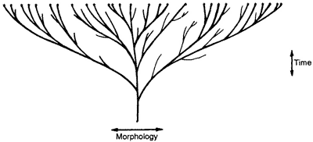
So God did not populate the earth using the evolutionary “tree” where all things are thought to descend from one single celled organism

Slide 93

Nor do we think God populated the earth using the stereotypical creationist “lawn” where little, if any variation occurs within a created kind.

Slide 94

We believe that God populated (and after the flood repopulated) the earth using the creationist “orchard” where there is variety and yet limits within each created kind.

Slide 95
Therefore while preserving a relatively small number of land animals on the ark, God was able to repopulate the earth with all the varieties of land animals that we see today!

Slide 96
How Could Noah Have Gotten All Those Animals to Fit on the Ark?

Slide 97
How Could Noah Have Gotten All Those Animals to Fit on the Ark?
To Answer This Question We Need to Know:
How big was the ark?
How many animals did Noah need to take on the ark?
How big were the animals that Noah took on the ark?

Slide 98
So how many “kinds” of animals did Noah take on the ark?
It is difficult to know for sure which animal species today are descended from a common ancestral “kind” because:
We are not always aware of different species that can successfully mate with other species and produce offspring
In many cases, due to such things as mutations or genetic drift over time, two species that have descended from a common ancestral kind can no longer successfully mate

Slide 99
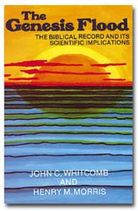
So how many “kinds” of animals did Noah take on the ark?
In 1961, Henry Morris, working with estimates of the number of animal species given by Ernst Mayr, a leading American systematic taxonomist, estimated that there were probably no more than 35,000 individual vertebrate animals on the ark.
Morris estimates that it takes 146 stock cars to carry 35,000 average (sheep) sized animals.
Based on the dimensions given for the ark (450 feet long x 75 feet wide x 45 feet high) it had a carrying capacity of 522 standard stock cars used by modern railroads.
Therefore, according to Morris’ estimates, the ark was three times bigger than necessary!
The above estimates come from Whitcomb and Morris, The Genesis Flood - The Biblical Record and Its Scientific Implications, 1961, pp.65-70

Slide 100
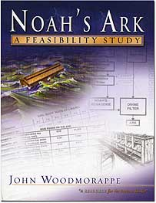
So how many “kinds” of animals did Noah take on the ark?
In a more recent study, John Woodmorappe shows that Morris’ figures may have been too conservative!
To estimate the number of animal kinds on the ark, Woodmorappe uses modern animal classifications.
John Woodmorappe , Noah's Ark: A Feasibility Study , 1996

Slide 101
Modern Animal Classification
Kingdom
Phylum
Class
Order
Family
Genus
Species

Slide 102

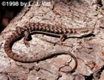
An Example of Modern Animal Classification
Kingdom - Animalia
Phylum – Chordata
Subphylum - Vertebrata
Class - Reptilia
Order - Squamata (amphisbaenians, lizards, and snakes)
Suborder Sauria (lizards)
Family - Anguidae (alligator lizards, glass lizards, and lateral fold lizards)
Genus - Elgaria (western alligator lizards)
Species – Elgaria kingii (Arizona alligator lizard and madrean alligator lizard)
Species – Elgaria multicarinata (southern alligator lizard)

Slide 103


An Example of Modern Animal Classification
Kingdom - Animalia
Phylum - Chordata
Subphylum - Vertebrata
Class - Mammalia (mammals)
Order - Carnivora (carnivores)
Family - Felidae (cats – cheetahs, small cats, leopards, lions, and tigers)
Genus - Panthera (roaring cats)
Species -
leo (lion)
tigris (tiger)

Slide 104
So how many “kinds” of animals did Noah take on the ark?
If we use the modern animal classification of genus as the most likely indicator of original “kind”, Woodmorappe shows that there would have been about 16,000 animals on the ark. (p. 7-8)
Woodmorappe believes that the family classification is probably a better approximation of the original kinds in which case there would only need to have been 2,000 animals on the ark.
But, in order to be conservative, Woodmorappe made all his calculations based on the assumption that there were 16,000 animals on the ark.
He analyzed the average size of these animals and found that half the animals on the ark would weigh less than a small rat! (p.13)
He goes on to state that only 11% of the animals on the ark would have been substantially larger than a sheep. (p.13)
The above estimates come from John Woodmorappe , Noah's Ark: A Feasibility Study , 1996

Slide 105
How could Noah fit all those HUGE dinosaurs (and other large animals) on the Ark ?
Note, the Bible does not say that the animals that Noah took on the ark had to be fully grown.
It would make sense for Noah to take younger animals on the ark for a couple of reasons:
Younger animals would (on the average) have more years of life left to repopulate the earth once they got off the ark.
In the case of the larger animals, such as the larger dinosaurs, the younger animals would be smaller and would more easily fit on the ark

Slide 106
So How Could Noah Have Gotten All Those Animals to Fit on the Ark?
Using standard floor space requirements recommended for:
The housing of laboratory animals for the smaller animals
Intensively housed livestock for the larger animals,
Woodmorappe calculated that the space required to house the 16,000 animals and their enclosures would require less than half of the floor space of the ark’s three decks. (p.16)
This calculation assumes no stacking of enclosures, which would allow at least some food and water to be stored overhead. (p.16)
There is also plenty of room left over for the ark’s infrastructure and passageways.
The above estimates come from John Woodmorappe , Noah's Ark: A Feasibility Study , 1996

Slide 107
How Could Noah Have Cared For So Many Animals On the Ark?

Slide 108
How Could Noah Have Cared For So Many Animals On the Ark?
We are not given the details of what was involved in caring for the animals on the ark or how Noah and his family went about doing what was necessary.
We are told that Noah was to bring food on the ark for himself and the animals:
Genesis 6:19,21 – And of every living thing of all flesh, you shall bring two of every sort into the ark to keep them alive with you. They shall be male and female…²¹ Also take with you every sort of food that is eaten, and store it up. It shall serve as food for you and for them."
From this we can at least infer that Noah and his family had to feed the animals.

Slide 109
How Could Noah Have Cared For So Many Animals On the Ark?
At the same time, we cannot rule out that God may have made special (perhaps even miraculous) provision to help Noah in his care of the animals .
For example, some have suggested that God could have caused many of the animals on the ark to hibernate during the flood, in order to make caring for them easier.
The Bible does not say anything about this, so we can’t assume it. But at the same time, it is a possibility.

Slide 110
How Could Noah Have Cared For So Many Animals On the Ark?
Some have argued that food taken on board rules out hibernation, but this is not so. Hibernating animals do not sleep all winter, despite what many think, so they would still need food occasionally.
John Woodmorappe in Noah' Ark: A Feasibility Study, 1996 shows in painstaking detail a variety of possible ways that Noah and his family could have cared for the animals on the Ark without any miraculous intervention on the part of God!

Slide 111
Food Requirements on the Ark
The Ark would probably have carried compressed and dried foodstuffs, and probably a lot of concentrated food.
Perhaps Noah fed the cattle mainly on grain, plus some hay for fiber.
Woodmorappe calculated that the volume of foodstuffs would have been only about 15 % of the Ark’s total volume.
Drinking water would only have taken up 9.4 % of the volume. This volume would be reduced further if rainwater was collected and piped into troughs.
(http://www.answersingenesis.org/home/area/Magazines/docs/cen_v19n2_animals_ark.asp)

Slide 112
Waste Disposal on the Ark
It is doubtful whether the humans had to clean the cages every morning.
Possibly they had sloped floors or slatted cages, where the manure could fall away from the animals and be flushed away (plenty of water around!) or destroyed by composting by worms which would also provide earthworms as a food source.
Very deep bedding can sometimes last for a year without needing a change. Absorbent material (e.g. sawdust, softwood wood shavings and especially peat moss) would reduce the moisture content and hence the odor.
(http://www.answersingenesis.org/home/area/Magazines/docs/cen_v19n2_animals_ark.asp)

Slide 113
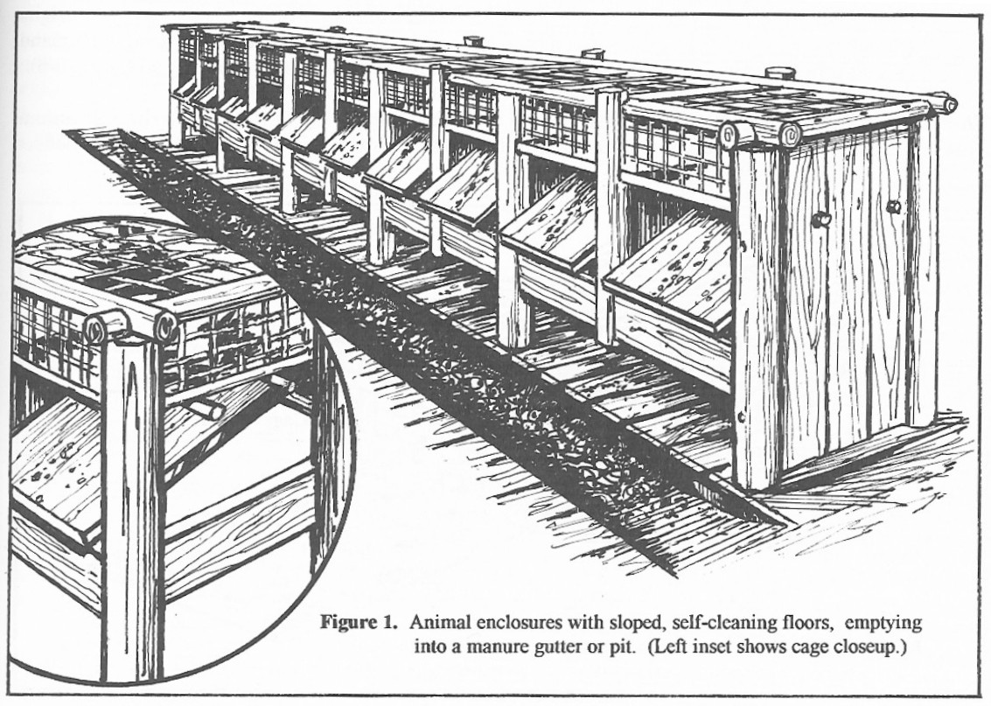
Waste Disposal on the Ark
John Woodmorappe , Noah's Ark: A Feasibility Study , 1996, p.25

Slide 114
How did Noah deal with ferocious animals on the ark?
How did Noah keep from the lions and tigers, for example, from attacking and eating other animals or even him and his family?
The Bible tells us that God put the fear of man into animals and permitted man to eat meat for the first time after the flood:
Genesis 9:2-3 - The fear of you and the dread of you shall be upon every beast of the earth and upon every bird of the heavens, upon everything that creeps on the ground and all the fish of the sea. Into your hand they are delivered. ³ Every moving thing that lives shall be food for you. And as I gave you the green plants, I give you everything.

Slide 115
How did Noah deal with ferocious animals on the ark?
Perhaps it was not until after the flood that animals began to eat meat (i.e. each other) as well. After all, Gen. 1:30 seems to imply that animals ate only plants at the time of creation – just as man did at that time.
Genesis 1:29-30 And God said, "Behold, I have given you every plant yielding seed that is on the face of all the earth, and every tree with seed in its fruit. You shall have them for food. ³⁰ And to every beast of the earth and to every bird of the heavens and to everything that creeps on the earth, everything that has the breath of life, I have given every green plant for food." And it was so.
Another possibility to keep in mind, is that Noah may have raised many of the animals that he took on the ark from their infancy, and thus domesticated them to a large degree.

Slide 116
How Would Fish Have Survived the Flood? (Outside the Ark)

Slide 117
How did freshwater and saltwater fish survive the Flood?
If the whole earth were covered by water in the Flood, then there would have been a mixing of fresh and salt waters.
Many of today’s fish species are specialized and do not survive in water of radically different saltiness. So how did they survive the Flood?
The first thing we should note is that many (probably most) of fish and sea creatures did not survive the flood!
http://www.answersingenesis.org/home/area/answersbook/fish14.asp

Slide 118
How did freshwater and saltwater fish survive the Flood?
Note also, that only two of each kind survived on the ark and lived to repopulate the earth. Therefore small numbers of surviving fish and sea creatures could, no doubt, do the same.
Note also that many fish today have a wide tolerance for variations in salinity.
For example, salmon, striped bass and Atlantic sturgeon spawn in freshwater and mature in saltwater.
Eels reproduce in saltwater and grow to maturity in freshwater streams and lakes.
http://www.answersingenesis.org/home/area/answersbook/fish14.asp

Slide 119
How did freshwater and saltwater fish survive the Flood?
There is also evidence of post-Flood specialization within a kind of fish.
For example, the Atlantic sturgeon is a migratory salt/freshwater species but the Siberian sturgeon (a different species of the same kind) lives only in freshwater.
Many families of fish contain both fresh and saltwater species. These include the families of toadfish, garpike, bowfin, sturgeon, herring/anchovy, salmon/trout/pike, catfish, clingfish, stickleback, scorpionfish, and flatfish.
http://www.answersingenesis.org/home/area/answersbook/fish14.asp

Slide 120
How did freshwater and saltwater fish survive the Flood?
Indeed, most of the families of fish alive today have both fresh and saltwater representatives.
This suggests that the ability to tolerate large changes in salinity was present in most fish at the time of the Flood. Specialization, through natural selection, may have resulted in the loss of this ability in many species since then.
http://www.answersingenesis.org/home/area/answersbook/fish14.asp

Slide 121
How did freshwater and saltwater fish survive the Flood?
Note also, that fish today can often adapt to a different level of salinity if the level of salinity is changed slowly enough.
Major public aquariums often use the ability of fish to adapt to water of different salinity from their normal habitat to exhibit freshwater and saltwater species together.
So, many fish species today have the capacity to adapt to both fresh and salt water within their own lifetimes.
http://www.answersingenesis.org/home/area/answersbook/fish14.asp

Slide 122
How did freshwater and saltwater fish survive the Flood?
There is also a possibility that during the flood stable fresh and saltwater layers developed and persisted in some parts of the ocean.
Turbulence may have been sufficiently low in some places on the earth for such layering to persist and allow the survival of both freshwater and saltwater species in those areas.
http://www.answersingenesis.org/home/area/answersbook/fish14.asp

Slide 123
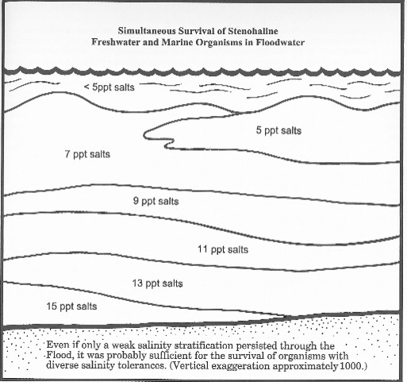
John Woodmorappe, Noah’s Ark: A Feasibility Study, p.149

Slide 124
How Would Plants Have Survived the Flood? (Outside the Ark)

Slide 125
How did plants survive the Flood?
Many terrestrial seeds can survive long periods of soaking in various concentrations of saltwater. Indeed, saltwater impedes the germination of some species so that the seed lasts better in saltwater than freshwater.
Other plants could have survived in floating vegetation masses, or on pumice from the volcanic activity.
Many plants could have survived as planned food stores on the ark, or accidental inclusions in such food stores.
http://www.answersingenesis.org/home/area/answersbook/fish14.asp

Slide 126
How did plants survive the Flood?
Many seeds have devices for attaching themselves to animals, and some could have survived the Flood by this means.
Others could have survived in the stomachs of the bloated, floating carcasses of dead herbivores.
The olive leaf brought back to Noah by the dove (Gen. 8:11) shows that plants were regenerating well before Noah and company left the Ark.
http://www.answersingenesis.org/home/area/answersbook/fish14.asp

Slide 127
How Could Animals Have Gotten to Remote Places Around the World After the Flood?

Slide 128
How Could Animals Have Gotten to Remote Places Around the World After the Flood?
Skeptics are fond of asking such things as, “How could a kangaroo have hopped such a long distance from the mountains of Ararat (where the ark landed), across the oceans, all the way to Australia?”
The first thing that we should note is that for the kangaroo population to reach Australia (for example) it would not have required that one kangaroo travel the entire distance from the mountains of Ararat to Australia.
Populations of kangaroos could have spread over long periods of time, gradually migrating.

Slide 129
How Could Animals Have Gotten to Remote Places Around the World After the Flood?
One possibility is that for a period of time after the flood the continental shelves might have been exposed, allowing animals to travel to various places throughout the world.
Even evolutionists acknowledge that men and animals could once freely cross the Bering Strait, which separates Asia and the Americas.
Before the idea of continental drift became popular, evolutionists believed that the world sea levels were lowered during an ice age and in this way the continental shelves became land bridges that allowed dry-land passage all the way from Europe to Australia.
http://www.answersingenesis.org/home/area/faq/migration.asp

Slide 130
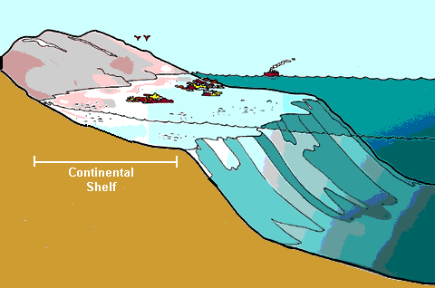

Slide 131
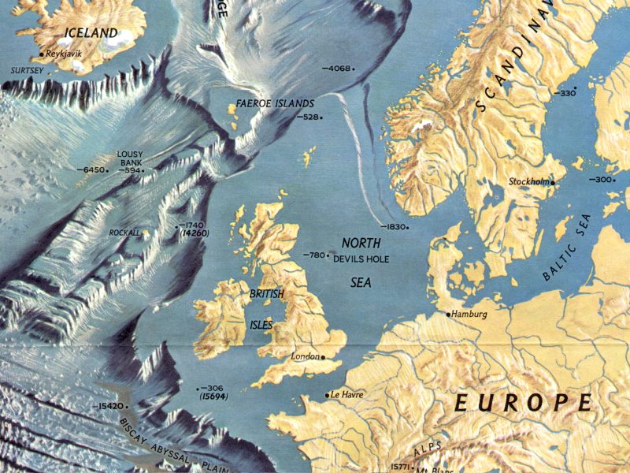
Continental Shelf

Slide 132
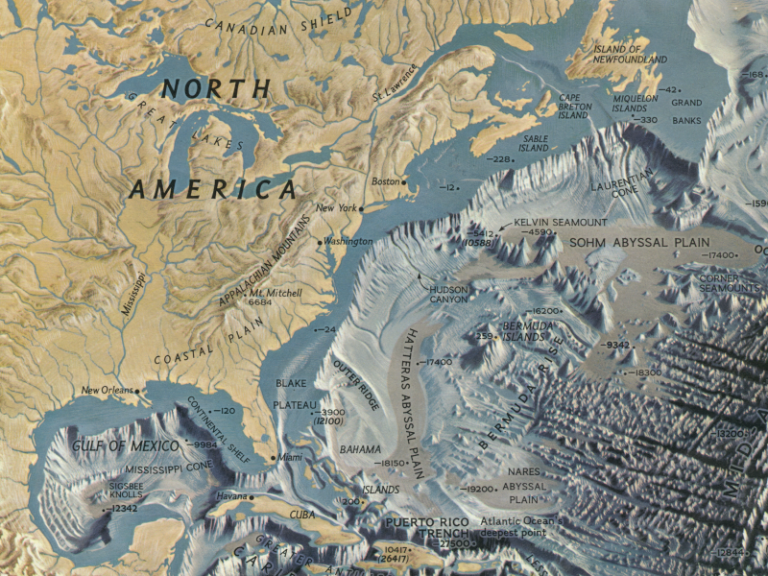
Continental Shelf

Slide 133
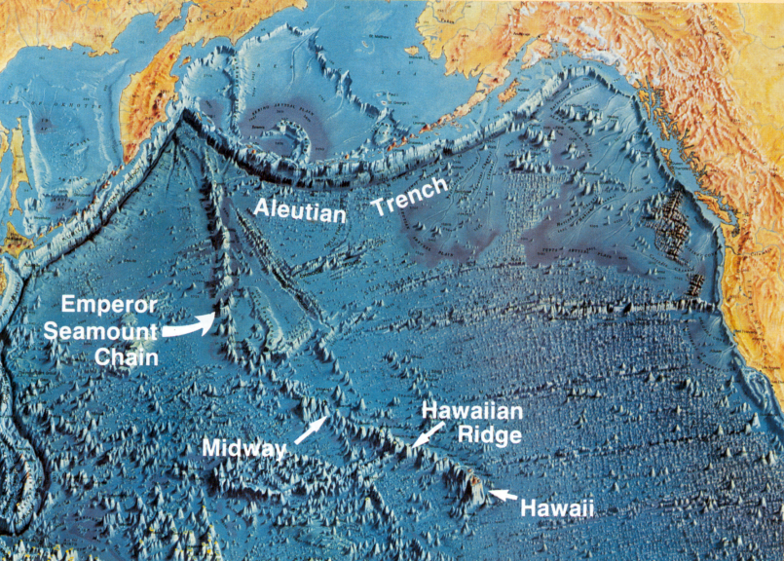
This Dynamic Earth the Story of Plate Tectonics US Geological Survey p. 52

Slide 134
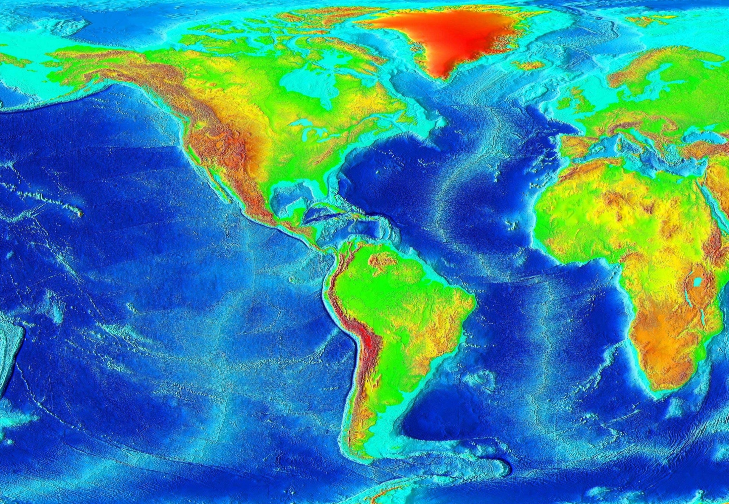
http://en.wikipedia.org/wiki/Continental_shelves

Slide 135
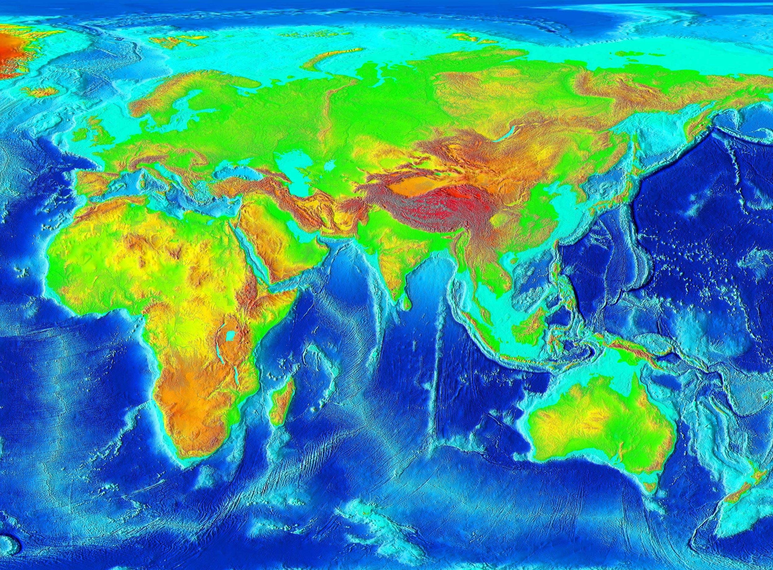
http://en.wikipedia.org/wiki/Continental_shelves

Slide 136
How Could Animals Have Gotten to Remote Places Around the World After the Flood?
Various other theories (besides the exposure of the continental shelves) have been suggested.
For example, comparisons can be made with more modern recolonizations by animals. The Encyclopædia Britannica has the following to say about Surtsey Island and Krakatoa and the multiplication of species:
Six months after the eruption of a volcano on the island of Surtsey off the coast of Iceland in 1963, the island had been colonized by a few bacteria, molds, insects, and birds. Within about a year of the eruption of a volcano on the island of Krakatoa in the tropical Pacific in 1883, a few grass species, insects, and vertebrates had taken hold. On both Surtsey and Krakatoa, only a few decades had elapsed before hundreds of species reached the islands. Not all species are able to take hold and become permanently established, but eventually the island communities stabilize into a dynamic equilibrium.¹
http://www.answersingenesis.org/articles/nab/how-did-animals-spread

Slide 137
How Could Animals Have Gotten to Remote Places Around the World After the Flood?
It’s no mystery, then, how non-flying animals may have travelled to distant parts of the world after the Flood:
Many of them could have floated on vast floating logs, leftovers from the massive pre-Flood forests that were ripped up during the Flood and likely remained afloat for many decades on the world’s oceans, transported by world currents.
Others could later have been taken by people.

Slide 138
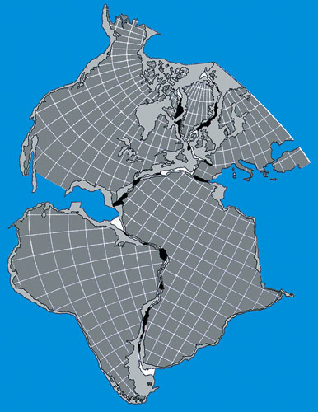
What About Continental Drift?

Slide 139
What About Continental Drift?
Before the 1960s, most evolutionary geologists were adamant that the continents were stationary.
A handful promoted the notion that the continents had moved (continental drift), but they were accused by the majority of indulging in pseudo-scientific fantasy.
Today, that opinion has reversed—plate tectonics, incorporating continental drift, is the ruling theory.
Interestingly, it was a creationist, Antonio Snider, who in 1859 first proposed horizontal movement of continents catastrophically during the Genesis flood.
http://www.answersingenesis.org/Home/Area/AnswersBook/continental11.asp

Slide 140
What About Continental Drift?
The Bible is silent about plate tectonics.
Some creationists believe the concept is helpful in explaining earth’s history. Other creationists disagree with the concept.
The idea is quite new and much work has yet to be done to flesh out the details.
Those who believe in the concept may end up making major modifications to the theory, or future discoveries could cause them to abandon the model altogether.
Such is the nature of scientific progress. Scientific models come and go, “But the word of the Lord endures forever” (1 Peter 1:25).
http://www.answersingenesis.org/Home/Area/AnswersBook/continental11.asp

Slide 141
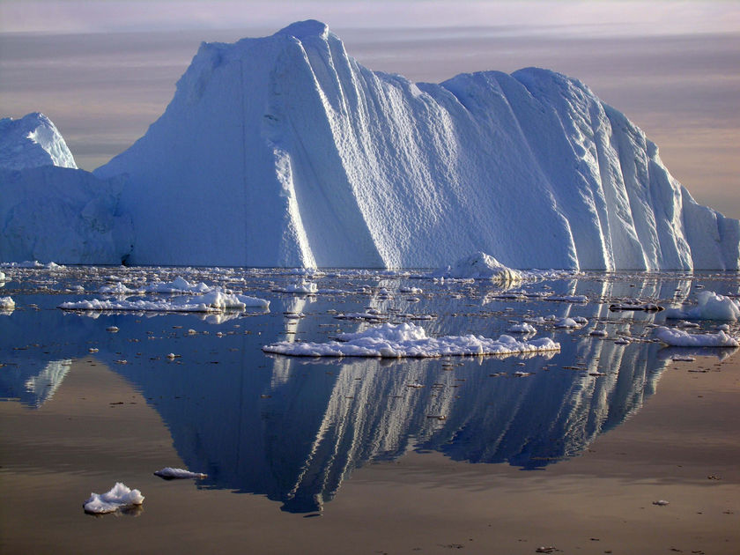
What About the Ice Age?
What role (if any) did the Flood play?
The information for this section was mostly taken from an article in Answers Magazine; Vol. 2 No. 2; “Setting the Stage for an Ice Age”; p. 59-61

Slide 142
What About the Ice Age?
Background
The Flood of Noah’s day was the greatest catastrophe in earth history, and it involved much more than rain.
As we have already seen, it reshaped the surface of the earth, with massive volcanoes and earthquakes that dwarf anything observed in modern times.
Such a tremendous catastrophe could have radically altered the earth’s climate, resulting in an Ice Age.
http://www.answersingenesis.org/articles/am/v2/n2/setting-stage-for-ice-age

Slide 143
What About the Ice Age?
Definitions
Ice Age: An ice age is defined as a time of extensive glacial activity in which a much greater portion of the earth’s land is covered by ice.

Slide 144
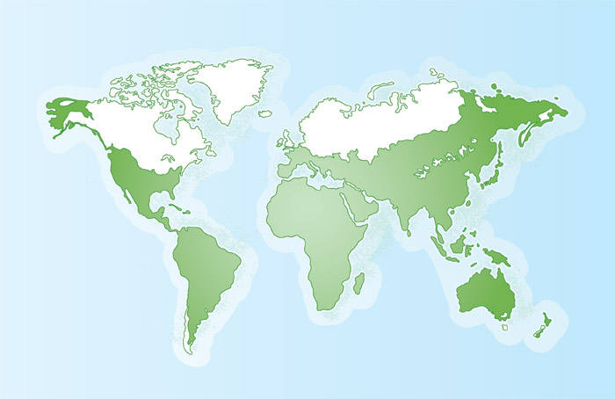
Extent of the Ice Age
During the Ice Age, nearly 30% of the land surface of the earth was covered by ice, which is identified in white. Today, only 10% of the earth’s surface is covered by ice.

Slide 145
What About the Ice Age?
Definitions
Glacier: a large mass of ice that has accumulated from snow over the years and is slowly moving from a higher place.
Moraines: stones, boulders, and debris that have been carried and dropped by a glacier.

Slide 146
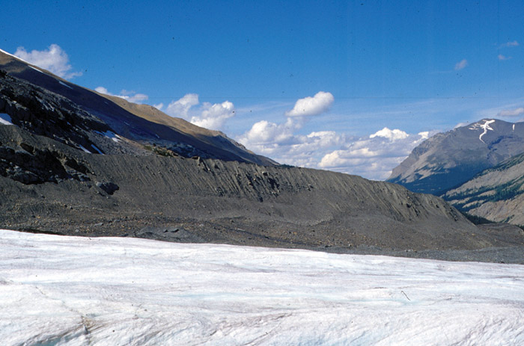
Evidence of an Ice Age
We know the extent of the Ice Age because the glaciers left features on the landscape similar to features we observe around glaciers today, such as the lateral moraine seen in the photo above.

Slide 147
What Causes an Ice Age?
Causes for an Ice Age
Scientists have collected mounds of evidence proving that ice once covered most of Canada and parts of the northern and central United States as well as other parts of the world.
But the truth is, evolutionary scientists still do not know the cause of the Ice Age as succinctly stated by David Alt: “Although theories abound, no one really knows what causes ice ages.”
http://www.answersingenesis.org/articles/fit/flood-caused-ice-age

Slide 148
What Causes an Ice Age?
Recipe for an Ice Age
Two things are thought to be required for there to be an Ice Age:
Cool Summers
Heavy Snow
http://www.answersingenesis.org/articles/fit/flood-caused-ice-age

Slide 149
What Causes an Ice Age?
The Flood-Caused Ice Age
Two particular aspects of the Flood could have been instrumental in causing the Ice Age:
Extensive Volcanic Activity (during and after the Flood)
Warm Oceans (following the Flood)

Slide 150
The Flood-Caused Ice Age
Extensive Volcanic Activity
As we have already seen, the flood was accompanied by a tremendous amount of volcanic activity.
This would have caused a shroud of volcanic dust and aerosols (very small particles) to be cast into the earth’s atmosphere and remain there for several years following the Flood.

Slide 151
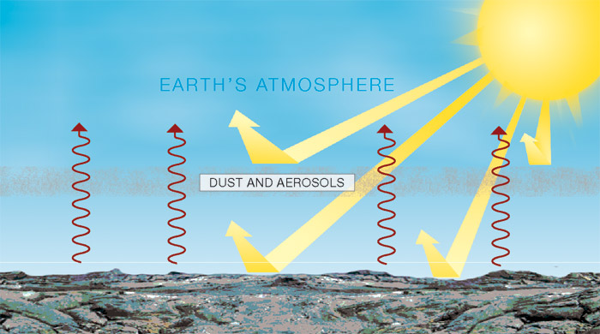
Flood-Caused Ice Age
These particles would have reflected some of the sunlight back to space and caused cooler summers.

Slide 152
The Flood-Caused Ice Age
Extensive Volcanic Activity
Extensive volcanic activity probably continued for a number of years after the Flood gradually declining as crustal magma solidified and crustal movements lessened.
This would have continued to push dust and aerosols into the atmosphere.
The fact that Ice cores taken from Greenland and Antarctica show abundant volcanic particles and acids in the sections associated with the Ice Age seems to confirm the idea that there was a great deal of volcanic activity during the Ice Age.

Slide 153
The Flood-Caused Ice Age
Warm Oceans
An Ice Age also requires huge amounts of water in the atmosphere, which then falls as snow.
But where would the tremendous amounts of water necessary to saturate the atmosphere have come from?

Slide 154
The Flood-Caused Ice Age
Warm Oceans
The Genesis account records that the “fountains of the great deep” burst forth during the Flood (Genesis 7:11).
Perhaps these “fountains” that “burst forth” were the result of movements in the earth’s crust that released high-pressure outflows of deep, hot water reservoirs
Both massive volcanic activity and large underwater lava flows that occurred during the flood probably added heat to the oceans.

Slide 155
The Flood-Caused Ice Age
Warm Oceans
If there were rapid currents during the Flood, it would have mixed the warm water, driving it from pole to pole.
As a result, the warm ocean would have a much higher level of evaporation than now occurs in the modern cool ocean.
Warm water and cooler continents (resulting from volcanic dust) are a recipe for the powerful and continuous snowstorms needed for an Ice Age to occur.
Warm water would also have prevented the formation of ice in the sea.

Slide 156
How Long Was the Ice Age?
The Rapid Ice Age
Evolutionary Ice Age views say that there were about 30 separate ice ages over the past 2.5 million years, with the most recent ones lasting 100,000 years and the earlier ones lasting 40,000 years.
Michael Oard, a retired meteorologist from the National Weather Service with Answers in Genesis, believes that by starting with the Bible’s history of the Flood and then looking at the evidence from this biblical perspective, we can better understand both how the Ice Age started and how it could have taken place in a much shorter period of time.

Slide 157
How Long Was the Ice Age?
The Rapid Ice Age
Oard estimates that the Ice Age caused by the Flood lasted for a total of about 700 years (500 years to accumulate, 200 years to melt).
Oard believes that based on what we know about the impact of the global Flood on the continents, sediments, and climate, an ice age would not require hundreds of thousands to millions of years, as taught by the evolutionary views.

