Slide 1
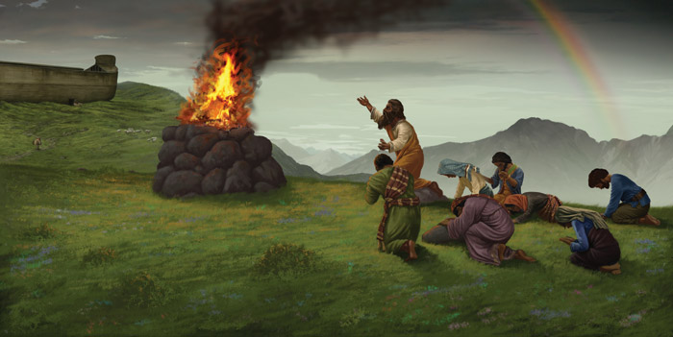
After the Flood

Slide 2
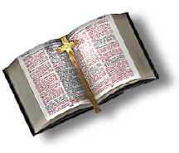
God’s Instructions to Noah (Genesis 8:15-9:7)
¹⁵ Then God said to Noah, ¹⁶ “Go out from the ark, you and your wife, and your sons and your sons' wives with you. ¹⁷ Bring out with you every living thing that is with you of all flesh-- birds and animals and every creeping thing that creeps on the earth-- that they may swarm on the earth, and be fruitful and multiply on the earth.” ¹⁸ So Noah went out, and his sons and his wife and his sons' wives with him. ¹⁹ Every beast, every creeping thing, and every bird, everything that moves on the earth, went out by families from the ark.

Slide 3
God’s Instructions to Noah (Genesis 8:15-9:7)
²⁰ Then Noah built an altar to the LORD and took some of every clean animal and some of every clean bird and offered burnt offerings on the altar. ²¹ And when the LORD smelled the pleasing aroma, the LORD said in his heart, "I will never again curse the ground because of man, for the intention of man's heart is evil from his youth. Neither will I ever again strike down every living creature as I have done. ²² While the earth remains, seedtime and harvest, cold and heat, summer and winter, day and night, shall not cease.”

Slide 4
God’s Instructions to Noah (Genesis 8:15-9:7)
And God blessed Noah and his sons and said to them, "Be fruitful and multiply and fill the earth. ² The fear of you and the dread of you shall be upon every beast of the earth and upon every bird of the heavens, upon everything that creeps on the ground and all the fish of the sea. Into your hand they are delivered. ³ Every moving thing that lives shall be food for you. And as I gave you the green plants, I give you everything. ⁴ But you shall not eat flesh with its life, that is, its blood.

Slide 5
God’s Instructions to Noah (Genesis 8:15-9:7)
⁵ And for your lifeblood I will require a reckoning: from every beast I will require it and from man. From his fellow man I will require a reckoning for the life of man. ⁶ "Whoever sheds the blood of man, by man shall his blood be shed, for God made man in his own image. ⁷ And you, be fruitful and multiply, increase greatly on the earth and multiply in it.

Slide 6
God Makes a Covenant With Noah and All Living Creatures (Genesis 9:8-17)
⁸ Then God said to Noah and to his sons with him, ⁹ "Behold, I establish my covenant with you and your offspring after you, ¹⁰ and with every living creature that is with you, the birds, the livestock, and every beast of the earth with you, as many as came out of the ark; it is for every beast of the earth. ¹¹ I establish my covenant with you, that never again shall all flesh be cut off by the waters of the flood, and never again shall there be a flood to destroy the earth.” ¹² And God said, "This is the sign of the covenant that I make between me and you and every living creature that is with you, for all future generations: ¹³ I have set my bow in the cloud, and it shall be a sign of the covenant between me and the earth.

Slide 7
Genesis 9:18-29 – The Sons of Noah
¹⁸ The sons of Noah who went forth from the ark were Shem, Ham, and Japheth. (Ham was the father of Canaan.) ¹⁹ These three were the sons of Noah, and from these the people of the whole earth were dispersed. ²⁰ Noah began to be a man of the soil, and he planted a vineyard. ²¹ He drank of the wine and became drunk and lay uncovered in his tent. ²² And Ham, the father of Canaan, saw the nakedness of his father and told his two brothers outside. ²³ Then Shem and Japheth took a garment, laid it on both their shoulders, and walked backward and covered the nakedness of their father. Their faces were turned backward, and they did not see their father's nakedness.

Slide 8
Genesis 9:18-29 – The Sons of Noah (continued)
²⁴ When Noah awoke from his wine and knew what his youngest son had done to him, ²⁵ he said, "Cursed be Canaan; a servant of servants shall he be to his brothers." ²⁶ He also said, "Blessed be the LORD, the God of Shem; and let Canaan be his servant. ²⁷ May God enlarge Japheth, and let him dwell in the tents of Shem, and let Canaan be his servant." ²⁸ After the flood Noah lived 350 years. ²⁹ All the days of Noah were 950 years, and he died.

Slide 9
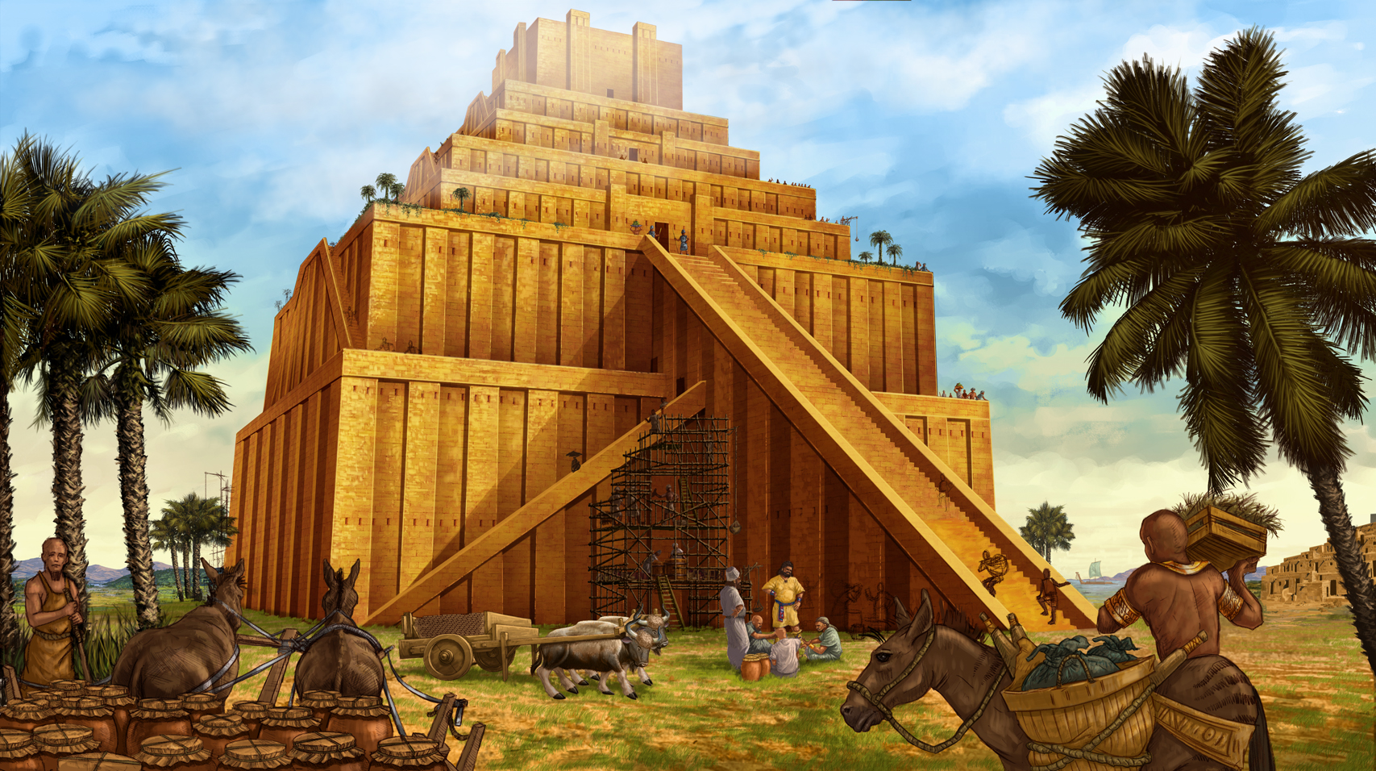
The Table of Nations And The Tower of Babel
Genesis 10-11

Slide 10
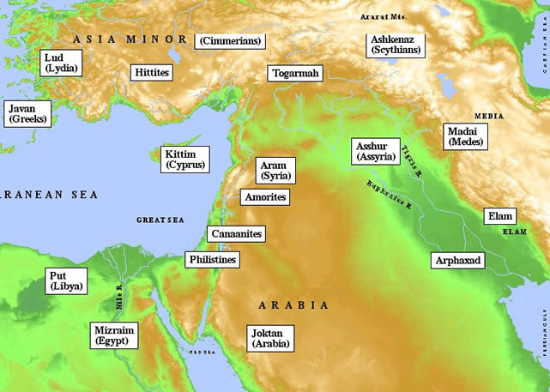
The Table of Nations
Genesis 10:1-34

Slide 11
The Table of Nations*
Even the liberals have often admitted that the tenth chapter of Genesis is a remarkably accurate historical document. It is unparalleled in its antiquity and comprehensiveness.
Genesis 10, or the “Table of Nations” as it is often called, is the one link between the historic nations of antiquity and the prehistoric times of Noah and those who lived before the flood.
The grandsons and great-grandsons of Noah are listed, each of whom is identified with the city or country established by his descendants.
*Much of the information in this section was gleaned from The Genesis Record by Henry Morris

Slide 12
Genesis 10:1-5 – The Sons of Jepheth
¹ These are the generations of the sons of Noah, Shem, Ham, and Japheth. Sons were born to them after the flood. ² The sons of Japheth: Gomer, Magog, Madai, Javan, Tubal, Meshech, and Tiras. ³ The sons of Gomer: Ashkenaz, Riphath, and Togarmah. ⁴ The sons of Javan: Elishah, Tarshish, Kittim, and Dodanim. ⁵ From these the coastland peoples spread in their lands, each with his own language, by their clans, in their nations.

Slide 13
The Sons of Japheth
There is enough clear identification to recognize that the descendants of Japheth spread all over Europe with one major branch heading eastward into Persia and India.
Gomer is identified by Herodotus, Plutarch and other ancient writers with the district of Cimmeria, north of the Black Sea, a name surviving in the present form of Crimea.
The Jews identified Gomer’s son Ashkenaz with Germany and, to this day, German Jews are called Ashkenazi.
Magog along with Meshecj and Tubal (Ezek 38:2) are thought to be the ancestors of the modern Russian peoples

Slide 14
The Sons of Japheth
Madai according to all authorities is the ancestor of the Medes. They settled in what is now Persia
Javan is the original form of Ionia, known to us as Greece.
The Iliad mentions the Eilesian people, the descendants of Javan’s son Elishah.
It is possible that the early descendants of Tarshish may have been the early settlers of Spain and North Africa.
Kittim is almost certainly a reference to Cyprus and possibly to the Greek mainland.
The descendants of Japheth were in general of an intellectual and philosophical turn of mind. This fact later made Europe the center of development of philosophy and science.

Slide 15
Genesis 10:6-20 – The Sons of Ham
⁶ The sons of Ham: Cush, Egypt, Put, and Canaan. ⁷ The sons of Cush: Seba, Havilah, Sabtah, Raamah, and Sabteca. The sons of Raamah: Sheba and Dedan. ⁸ Cush fathered Nimrod; he was the first on earth to be a mighty man. ⁹ He was a mighty hunter before the LORD. Therefore it is said, "Like Nimrod a mighty hunter before the LORD." ¹⁰ The beginning of his kingdom was Babel, Erech, Accad, and Calneh, in the land of Shinar. ¹¹ From that land he went into Assyria and built Nineveh, Rehoboth-Ir, Calah, and ¹² Resen between Nineveh and Calah; that is the great city.

Slide 16
Genesis 10:6-20 – The Sons of Ham (Continued)
⁶ The sons of Ham: Cush, Egypt, Put, and Canaan…¹³ Egypt fathered Ludim, Anamim, Lehabim, Naphtuhim, ¹⁴ Pathrusim, Casluhim (from whom the Philistines came), and Caphtorim. ¹⁵ Canaan fathered Sidon his firstborn and Heth, ¹⁶ and the Jebusites, the Amorites, the Girgashites, ¹⁷ the Hivites, the Arkites, the Sinites, ¹⁸ the Arvadites, the Zemarites, and the Hamathites. Afterward the clans of the Canaanites dispersed. ¹⁹ And the territory of the Canaanites extended from Sidon in the direction of Gerar as far as Gaza, and in the direction of Sodom, Gomorrah, Admah, and Zeboiim, as far as Lasha. ²⁰ These are the sons of Ham, by their clans, their languages, their lands, and their nations.

Slide 17
The Sons of Ham
Ham’s son Cush is the same in the Bible as Ethiopia.
Mizraim is the ancestor of the Egyptians. Egypt is also called the “land of Ham” (Psalm 105:23)
Put, in the Bible, is the same as Libya, applied to th region of North Africa west of Egypt. This identification was confirmed by Josephus.
Canaan is, of course, the ancestor of the Canaanites.
Canaan’s son Heth is undoubtedly the ancestor of the Hittites (Gen 23:10)

Slide 18
Genesis 10:21-32 – The Sons of Shem
²¹ To Shem also, the father of all the children of Eber, the elder brother of Japheth, children were born. ²² The sons of Shem: Elam, Asshur, Arpachshad, Lud, and Aram. ²³ The sons of Aram: Uz, Hul, Gether, and Mash. ²⁴ Arpachshad fathered Shelah; and Shelah fathered Eber. ²⁵ To Eber were born two sons: the name of the one was Peleg, for in his days the earth was divided, and his brother's name was Joktan. ²⁶ Joktan fathered Almodad, Sheleph, Hazarmaveth, Jerah, ²⁷ Hadoram, Uzal, Diklah, ²⁸ Obal, Abimael, Sheba, ²⁹ Ophir, Havilah, and Jobab; all these were the sons of Joktan. ³⁰ The territory in which they lived extended from Mesha in the direction of Sephar to the hill country of the east. ³¹ These are the sons of Shem, by their clans, their languages, their lands, and their nations. ³² These are the clans of the sons of Noah, according to their genealogies, in their nations, and from these the nations spread abroad on the earth after the flood.

Slide 19
The Sons of Shem
Shem is identified as “the father of all the children of Eber”. It is from “Eber” that the term “Hebrew” has apparently been derived. The term obviously is applied in these early scriptures to a much larger group of peoples than to only the descendants of Abraham.
Elam is the ancestor of the Elamites, well known in both scripture and ancient monuments.The Elamites apparently later merged with others, especially the Medes to form the Persian empire.
Asshur was evidently the founder of the Assyrians. However as Gen 10:11 records, Nimrod and his followers later invaded the land of Asshur and there founded Ninevah (later to become the capital). Consequently the Assyrian people were a mixture of both Semitic racial stock and Hamitic culture, language, and religion.

Slide 20
The Sons of Shem
Lud was the ancestor of the Lydians in Asia Minor according to Josephus.
Aram is the father of the Arameans, same as the Syrians. These people became a great nation and are the ones who developed the Aramaic language, adopted as a common language for the leading nations of the ancient world including Assyria and Babylonia. Some of the Old Testament (portions of Daniel and Ezra) were originally written in Aramaic, and it was a common spoken language among the Jews at the time of Christ.
Uz evidently gave his name to a region of Arabia which was later Job’s homeland (Job 1:1)

Slide 21
The Sons of Shem
The most important son of Shem was Arphaxad, since he was in the line of the promised Seed.
He is the father of the Selah who is the father of Eber.
Eber named his son Peleg (meaning “division”) because “in his days the earth was divided” apparently a reference to the dividing of languages at the tower of Babel.
One remarkable feature of the Table of Nations is that there are exactly seventy families of the sons of Noah mentioned by name. There may well have been others, but for some reason only seventy are listed.

Slide 22
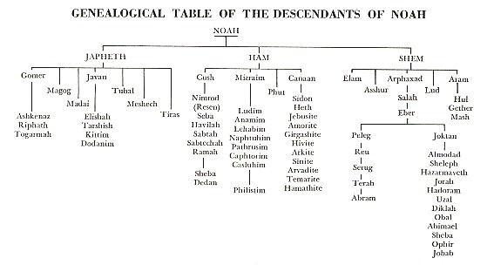

Slide 23
Table of Nations – Genesis 10:1-32
http://www.austingrad.edu/images/Resources/Shipp/Maps/TableofNations.jpg

Slide 24
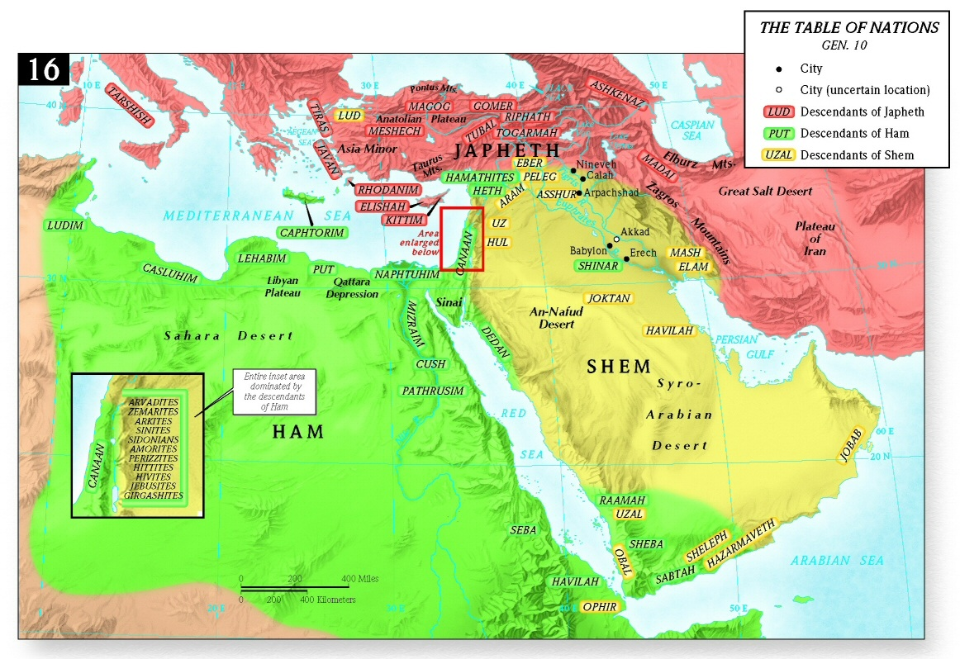
Table of Nations – Genesis 10:1-32
Geographic locations of the table of nations (Logos Bible Software - Holman Bible Atlas)

Slide 25
The Tower of Babel
Genesis 11:1-9

Slide 26
Genesis 11:1-9 – The Tower of Babel
¹ Now the whole earth had one language and the same words. ² And as people migrated from the east, they found a plain in the land of Shinar and settled there. ³ And they said to one another, "Come, let us make bricks, and burn them thoroughly." And they had brick for stone, and bitumen for mortar. ⁴ Then they said, "Come, let us build ourselves a city and a tower with its top in the heavens, and let us make a name for ourselves, lest we be dispersed over the face of the whole earth." ⁵ And the LORD came down to see the city and the tower, which the children of man had built.

Slide 27
Genesis 11:1-9 – The Tower of Babel (Continued)
⁶ And the LORD said, “Behold, they are one people, and they have all one language, and this is only the beginning of what they will do. And nothing that they propose to do will now be impossible for them. ⁷ Come, let us go down and there confuse their language, so that they may not understand one another's speech.” ⁸ So the LORD dispersed them from there over the face of all the earth, and they left off building the city. ⁹ Therefore its name was called Babel, because there the LORD confused the language of all the earth. And from there the LORD dispersed them over the face of all the earth.

Slide 28
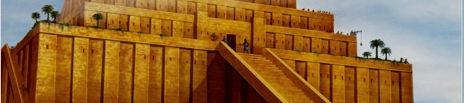
Tongue Twisting Tales
http://www.answersingenesis.org/articles/am/v3/n2/tongue-twisting-tales

Slide 29
Tongue Twisting Tales
As we have seen, there are many stories about a global Flood and a surviving family are worldwide.
While not as common, there are also many stories about a time when there was only one language and how God divided them.
http://www.answersingenesis.org/articles/am/v3/n2/tongue-twisting-tales

Slide 30
Central America
An Aztec legend claimed:
“Humanity was wiped out by a flood, but one man Coxcoxtli and one woman Xochiquetzal escaped in a boat, and reached a mountain called Colhuacan.
They had many children, who were dumb until the time when a dove on top of a tree made them the gift of languages; but these differed so much that the children could not understand each other.”
http://www.answersingenesis.org/articles/am/v3/n2/tongue-twisting-tales

Slide 31
Guatemala
The Quiches (Mayan Indians) of Guatemala told of a time when the tribes multiplied and left their old home to a place called Tulan.
Here the language changed, and the people sought new homes in various parts of the world as a result of not being able to understand each other.
http://www.answersingenesis.org/articles/am/v3/n2/tongue-twisting-tales

Slide 32
Africa
A legend of the Wa-Sania tribe in East Africa says
“that of old all the tribes of the earth knew only one language, but that during a severe famine the people went mad and wandered in all directions, jabbering strange words, and so the different languages arose.”
http://www.answersingenesis.org/articles/am/v3/n2/tongue-twisting-tales

Slide 33
India
The Mikir tribe in northeastern India tells of the descendants of Ram who were strong men and were growing dissatisfied with earth and aspired to conquer heaven. They began to build a tower.
“Higher and higher rose the building, till at last the gods and demons feared lest these giants should become the masters of heaven, as they already were of earth.
So they confounded their speech, and scattered them to the four corners of the world. Hence arose all the various tongues of mankind.”
http://www.answersingenesis.org/articles/am/v3/n2/tongue-twisting-tales

Slide 34
Europe
The Greeks had a legend that
“for many ages men lived at peace, without cities and without laws, speaking one language, and ruled by Zeus alone. . . . At last Hermes introduced diversities of speech and divided mankind into separate nations.”
http://www.answersingenesis.org/articles/am/v3/n2/tongue-twisting-tales

Slide 35
Polynesia
Polynesians on the island of Hao said that Rata and his three sons survived a great flood. Then
“they made an attempt to erect a building by which they could reach the sky, and see the creator god Vatea; but the god in anger chased the builders away, broke down the building, and changed their language, so that they spoke diverse tongues.”
http://www.answersingenesis.org/articles/am/v3/n2/tongue-twisting-tales

Slide 36
Middle East
Sumerians believed that all people spoke one language, as claimed in the poem “Enmerkar and the Lord of Aratta”:
In those days … the people [were] in unison, …
Enki, the Lord of abundance, … changed the speech in their mouths, and [brought] contention into the speech of man that [until then] had been one.
http://www.answersingenesis.org/articles/am/v3/n2/tongue-twisting-tales

Slide 37
Southeast Asia
A legend of the Gaikho tribe of Burma (Myanmar) says,
“In the days of Pan-dan-man, the people determined to build a pagoda that should reach up to heaven. . . .
When the pagoda was half way up to heaven, God came down and confounded the language of the people, so that they could not understand each other.
Then the people scattered, and Than-mau-rai, the father of the Gaikho tribe, came west, with eight chiefs, and settled in the valley of the Sitang.”
http://www.answersingenesis.org/articles/am/v3/n2/tongue-twisting-tales

Slide 38
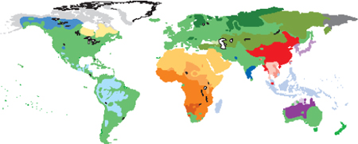
Origin of World Languages
http://www.answersingenesis.org/articles/am/v3/n2/more-than-pie

Slide 39
Origin of World Languages
About 6,912 distinct languages exist in the world today.
The Bible says God confounded the language at Babel to separate the people and stop their advance into the heavens.
Secular theories argue that all language differences are a result of differences in language that naturally occur when people are separated.
So which story fits the facts? The miracle of Babel or gradual change? How did we get all these languages?
http://www.answersingenesis.org/articles/am/v3/n2/more-than-pie

Slide 40
Origin of World Languages
Languages do tend to change over time:
The English of Beowulf’s time—between AD 680 and 800—is unintelligible to speakers of modern English
Modern English is dated roughly from Shakespeare (1564–1616) and the King James Bible (1611). If we met Shakespeare today, we would understand him, but not folks from Beowulf’s time.
http://www.answersingenesis.org/articles/am/v3/n2/more-than-pie

Slide 41
Origin of World Languages
By studying existing languages we can often determine their recent origin.
For example, with the help of written records, we know that French and Spanish (also, Italian, Portuguese, and Romanian) come from Latin.
Based on similarities as simple as the numbers un–uno, deux–dos, and trois–tres, we can see evidence of a common source language.
But Chinese numbers do not resemble French, Spanish, or English at all. The first three numbers in Chinese are yıˉ, èr, saˉn.
http://www.answersingenesis.org/articles/am/v3/n2/more-than-pie

Slide 42
Origin of World Languages
From evidences like this, linguists can infer family relations between languages, and can partially reconstruct “protolanguages” and theoretical family trees of languages that show where modern languages come from.
One of the most widely studied language groups in the world is a group made up of about 449 distinct languages known to linguists as the Indo-European language family.
http://www.answersingenesis.org/articles/am/v3/n2/more-than-pie

Slide 43
Origin of World Languages
Approximately 45 percent of the people in the world today speak one of the languages in this group. It includes Greek, Latin, Spanish, French, German, English, and Russian.
All these languages are thought to have come from a single source commonly known as Proto-Indo-European (PIE).
Based on the scant historical evidence, secular linguists believe PIE was spoken in Europe sometime between the third and seventh millennium BC, give or take a couple thousand years.
http://www.answersingenesis.org/articles/am/v3/n2/more-than-pie

Slide 44
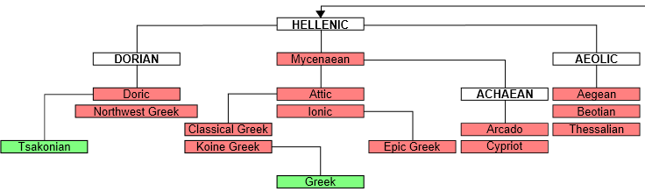
Indo-European Languages
http://en.wikipedia.org/wiki/Proto-Indo-European_language

Slide 45
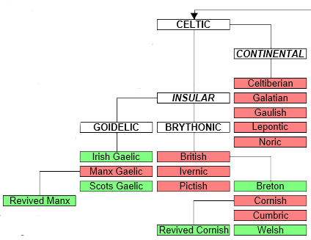
Indo-European Languages

Slide 46
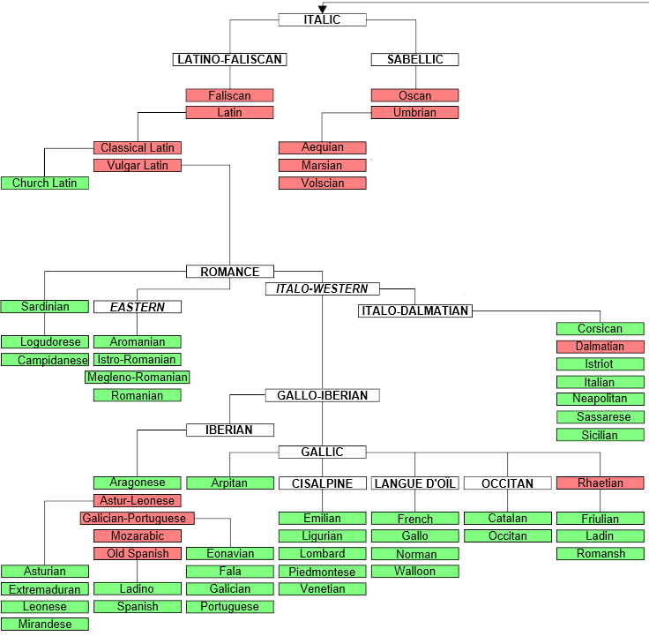
Indo-European Languages

Slide 47
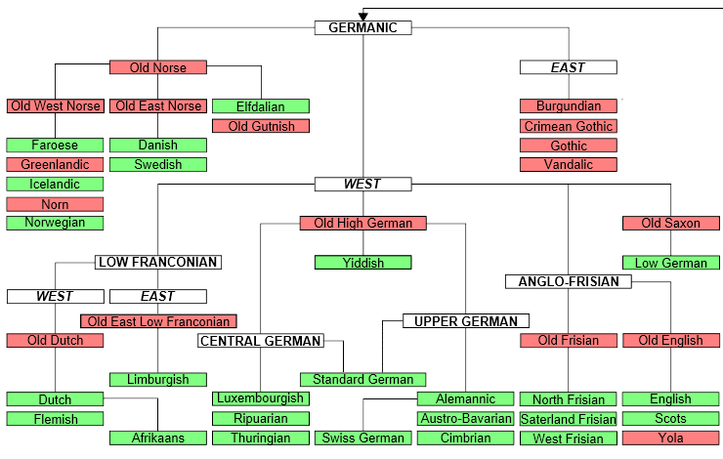
Indo-European Languages

Slide 48
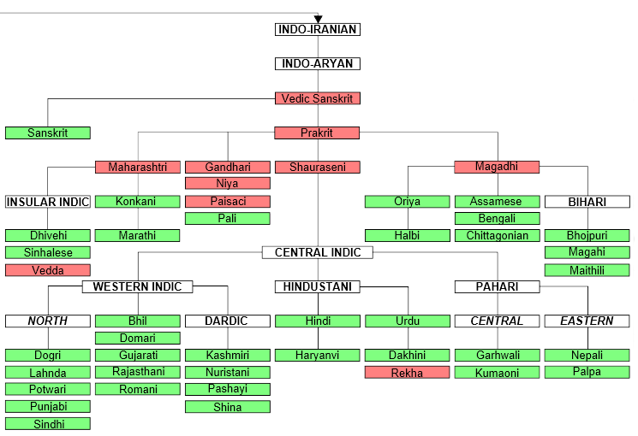
Indo-European Languages

Slide 49
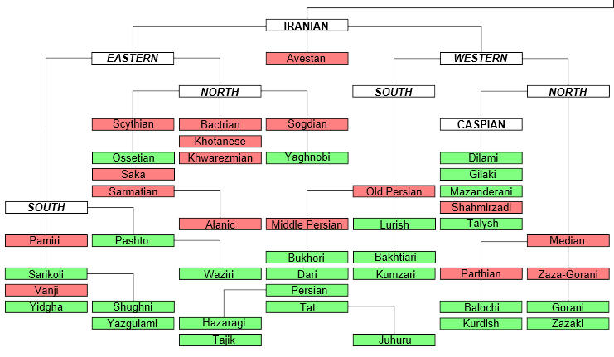
Indo-European Languages

Slide 50
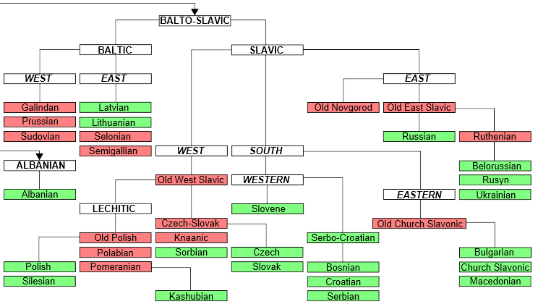
Indo-European Languages

Slide 51
Origin of World Languages
The next most widely spoken language family is the Sino-Tibetan group, which includes Chinese.
It is estimated to have about 403 distinct languages and accounts for about 22 percent of the world’s population.
That language family, too, is believed to have come from a common source, but different from Proto-Indo-European (PIE).
Neither of these distinct source languages, however, can reasonably be dated earlier than the miracle at Babel.
http://www.answersingenesis.org/articles/am/v3/n2/more-than-pie

Slide 52
Origin of World Languages
Besides these two families, 92 other distinct language families are thought to exist.
There are two secular theories given to explain the world’s diverse languages:
All these language groups (and their derived languages) came from a single original language,
Or the language capacity must have evolved and expressed itself multiple times.
Both ideas have been advocated by secular linguists, but neither idea makes much sense.
http://www.answersingenesis.org/articles/am/v3/n2/more-than-pie

Slide 53
Origin of World Languages
The idea that something as complex as human language could arise by chance even once defies all common sense.
The idea that the language capacity could come about by chance more than once is simply unbelievable.
Furthermore, no one has shown how language families as different as Proto-Indo-European and Proto-Sino-Tibetan could derive from a common source.
The vast differences in the various language groups cannot be convincingly explained by mere change of languages over time.
http://www.answersingenesis.org/articles/am/v3/n2/more-than-pie

Slide 54
Origin of World Languages
On the other hand, the account given in scripture of the tower of Babel fits very nicely with the evidence that we see in the languages of the world today.
Because God’s purpose at Babel was to confuse men’s ability to understand one another, we would expect that the languages created at Babel to be radically distinct from each other.
http://www.answersingenesis.org/articles/am/v3/n2/more-than-pie

Slide 55
Origin of World Languages
Furthermore, when we study the rate of change in language that has occurred in known language subgroups—notably those based on Latin, Sanskrit, Greek, and the Germanic and Slavic languages—we can see that all the languages in the world today could easily have been produced within the space of about 4,000 years that have passed since the tower of Babel.
http://www.answersingenesis.org/articles/am/v3/n2/more-than-pie

Slide 56
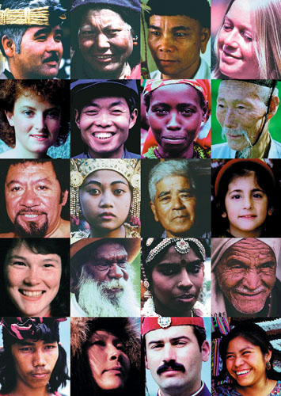
How Did the Different Races of Men Arise From Noah and His Family?

Slide 57
How Did the Different Races of Men Arise From Noah and His Family?
Japan
Tibet
Borneo
Holland
Visualize those pictured on the right without the variations in dress, hair style, age, and skin color. How different are we? People continents apart laugh alike and cry alike. Our differences are small; the ways we are the same are great.
(Walt Brown, In the Beginning, p.271)
Ireland
China
Rwanda
Korea
New Zealand
Bali
Okinawa
Israel
United States
Australia
India
Egypt
Molucca Islands
Canada
Greece
Guatemala

Slide 58
How Did the Different Races of Men Arise From Noah and His Family?
According to the Bible, all humans on earth today are descended from Noah and his wife, his three sons and their wives and before that from Adam and Eve.
Acts 17:26 - And he made from one man every nation of mankind to live on all the face of the earth, having determined allotted periods and the boundaries of their dwelling place

Slide 59
How Did the Different Races of Men Arise From Noah and His Family?
The Bible does not speak of races per se; it speaks instead of tribes, people groups, languages and nations.
Revelation 5:9b - … and by your blood you ransomed people for God from every tribe and language and people and nation
Revelation 13:7 - And authority was given it over every tribe and people and language and nation
Therefore, in one sense, there is really only one race: the human race!
Clearly, though, there are groups of people who have certain features (e.g., skin color) in common, which distinguish them from other groups.
http://www.answersingenesis.org/home/area/answersbook/races18.asp

Slide 60
How Did the Different Races of Men Arise From Noah and His Family?
We have seen in our study of Genesis how the population that descended from Noah’s family had one language and by living in one place were disobeying God’s command to “fill the earth” (Genesis 9:1, 11:4).
God confused their language, causing a break-up of the population into smaller groups which scattered over the earth (Genesis 11:8-9).
Modern genetics show how, following such a break-up of a population, variations in skin color, for example, between the dispersed groups can develop in only a few generations.
http://www.answersingenesis.org/home/area/answersbook/races18.asp

Slide 61
How Did the Different Races of Men Arise From Noah and His Family?
We all have the same coloring pigment in our skin—melanin.
Melanin is a dark-brownish pigment that is produced in different amounts in special cells in our skin.
Those who have none (like albinos, who inherit a mutation-caused defect, and cannot produce melanin), have a very white or pink skin coloring.
Those with relatively little melanin are European white.
Those with significantly large amounts of melanin, are black.
And in between, of course, are various shades of brown.
http://www.answersingenesis.org/home/area/answersbook/races18.asp

Slide 62
How Did the Different Races of Men Arise From Noah and His Family?
How is it that many different skin colors can arise in a short time?
Remember, whenever we speak of different ‘colors’ we are referring to different shades of the one color, melanin.
If a person from a very black people group marries someone from a very white group, their offspring, known as “mulattos”, tend to be mid-brown.
It has long been known that when mulattos marry each other, their offspring may be virtually any ‘color,’ ranging from very dark to very light.
Understanding this gives us the clues we need to answer our question, but first we must look, in a simple way, at some of the basic principles of heredity.
http://www.answersingenesis.org/home/area/answersbook/races18.asp

Slide 63

How Did the Different Races of Men Arise From Noah and His Family?
A Look at What We Know Today About Genetics Using Eye Color as an Example:
Example #1:
Father
(Brown Eyes)
Mother
(Brown Eyes)
BB
BB
Only B is possible
for sperm
Only B is possible
for egg
Child
(Brown Eyes)
BB

Slide 64

How Did the Different Races of Men Arise From Noah and His Family?
A Look at What We Know Today About Genetics Using Eye Color as an Example:
Example #2:
Father
(Blue Eyes)
Mother
(Blue Eyes)
bb
bb
Only b is possible
for sperm
Only b is possible
for egg
Child
(Blue Eyes)
bb

Slide 65
How Did the Different Races of Men Arise From Noah and His Family?
A Look at What We Know Today About Genetics Using Eye Color as an Example:
Example #3:
Father
(Blue Eyes)
Mother
(Brown Eyes)
bb
BB
Only b is possible
for sperm
Only B is possible
for egg
Child
(Brown Eyes)
bB

Slide 66

How Did the Different Races of Men Arise From Noah and His Family?
A Look at What We Know Today About Genetics Using Eye Color as an Example:
Example #4:
Father
(Brown Eyes)
Mother
(Brown Eyes)
Bb
Bb
B or b is possible
for sperm
B or b is possible
for egg
Child
(Blue Eyes)
(Brown Eyes)
(Brown Eyes)
BB
bb
bB

Slide 67
How Did the Different Races of Men Arise From Noah and His Family?
We know that skin color is governed by more than one pair of genes.
For simplicity, let’s assume there are only two, located at positions A and B on the chromosomes.
One form of the gene, ‘M’, tells the body to make lots of melanin;
Another form of the gene, ‘m,’ says to only make a little melanin.
The number of ‘M’ versus ‘m’ forms of the gene that exist at each position would determine the skin color of the individual.
http://www.answersingenesis.org/home/area/answersbook/races18.asp

Slide 68
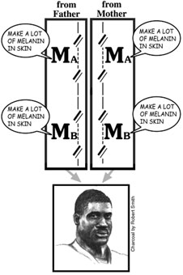
A ‘black’ gene combination
http://www.answersingenesis.org/home/area/answersbook/races18.asp

Slide 69
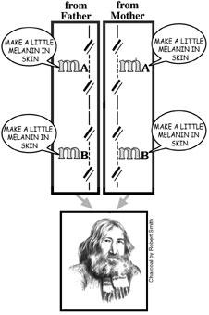
A ‘white’ gene combination
http://www.answersingenesis.org/home/area/answersbook/races18.asp

Slide 70
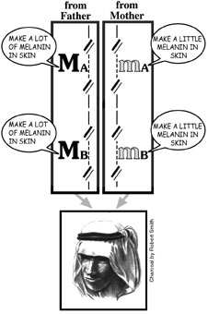
A ‘brown’ gene combination
http://www.answersingenesis.org/home/area/answersbook/races18.asp

Slide 71
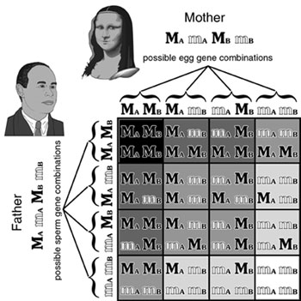
‘Punnet square’ showing the possible offspring from ‘mulatto’ brown parents.
http://www.answersingenesis.org/home/area/answersbook/races18.asp

Slide 72
Example of a Family With Mixed Skin Color

Slide 73
Example of a Family With Mixed Skin Color

Slide 74
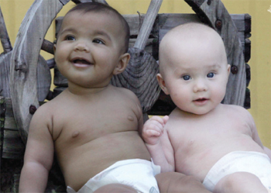
Example of a Family With Mixed Skin Color
The Singerl twins (above - born May 2006 in Australia) are just one example where one twin is very dark and the other is very light. This is a vivid reminder that we are all one race.
http://www.answersingenesis.org/articles/am/v3/n2/twins-black-and-white

Slide 75
How Did the Different Races of Men Arise From Noah and His Family?
Noah and his family were probably mid-brown, with genes for both dark and light skin.
Likewise, as all the factors for skin color were present in Adam and Eve, they would most likely have been mid-brown.
In fact, most of the world’s population today is still mid-brown.
http://www.answersingenesis.org/home/area/answersbook/races18.asp

Slide 76
How Did the Different Races of Men Arise From Noah and His Family?
After the Flood, for the century or so until the tower of Babel incident, there was only one language and one culture group.
Assuming there were no barriers to marriage within this group, this would tend to keep the skin color of the general population away from the extremes.
To produce a change in skin color, you would need to break the larger population of humans into smaller groups and keep them separate, that is, prevent interbreeding between groups.
http://www.answersingenesis.org/home/area/answersbook/races18.asp

Slide 77
How Did the Different Races of Men Arise From Noah and His Family?
This is exactly what happened at Babel. Once separate languages were imposed, there were instantaneous barriers. Entire groups which spoke the same language suddenly had difficulty relating to and trusting those who spoke a different language.
Thus, they moved away from each other into different environments. This, of course, is what God intended.
http://www.answersingenesis.org/home/area/answersbook/races18.asp

Slide 78
How Did the Different Races of Men Arise From Noah and His Family?
It is unlikely that each small group would carry the same broad range of skin colors as the original, larger group.
One group might have more dark genes, on average, while another might have more light genes.
The same thing would occur with other characteristics as well: nose shape, eye shape, etc.
And since they would intermarry only within their own language group, these differences would no longer be averaged out as much as before.
http://www.answersingenesis.org/home/area/answersbook/races18.asp

Slide 79
How Did the Different Races of Men Arise From Noah and His Family?
So, by isolating groups of peoples with certain genetic characteristics, the dispersion of the human race at Babel, would have contributed to the development of people groups with distinct characteristics - some of which we consider to be “racial” characteristics.
http://www.answersingenesis.org/home/area/answersbook/races18.asp

Slide 80
How Did the Different Races of Men Arise From Noah and His Family?
One additional factor that probably led to the development of particular characteristics within the dispersed people groups after Babel is natural selection.
For example, because of the protective factor of melanin, those with darker skin would have been more likely to survive in areas where sunlight is more intense (warmer, tropical areas near the equator), as they are less likely to suffer from diseases such as skin cancer.
Those with lighter skin, on the other hand, lack the melanin needed to protect them from the harmful UV rays, and so may have been more likely to die before they were able to reproduce.
http://www.answersingenesis.org/home/area/answersbook/races18.asp

Slide 81
How Did the Different Races of Men Arise From Noah and His Family?
On the flip side, melanin works as a natural sunblock, limiting the sunlight’s ability to stimulate the liver to produce vitamin D, which helps the body absorb calcium and build strong bones.
Since those with darker skin need more sunlight to produce vitamin D, they may not have been as able to survive as well in areas of less sunlight (northern, colder regions) as their lighter-skinned family members, who don’t need as much sunlight to produce adequate amounts of vitamin D.
http://www.answersingenesis.org/home/area/answersbook/races18.asp

Slide 82
How Did the Different Races of Men Arise From Noah and His Family?
Of course, these are generalities. Exceptions occur, such as in the case of the darker-skinned Inuit tribes living in cold northern regions.
However, their diet consists of fish, the oil of which is a ready source of vitamin D, which could account for their survival in this area.
http://www.answersingenesis.org/home/area/answersbook/races18.asp

Slide 83
When Did the Confusion of Languages Take Place?
A Brief Look at Chronologies

Slide 84
The Dividing of Nations
Gen 10:25 gives us a clue as to when it was that the human race was divided at the Tower of Babel.
It says the great-great-great grandson of Noah was named Peleg (meaning division) “for in his days the earth was divided”.
According to the biblical chronology as deduced by Archbishop Ussher, the Flood occurred in 2349-2348 BC, and Peleg was born in 2247 BC about a hundred years later.

Slide 85
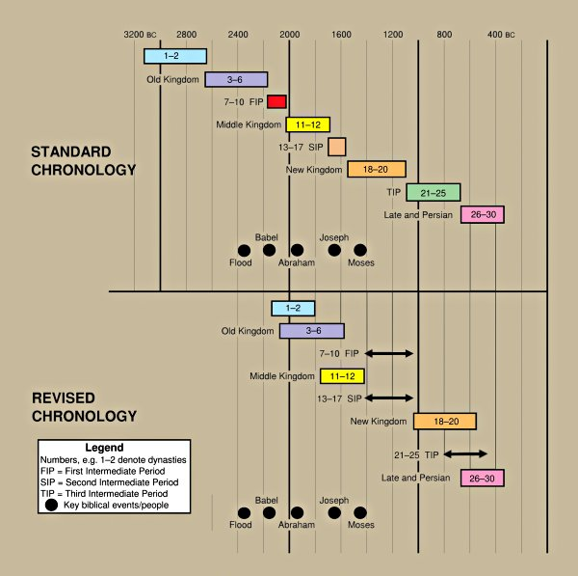
Egypt – Archaeologist David Down’s Chronology
http://www.answersingenesis.org/creation/images/v27/i3/down_chronology.jpg

Slide 86
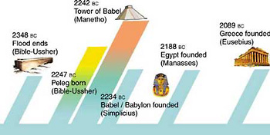
When Did the Confusion of Languages Take Place?
http://www.answersingenesis.org/articles/cm/v22/n1/peleg

Slide 87

Some Final Things to Think About

Slide 88
Some Final Things to Think About
There is a war going on and we are right in the middle of it!
2 Corinthians 10:3-5 - For though we live in the world, we do not wage war as the world does. The weapons we fight with are not the weapons of the world. On the contrary, they have divine power to demolish strongholds. We demolish arguments and every pretension that sets itself up against the knowledge of God, and we take captive every thought to make it obedient to Christ.

Slide 89
Some Final Things to Think About
To Challenge Creation (As Taught in the Bible) Is to Challenge God's Credibility and His Ability to Communicate Clearly.
John 3:12 - I have spoken to you of earthly things and you do not believe; how then will you believe if I speak of heavenly things?

Slide 90
Some Final Things to Think About
We Must Hold Fast To God's Word and Turn Away From False "Knowledge" That May Cause Others to Wander Away From the Faith.
1 Timothy 6:20-21 - Timothy, guard what has been entrusted to your care. Turn away from godless chatter and the opposing ideas of what is falsely called knowledge, which some have professed and in so doing have wandered from the faith.
Colossians 2:8 - See to it that no one takes you captive through hollow and deceptive philosophy, which depends on human tradition and the basic principles of this world rather than on Christ.

Slide 91
Some Final Things to Think About
It Should Not Surprise Us In These "Last Days" That There Are Many Scoffers Who Deliberately Ignore God As Creator and Judge
2 Peter 3:3-7 - In the last days scoffers will come, scoffing and following their own evil desires. They will say, "Where is this 'coming' he promised? Ever since our fathers died, everything goes on as it has since the beginning of creation." But they deliberately forget that long ago by God's word the heavens existed and the earth was formed out of water and by water. By these waters also the world of that time was deluged and destroyed. By the same word the present heavens and earth are reserved for fire, being kept for the Day of Judgment and destruction of ungodly men.

Slide 92
Some Final Things to Think About
It Should Not Surprise Us That Many Brilliant Scientific Minds Have Bought Into the Lie of Evolution
1 Corinthians 1:26-29 - Brothers, think of what you were when you were called. Not many of you were wise by human standards; not many were influential; not many were of noble birth. But God chose the foolish things of the world to shame the wise; God chose the weak things of the world to shame the strong. He chose the lowly things of this world and the despised things--and the things that are not--to nullify the things that are, so that no one may boast before him.

Slide 93
Some Final Things to Think About
Regardless Of How Confident and Dogmatic a Secular Evolutionist Might Sound - In His Heart of Hearts He Is Suppressing the Obvious Truth That God Is His Creator and Judge
Romans 1:18-20 - The wrath of God is being revealed from heaven against all the godlessness and wickedness of men who suppress the truth by their wickedness, since what may be known about God is plain to them, because God has made it plain to them. For since the creation of the world God's invisible qualities--his eternal power and divine nature--have been clearly seen, being understood from what has been made, so that men are without excuse.

