Slide 1
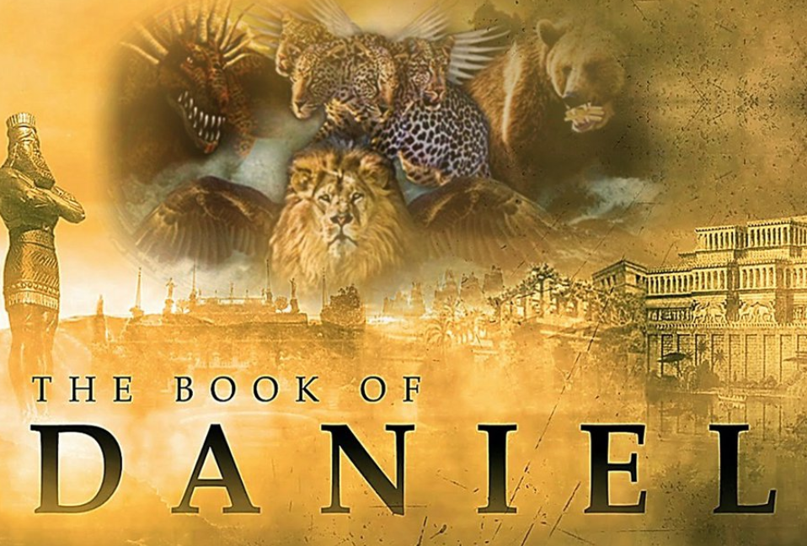
The Most High God rules over the kingdoms of the world and appoints anyone he desires to rule over them.
(Dan 5:21b NLT)
To Download this lesson go to:
http://www.purifiedbyfaith.com/Daniel/Daniel.htm
https://subsplash.com/charis/media/ms/+b72rmnj

Slide 2
Introduction to Daniel 8
In chapter 8, the language of the original text shifts from Aramaic back to Hebrew.
No one is certain why the book was written in this way.
One possible explanation is that those portions of Daniel dealing more directly with the destiny and experience of Israel (such as chapters 8–12) were written in Hebrew and those dealing with the Gentile nations were written in Aramaic.
Daniel received this vision when he was about 69 years old:
  Chapter 7 – 553 BC (1st year of Belshazzar) – Age 67
  Chapter 8 – 551 BC (3rd year of Belshazzar) – Age 69
  Chapter 5 – 539 BC (14th and final year of Belshazzar) – Age 77
In chapter 8, Daniel provides us with more in-depth information on the kingdoms of Medo-Persia and Greece.
Once again Daniel uses imagery to represent these empires.
The kingdoms are not represented as beasts this time, but sacrificial animals: a ram and a goat.
Storms, Sam; Daniel, Biblical Studies; (2016)

Slide 3
Correlation of Dreams and Visions in Daniel
 | Image Chapter 2 | Beasts Chapter 7 | Animals Chapter 8 | Kingdoms Represented
The Times of the Gentiles Luke 21:24 | Head of fine gold | Like a lion with eagle's wings |  | Babylonia 626-539 BC
 | Chest and arms of silver | Like a bear – with one side raised up (higher than the other?) | Ram with two horns – one higher than the other | Medo-Persia 539-330 BC
 | Belly and thighs of bronze | Like a leopard with four wings and four heads | Male goat with one great horn, four horns, and a little horn | Greece 330-63 BC
 | Legs of iron, feet of iron and clay | Incomparable beast with ten horns and a little horn |  | Rome 46 BC - ?
 | Stone that becomes a great mountain | Messiah (son of Man) and saints receive the kingdom |  | Kingdom of God
Slightly adapted from Criswell, The Believer’s Study Bible (p. 1180)

Slide 4
Daniel’s Second Vision (8:1-14)
^{8:1} In the third year of King Belshazzar's reign, I, Daniel, had a vision, after the one that had already appeared to me. ² In my vision I saw myself in the citadel of Susa in the province of Elam; in the vision I was beside the Ulai Canal. ³ I looked up, and there before me was a ram with two horns, standing beside the canal, and the horns were long. One of the horns was longer than the other but grew up later. ⁴ I watched the ram as he charged toward the west and the north and the south. No animal could stand against him, and none could rescue from his power. He did as he pleased and became great.

Slide 5
Daniel’s Second Vision (8:1-14)
^{8:5} As I was thinking about this, suddenly a goat with a prominent horn between his eyes came from the west, crossing the whole earth without touching the ground. ⁶ He came toward the two-horned ram I had seen standing beside the canal and charged at him in great rage. ⁷ I saw him attack the ram furiously, striking the ram and shattering his two horns. The ram was powerless to stand against him; the goat knocked him to the ground and trampled on him, and none could rescue the ram from his power.

Slide 6
Daniel’s Second Vision (8:1-14)
^{8:8} The goat became very great, but at the height of his power his large horn was broken off, and in its place four prominent horns grew up toward the four winds of heaven. ⁹ Out of one of them came another horn, which started small but grew in power to the south and to the east and toward the Beautiful Land. ¹⁰ It grew until it reached the host of the heavens, and it threw some of the starry host down to the earth and trampled on them. ¹¹ It set itself up to be as great as the Prince of the host; it took away the daily sacrifice from him, and the place of his sanctuary was brought low.

Slide 7
Daniel’s Second Vision (8:1-14)
^{8:12} Because of rebellion, the host of the saints and the daily sacrifice were given over to it. It prospered in everything it did, and truth was thrown to the ground. ¹³ Then I heard a holy one speaking, and another holy one said to him, “How long will it take for the vision to be fulfilled--the vision concerning the daily sacrifice, the rebellion that causes desolation, and the surrender of the sanctuary and of the host that will be trampled underfoot?” ¹⁴ He said to me, “It will take 2,300 evenings and mornings; then the sanctuary will be reconsecrated.” (NIV)

Slide 8
^{8:1} In the third year of the reign of King Belshazzar a vision appeared to me, Daniel, after that which appeared to me at the first. ² And I saw in the vision; and when I saw, I was in Susa the capital, which is in the province of Elam. And I saw in the vision, and I was at the Ulai canal. (ESV)
Daniel begins by describing when he received this second vision: “In the third year of the reign of King Belshazzar ” (551 B.C.)
“after that which appeared to me at the first” is a reference to Daniel’s first vision that is recorded for us in Chapter 7.
“I saw in the vision” – In the vision that came to him, Daniel sees himself in the citadel of “Susa” beside the “Ulai canal”.
Susa is approximately 200 miles East of Babylon.
According to Scripture, both Esther and Nehemiah lived in Susa, and Daniel probably had visited the city on official business.
Susa is located in southwest Iran, about 150 miles north of the Persian Gulf and due east of the well-known city of Babylon.
Howe, Thomas A.; Daniel in the Preterists' Den: A Critical Look at Preterist Interpretations of Daniel; (p. 271- 272)

Slide 9
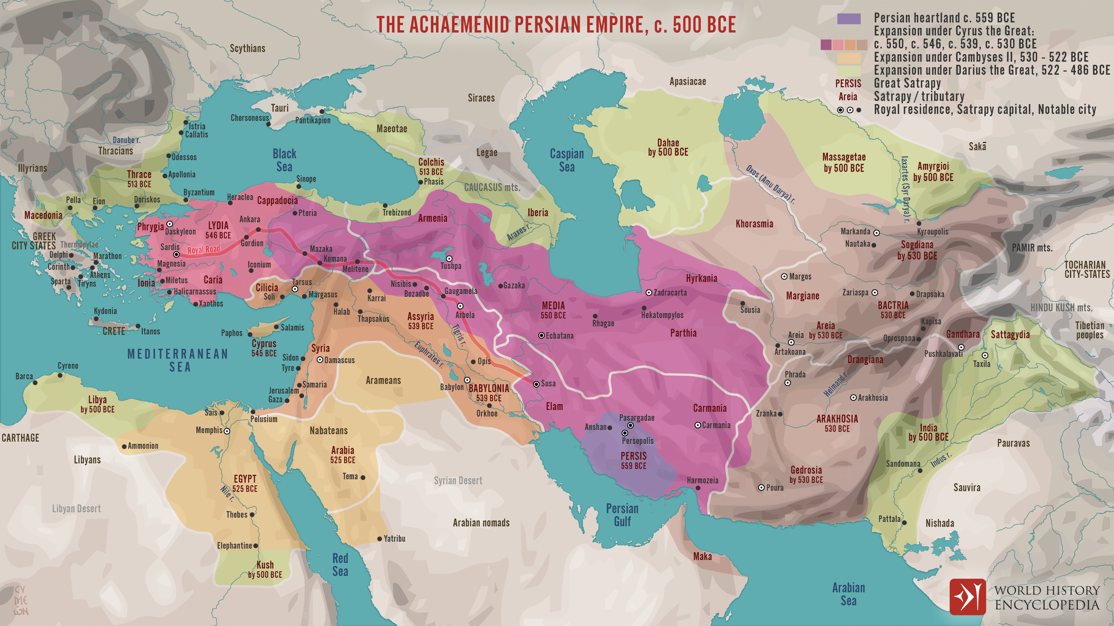
Persian Empire
https://www.worldhistory.org/uploads/images/16107.png?v=1673278143

Slide 10
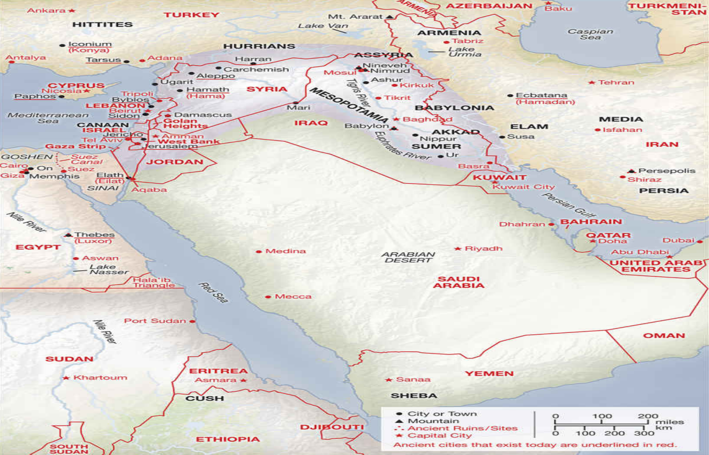
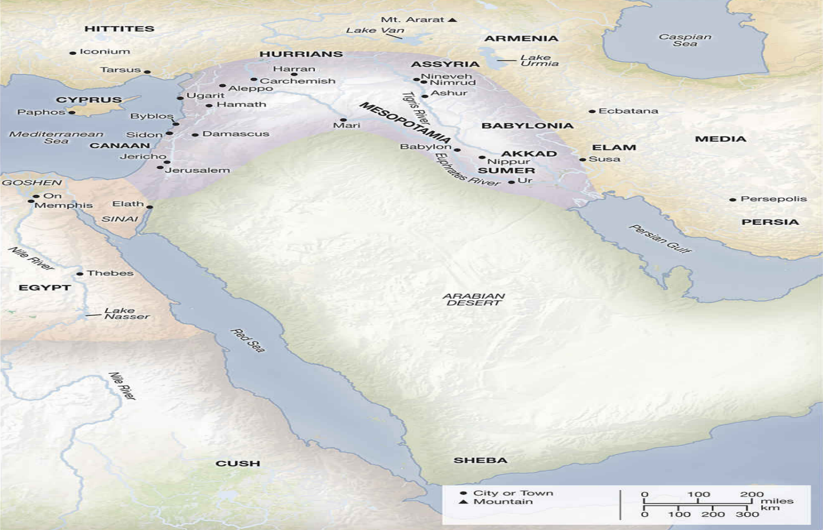
Middle East - Then
Middle East - Now
Fordow
Deluxe Then and Now Bible Maps; Rose Publishing

Slide 11
^{8:1} In the third year of the reign of King Belshazzar a vision appeared to me, Daniel, after that which appeared to me at the first. ² And I saw in the vision; and when I saw, I was in Susa the capital, which is in the province of Elam. And I saw in the vision, and I was at the Ulai canal. (ESV)
At the time of Daniel’s vision “Susa” was the capital of “Elam” and later became one of the Medo-Persian royal cities (cf. Neh 1:1 and 2:1; Esth 1:2).
In 1901 archaeologists discovered the famous Code of Hammurabi in Susa.
This outstanding find had been taken from Babylon to Susa by the Elamites probably in the thirteenth century B.C.
The “Ulai canal”, known classically as the Eulaeus, was about nine hundred feet wide and passed close to Susa on the northeast.
Today the canal is dry.
Miller, Stephen R., Daniel, vol. 18, The New American Commentary (p. 221)

Slide 12
^{8:3} I raised my eyes and saw, and behold, a ram standing on the bank of the canal. It had two horns, and both horns were high, but one was higher than the other, and the higher one came up last. (ESV)
Next Daniel looks and sees a “ram” with “two horns”.
Later on in this chapter (v. 20) the angel Gabriel will interpret this “ram” with the “two horns” as representing the Medo-Persian Empire.
It turns out that a “ram” is a fitting symbol for that empire.
According to Ammianus Marcellinus (a Roman historian), Cyrus, the first ruler of the Persian Empire, used to carry the gold head of a ram when he marched before his army.
Rams normally have two horns, but these horns were unique: one horn “came up last”, and “was higher than the other”.
Miller, Stephen R., Daniel, vol. 18, The New American Commentary (pp. 221–222)

Slide 13
^{8:3} I raised my eyes and saw, and behold, a ram standing on the bank of the canal. It had two horns, and both horns were high, but one was higher than the other, and the higher one came up last. (ESV)
Most biblical scholars agree that the symbolism of the two horns represents the two divisions of the empire, Media and Persia.
Before Cyrus came to power, Media was already a major kingdom, while Persia was a small country with less than fifty thousand square miles of territory.
But in around 550 B.C., Cyrus succeeded in gaining control of the powerful state of Media to the north and then later (“came up last”) made Persia the more important (“higher than the other”) of the two states.
With these nations united, he established the vast Medo-Persian Empire.
Miller, Stephen R., Daniel, vol. 18, The New American Commentary (pp. 221–222)

Slide 14
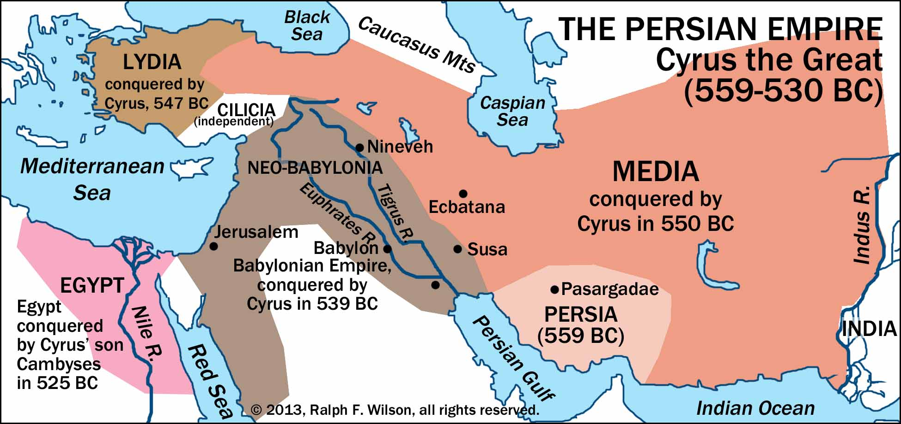
The Medo-Persian Empire
persian-empire-1950x920x300.jpg (1950×920)

Slide 15
^{8:4} I saw the ram charging westward and northward and southward. No beast could stand before him, and there was no one who could rescue from his power. He did as he pleased and became great. (ESV)
The ram seemed invincible as it charged “westward and northward and southward”.
Medo-Persia made most of its conquests in these three directions:
  “westward” – it subdued Babylonia, Syria, Asia Minor, and made raids upon Greece
  “northward” – Armenia, Scythia, and the Caspian Sea region;
  “southward”– Egypt and Ethiopia.
“No beast could stand before” the ram, and no one could be “rescue[d] from his power”.
In other words, in its heyday, no country could stand against Medo-Persia.
Medo-Persia did as it “pleased” and “became great” meaning that the Medo-Persian Empire would become large and powerful, which is exactly what happened.
This empire controlled more territory than had been controlled by any other empire prior to that time.
Miller, Stephen R., Daniel, vol. 18, The New American Commentary (pp. 221–222)

Slide 16
^{8:5} As I was considering, behold, a male goat came from the west across the face of the whole earth, without touching the ground. And the goat had a conspicuous horn between his eyes. (ESV)
Daniel was impressed by the ram and was “considering” what he had seen, evidently in an attempt to understand the significance of the ram and its actions, when suddenly a charging “goat” appeared.
It moved swiftly (“without touching the ground”) from the “west” to encounter and conquer the ram.
In v. 21 Gabriel will tell Daniel that the “goat” symbolizes the Greek Empire, and the “conspicuous horn” is its first king, who we now know historically to be Alexander the Great.
Coming “from the west” points to the location of Greece, which was to the west of Medo-Persia (and Palestine).
“across the face of the whole earth” means that Alexander conquered the much of the known world of his day, and the goat speeding across the globe “without touching the ground” portrays the swiftness of Alexander’s conquests.
Miller, Stephen R., Daniel, vol. 18, The New American Commentary (p. 223)

Slide 17
^{8:5} As I was considering, behold, a male goat came from the west across the face of the whole earth, without touching the ground. And the goat had a conspicuous horn between his eyes. (ESV)
Alexander was one of the great military strategists of history.
He was born in 356 B.C., the son of a great conqueror in his own right, Philip of Macedon.
Philip had united Greece with Macedonia and was planning to attack Persia when he was murdered.
Alexander, educated under the famous Greek philosopher Aristotle, was only twenty years old when he succeeded his father as king in 336 B.C.
A year and a half later (334 B.C.), he launched his attack against the Persians.
In that same year Alexander won the Battle of Granicus in Asia Minor, thereby bringing to an end the dominance of the Medo-Persian Empire.
Incredibly within only three years Alexander had conquered the entire Near East.
Miller, Stephen R., Daniel, vol. 18, The New American Commentary (p. 223)

Slide 18
^{8:6} He came to the ram with the two horns, which I had seen standing on the bank of the canal, and he ran at him in his powerful wrath. ⁷ I saw him come close to the ram, and he was enraged against him and struck the ram and broke his two horns. And the ram had no power to stand before him, but he cast him down to the ground and trampled on him. And there was no one who could rescue the ram from his power. (ESV)
The goat charging the ram in a fit as “he was enraged” aptly describes Alexander’s assault on the Persian Empire.
Hatred for the Persians had grown steadily since the time of Cyrus due to constant quarreling and fighting between Persia and Greece, and the Greeks were especially bitter over the invasions of Darius I (490 B.C.) and his son, Xerxes I (480 B.C.).
Alexander was determined to avenge these assaults on his homeland, and verse 7 graphically portrays the utter defeat of the Persian armies at the hands of the Greek forces.
Miller, Stephen R., Daniel, vol. 18, The New American Commentary (p. 223)

Slide 19
^{8:8} Then the goat became exceedingly great, but when he was strong, the great horn was broken, and instead of it there came up four conspicuous horns toward the four winds of heaven. (ESV)
“the goat became exceedingly great” – Alexander conquered most of the known world in his day, carving out an empire of 1.5 million square miles, making Greece the greatest nation on earth.
Alexander spread the Greek language and culture all over the world, an act that prepared the world for the spread of the gospel by giving it a common language, Koine Greek, the language of the New Testament.
“but when he was strong, the great horn was broken” – at 32 years of age while at the pinnacle of his career, Alexander (“the great horn”) was taken with a severe fever (possibly malaria) and died in 323 B.C.
After a period of infighting and struggle, the empire ended up being divided among four Greek military leaders (“four conspicuous horns”), who became his successors.
This four-fold division took place in roughly four directions – i.e., “toward the four winds”.
Miller, Stephen R., Daniel, vol. 18, The New American Commentary (pp. 223–224)

Slide 20
^{8:9} Out of one of them came a little horn, which grew exceedingly great toward the south, toward the east, and toward the glorious land. (ESV)
Out of one of the four horns grew a “little horn” that became “exceedingly great ”.
The meaning is that from one of the divisions of the Greek Empire would emerge a king of unusual significance.
Most Bible scholars agree that this “little horn” represents the eighth ruler of the Seleucid Greek Empire, Antiochus IV Epiphanes (175–163 B.C.).
Antiochus IV was particularly important because of his exploits against the inhabitants of Palestine and for that reason he receives special attention in the Book of Daniel (cf. 11:21–35).
Miller, Stephen R., Daniel, vol. 18, The New American Commentary (p. 225)

Slide 21
^{8:9} Out of one of them came a little horn, which grew exceedingly great toward the south, toward the east, and toward the glorious land. (ESV)
Starting “little” indicates that Antiochus would have an insignificant beginning.
Although his nephew, son of his older brother Seleucus IV, was the rightful heir to the throne, Antiochus gained this position through bribery and flattery.
He made notable conquests “toward the south” (Egypt), “the east” (Persia, Parthia, Armenia), and “the glorious land” (Palestine).
Palestine is called “glorious” here because Yahweh God had chosen it as the center of his operations on the earth and because his people lived there.
Though Palestine was in the southern regions, it is singled out because the little horn’s rule over the holy land would have enormous consequences for the Jewish people
Miller, Stephen R., Daniel, vol. 18, The New American Commentary (p. 225)

Slide 22
^{8:10} It grew great, even to the host of heaven. And some of the host and some of the stars it threw down to the ground and trampled on them. (ESV)
The term “host of heaven” refers here to “the stars” of heaven (cf. Deut 4:19).
We are told here that “it” (i.e., “the little horn”) took “some of the stars” and “threw [them] down to the ground and trampled on them.”
Based on the interpretation of this vision that is given later (in vs. 24) , it appears that the “stars” being thrown “down to the ground” and “trampled on” symbolize the Jewish saints in Palestine as shining lights (cf. 12:3) who will be severely persecuted by the little horn.
This king (the little horn) will become so arrogant that he is willing to assert himself against the saints of God and even against God himself.
Antiochus’s persecution of the Jews began in 170 B.C. with the assassination of the high priest Onias III and ended when the temple was rededicated in December 164 B.C.
Miller, Stephen R., Daniel, vol. 18, The New American Commentary (pp. 225–226)

Slide 23
^{8:10} It grew great, even to the host of heaven. And some of the host and some of the stars it threw down to the ground and trampled on them. (ESV)
During this period of persecution, Antiochus executed thousands of Jews who resisted his unfair regulations.
In 169 B.C., he plundered the temple in Jerusalem (taking its treasures, including the furniture that was adorned with precious metals) and committed “deeds of murder” (cf. 1 Macc 1:20–24; 2 Macc 5:1ff.).
In 2 Macc 5:11–14 these “deeds of murder” are said to have included the slaughter of eighty thousand men, women, boys, girls, even infants by Antiochus’s soldiers during this attack upon Jerusalem.
In December 167 B.C. Antiochus committed his crowning act of sacrilege against the Jewish religion by erecting an altar to Zeus in the temple precincts and offering swine on it (cf. 1 Macc 1:37, 39, 44–47, 54, 59; 2 Macc 6:2–5).
Miller, Stephen R., Daniel, vol. 18, The New American Commentary (pp. 225–226)

Slide 24
^{8:11} It became great, even as great as the Prince of the host. And the regular burnt offering was taken away from him, and the place of his sanctuary was overthrown. (ESV)
“the Prince of the host” refers to the God of the Jews who the little horn is persecuting (cf. vs. 25).
Not only would the “little horn” consider himself the Prince’s equal; he would also set himself against the Prince.
He believed that he and his Greek gods were above Yahweh, and he blatantly attacked Yahweh and his worshipers.
“the regular burnt offering was taken away from him” – in 167 B.C., Antiochus issued an order that the regular ceremonial observances to Yahweh were forbidden, and thus sacrifices ceased being offered to him (cf. 1 Macc 1:44–45).
“the place of his sanctuary was overthrown” is probably a reference to Antiochus’ desecration of the temple mentioned earlier (cf. 1 Macc 1:20–23, 47, 54; 2 Macc 6:2–5).
Miller, Stephen R., Daniel, vol. 18, The New American Commentary (pp. 226–227)

Slide 25
^{8:12} And a host will be given over to it together with the regular burnt offering because of transgression, and it will throw truth to the ground, and it will act and prosper. (ESV)
Here we’re given the reason why “a host” [of the Jewish saints] were “given over” to Antiochus (the “little horn”) for persecution: “because of transgression” on the part of the Jewish people.
During that time the “regular burnt offering” would be terminated by Antiochus (cf. v. 11) and “it” [the little horn, Antiochus] “will act [as he pleases] and prosper”
The evil dictator will “throw truth to the ground” (cf. Ezek 19:12) by repressing the true teachings (religion) of Yahweh and attempting to destroy the Hebrew Scriptures, which embodied the true religion.
According to 1 Macc 1:56–57: “The books of the law which they found they tore to pieces and burned with fire. Where the book of the covenant was found in the possession of any one, or if any one adhered to the law, the decree of the king condemned him to death.”
The satanically inspired king was endeavoring to rid the world of the Word of God as tyrants have attempted to do many times since.
Miller, Stephen R., Daniel, vol. 18, The New American Commentary (pp. 227–228)

Slide 26
^{8:13} Then I heard a holy one speaking, and another holy one said to the one who spoke, "For how long is the vision concerning the regular burnt offering, the transgression that makes desolate, and the giving over of the sanctuary and host to be trampled underfoot?" (ESV)
Without introduction two heavenly beings suddenly appeared on the scene.
Daniel “heard” an angel (“a holy one”) “speaking” (to another angel).
A second angel (“another holy one”) said to the one who was speaking, “how long is the… giving over of the sanctuary and host to be trampled underfoot?”
The angel’s question is, How long would temple worship cease and the persecution of the saints described in Daniel’s vision continue?
During that time, no services would be held in the temple because it would be defiled by Antiochus, and idols would be set up in the temple precincts.
“the transgression that makes desolate” probably refers to the Zeus statue set up by Antiochus in the temple and designated in 11:31 as the “abomination that makes desolate.”
The angel desired to know “how long” this period of desolation would last.
Here it is demonstrated that angels are deeply interested in the affairs of God’s people.
Miller, Stephen R., Daniel, vol. 18, The New American Commentary (pp. 227–228)

Slide 27
^{8:14} And he said to me, “For 2,300 evenings and mornings. Then the sanctuary shall be restored to its rightful state.” (ESV)
The question was apparently asked for Daniel’s sake, since the answer was given to Daniel rather than the angel.
Daniel is told here that the “giving over of the sanctuary and host to be trampled underfoot” (vs. 13) would last “2,300 evenings and mornings” which is a period of about six years and four months.
He is then told that after this period of persecution, “the sanctuary (i.e. the temple) shall be restored to its rightful state”
We know historically this took place when Judas Maccabeus cleansed and rededicated the temple on December 14, 164 B.C. (cf. 1 Macc 4:52).
Thus the 2,300 days began in the fall of 170 B.C. when Onias III (a former high priest) was murdered at the urging of the wicked high priest Menelaus, whom Antiochus had appointed to that position for a bribe.
Today the Jews celebrate the Feast of Hanukkah (“dedication”) to commemorate this momentous event (cf. John 10:22).
Miller, Stephen R., Daniel, vol. 18, The New American Commentary (pp. 228–230)

Slide 28

Class Discussion Time
In today’s text we saw a number of very accurate and specific prophesies given by Daniel in many cases hundreds of years prior to the events predicted:
  The rise of the great Medo-Persian Empire symbolized by a “ram” (the symbol carried in battle by its first ruler).
  The two parts of the Medo-Persian Empire, one later being made more powerful than the other, symbolized by the “two horns”, one later being made “higher than the other”.
  The subsequent conquest of Persia by the Greek Empire symbolized by the “goat” charging the “ram” (coming from “the west”).
  The rapid conquests by the Greeks under the leadership of Alexander the Great (the “conspicuous horn”) of virtually all of the known world.
  The Greek Empire, when its first leader died in his prime ("when he was strong, the great horn was broken"), was divided up among four leaders ("four conspicuous horns") .
  Out of one of those divisions of the Greek Empire eventually came an evil ruler (Antiochus IV Epiphanes) who heavily persecuted the Jews in Palestine for a little over six years (2,300 days):
    He murdered many of the Jews
    He stopped the Temple offerings
    He desecrated the temple
  At the end of this persecution the Temple was “restored to its rightful state”.
While we know the scriptures were written by a sovereign God, is it still not encouraging to see him demonstrate his sovereignty in this way?

Slide 29
Class Discussion Time
We live in a nation that is currently able to dominate any other nation in the world militarily.
But we see in today’s text that over the course of history, powerful nations have their “day in the sun” for a season, after which, the Lord will bring along another nation to defeat and replace it.
Is it troubling to you to think that such a fate could possibly await our own nation – perhaps during our lifetime?
At this same time, Daniel speaks of another kingdom that conquers the kingdoms of this world “that shall never be destroyed, nor shall the kingdom be left to another people.” (Dan 2:44)
Is it encouraging to you to know that you are a part of this kingdom?

