Slide 1

The Most High God rules over the kingdoms of the world and appoints anyone he desires to rule over them.
(Dan 5:21b NLT)
To Download this lesson go to:
http://www.purifiedbyfaith.com/Daniel/Daniel.htm
https://subsplash.com/charis/media/ms/+b72rmnj

Slide 2
Introduction to the Remaining Chapters (11-12)
Chapters 11–12 contain a vision communicated to Daniel by the angel Gabriel (11:2–12:3) followed by a set of final instructions given to him (12:4–13).
The vision, which we will begin looking at today, contains a considerable amount of tedious historical detail, making it difficult and somewhat cumbersome to try to follow.
But I believe the best way to proceed through this difficult chapter is by reading the text and identifying of these historical situations that were prophesied in excruciating detail, hundreds of years in advance.
Pretty much all commentaries agree Daniel 11:2-4 begins with a reference to the Persian kings who were the successors of Cyrus and extends through the Greek conqueror, Alexander the Great and his successors.
Then, starting in Daniel 11:5, there is a detailed summary of the on-going conflict between the Seleucid and Ptolemaic dynasties (the primary powers of the divided Greek empire that arose after the death of Alexander), with special emphasis on Antiochus IV Epiphanes starting in Daniel 11:21.
Storms, Sam; Daniel, Biblical Studies; (2016)

Slide 3
Introduction to the Remaining Chapters (11-12)
Many evangelical interpreters believe that in verse 36 the angel leaps forward several thousand years to the end of human history and begins describing the Antichrist, of whom Antiochus is the prototype, who they believe will appear just prior to the second coming of Jesus.
Their primary argument is that we have no explicit evidence that the details given in vv. 36–45 correspond to anything in the life and career of Antiochus.
Others argue that these verses are, nevertheless, a continuation of the description given of Antiochus in the preceding verses (vss. 21-35).
Storms, Sam; Daniel, Biblical Studies; (2016)

Slide 4
Introduction to the Remaining Chapters (11-12)
There does not seem to be a clear indication in verse 36 that we have moved on and are now talking about another king.
Rather, the things discussed in verses 36–45 appear be a continuation of what was discussed in the preceding paragraph.
There are references to the “king”; the “king of the South ” and “king of the North” without the slightest indication that the three are any different from those who are described using these same names in the preceding verses.
But we will further explore these and other possible options when we get to that section.
Storms, Sam; Daniel, Biblical Studies; (2016)

Slide 5
Prophesies Concerning Persia and Greece (11:2-4)
^{11:2} “And now I will show you the truth. Behold, three more kings shall arise in Persia, and a fourth shall be far richer than all of them. And when he has become strong through his riches, he shall stir up all against the kingdom of Greece. ³ Then a mighty king shall arise, who shall rule with great dominion and do as he wills. ⁴ And as soon as he has arisen, his kingdom shall be broken and divided toward the four winds of heaven, but not to his posterity, nor according to the authority with which he ruled, for his kingdom shall be plucked up and go to others besides these. (NIV)

Slide 6
^{11:2} “And now I will show you the truth. Behold, three more kings shall arise in Persia, and a fourth shall be far richer than all of them. And when he has become strong through his riches, he shall stir up all against the kingdom of Greece. (ESV)
Daniel’s vision here begins in much the same way that it did in chapter 8, with a brief summary of the Persian and Greek empires.
After Cyrus, who was the Persian ruler at the time this vision was given (cf. 10:1), “three more kings” would arise in Persia and then a “fourth”, who would be “far richer” and stronger than the other three.
Using his riches and strength he will pick a fight with the “kingdom of Greece”.
This “fourth” king is Xerxes I (who ruled from 486-465 B.C.), the husband of Esther (cf. Esther 1:10ff. translated “Ahasuerus” in some translations).
He was a great and mighty king, under whom Persian power reached its pinnacle, but he is also remembered for invading Greece, only to be defeated at the battle of Salamis.
This began a conflict that would ultimately lead to the downfall of the Persian empire to Greece.
Duguid, Iain M.; Daniel (Reformed Expository Commentaries)

Slide 7
^{11:3} Then a mighty king shall arise, who shall rule with great dominion and do as he wills. (ESV)
The heavenly messenger had already advised Daniel that the Persian Empire would be followed by that of Greece.
The “mighty king… who shall rule with great dominion” is clearly a reference to the “goat” of chapter 8 (i.e. Greece and it’s first king, Alexander the Great).
That Alexander the Great should be described in these animal terms may seem strange to the secular historian and the fact that his life is summarized here in just a few words may seem surprising for such an important figure.
This prophecy, however, is focused on God’s reign and its ultimate focus is on God’s people.
In the light of that, the great empires and emperors of history are but a “drop in the bucket” when compared to God (Isaiah 40:15).
Even one who “shall rule with great dominion and do as he wills” is still dependent upon God for his ability to exercise that will.
Ferguson, Sinclair B.; The Preacher's Commentary - Vol. 21: Daniel; (p. 223)

Slide 8
^{11:4} And as soon as he has arisen, his kingdom shall be broken and divided toward the four winds of heaven, but not to his posterity, nor according to the authority with which he ruled, for his kingdom shall be plucked up and go to others besides these. (ESV)
Here we see the difference between biblical prophecy and secular biography.
One of Alexander’s earliest biographers wrote that “he seemed to the nations to do whatever pleased him.”
Scripture agrees, on the surface (as we just saw in the previous verse).
But Scripture also sees the hand of God lying behind the day when “[Alexander’s] kingdom shall be broken and divided toward the four winds of heaven, but not to his posterity [i.e. descendants]”.
Alexander could not even secure what every father desires, namely, that his children inherit his achievements.
His two sons were soon assassinated, and, as we have already seen, his empire passed into the hands of his four generals.
Scripture’s assessment of Alexander is that he was a broken horn (Dan. 8:22).
We need this heaven-given and long-term perspective on the affairs of our own time.
Ferguson, Sinclair B.; The Preacher's Commentary - Vol. 21: Daniel; (pp. 223-224)

Slide 9
^{11:4} And as soon as he has arisen, his kingdom shall be broken and divided toward the four winds of heaven, but not to his posterity, nor according to the authority with which he ruled, for his kingdom shall be plucked up and go to others besides these. (ESV)
The people of God do not view the great ones of this world through the eyes of the media or the “talking heads”, but through the lens of scriptural revelation.
They know that it is God, not great men, who “sits enthroned above the circle of the earth, and its people are like grasshoppers. He stretches out the heavens like a canopy, and spreads them out like a tent to live in. He brings princes to naught and reduces the rulers of this world to nothing.” (Isaiah 40:22-23 NIV)
Ferguson, Sinclair B.; The Preacher's Commentary - Vol. 21: Daniel; (pp. 223-224)

Slide 10
Prophesies Concerning Egypt and Syria (11:5-20)
^{11:5} "The king of the South will become strong, but one of his commanders will become even stronger than he and will rule his own kingdom with great power. ⁶ After some years, they will become allies. The daughter of the king of the South will go to the king of the North to make an alliance, but she will not retain her power, and he and his power will not last. In those days she will be handed over, together with her royal escort and her father and the one who supported her. ⁷ “One from her family line will arise to take her place. He will attack the forces of the king of the North and enter his fortress; he will fight against them and be victorious. ⁸ He will also seize their gods, their metal images and their valuable articles of silver and gold and carry them off to Egypt. For some years he will leave the king of the North alone. ⁹ Then the king of the North will invade the realm of the king of the South but will retreat to his own country.

Slide 11
Prophesies Concerning Egypt and Syria (11:5-20)
^{11:10} His sons will prepare for war and assemble a great army, which will sweep on like an irresistible flood and carry the battle as far as his fortress. ¹¹ "Then the king of the South will march out in a rage and fight against the king of the North, who will raise a large army, but it will be defeated. ¹² When the army is carried off, the king of the South will be filled with pride and will slaughter many thousands, yet he will not remain triumphant. ¹³ For the king of the North will muster another army, larger than the first; and after several years, he will advance with a huge army fully equipped. ¹⁴ “In those times many will rise against the king of the South. The violent men among your own people will rebel in fulfillment of the vision, but without success.

Slide 12
Introduction to 11:5-20
The perspective from which history is assessed now changes.
Up until this point, the viewpoint of the events described has been reported as though viewed from above.
But now we see the events being reported from the viewpoint of being in the middle of what is taking place.
The long and complex prophecy from verse 5 onward sees the ensuing history as a conflict between the kings of the “north” and the kings of the “south”.
But north and south of where?
The center of the compass used here is the “glorious [or beautiful] land” (see verse 16).
In other words, the point from which history is now being viewed is through the eyes of God’s covenant people.
The “land” is “glorious” because it is there that the promises of God’s covenant were enshrined and His shekinah presence was made known.
Ferguson, Sinclair B.; The Preacher's Commentary - Vol. 21: Daniel; (p. 227)

Slide 13
Introduction to 11:5-20
While, at least at first glance, this prophecy has to do with foreign nations and their conflicts, Daniel is learning that all of human history is part of the fundamental conflict in which the object of the forces of darkness is the destruction of the city of God.
In one sense Daniel 11 is a mosaic or tapestry of historical events in which the connection between events is not always clear.
Since most of us have a limited knowledge of ancient history, we may have difficulty identifying the events to which the vision points.
We may find ourselves in agreement with the words of the Biblical scholar H. C. Leupold, who says concerning Daniel 11, “We do not see how it could be used for a sermon or for sermons.”
The exposition of this passage becomes somewhat easier when we realize what lies behind it, and we are able to see the details as pieces of a larger design.
As I have already stated, I believe the best approach to the exposition of this detailed and tedious passage is to connect what is said here to the actual history of which verses 5-35 speak.
Ferguson, Sinclair B.; The Preacher's Commentary - Vol. 21: Daniel; (p. 227)

Slide 14
^{11:5} “Then the king of the south shall be strong, but one of his princes shall be stronger than he and shall rule, and his authority shall be a great authority. (ESV)
As mentioned earlier, Alexander the Great’s empire was eventually divided among four of his generals:
  Macedonia was ruled by Cassander
  Thrace and Asia Minor was ruled by Lysimachus
  Syria was ruled by Seleucus
  Egypt was ruled by Ptolemy. ¹
The “king of the south” here (whose land is said in verse 8 to be “Egypt”) is a reference to Ptolemy I, the ruler of Egypt.²
Ptolemy had been a highly capable general under Alexander. ²
¹ Ferguson, Sinclair B.; The Preacher's Commentary - Vol. 21: Daniel; (p. 227)
² Miller, Stephen R., Daniel, vol. 18, The New American Commentary (p. 293)

Slide 15
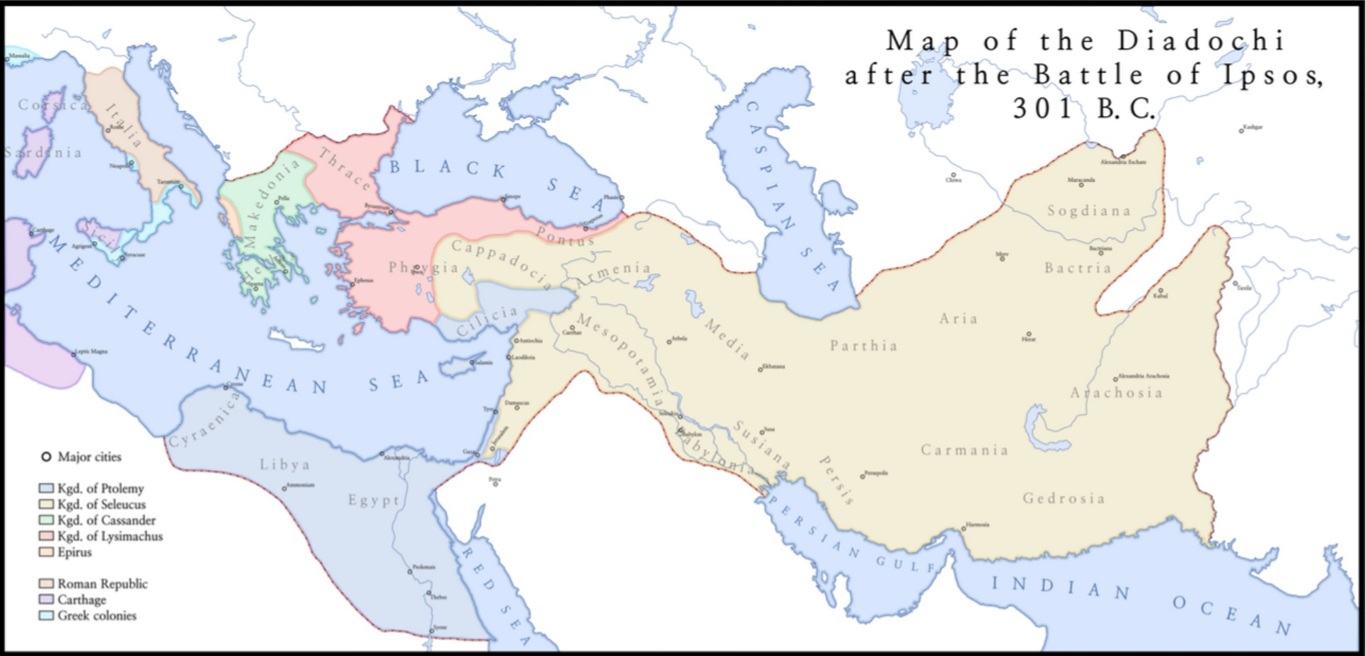
Four-Fold Division of Greek Empire After Alexander
Cassander
Lysimachus
Seleucus
Ptolemy
https://www.reddit.com/r/MapPorn/comments/6itp66/map_of_diadochi_kingdoms_after_the_battle_of/#lightbox

Slide 16
^{11:5} “Then the king of the south shall be strong, but one of his princes shall be stronger than he and shall rule, and his authority shall be a great authority. (ESV)
Seleucus had been a lesser general under Alexander.
Seleucus was appointed king of Babylonia, but when another general, Antigonus, seized Babylonia, Seleucus fled to Ptolemy in Egypt to serve under him, thus becoming “one of his princes.”
But then Antigonus was later defeated and Seleucus returned to his former kingdom.
In doing so he greatly increased his power, eventually controlling more territory than Ptolemy, which is why it says “one of his princes shall be stronger than [the king of the south]”
Seleucus’s kingdom included Babylonia, Syria, and Media making it the largest of all the divisions of the Greek Empire, which is why it says “his authority shall be a great authority”
Miller, Stephen R., Daniel, vol. 18, The New American Commentary (p. 293)

Slide 17
^{11:6} After some years they shall make an alliance, and the daughter of the king of the south shall come to the king of the north to make an agreement. But she shall not retain the strength of her arm, and he and his arm shall not endure, but she shall be given up, and her attendants, he who fathered her, and he who supported her in those times. (ESV)
Here we see that from the very beginning, conflicts arose between the kingdoms of the Ptolemies (Egypt) and the Seleucids (Syria).
After Ptolemy I died these clashes continued under his son Ptolemy II who, according to tradition, instigated the translation of the Hebrew Bible into Greek called the Septuagint.
“After some years”, Ptolemy II made an “alliance” with the Seleucid ruler, Antiochus II (grandson of Seleucus).
Under the terms of the agreement, Ptolemy’s daughter Berenice (“the daughter of the king of the south ”) was to marry Antiochus II (“the king of the north”).
Miller, Stephen R., Daniel, vol. 18, The New American Commentary (pp. 293–294)

Slide 18
^{11:6} After some years they shall make an alliance, and the daughter of the king of the south shall come to the king of the north to make an agreement. But she shall not retain the strength of her arm, and he and his arm shall not endure, but she shall be given up, and her attendants, he who fathered her, and he who supported her in those times. (ESV)
Berenice’s son was then become heir to the Seleucid throne.
However, Antiochus II was already married to a powerful and influential woman named Laodice who succeeded in murdering Antiochus II, Berenice, and their child!
Which is why it says their “strength” did “not endure” but that they “shall be given up”.
Laodice then ruled as queen regent until her son, Seleucus II, was old enough to serve as ruler.
Miller, Stephen R., Daniel, vol. 18, The New American Commentary (pp. 293–294)

Slide 19
^{11:7} "And from a branch from her roots one shall arise in his place. He shall come against the army and enter the fortress of the king of the north, and he shall deal with them and shall prevail. (ESV)
“a branch from her [Berenice’s] roots [i.e., family line]” refers here to Berenice’s brother, Ptolemy III who “shall arise in his [father, Ptolemy II’s] place”.
In retaliation for his sister’s murder, Ptolemy III “shall come against the army and enter the fortress of the king of the north”
This war lasted from 246 to 241 B.C. during the course of which Ptolemy III eventually captured and looted the Seleucid capital of Antioch.
The Egyptian king soundly defeated the Syrian forces and evidently put to death the evil Laodice who had murdered his sister along with her husband and child.
Miller, Stephen R., Daniel, vol. 18, The New American Commentary (pp. 293–294)

Slide 20
^{11:8} He shall also carry off to Egypt their gods with their metal images and their precious vessels of silver and gold, and for some years he shall refrain from attacking the king of the north. ⁹ Then the latter shall come into the realm of the king of the south but shall return to his own land. (ESV)
Ptolemy III also seized Syria’s “gods” and other valuables.
May of these valuables had been taken from Egypt years earlier by the Persian monarch Cambyses in 524 B.C.
For this feat the native Egyptians bestowed upon Ptolemy III the title “Euergetes [Benefactor].”
Ptolemy III then “for some years… shall refrain from attacking the king of the north”.
Seleucus II, perhaps encouraged by this lack of aggression, eventually attempted to launch a retaliatory strike against Ptolemy III, but was immediately driven back “to his own land”.
Miller, Stephen R., Daniel, vol. 18, The New American Commentary (pp. 293–294)

Slide 21
^{11:10} “His sons shall wage war and assemble a multitude of great forces, which shall keep coming and overflow and pass through, and again shall carry the war as far as his fortress. ¹¹ Then the king of the south, moved with rage, shall come out and fight against the king of the north. And he shall raise a great multitude, but it shall be given into his hand. ¹² And when the multitude is taken away, his heart shall be exalted, and he shall cast down tens of thousands, but he shall not prevail. (ESV)
Seleucus II died in 226 B.C., but “his sons”, Seleucus III and Antiochus III continued the wars with the Ptolemies.
In response Ptolemy IV, “moved with rage”, launched a counterattack “against the king of the north”.
“And he shall raise a great multitude” – both armies were quite large.
When the battle ended [in 217 B.C.], Ptolemy had won a great victory over the Syrians at Raphia (located in Palestine).
Because of this victory, Ptolemy’s “heart shall be exalted”.
“but he shall not prevail” – The Egyptian army “cast down tens of thousands” of the Syrian troops in the battle. But Ptolemaic supremacy was not to continue in the end.
Miller, Stephen R., Daniel, vol. 18, The New American Commentary (pp. 294–295)

Slide 22
^{11:13} For the king of the north shall again raise a multitude, greater than the first. And after some years he shall come on with a great army and abundant supplies. (ESV)
At this point in the chapter a significant development takes place.
No longer are the Ptolemies dominant, but vv. 13–35 describe the ensuing period of Seleucid supremacy.
Approximately fifteen years later (202 B.C.) Antiochus III again invaded Ptolemaic territories with “with a great army and abundant supplies”.
The occasion for this invasion was the death of Ptolemy IV in 203 B.C. and the crowning of his young son (between four and six years of age), Ptolemy V as the new king.
Antiochus III took full advantage of the opportunity and attacked Phoenicia and Palestine.
Miller, Stephen R., Daniel, vol. 18, The New American Commentary (pp. 294–295)

Slide 23
^{11:14} "In those times many shall rise against the king of the south, and the violent among your own people shall lift themselves up in order to fulfill the vision, but they shall fail. (ESV)
“many shall rise against the king of the south” – With the death of Ptolemy IV, various uprisings occurred that significantly weakened the Egyptian power and broke it by internal dissension.
But that, unfortunately, led some of the Jews (“your own people ,” says the angel) to attempt an uprising against the Egyptian dominion under which they had fared relatively well.
That undertaking was to bring trouble upon them – trouble that had been prophesied in the visions of Daniel.
The angel refers to that fact when he says that the Jews shall do this to “fulfill the vision.”
This uprising on the part of the Jews proved problematic: “but they shall fail.”
We see from this one incident how intimately the fortunes of the Jews were intertwined with these of these two warring nations, and how quickly the Jews could end up in deep trouble as they tried to align themselves with the wrong external power.
Leupold, H. C.; Exposition of Daniel (1949); (pp. 487–488)

Slide 24
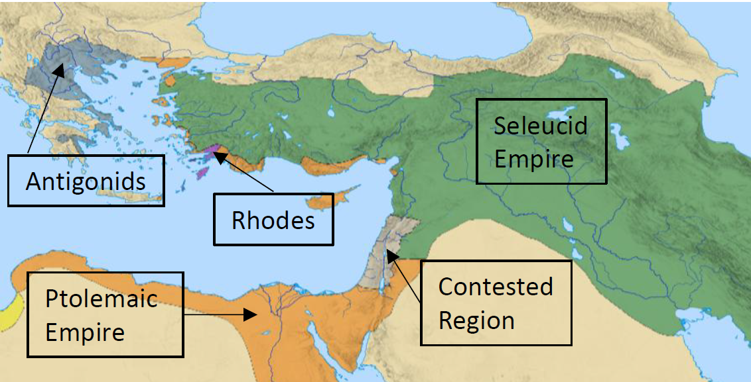
Greek Successor States: 300-250 BC
https://www.reddit.com/r/MapPorn/comments/6itp66/map_of_diadochi_kingdoms_after_the_battle_of/#lightbox

Slide 25

Class Discussion Time
We know that all scripture is God breathed and that God is the author of all of history, knowing every detail of history from eternity past.
Nevertheless, do you not find it stunning that Daniel was able to make such detailed predictions of major historical events in writing, hundreds of years before these events occurred?
The liberal scholars are particularly irked by this, and try to claim that Daniel must have been written after the fact.
In their view, there is no way Daniel could have made such detailed predictions this far in advance.

Slide 26
Class Discussion Time
We saw today where the scriptural perspective of historical events is often at odds with the perspective of secular historians.
This is why it is important that we constantly evaluate the events of our own day through a scriptural lens.
Can you think of some examples of a modern secular perspective that you would take issue with in light of your biblical perspective on the things that are happening around us?

Slide 27
Class Discussion Time
Were you surprised that (in the days prior to feminism!) Loadice was able to get away with murdering her husband, his former wife and their son so that she could serve as queen regent and eventually have her own son take the throne?
Do things like this still happen in our day?
Can you think of an example?

Slide 28
The Most High God rules over the kingdoms of the world and appoints anyone he desires to rule over them.
(Dan 5:21b NLT)
To Download this lesson go to:
http://www.purifiedbyfaith.com/Daniel/Daniel.htm
https://subsplash.com/charis/media/ms/+b72rmnj

Slide 29
Prophesies Concerning Egypt and Syria (11:5-20)
^{11:15} Then the king of the North will come and build up siege ramps and will capture a fortified city. The forces of the South will be powerless to resist; even their best troops will not have the strength to stand. ¹⁶ The invader will do as he pleases; no one will be able to stand against him. He will establish himself in the Beautiful Land and will have the power to destroy it. ¹⁷ He will determine to come with the might of his entire kingdom and will make an alliance with the king of the South. And he will give him a daughter in marriage in order to overthrow the kingdom, but his plans will not succeed or help him. ¹⁸ Then he will turn his attention to the coastlands and will take many of them, but a commander will put an end to his insolence and will turn his insolence back upon him. ¹⁹ After this, he will turn back toward the fortresses of his own country but will stumble and fall, to be seen no more.

Slide 30
Prophesies Concerning Egypt and Syria (11:5-20)
^{11:20} “His successor will send out a tax collector to maintain the royal splendor. In a few years, however, he will be destroyed, yet not in anger or in battle. (NIV)

