Slide 1
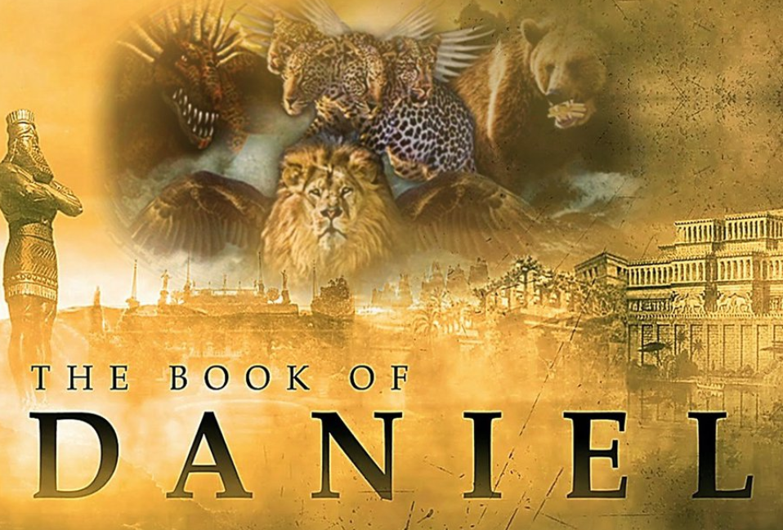
The Most High God rules over the kingdoms of the world and appoints anyone he desires to rule over them.
(Dan 5:21b NLT)
To Download this lesson go to:
http://www.purifiedbyfaith.com/Daniel/Daniel.htm
https://subsplash.com/charis/media/ms/+b72rmnj

Slide 2
Summary of What We’ve Covered So Far in Chapter 11
Last week we began looking at the vision communicated to Daniel by the angel Gabriel in Daniel 11:2–12:3.
This vision contains a considerable amount of tedious historical detail, making it difficult and somewhat cumbersome to try to follow.
But, as we have seen so far, this vision gives an astoundingly detailed and accurate prediction of a number of historical events, many of which would not occur for hundreds of years.
So far, we have looked at Daniel 11:2-4 which begins with a reference to the Persian kings who were the successors of Cyrus and extends through the Greek conqueror, Alexander the Great and his successors.
Then, we began covering Daniel 11:5-20 (we got as far as verse 14) which gives a detailed summary of the on-going conflict between the Seleucid and Ptolemaic dynasties (the primary powers of the divided Greek empire that arose after the death of Alexander).

Slide 3
Prophesies Concerning Egypt and Syria – Part B (11:15-20)
^{11:15} Then the king of the North will come and build up siege ramps and will capture a fortified city. The forces of the South will be powerless to resist; even their best troops will not have the strength to stand. ¹⁶ The invader will do as he pleases; no one will be able to stand against him. He will establish himself in the Beautiful Land and will have the power to destroy it. ¹⁷ He will determine to come with the might of his entire kingdom and will make an alliance with the king of the South. And he will give him a daughter in marriage in order to overthrow the kingdom, but his plans will not succeed or help him. ¹⁸ Then he will turn his attention to the coastlands and will take many of them, but a commander will put an end to his insolence and will turn his insolence back upon him. ¹⁹ After this, he will turn back toward the fortresses of his own country but will stumble and fall, to be seen no more. ²⁰ “His successor will send out a tax collector to maintain the royal splendor. In a few years, however, he will be destroyed, yet not in anger or in battle. (NIV)

Slide 4
^{11:15} Then the king of the north shall come and throw up siegeworks and take a well-fortified city. And the forces of the south shall not stand, or even his best troops, for there shall be no strength to stand. (ESV)
There was a brief interruption of the victorious advance of “the king of the north” (Antiochus III, as described in verse 13) in which his attention was temporarily diverted by other difficulties.
During his absence the Egyptian general Scopas recaptured some of the territory that Antiochus had just gained.
But Antiochus soon ousted him at the battle of Panium and drove him back to the city of Sidon, described here as “a well-fortified city”.
When it says that the king “[threw] up siegeworks,” this refers to his assault upon Sidon, which ultimately succeeded.
For though the Egyptians sent three of their best generals to counter the siege against that city, they were ultimately driven back so that “the forces of the south shall not stand… even his best troops, for there shall be no strength to stand.”
Leupold, H. C.; Exposition of Daniel (1949); (pp. 488–489)

Slide 5
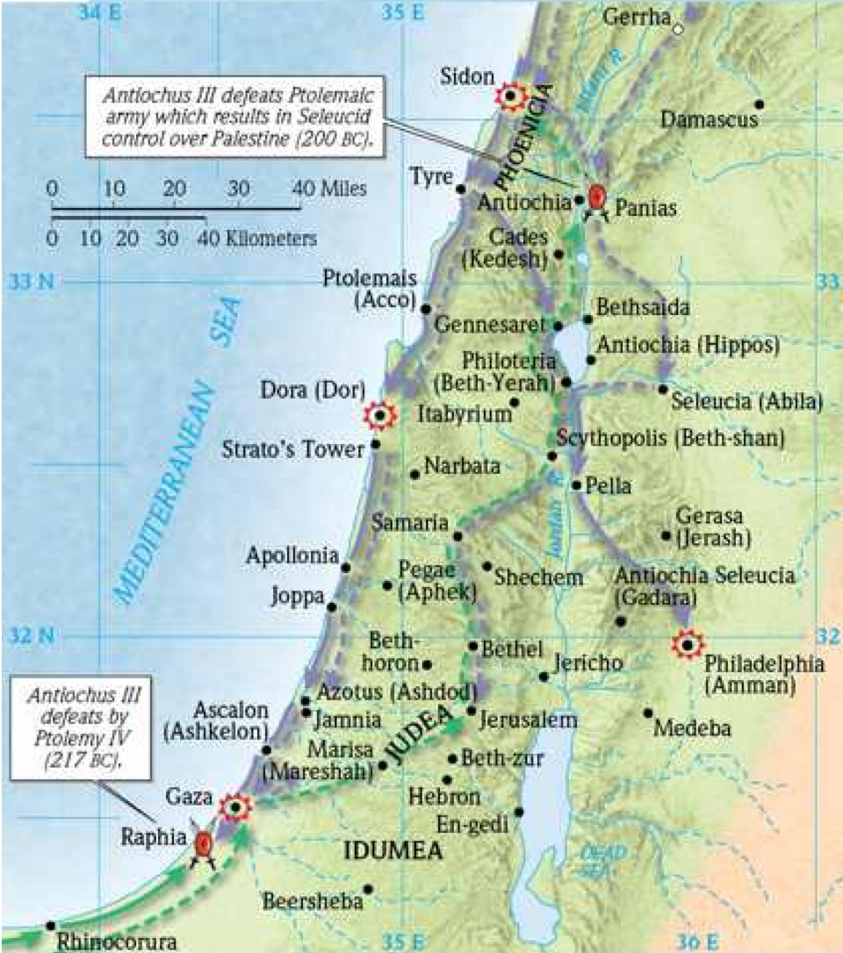
Antiochus III Defeats Ptolemaic Army – 200 BC
Wright, Paul H., Ultimate Bible Atlas (Ultimate Guide) (p. 346)

Slide 6
^{11:16} But he who comes against him shall do as he wills, and none shall stand before him. And he shall stand in the glorious land, with destruction in his hand. (ESV)
With the defeat of the Egyptians at Sidon, Antiochus III (“he who comes against [the king of the south] ”) acquired complete control over Phoenicia and Palestine.
Although the “glorious land” (Palestine) had come under Antiochus’s control for a brief time previously (219–217 B.C.), it would now become a permanent possession of the Syrian Empire.
This fact is extremely important because it sets the stage for the reign of terror to follow under the Syrian Greek ruler Antiochus IV Epiphanes (see verses 21ff).
“And he shall stand… with destruction in his hand” most likely means that Antiochus had the power to completely destroy the land, had he decided to do so. But for the most part he didn’t.
Antiochus did punish the Jews who were pro-Egyptian, but when he entered Jerusalem in 198 B.C., he received a warm welcome, for most looked upon him “as a deliverer and benefactor.”
Little did those welcoming Jews realize that within twenty-three years this change in government would lead to one of the most horrible periods in their history.
Miller, Stephen R., Daniel, vol. 18, The New American Commentary (p. 296)

Slide 7
^{11:17} He shall set his face to come with the strength of his whole kingdom, and he shall bring terms of an agreement and perform them. He shall give him the daughter of women to destroy the kingdom, but it shall not stand or be to his advantage. (ESV)
The idiom “set his face ” means “to determine.” ¹
“he shall bring terms of an agreement” refers to a treaty in which Antiochus III betrothed his daughter Cleopatra (“the daughter of women”) to Ptolemy V. ¹
Note: This was the first woman in that royal family to bear the name Cleopatra. The more commonly known Cleopatra VII who was associated with Julius Caesar and Mark Antony lived much later (69–30 B.C.). ²
When the marriage agreement of Cleopatra to Ptolemy V was made, Ptolemy V was only seven years old! The marriage was not actually consummated until five years later. ¹
“He shall give him the daughter… to destroy the kingdom” – the marriage, was proposed by Antiochus, in hopes of destroying his enemy. ¹
“but it shall not stand or be to his advantage” – But in the end, Antiochus’ strategy failed, because Cleopatra ended up siding with her husband over against her father. ¹
¹ Young, Edward J.; The Prophecy of Daniel: A Commentary; (p. 240)
² Miller, Stephen R., Daniel, vol. 18, The New American Commentary (p. 296)

Slide 8
^{11:18} Afterward he shall turn his face to the coastlands and shall capture many of them, but a commander shall put an end to his insolence. Indeed, he shall turn his insolence back upon him. ¹⁹ Then he shall turn his face back toward the fortresses of his own land, but he shall stumble and fall, and shall not be found. (ESV)
Verses 18–19 prophesy the ultimate humiliating defeat of Antiochus III. ¹
Having vanquished the Egyptians, in 197 B.C. or shortly thereafter Antiochus III turned “his face to the coastlands,” the islands or countries around the Mediterranean. ¹
After Antiochus had some initial successes, “a commander” (Lucius Scipio Asiaticus) was sent against him by the Roman government. ¹
“[this] commander shall put an end to [Antiochus III’s] insolence” – a reference to the high-handed and haughty dealings of Antiochus with the Romans. ²
“he shall turn his insolence back upon him” – Antiochus’ insolence comes back on his own head, in that he is greatly humiliated by his defeat. ²
¹ Miller, Stephen R., Daniel, vol. 18, The New American Commentary (p. 296)
² Young, Edward J.; The Prophecy of Daniel: A Commentary; (p. 240)

Slide 9
^{11:18} Afterward he shall turn his face to the coastlands and shall capture many of them, but a commander shall put an end to his insolence. Indeed, he shall turn his insolence back upon him. ¹⁹ Then he shall turn his face back toward the fortresses of his own land, but he shall stumble and fall, and shall not be found. (ESV)
In 191 B.C. the Romans routed Antiochus III and forced him to withdraw from Greece and flee to Asia Minor. ¹
Then thirty thousand Roman troops pursued Antiochus into Asia and defeated his much larger army of seventy thousand at the Battle of Magnesia near Smyrna (Turkey) in 190 B.C. ¹
In 188 B.C. the Romans forced Antiochus to surrender territory, much of his military force, twenty hostages (one of whom was Antiochus IV), and pay a heavy indemnity (compensation money) to Rome. ¹
“Then he shall turn his face back toward the fortresses of his own land” – at this point, Antiochus can no longer attack the strongholds of foreign lands, but must focus his attention on defending the fortresses in his own land. ²
But when Antiochus returned to his own country after this humiliating defeat, he was killed by an angry mob in 187 B.C. ¹
¹ Miller, Stephen R., Daniel, vol. 18, The New American Commentary (p. 296)
² Young, Edward J.; The Prophecy of Daniel: A Commentary; (p. 240)

Slide 10
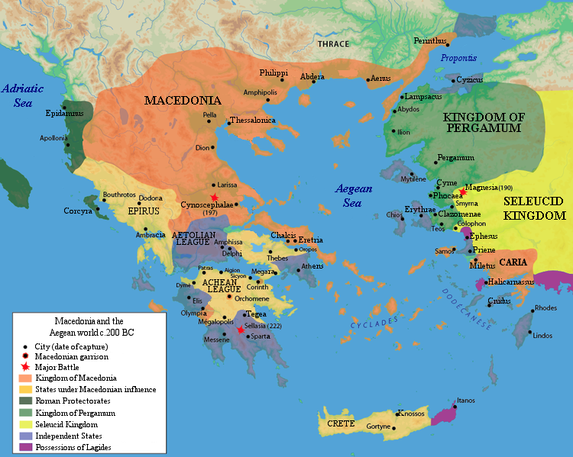
The Defeat of Antiochus III by the Romans
Wright, Paul H., Ultimate Bible Atlas (Ultimate Guide) (p. 346)

Slide 11
^{11:20} “Then shall arise in his place one who shall send an exactor of tribute for the glory of the kingdom. But within a few days he shall be broken, neither in anger nor in battle. (ESV)
The son and successor of Antiochus III was Seleucus IV, who sent a tax collector (Heliodorus) to collect money to pay the thousand talents indemnity (compensation money) demanded annually by the Romans.
According to 2 Macc 3:7–40, Seleucus even sent Heliodorus to plunder the temple in Jerusalem in order to provide funds for the Syrian treasury, but a frightful vision of mighty angels ended up preventing him from doing so.
Seleucus IV reigned only “a few days” (a short time) though he was not killed by an angry mob (“in anger ”) like his father nor was he killed “in battle.”
Instead, he was poisoned by his tax collector and prime minister, Heliodorus (possibly with the encouragement and/or assistance of Antiochus IV), who was evidently seeking to gain the throne for himself.
Miller, Stephen R., Daniel, vol. 18, The New American Commentary (p. 297)

Slide 12
Introduction to the Prophesies Concerning
Antiochus IV Epiphanes (Daniel 11:21-35)
Verses 21–35 serve as the climax of this section.
The historical preview in vv. 2–20 was furnished in order to set the stage for the prediction of an eighth Seleucid-Greek ruler, Antiochus IV Epiphanes (175-163 B.C.), the “little horn” of chapter 8 (cf. 8:9–12, 23–25).
Much attention is given to this wicked king in the book of Daniel because his actions profoundly affected Israel.
Miller, Stephen R., Daniel, vol. 18, The New American Commentary (p. 298)

Slide 13
Prophesies Concerning Antiochus IV Epiphanes (11:21-35)
^{11:21} “He will be succeeded by a contemptible person who has not been given the honor of royalty. He will invade the kingdom when its people feel secure, and he will seize it through intrigue. ²² Then an overwhelming army will be swept away before him; both it and a prince of the covenant will be destroyed. ²³ After coming to an agreement with him, he will act deceitfully, and with only a few people he will rise to power. ²⁴ When the richest provinces feel secure, he will invade them and will achieve what neither his fathers nor his forefathers did. He will distribute plunder, loot and wealth among his followers. He will plot the overthrow of fortresses--but only for a time.

Slide 14
Prophesies Concerning Antiochus IV Epiphanes (11:21-35)
^{11:25} “With a large army he will stir up his strength and courage against the king of the South. The king of the South will wage war with a large and very powerful army, but he will not be able to stand because of the plots devised against him. ²⁶ Those who eat from the king's provisions will try to destroy him; his army will be swept away, and many will fall in battle. ²⁷ The two kings, with their hearts bent on evil, will sit at the same table and lie to each other, but to no avail, because an end will still come at the appointed time. ²⁸ The king of the North will return to his own country with great wealth, but his heart will be set against the holy covenant. He will take action against it and then return to his own country. ²⁹ “At the appointed time he will invade the South again, but this time the outcome will be different from what it was before.

Slide 15
Prophesies Concerning Antiochus IV Epiphanes (11:21-35)
^{11:30} Ships of the western coastlands will oppose him, and he will lose heart. Then he will turn back and vent his fury against the holy covenant. He will return and show favor to those who forsake the holy covenant. ³¹ “His armed forces will rise up to desecrate the temple fortress and will abolish the daily sacrifice. Then they will set up the abomination that causes desolation. ³² With flattery he will corrupt those who have violated the covenant, but the people who know their God will firmly resist him. ³³ “Those who are wise will instruct many, though for a time they will fall by the sword or be burned or captured or plundered. ³⁴ When they fall, they will receive a little help, and many who are not sincere will join them. ³⁵ Some of the wise will stumble, so that they may be refined, purified and made spotless until the time of the end, for it will still come at the appointed time. (NIV)

Slide 16
^{11:21} In his place shall arise a contemptible person to whom royal majesty has not been given. He shall come in without warning and obtain the kingdom by flatteries. (ESV)
When Seleucus IV died in 175 B.C., his younger brother, Antiochus IV, another son of Antiochus III, seized the throne. ¹
Antiochus IV is labeled here as a “contemptible person” because from the Jewish vantage point he was a monster. ¹
Antiochus IV severely persecuted the Jews, massacring thousands, and represented one of the greatest threats to Yahweh worship in all of Israel’s history. ¹
This arrogant monarch referred to himself as Epiphanes, the “Manifest One,” or “Illustrious One”; but others called him Epimanes, the “Madman.” ¹
The honor of “royal majesty” was not due Antiochus, for the throne rightfully belonged to Demetrius I, the son of Seleucus IV. ¹
However, Demetrius I was being held hostage in Rome, and this allowed Antiochus IV to seize power. ¹
A crafty one, he will arise suddenly (“without warning”) through “flatteries”. ²
¹ Miller, Stephen R., Daniel, vol. 18, The New American Commentary (pp. 298–299)
² House, Paul R.; Daniel (Tyndale Old Testament Commentaries); (p. 174)

Slide 17
^{11:22} Armies shall be utterly swept away before him and broken, even the prince of the covenant. ²³ And from the time that an alliance is made with him he shall act deceitfully, and he shall become strong with a small people. (ESV)
Commentaries disagree over the interpretation of these two verses.
I’m inclined to see them as a general description of how Antiochus IV was able to exert the kind of power that he did in the region.
Verse 22 begins with a description of how “armies” were often “utterly swept away before him and broken, even the prince of the covenant. ”
Some commentaries understand “the prince of the covenant” to be a reference to Ptolemy VI, a “prince” who, after being captured by Antiochus, agreed (made a “covenant”) to become an ally of Antiochus IV if Antiochus would help him regain his throne in Egypt, which had been taken by his younger brother, Ptolemy VII. ¹
¹ Miller, Stephen R., Daniel, vol. 18, The New American Commentary (p. 299)
² Howe, Thomas A.; Daniel in the Preterists' Den: A Critical Look at Preterist Interpretations of Daniel; (p. 217)

Slide 18
^{11:22} Armies shall be utterly swept away before him and broken, even the prince of the covenant. ²³ And from the time that an alliance is made with him he shall act deceitfully, and he shall become strong with a small people. (ESV)
Other commentaries understand “the prince of the covenant” to be a reference to the high priest in Israel who bore this title because he was the de facto head of the theocracy at that time. ²
In which case, “the prince of the covenant” being “swept away” might be a reference to the murder of the High Priest Onias, which was ordered by Antiochus in 172 B.C. ²
Verse 23 seems to be a further description of how Antiochus IV, by acting “deceitfully”, was able to exert a “strong” force in the region “with a small [number of] people.”
¹ Miller, Stephen R., Daniel, vol. 18, The New American Commentary (p. 299)
² Howe, Thomas A.; Daniel in the Preterists' Den: A Critical Look at Preterist Interpretations of Daniel; (p. 217)

Slide 19
^{11:24} Without warning he shall come into the richest parts of the province, and he shall do what neither his fathers nor his fathers' fathers have done, scattering among them plunder, spoil, and goods. He shall devise plans against strongholds, but only for a time. (ESV)
Here we see the description of another tactic used by Antiochus IV to gain power and influence.
It was common for Oriental princes in that day to plunder their provinces to the fullest extent.
Antiochus also does this, concentrating on the “the richest parts of the province”
But Antiochus did not squander these things on himself in luxurious living but instead did the unusual thing of distributing “plunder, spoil, and goods” to other men
Through this method he was able to buy other men’s allegiance and gain further influence.
It was, however, not the traditional thing to do, for neither his “his fathers nor his fathers' fathers ” had done thus.
Such underhand dealings gave him an advantage, “but only for a time.”
Leupold, H. C.; Exposition of Daniel (1949); (pp. 496–497)

Slide 20
^{11:25} And he shall stir up his power and his heart against the king of the south with a great army. And the king of the south shall wage war with an exceedingly great and mighty army, but he shall not stand, for plots shall be devised against him. ²⁶ Even those who eat his food shall break him. His army shall be swept away, and many shall fall down slain. (ESV)
Antiochus IV will particularly scheme to defeat his old foe, “the king of the south” (Ptolemy VI).
This strategy had practical implications, for Egypt was a lush, wealthy land.
Though Ptolemy will raise large armies, “the king of the south ” will not stand against his northern foe.
He will suffer from internal “plots… devised against him”
Perhaps some of the wealth Antiochus IV has distributed to key individuals over the years (see 11:24) will buy him a few traitors down south.
House, Paul R.; Daniel (Tyndale Old Testament Commentaries); (p. 175)

Slide 21
^{11:27} And as for the two kings, their hearts shall be bent on doing evil. They shall speak lies at the same table, but to no avail, for the end is yet to be at the time appointed. ²⁸ And he shall return to his land with great wealth, but his heart shall be set against the holy covenant. And he shall work his will and return to his own land. (ESV)
Here we see that neither one of these warring kings has any integrity.
“They shall speak lies at the same table” to gain an edge over the other, “but to no avail”, for God rules their times.
In verse 28 we see the real purpose of all this historical data – to set the stage for the persecution of the Jewish people (“the holy covenant”).
After plundering Egypt, Antiochus returned home by way of Palestine and found an insurrection in progress (cf. 1 Macc 1:16–28; 2 Macc 5:1–11).
He put down the rebellion, massacring eighty thousand men, women, and children (2 Macc 5:12–14) and then looted the temple with the help of the evil high priest, Menelaus (cf. 2 Macc 5:15–21).
The persecution of the Jews by this evil tyrant had now escalated to calamitous proportions.
Miller, Stephen R., Daniel, vol. 18, The New American Commentary (p. 300)

Slide 22
^{11:29} "At the time appointed he shall return and come into the south, but it shall not be this time as it was before. ³⁰ For ships of Kittim shall come against him, and he shall be afraid and withdraw, and shall turn back and be enraged and take action against the holy covenant. He shall turn back and pay attention to those who forsake the holy covenant. (ESV)
In 168 B.C. (God’s “time appointed ”) Antiochus invaded Egypt again, but this time he was not successful.
The cause of Antiochus’s failure was that he encountered opposition from the “ships of Kittim”
“Kittim” was an ancient name for Cyprus that came to be used for the lands of the Mediterranean in general.
Here it refers to the Roman fleet that had come to Alexandria at the request of the Ptolemies.
As the Syrians were moving to besiege Alexandria, the Roman commander Gaius Popilius Laenas met Antiochus four miles outside of the city and handed him a letter from the Roman Senate ordering him to leave Egypt or face war with Rome.
Miller, Stephen R., Daniel, vol. 18, The New American Commentary (pp. 300–301)

Slide 23
^{11:29} "At the time appointed he shall return and come into the south, but it shall not be this time as it was before. ³⁰ For ships of Kittim shall come against him, and he shall be afraid and withdraw, and shall turn back and be enraged and take action against the holy covenant. He shall turn back and pay attention to those who forsake the holy covenant. (ESV)
Then the Roman commander drew a circle in the sand around Antiochus and told him that he must respond before stepping from the circle.
Well aware of the might of Rome, having been a hostage there, and also remembering his father’s (Antiochus III) defeat by the Roman legions at the Battle of Magnesia, the Syrian king stood in humiliated silence for a brief interval and then acquiesced to the demand.
Antiochus withdrew from Egypt to Antioch in utter humiliation. In 167 B.C., Antiochus turned his humiliation into anger against the Jewish people (“the holy covenant”).
He sent Apollonius (2 Macc 5:23–26), the head of his mercenaries and the “chief collector of tribute” (1 Macc 1:29), to Jerusalem.
Apollonius pretended to come in peace, but on the Sabbath Day he suddenly attacked, massacring many people and plundering the city (cf. 1 Macc 1:30–32).
Miller, Stephen R., Daniel, vol. 18, The New American Commentary (pp. 300–301)

Slide 24
^{11:31} Forces from him shall appear and profane the temple and fortress, and shall take away the regular burnt offering. And they shall set up the abomination that makes desolate. ³² He shall seduce with flattery those who violate the covenant, but the people who know their God shall stand firm and take action. (ESV)
The temple is spoken of here as a “fortress” either because it was a place of spiritual strength or more likely because it was used as a military citadel.
Later, in 167 B.C., the suppression of the Jewish religion began on a grand scale (1 Macc 1:41–50; 2 Macc 6:1–6).
All Jewish religious practices such as circumcision, possessing the Scriptures, sacrifices, and feast days were forbidden on penalty of death (1 Macc 1:50, 63); and the imperial cult was introduced.
Desecration of the Jewish religion reached its climax in 167 B.C. (1 Macc 1:54) when an altar or idol-statue devoted to Olympian Zeus (Jupiter) was erected in the temple (“the abomination that makes desolate”), and sacrifices, probably including swine (cf. 1 Macc 1:47; 2 Macc 6:4–5), were offered on the altar (cf. 1 Macc 1:54, 59).
Miller, Stephen R., Daniel, vol. 18, The New American Commentary (pp. 301–302)

Slide 25
^{11:31} Forces from him shall appear and profane the temple and fortress, and shall take away the regular burnt offering. And they shall set up the abomination that makes desolate. ³² He shall seduce with flattery those who violate the covenant, but the people who know their God shall stand firm and take action. (ESV)
In this manner the temple was desecrated and rendered empty of Yahweh worshipers. ¹
Two groups will emerge in Jerusalem during this time:
  Those who are seduced with flattery and follow Antiochus IV
  Those who know their God and thus stand firm and take action. ²
The latter group’s actions are not specified.
They could include accepting martyrdom, or engaging in armed conflict, as the Maccabeans did during the rest of Antiochus IV’s reign (167-164 BC). ²
¹ Miller, Stephen R., Daniel, vol. 18, The New American Commentary (pp. 301–302)
² House, Paul R.; Daniel (Tyndale Old Testament Commentaries); (p. 176)

Slide 26
^{11:33} And the wise among the people shall make many understand, though for some days they shall stumble by sword and flame, by captivity and plunder. (ESV)
“the wise among the people” refers to those who have spiritual discernment, i.e., true believers.
These saints would remain true to Yahweh during Antiochus’s persecution and would “make many [in Israel] understand” concerning the truth and the correct course of action, which included a military revolt against the Syrian government.
Because of their stand many of the Jewish faithful would be killed.
Tens of thousands were slaughtered in these persecutions, and many others died during the fighting (1 Macc 6:43–46; 1 Macc 9:3, 15-18).
Others were “captured” for slaves or had their property confiscated (“plundered”).
Though intense, this persecution would last only for a short while.
Some of these faithful heroes seem to be noted in Heb 11:34.
Hebrews 11:35 is thought by some to speak of the martyrdom of a mother and her seven sons who were horribly tortured and then burned (cf. 2 Macc 7:1–41).
Miller, Stephen R., Daniel, vol. 18, The New American Commentary (pp. 302–303)

Slide 27
^{11:34} When they stumble, they shall receive a little help. And many shall join themselves to them with flattery, ³⁵ and some of the wise shall stumble, so that they may be refined, purified, and made white, until the time of the end, for it still awaits the appointed time. (ESV)
During this period of oppression (“when they stumble”), those faithful to Yahweh “shall receive a little help,” presumably an allusion to the small number of forces who at the first fought against Antiochus.
“And many shall join themselves to them with flattery” refers to the fact that as the strength of the Maccabean revolt grew, many uncommitted Jews sided with the rebels out of expediency, particularly when the Maccabean forces began to put to death those who had collaborated with the Seleucids (cf. 1 Macc 2:42–48).
“some of the wise shall stumble, so that they may be refined, purified, and made white” – The purpose of this fiery ordeal that fell upon Israel was to cleanse individuals and the nation as a whole of sinful practices and to strengthen their faith.
In this context the “end” that has been “appointed” by the Lord denotes the termination of Antiochus’s persecutions.
Antiochus IV died in a horrible death 163 B.C. during an expedition in Persia, bringing to a conclusion both his wicked life and his atrocities against God’s people.
Miller, Stephen R., Daniel, vol. 18, The New American Commentary (pp. 303–304)

Slide 28

Class Discussion Time
We saw in verses 32-33 that “the wise among the people” (those who have spiritual discernment, i.e., true believers) would remain true to Yahweh during Antiochus’s persecution and would “make many [in Israel] understand” concerning the truth and the correct course of action, which included a military revolt against the government of Antioch IV.
Because of their stand many of these Jewish faithful would be killed.
Heb 11:34-35 seems to make honorable mention of these saints when it talks about those who “became mighty in war, put foreign armies to flight… some were tortured, refusing to accept release, so that they might rise again to a better life.”

Slide 29
Class Discussion Time
This brings to mind a question concerning a proper Christian response to governing authorities – in particular those who are extraordinarily evil.
In general, we are told to obey governing authorities, since they are (ideally) appointed by God to punish evildoers (Romans 13).
But what about when the governing authorities themselves become the evildoers?
Is there ever a time when it is appropriate for those with “spiritual discernment” to fight against evil governing authorities?
One historical example that comes to mind is Dietrich Bonhoeffer who was put to death for his efforts to undermine the Hitler regime.

Slide 30
Class Discussion Time
In our lesson today, we saw Antiochus IV, after being defeated and public ally humiliated by the Roman army, turned around and vented his rage against the Jewish people who had nothing to do with his defeat at the hands of the Romans.
This unfortunately is a common human behavior, what we might call the “kick the dog” syndrome.
Have you seen an example of this kind of behavior in your dealings with other people?
Or have you ever been guilty of this kind of behavior yourself?

