Slide 1
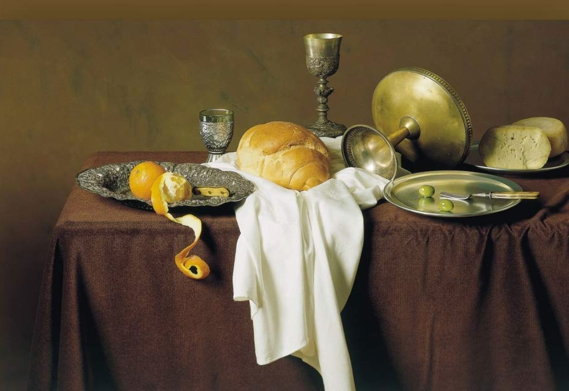
New Covenant Theology
An Exploration of the
Biblical Covenants
as they Culminate in the
New Covenant
Image credit – https://www.amazon.com/New-Covenant-Community-Significance-Understanding/dp/1842272489

Slide 2
Overview
New Covenant Theology (NCT) is a Christian theological framework, presented in the scriptures, that views biblical history through the lens of the New Covenant established by Jesus Christ – emphasizing that His person and work serve as the central focus of Scripture.
A proper understanding of the New Covenant Theology will help us:
See how the biblical writers present the progressive unfolding of God’s sovereign plan of redemption.
Do a better job of rightly understanding and applying the Word of God in our lives.
In this brief overview today, we will:
Begin by laying out the major covenants named by and described in the Bible
See what the biblical writers say about the New Covenant and how they compare and contrast it with the Old (Mosaic) Covenant.
Look at two faulty man-made theological systems that have commonly been used to create a framework for viewing the structure and history of the Bible.

Slide 3
What Is a Covenant?
Dictionary Definition:
A solemn agreement between two or more persons or groups to do or not do a certain thing (World Book Dictionary)
Definition of a Covenant between God and Man:
A covenant is an unchangeable, divinely imposed legal agreement between God and man that stipulates the conditions of their relationship. (Grudem, Systematic Theology p.515)
Each of the major biblical covenants is covenant is made between God and a specific person or group of people.
These covenant were often accompanied by a sign that served as a symbol and future reminder of the covenant.

Slide 4
The Major Covenants in the Bible
Noahic (Genesis 9:8-17)
Abrahamic (Genesis 12-17)
Mosaic (Exodus 19-24)
Davidic (2 Samuel 23:5, Psalm 89:3)
New (Jer.31:31-34 ; Heb.7-13; 2 Cor.3:6-18)

Slide 5
The Noahic Covenant
Description: A divine promise to never again destroy the entire earth and kill all living things with a flood.
Made with: Noah, his descendants, and every living thing on the earth
Sign: Rainbow
Key Scripture:
Genesis 9:8-13 – Then God said to Noah and to his sons with him, ⁹ “Behold, I establish my covenant with you and your offspring after you, ¹⁰ and with every living creature… that never again shall all flesh be cut off by the waters of the flood, and never again shall there be a flood to destroy the earth…¹³ I have set my bow in the cloud, and it shall be a sign of the covenant between me and the earth.

Slide 6
The Abrahamic Covenant
Description: A divine promise of land, offspring, and blessing.
Made with: Abraham and his descendants
Sign: Circumcision
The Abrahamic Covenant had two fulfillments:
Physical land, offspring, and blessing
Spiritual land, offspring, and blessing

Slide 7
The Abrahamic Covenant – Key Scriptures
Physical Fulfillment:
Genesis 15:18 – On that day the LORD made a covenant with Abram, saying, “To your offspring I give this land…”
Genesis 12:2-3 – “And I will make of you a great nation, and I will bless you and make your name great, so that you will be a blessing. I will bless those who bless you, and him who dishonors you I will curse, and in you all the families of the earth shall be blessed.”
Genesis 17:11 – You shall be circumcised in the flesh of your foreskins, and it shall be a sign of the covenant between me and you.
Spiritual Fulfillment:
Hebrews 11:9-10,16 – By faith [Abraham] went to live in the land of promise, as in a foreign land, living in tents... For he was looking forward to the city that has foundations, whose designer and builder is God… a better country, that is, a heavenly one.
Romans 4:16 – Therefore, the promise comes by faith . . . to all Abraham's offspring-- not only to those who are of the law but also to those who are of the faith of Abraham. He is the father of us all.
Galatians 3:8 – And the Scripture, foreseeing that God would justify the Gentiles by faith, preached the gospel beforehand to Abraham, saying, "In you shall all the nations be blessed.”

Slide 8
The Mosaic Covenant
Description: God’s pledge to treasure and protect the nation of Israel – to be their God and have them as His chosen nation if they faithfully keep his laws.
Summarized in the Ten Commandments (cf. Exodus 34:27-28; Deuteronomy 7:12)
Ultimately embodied in the 600+ laws given to Moses on Mount Sinai
Usually referred to in the New Testament as “the old covenant” or “the law”
Made with: The nation of Israel exclusively (see Psalm 147:19-20) – it included both:
Regenerate Jews (Heb.11:23-40)
Unregenerate Jews (Jer.2:8; 4:22)
Sign: The Sabbath
Key Scriptures:
Exodus 19:3-8 – Moses went up to God. The LORD called to him out of the mountain, saying, "Thus you shall say to the house of Jacob, and tell the people of Israel: ⁴ You yourselves have seen what I did to the Egyptians, and how I bore you on eagles' wings and brought you to myself. ⁵ Now therefore, if you will indeed obey my voice and keep my covenant, you shall be my treasured possession among all peoples, for all the earth is mine;
Exodus 31:16-17 – And the LORD said to Moses … ¹⁶ “the people of Israel shall keep the Sabbath, observing the Sabbath throughout their generations, as a covenant forever. ¹⁷ It is a sign forever between me and the people of Israel …

Slide 9
The Davidic Covenant
Description: God’s promise that David’s royal lineage will endure forever
Made with: David and his descendants
Sign: ?
Key Scriptures:
2 Samuel 7:8,16 – Now, therefore, thus you shall say to my servant David, “Thus says the LORD of hosts: … Your house and your kingdom shall be made sure forever before me. Your throne shall be established forever.”
Psalm 89:3-4 – I [the Lord] have made a covenant with my chosen one; I have sworn to David my servant: “I will establish your offspring forever, and build your throne for all generations.”

Slide 10
The New Covenant
Description: God’s promise to redeem His people from their sins and write His law on their hearts, giving them an eternal inheritance.
Made with: Genuine believers since the coming of Christ
Sign: ?

Slide 11
The New Covenant – Key Scriptures
Jeremiah 31:31-34 – Behold, the days are coming, declares the LORD, when I will make a new covenant with the house of Israel and the house of Judah, not like the covenant that I made with their fathers on the day when I took them by the hand to bring them out of the land of Egypt, my covenant that they broke, though I was their husband, declares the LORD. For this is the covenant that I will make with the house of Israel after those days, declares the LORD: I will put my law within them, and I will write it on their hearts. And I will be their God, and they shall be my people. And no longer shall each one teach his neighbor and each his brother, saying, 'Know the LORD,' for they shall all know me, from the least of them to the greatest, declares the LORD. For I will forgive their iniquity, and I will remember their sin no more.

Slide 12
The New Covenant – Key Scriptures
Luke 22:20b (cf. 1Cor 11:25) – This cup that is poured out for you is the new covenant in my blood.
Hebrews 9:15 – Therefore [Christ] is the mediator of a new covenant, so that those who are called may receive the promised eternal inheritance, since a death has occurred that redeems them from the transgressions committed under the first covenant.
2 Corinthians 3:6-8 – [God] has made us sufficient to be ministers of a new covenant, not of the letter but of the Spirit. For the letter kills, but the Spirit gives life. Now if the ministry of death, carved in letters on stone, came with such glory that the Israelites could not gaze at Moses' face because of its glory, which was being brought to an end, will not the ministry of the Spirit have even more glory?

Slide 13
The New Covenant - Summary
Was established by Jesus’ blood sacrifice on the cross (1 Cor. 11:25)
Includes only regenerate people (those who “know the Lord”) (Jer. 31:31-34)
Is characterized by the Holy Spirit indwelling the hearts of all of God’s people (2 Cor. 3:6 – see also: Acts 2:17; 2 Corinthians 1:22; 1 Corinthians 12:13)
Includes Jews and Gentiles on an equal basis before God (Ephesians 2:11-18)
Believers in the New Covenant are not under the Law of Moses, instead they are under the “Law of Christ” (1 Corinthians 9:19-21; Galatians 6:2)
There are a number of places in scripture (especially in the Old Testament) where the New Covenant is referenced by other terms such as:
Everlasting Covenant (Jer. 32:36-41; 50:2-5; Ezek 37:15-28 (esp. v.26); Isaiah 55:1-5; 61:8-9; Heb 13:20)
Covenant of Peace (Isaiah 54:1-10 (esp. vv.9-10); Ezek 34:20-31 (esp. v.25); 37:15-18 (esp. v.26)
Promise of a new heart and a new spirit (Ezek 11:18-21; 18:30-32; 36:24-32 (esp. v.26) [cf. Isa. 59:21]

Slide 14
The Structure and Message of the Bible
Based on a Chart Originally Developed by David N. Steele
The Triune God
(1) The Father
(2) The Son (Jesus Christ)
(3) The Holy Spirit
Gentiles (The Nations of the World)
Unbelieving Jews and Gentiles
Jews (The Nation of Israel)
A New Nation –
The Church (Christ’s Body)
Composed of Believing
Jews and Gentiles
“Christians”
The Incarnation
(John 1:1-3,14)
Ascension
(Luke 24; Acts 1)

(1)
(2)
( 3 )
“R”
Creation
Abraham
Moses
the Law Giver
King David
Jesus Christ
Holy Spirit
)()()()()(
The Four Gospels
The Book of Acts
Chs. 1-12 Peter (Jews) AD 30-44
Chs. 13-28 Paul (Gentiles) AD 44-60
The Call of Abraham
(the Father of the Jews)
(1) Birth
(2) Baptism
The
Fall
(Adam)
(3) Public Ministry
Letters to Churches and
Individual Christians - Revelation

= Crucifixion
The
Flood
(Noah)
“R” = Resurrection
Jews (The Nation of Israel)
Gentiles (The Nations of the World)
Unbelieving Jews and Gentiles
4000
2300
2000
1400
1000
5BC
AD 28
44
95
The Old Testament (39 Books)
Written in Hebrew
Genesis --- (Promises -- Prophecy) --- Malachi
400
Years
The New Testament (27 Books & Letters)
Written in Greek
Matthew ----- (Fulfillment) ------ Revelation

Slide 15
A Comparison of the Old and New Covenants
The
Old
(Mosaic) Covenant
The
New Covenant
Fundamentally Different
Superior
Fulfills
Replaces

Slide 16
The New Covenant Is Fundamentally Different
The Old Covenant Was Made With One Nation (Exodus 19:3-5; Psalm 147:19-20)
The New Covenant Includes Many Nations (Matthew 28:18-20; Acts 1:8; Galatians 3:8; Revelation 7:9)
The Old Covenant Included:
Believers (Hebrews 11:23-40 )
Unbelievers (Jeremiah 2:8; Jeremiah 4:22; Romans 9:6ff)
The New Covenant Includes Believers Only (Jeremiah 31:34)
The Old Covenant Focused on Physical Blessings:
Physical Health (Deuteronomy 7:15)
Physical Wealth (Deuteronomy 28:11-12)
Military Victory (Deuteronomy 28:7)
The New Covenant Focuses on Spiritual Blessings:
Spiritual Health (1 Timothy 4:8)
Spiritual Wealth (1 Timothy 6:18; James 2:5; Revelation 2:9a)
Spiritual Victory (Ephesians 6:12; 2 Corinthians 10:5)

Slide 17
The New Covenant is Superior to the Old Covenant
Hebrews 8:6-13; 2 Corinthians 3:6-11; Galatians 4:22-31

Slide 18
The New Covenant is Superior – Hebrews 6:8-13
^{Hebrews 8:6} But now Jesus… mediates for us a far better covenant with God, based on better promises. ⁷ If the first covenant had been faultless, there would have been no need for a second covenant to replace it. ⁸ But when God found fault with the people, he said [in Jer. 31:31-34]: "The day is coming, says the LORD, when I will make a new covenant with the people of Israel and Judah. ⁹ This covenant will not be like the one I made with their ancestors when I took them by the hand and led them out of the land of Egypt. They did not remain faithful to my covenant, so I turned my back on them, says the LORD. ¹⁰ But this is the new covenant I will make with the people of Israel on that day, says the LORD: I will put my laws in their minds, and I will write them on their hearts. I will be their God, and they will be my people. ¹¹ And they will not need to teach their neighbors, nor will they need to teach their relatives, saying, 'You should know the LORD.' For everyone, from the least to the greatest, will know me already. ¹² And I will forgive their wickedness, and I will never again remember their sins." ¹³ When God speaks of a "new" covenant, it means he has made the first one obsolete. It is now out of date and will soon disappear. (NLT)
Hebrews 8:6-13 teaches us that when God promised Israel a new covenant in Jer. 31:31-34 it demonstrated that the old covenant had a problem and therefore needed to be replaced with a covenant that was superior to it.

Slide 19
The New Covenant is Superior – 2 Corinthians 3:6-11
^{2 Corinthians 3:6} [God] has made us competent to be ministers of a new covenant, not of the letter but of the Spirit. For the letter kills, but the Spirit gives life. ⁷ Now if the ministry of death, carved in letters on stone, came with such glory that the Israelites could not gaze at Moses' face because of its glory, which was being brought to an end, ⁸ will not the ministry of the Spirit have even more glory? ⁹ For if there was glory in the ministry of condemnation, the ministry of righteousness must far exceed it in glory. ¹⁰ Indeed, in this case, what once had glory has come to have no glory at all, because of the glory that surpasses it. ¹¹ For if what was being brought to an end came with glory, much more will what is permanent have glory.
2 Corinthians 3:6-11 tells us that the “glory” of the New Covenant is so superior to that of the Old Covenant, the Old Covenant has “no glory at all” in comparison.
The Old Covenant, as summarized by the Ten Commandments, is described as a “ministry of death, carved in letters on stone” that condemns us as spiritually dead.
In contrast, the New Covenant is called a “ministry of the Spirit” because it is written by the Spirit on the hearts of believers which makes us spiritually alive through regeneration.

Slide 20
The New Covenant is Superior – Galatians 4:22-31
^{Galatians 4:22} For it is written that Abraham had two sons, one by a slave woman and one by a free woman. ²³ But the son of the slave was born according to the flesh, while the son of the free woman was born through promise. ²⁴ Now this may be interpreted allegorically: these women are two covenants. One is from Mount Sinai, bearing children for slavery; she is Hagar. ²⁵ Now Hagar is Mount Sinai in Arabia; she corresponds to the present Jerusalem, for she is in slavery with her children. ²⁶ But the Jerusalem above is free, and she is our mother… ²⁸ Now you, brothers, like Isaac, are children of promise. ²⁹ But just as at that time he who was born according to the flesh persecuted him who was born according to the Spirit, so also it is now. ³⁰ But what does the Scripture say? "Cast out the slave woman and her son, for the son of the slave woman shall not inherit with the son of the free woman." ³¹ So, brothers, we are not children of the slave but of the free woman.
Galatians 4:21-31 teaches us that Abraham’s sons: Ishmael and Isaac, the kind of mother they each had (“slave” versus “free”), and the kind of birth they each had (born “according to the flesh” versus “born through promise”) picture the superiority of the New Covenant over the Old:
As Christians, we do not belong to a covenant that is in bondage to the Law (i.e., the Old Covenant)
We belong to the promised New Covenant and are free from that Law and the burden and condemnation that it brings – therefore we should “cast out” those who would seek to put us back under the Old Covenant.

Slide 21
The New Covenant is Superior – Summary
Old Covenant Slavery
Gives Way To
New Covenant Freedom
Mediator, Moses
Gives Way To
Mediator, Christ
Law of Moses
Gives Way To
Law of Christ
Ministry of Death
Gives Way To
Ministry of Life
Ministry of Letter
Gives Way To
Ministry of Spirit
Writing on Stones
Gives Way To
Writing on Hearts
Fading Glory
Gives Way To
Abiding Glory
Ministry of Condemnation
Gives Way To
Ministry of Righteousness
Disobedient People (Heb.8:9)
Gives Way To
Obedient People (Heb.8:10)
People Who Do Not "Know the Lord" (Jer.2:8; 4:22; 9:3)
People Who "Know the Lord" (Jer. 31:34; 24:7)
Gives Way To

Slide 22
The New Covenant Fulfills the Old Covenant
Matthew 5:17-20; Luke 24:44

Slide 23
The New Covenant Fulfills the Old – Matthew 5:17-20
^{Matthew 5:17} “Do not think that I have come to abolish the Law or the Prophets; I have not come to abolish them but to fulfill them. ¹⁸ For truly, I say to you, until heaven and earth pass away, not an iota, not a dot, will pass from the Law until all is accomplished. ¹⁹ Therefore whoever relaxes one of the least of these commandments and teaches others to do the same will be called least in the kingdom of heaven, but whoever does them and teaches them will be called great in the kingdom of heaven. ²⁰ For I tell you, unless your righteousness exceeds that of the scribes and Pharisees, you will never enter the kingdom of heaven.
Jesus, the Mediator of the New Covenant, tells us that his purpose in coming to earth was to fulfill all that was written in the Old Covenant scriptures:
the Law or the Prophets = A phrase that refers to the Old Testament in its entirety
abolish (kataluo) – to dissolve, to destroy, demolish, deprive of success, bring to naught
fulfill (pleroo) – to make full, to fill up, to complete, to fill to the top: so that nothing shall be wanting, to make complete in every particular, to bring to realization

Slide 24
The New Covenant Fulfills the Old Covenant
Matthew uses the same Greek word (that is translated “fulfill”) in relation to Jesus at least 13 times (outside of Matthew 5:17).
In each case, Matthew shows where Jesus or an event related to Jesus’ coming fulfills an Old Testament prophesy:
Matthew 1:22 – Virgin Birth, Called Immanuel
Matthew 2:15 – Called out of Egypt
Matthew 2:17 – Mothers weeping over babies
Matthew 2:23 – From Nazareth
Matthew 3:15 – To “fulfill all righteousness”
Matthew 4:14 – A great light
Matthew 8:17 – Healing
Matthew 12:17 – God’s Chosen Servant
Matthew 13:35 – Spoke in Parables
Matthew 21:4 – Riding on a donkey
Matthew 26:54ff – The events of His arrest
Matthew 27:9 – Betrayed by 30 pieces of silver

Slide 25
The New Covenant Fulfills the Old – Matthew 5:17-20
^{Matthew 5:19} Therefore whoever relaxes one of the least of these commandments and teaches others to do the same will be called least in the kingdom of heaven, but whoever does them and teaches them will be called great in the kingdom of heaven. ²⁰ For I tell you, unless your righteousness exceeds that of the scribes and Pharisees, you will never enter the kingdom of heaven.
Jesus is not teaching here that we are to continue “keeping” all of the Old Testament Laws, including the commands to offer sacrifices, not eat certain foods, etc.
Instead, we are now to “keep” the Old Testament laws by obeying him, because these laws pointed to him and he is their fulfillment, which is why in the rest of this chapter (Mat. 5:21-34) Jesus points his audience away from the Old Testament commands and practices and points instead towards his commands:
Matthew 5:21-22 - You have heard that it was said to those of old, “You shall not murder; and whoever murders will be liable to judgment.” But I say to you that everyone who is angry with his brother will be liable to judgment.
Matthew 5:27-28 - You have heard that it was said, “You shall not commit adultery.” But I say to you that everyone who looks at a woman with lustful intent has already committed adultery with her in his heart.
Matthew 5:33-34 - Again you have heard that it was said to those of old, “You shall not swear falsely, but shall perform to the Lord what you have sworn.” But I say to you, Do not take an oath at all…

Slide 26
The New Covenant Replaces the Old Covenant
Hebrews 8:7-8,13; 2 Corinthians 3:6-7,11; Ephesians 2:14-16; Colossians 2:14,16-17

Slide 27
The New Covenant Replaces the Old Covenant
Hebrews 8:7-8,13 - For if that first covenant had been faultless, there would have been no occasion to look for a second. ⁸ For he finds fault with them when he says: "Behold, the days are coming, declares the Lord, when I will establish a new covenant with the house of Israel and with the house of Judah… ¹³ In speaking of a new covenant, he makes the first one obsolete. And what is becoming obsolete and growing old is ready to vanish away.
2 Corinthians 3:6-7, 11 – [God] has made us sufficient to be ministers of a new covenant, not of the letter but of the Spirit. For the letter kills, but the Spirit gives life. ⁷ Now if the ministry of death, carved in letters on stone, came with such glory that the Israelites could not gaze at Moses' face because of its glory, which was being brought to an end… ¹¹ For if what was being brought to an end came with glory, much more will what is permanent have glory.
Ephesians 2:14-16 – For [Christ] himself is our peace, who has made the two [peoples – Jews and Gentiles] one and has destroyed the barrier, the dividing wall of hostility, by abolishing in his flesh the law with its commandments and regulations. His purpose was to create in himself one new man out of the two, thus making peace, and in this one body to reconcile both of them to God through the cross. (NIV)
Colossians 2:14, 16-17 – having canceled the written code, with its regulations, that was against us and that stood opposed to us; he took it away, nailing it to the cross . . . Therefore do not let anyone judge you by what you eat or drink, or with regard to a religious festival, a New Moon celebration or a Sabbath day. These are a shadow of the things that were to come; the reality, however, is found in Christ. (NIV)

Slide 28
The New Covenant Replaces the Old Covenant
In Summary, the New Testament writers tell us that the Old Covenant, including all of its parts (laws) was:
“brought to an end” (2 Corinthians 3:11)
“growing old” (Hebrews 8:13)
“ready to vanish away” (Hebrews 8:13)
Is now:
“obsolete” (Hebrews 8:13)
“abolished” (Ephesians 2:15)
“cancelled” (Colossians 2:14)
The Old Covenant has been replaced with a new and better covenant that is more glorious and permanent!
Hebrews 8:6b – The covenant [Jesus] mediates is better, since it is enacted on better promises.
Hebrews 8:13a – In speaking of a new covenant, he makes the first one obsolete.
2 Corinthians 3:11 – For if what was being brought to an end came with glory, much more will what is permanent have glory.

Slide 29
A Brief Look at Two Commonly Used But Faulty Theological Systems:
Two faulty man-made theological systems commonly used to create a framework for viewing the structure and history of the Bible are:
Dispensationalism
Covenant Theology

Slide 30
Dispensationalism
Dispensationalism arose in the nineteenth century through John Nelson Darby and spread widely in the United States via the Bible Conference movement and the Scofield Reference Bible (1909), whose study notes promoted a dispensational reading of Scripture.
Its institutional center became Dallas Theological Seminary (founded 1924 by Lewis Sperry Chafer), where influential dispensational theologians such as Walvoord, Ryrie, and Pentecost taught.
In recent years (starting around 1990) a new version of dispensationalism began to emerge known a “Progressive Dispensationalism”.
Proponents of this view include Robert Saucy, Craig Blaising, Darrell Bock, Bruce Ware, John MacArthur and others.
Progressive Dispensationalism dropped some of what they see as the more radical, less defensible tenants of early Dispensationalism, while still holding on to many of the fundamental underlying ideas.
Dispensationalism is best known for its eschatology, especially the pre-tribulation rapture, which teaches that the church will be taken to heaven before a seven-year tribulation, return with Christ at His second coming, and reign with Him in a literal thousand year millennial kingdom.
https://learn.ligonier.org/articles/dispensationalism

Slide 31
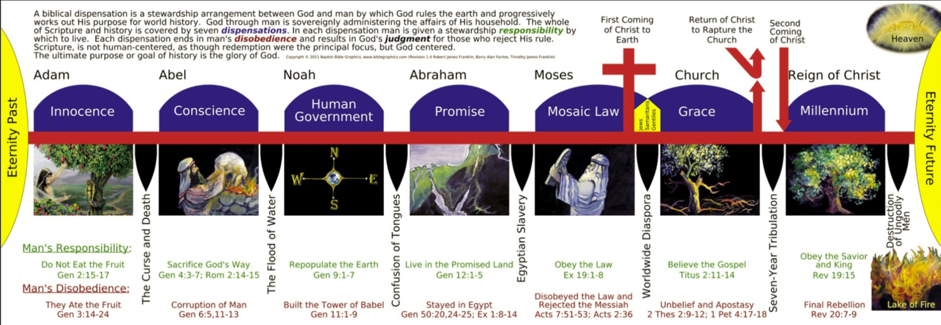
Dispensational Chart
https://biblegraphics.com/downloads/Dispensational%20Chart%201-4%20BIG%20EN.pdf

Slide 32
Dispensationalism – The Israel/Church Distinction
At the heart of dispensationalism is the claim that there are two distinct peoples of God:
Israel (ethnic descendants of Abraham), and
The church (believers from Pentecost to the rapture).
This distinction undergirds the pre-tribulation rapture, which removes the church so God can resume dealing with national Israel.
The scriptures, by contrast, teach that under the New Covenant, Jews and Gentiles have been united and there is now one people of God
New Testament writers do continue to use the categories “Israel”, “church”, and “Gentile”, but not in a way that creates two peoples of God; the New Testament recognizes ethnic Jews and Gentiles both inside and outside the church while maintaining a single (new) covenant people.
The New Testament portrays the people of God as one continuous “tree”: unbelieving Jewish branches are pruned, believing Jews remain, and believing Gentiles are “grafted in” to the same tree by faith in Christ (cf. Rom 11:17-24).
This contradicts the Israel–church distinction taught by dispensationalism.
https://learn.ligonier.org/articles/dispensationalism

Slide 33
The Unity of the People of God in the New Covenant
Ephesians 2:11-19 – Therefore remember that at one time you Gentiles … were … separated from Christ, alienated from the commonwealth of Israel and strangers to the covenants of promise, having no hope and without God in the world. But now in Christ Jesus you who once were far off have been brought near by the blood of Christ. For he himself is our peace, who has made us both one and has broken down in his flesh the dividing wall of hostility by abolishing the law of commandments expressed in ordinances, that he might create in himself one new man in place of the two, so making peace, and might reconcile us both to God in one body through the cross, thereby killing the hostility. And he came and preached peace to you who were far off and peace to those who were near. For through him we both have access in one Spirit to the Father. So then you are no longer strangers and aliens, but you are fellow citizens with the saints and members of the household of God.

Slide 34
Covenant Theology
Covenant theology is a Reformed hermeneutical framework that interprets Scripture through its covenantal structure of its own making.
Covenant theology teaches that there are three overarching covenants:
Covenant of Redemption – An eternal, intratrinitarian covenant in which the Father chose a people, the Son agreed to redeem them through His obedience, death, and resurrection, and the Spirit applies that redemption, with all three persons involved in every aspect.
Covenant of Works – Made with Adam as the federal head of humanity. Perfect obedience would have resulted in eternal life for all; Adam’s disobedience is imputed to humanity, resulting in sin and estrangement. The covenant’s demands remain in force for all people.
Covenant of Grace – Established after the Fall, in which God graciously saves sinners through Jesus Christ. Salvation is received by faith alone, which produces obedience. This covenant is gracious because Christ fulfills the covenant of works on behalf of His people.
https://learn.ligonier.org/guides/covenant-theology

Slide 35
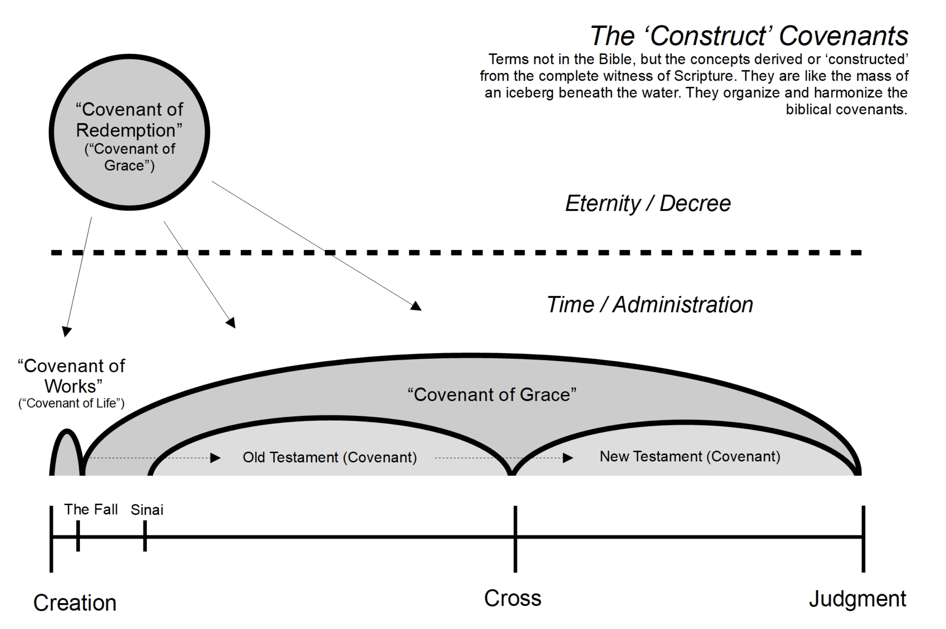
Covenant Theology Chart
https://westportexperiment.com/wp-content/uploads/2022/03/wcf-07-the-covenants.jpg

Slide 36
Problems With Covenant Theology
One problem with Covenant Theology is that it reads a number of theological ideas into scripture that are not specifically stated.
For example, it claims to see theological “covenants” that the scriptures never mention, but then turns around and refers to the covenants actually given in the Bible as “administrations” of their made-up covenants.
But the biggest problem I have with Covenant Theology is that, by viewing all of the biblical covenants as being a part of a bigger “Covenant of Grace”, there is a strong tendency on the part of Covenant theologians to blur the distinctions that exist between the biblical covenants – something the Bible itself is careful not to do.

Slide 37
Problems With Covenant Theology
Some examples where we see this blurring of distinctions are:
Tithing – Since tithing took place in earlier “administrations” of the Covenant of Grace (i.e. Abraham tithed, Jacob tithed, Moses prescribed tithing) then it is natural to assume that Cain and Abel must have been required to tithe and that tithing is expected in the final “administration” of the Covenant of Grace (i.e., the New Covenant)
Sabbath Keeping – The “people of God” were commanded to keep the Sabbath in an earlier “administration” of the Covenant of Grace (i.e. Moses prescribed Sabbath-keeping), therefore it’s natural to assume that God expects men in all “administration” of the Covenant of Grace to “keep the Sabbath”.

Slide 38
Problems With Covenant Theology
What this kind of thinking ultimately leads to is Infant “Baptism”:
Since infants were included in the earlier “administrations” of the Covenant of Grace (i.e. circumcision in the Abrahamic and Mosaic “administrations” of the Covenant of Grace ) then it is only natural to assume that we should expect to include infants in the final “administration” of the Covenant of Grace (i.e. infant baptism in the New Covenant)
So, following this line of thinking, it seems natural to those attending an Orthodox Presbyterian Church service for the “baptism” of an infant to see the parents being asked:
Do you acknowledge that, although our children are conceived and born in sin and therefore subject to condemnation, they are holy in Christ, and as members of his church ought to be baptized? (Trinity Hymnal [Confessional Edition], Philadelphia, 1961, p.667 – emphasis added).
To be clear, I realize that not everyone who holds to Covenant Theology believes in infant baptism. But I think that to be consistent in holding to Covenant Theology, you would ultimately have to end up there.

Slide 39
In Summary
While the man-made theological systems may, at points, offer helpful insights – by adding to what the scriptures present they end up introducing ideas and practices that are contrary to scripture.
We should instead:
Recognize that man’s relationship with God throughout redemption history has been governed by a series of divine covenants identified in scripture.
Recognize there is now one people of God united in Christ (Eph 2:11-19) and that we are now under a New Covenant that was promised and foreshadowed in earlier covenants and was secured by the precious blood of Christ in his death on the cross (1 Corinthians 9:19-21; Galatians 6:2).
Therefore, should not try to impose on the people of God the laws and requirements of earlier covenants which were but “a shadow” of the things to come (Colossians 2:14, 16-17 )
Instead, we should recognize that being under a New Covenant we are to be governed by the “Law of Christ” given in these “last days” (Heb 1:1-2) through Christ and his apostles.

