Slide 1
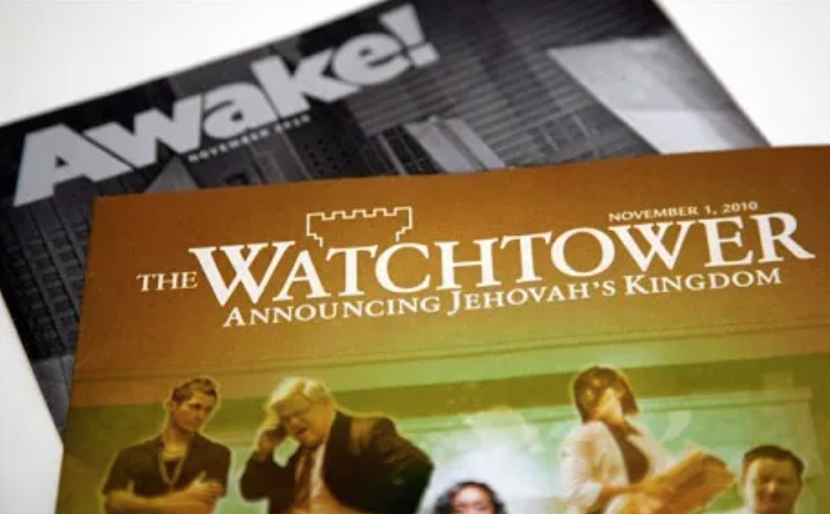
Sharing the Light of God’s Truth with Jehovah Witnesses
Russia Supreme Court bans Jehovah’s Witnesses as extremist | Premium Times Nigeria

Slide 2
Some Questions Before We Start
How many of you have had the Jehovah’s Witness come to your door?
If you have, how did that go?
Or, if it’s happened multiple times, how does it typically go for you?
Do you believe we have an obligation to at least try and share the Gospel with Jehovah Witnesses who come and knock on our door? Why or why not?

Slide 3
Some Introductory Comments
My Personal Experience with Jehovah’s Witnesses
What Jehovah Witnesses Believe (Quick High-Level Overview)
The Source of Jehovah Witnesses Erroneous Beliefs:
Their Organization
Their Twisted Bible Translation (New World Translation)
Their Most Significant Erroneous Belief
How Do We Best Attempt to Dissuade Them of Their Erroneous View of Who God is and Who Jesus is?
I don’t recommend arguing with them over John 1:1
I recommend using other texts (and there are many available) that they have not been brainwashed on

Slide 4
Questions to Ask:
Psalm 102:22-27 (LSV)
²² When the peoples are gathered together, And the kingdoms, to serve Yahweh.
²³ He has afflicted my strength in the way; He has shortened my days.
²⁴ I say, “O my God, do not take me away in the midst of my days, Your years are from generation to all generations.
²⁵ Of old You founded the earth, And the heavens are the work of Your hands.
^{26a} Even they will perish, but You will remain; And all of them will wear out like a garment;
^{26b} Like clothing You will change them and they will be changed.
²⁷ But You are the same, And Your years will not come to an end.
Who is being addressed in this passage?
(YHWH – see verse 22)
What is being said about YHWH here?
He is unchanging. He is immutable: You are the same And Your years will not come to an end (verse 27).
And he is put in direct contrast to the creation, which comes into existence and ages, but he does not age.
Would you agree with me that only YHWH is unchanging? Because he is the creator of all things. He is eternal. He did not have a beginning, and will not have an end.
https://www.aomin.org/aoblog/the-dividing-line/lets-bring-the-light-of-gods-truth-to-jehovahs-witnesses/

Slide 5
Psalm 102:22-27 (LSV) | Heb 1:8-12 (LSV)
²² When the peoples are gathered together, And the kingdoms, to serve Yahweh.
²³ He has afflicted my strength in the way; He has shortened my days. | ⁸ But of the Son He says, “Your throne, O God, is forever and ever, And the scepter of uprightness is the scepter of Your kingdom.
²⁴ I say, “O my God, do not take me away in the midst of my days, Your years are from generation to all generations. | ⁹ You have loved righteousness and hated lawlessness; Therefore God, Your God, has anointed You with the oil of gladness above Your companions.”
²⁵ Of old You founded the earth, And the heavens are the work of Your hands. | ¹⁰ And, “You, Lord, in the beginning founded the earth, and the heavens are the works of Your hands;
^{26a} Even they will perish, but You will remain; And all of them will wear out like a garment; | ¹¹ They will perish, but You remain; And they all will wear out like a garment,
^{26b} Like clothing You will change them and they will be changed. | ^{12a} And like a mantle You will roll them up; Like a garment they will also be changed.
²⁷ But You are the same, And Your years will not come to an end. | ^{12b} But You are the same, And Your years will not come to an end.”
https://www.aomin.org/aoblog/the-dividing-line/lets-bring-the-light-of-gods-truth-to-jehovahs-witnesses/

Slide 6
Observations on the Citation of Psalm 102:25-27 in Hebrews 1:10-12
Notice verse 12 applies Ps 102:28 (which says that says that only YHWH is unchanging) to the Son.
The implication is that since only YHWH is unchanging, and Jesus is said her to be unchanging, then Jesus must be YHWH.
Do you see that?
Note: The New World Translation Study Edition (which is available online) has a footnote on Hebrews 1:10 that says “The psalmist addressed these words to God. (Ps 102:1, 24) But Paul applies them to Jesus because Jesus is the one whom God used as His agent, or instrument, in creating everything, as Heb 1:2 and other verses show.” (https://www.jw.org/en/library/bible/study-bible/books/hebrews/1/ )
https://www.aomin.org/aoblog/the-dividing-line/lets-bring-the-light-of-gods-truth-to-jehovahs-witnesses/

Slide 7
Questions to Ask:
John 12:38-41 (LSV)
³⁶ While you have the Light, believe in the Light, so that you may become sons of Light.” These things Jesus spoke, and He went away and hid Himself from them.
³⁷ But though He had done so many signs before them, they still were not believing in Him,
³⁸ so that the word of Isaiah the prophet might be fulfilled, which he spoke: “Lord, who has believed our report? And to whom has the arm of the Lord been revealed?”
³⁹ For this reason they could not believe, for Isaiah said again,
⁴⁰ “He has blinded their eyes and He hardened their heart, lest they see with their eyes and understand with their heart, and return and I heal them.”
⁴¹ These things Isaiah said because he saw His glory, and he spoke about Him.
In verse 40, John gives a second citation from the book of Isaiah (Isaiah 53:1 is cited in verse 38).
In the next verse (verse 41) John tells us that these words (given in the citation in verse 40) were spoken by Isaiah when Isaiah “saw His glory”.
Whose “glory” did Isaiah see?
It would have to be Jesus’ glory, since the “he” being spoken of in this text is “Jesus” (see verse 36).
When was it that Isaiah gave this citation “because he saw [Jesus’] glory” and “spoke about Him”?
https://www.aomin.org/aoblog/the-dividing-line/lets-bring-the-light-of-gods-truth-to-jehovahs-witnesses/

Slide 8
Observations:
Isaiah 6:1-3; 8-10 (LSV)
¹ In the year of King Uzziah’s death I saw the Lord sitting on a throne, high and lifted up, with the train of His robe filling the temple.
² Seraphim stood above Him, each having six wings: with two he covered his face, and with two he covered his feet, and with two he flew.
³ And one called out to another and said, “Holy, Holy, Holy, is Yahweh of hosts; The whole earth is full of His glory.”
⁸ Then I heard the voice of the Lord, saying, “Whom shall I send, and who will go for Us?” Then I said, “Here am I. Send me!”
⁹ He said, “Go, and tell this people: ‘Keep on hearing, but do not understand; Keep on seeing, but do not know.’
¹⁰ Render the hearts of this people insensitive, Their ears dull, And their eyes dim, Lest they see with their eyes, And hear with their ears, And understand with their hearts, And return and be healed.”
So, when you ask Isaiah, whose glory did you see? Isaiah is going to say “Yahweh”. (verse 3)
But when you ask John, whose glory did Isaiah see? John's answer is “Jesus”.
And we know from Isaiah 42:8 that Yahweh does not share his glory with another: “I am Yahweh, that is My name; I will not give My glory to another…”.
https://www.aomin.org/aoblog/the-dividing-line/lets-bring-the-light-of-gods-truth-to-jehovahs-witnesses/

Slide 9
Why Do We Believe in the Trinity?
We believe there is only one God, Yahweh.
We see that the Father is sometimes identified as Yahweh in the scriptures.
In Isaiah 53, for example, Yahweh (the Father) places our sins upon the Messiah.
So, the Father is identified as Yahweh.
But in the two passages we looked at this morning, and in many other places, the Son is identified as Yahweh.
And the Holy Spirit is often referred to in the scriptures as the “Spirit of Yahweh”. (e.g., Isaiah 40:13)
Jehovah’s Witnesses believe don’t believe the Holy Spirit is a person (they believe He is Jehovah’s “active force”).
Yet the scriptures tell us that the Holy Spirit gives the gifts “as he wills” (1Cor 12:11) – that's the action of a person.
https://www.aomin.org/aoblog/the-dividing-line/lets-bring-the-light-of-gods-truth-to-jehovahs-witnesses/

Slide 10
Why Do We Believe in the Trinity?
We believe there is one being of God, shared fully and completely (not divided into thirds) by three divine persons: Father, Son, and Holy Spirit.
The Father's not the Son, the Son is not the Spirit, the Spirit is not the Father.
They're distinguished from one another, but they are all fully divine. And this is why I am a Trinitarian.
We are baptized into the name (singular) of the Father, the Son, and the Holy Spirit (Mat 28:19) – not Jehovah God, Michael the Archangel, and an impersonal force.
https://www.aomin.org/aoblog/the-dividing-line/lets-bring-the-light-of-gods-truth-to-jehovahs-witnesses/

Slide 11
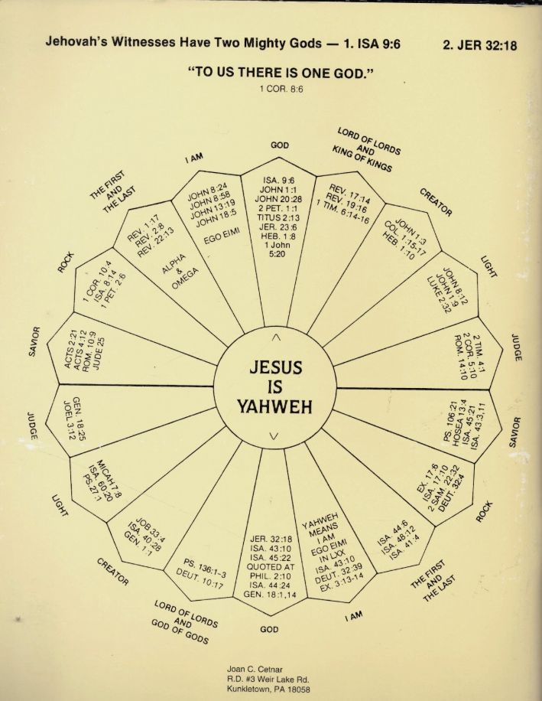
https://www.ebay.com/itm/267436218198

