Slide 1
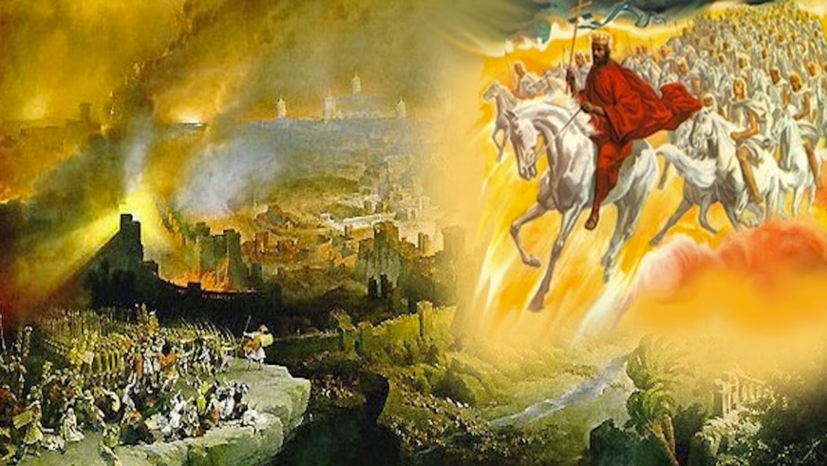
The Book of Revelation
Image credit – https://www.bible.com/events/84698
“The kingdom of the world has become the kingdom of our Lord and of His Christ,
and He shall reign forever and ever.” (Revelation 11:15)
Class Recording and Notes Will Be Available on https://www.purifiedbyfaith.com/

Slide 2
Introduction to Revelation 5
Revelation 5 continues the throne-room vision that we looked at last week in chapter 4.
It has been said that chapter 4 provides the setting, while chapter 5 introduces the drama in this throne-room scene:
Chapter 4
a throne stood elders sitting lamps burning creatures having eyes creatures saying elders worshiping
Chapter 5
John sees a scroll a mighty angel proclaims no one is able to open it John weeps an elder speaks the Lamb comes He takes the scroll heaven erupts in worship

Slide 3
Introduction to Revelation 5
In chapter 5, the focus shifts from God the Creator, seated on the throne, to Jesus Christ, the Lamb, who alone is worthy to carry out God’s redemptive plan.
Most commentators agree that Revelation 5 is one of the central chapters of the book and serves as a key to understanding all that follows.
The chapter presents Christ as the slain and risen Redeemer who shares God’s authority and is worthy of universal worship.

Slide 4
The Scroll and the Lamb (5:1-7)
^{5:1} Then I saw in the right hand of him who sat on the throne a scroll with writing on both sides and sealed with seven seals. ² And I saw a mighty angel proclaiming in a loud voice, “Who is worthy to break the seals and open the scroll?” ³ But no one in heaven or on earth or under the earth could open the scroll or even look inside it. ⁴ I wept and wept because no one was found who was worthy to open the scroll or look inside. ⁵ Then one of the elders said to me, “Do not weep! See, the Lion of the tribe of Judah, the Root of David, has triumphed. He is able to open the scroll and its seven seals.” ⁶ Then I saw a Lamb, looking as if it had been slain, standing in the center of the throne, encircled by the four living creatures and the elders. He had seven horns and seven eyes, which are the seven spirits of God sent out into all the earth. ⁷ He came and took the scroll from the right hand of him who sat on the throne. (NIV)

Slide 5
^{5:1} Then I saw in the right hand of him who was seated on the throne a scroll written within and on the back, sealed with seven seals. (ESV)
Here John sees a “scroll” in the “right hand” of God, “sealed with seven seals”
The “right hand” symbolizes God's power and authority (Exod. 15:6, 12; Ps. 98:1; Isa. 48:13).
The fact that the scroll is written on both sides (“within and on the back”) is significant.
Papyrus scrolls were normally written on one side only, since the grain of the papyrus ran more smoothly on the front.
Writing on the back was awkward and generally indicated either poverty or an extraordinary amount of content to communicate.
God is obviously not poor, so the double-sided writing suggests that the scroll is so full of content that both sides are required.

Slide 6
^{5:1} Then I saw in the right hand of him who was seated on the throne a scroll written within and on the back, sealed with seven seals. (ESV)
This scroll is reminiscent of Ezekiel 2:9–10 where it also describes a scroll written on both sides containing a message of God's judgment.
Pulling together these observations most commentaries have come to the conclusion that the “scroll” here in verse 1 contains God's plan for history—his purposes of salvation, judgment, and the final establishment of his kingdom.
The “seven seals” emphasize both security and completeness.
The contents cannot be accessed until the seals are broken.
In Daniel 12:4, 9 the prophet Daniel was given a document concerning which he was instructed: “shut up the words and seal the book, until the time of the end”.
Here we see those hidden purposes are finally ready to be revealed and enacted.

Slide 7
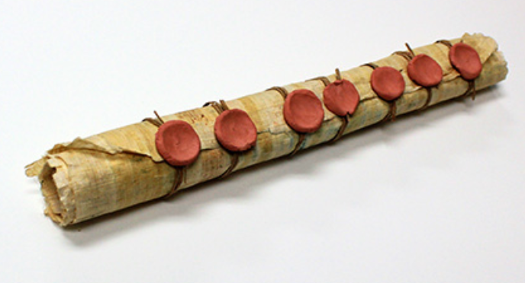
^{5:1} Then I saw in the right hand of him who was seated on the throne a scroll written within and on the back, sealed with seven seals. (ESV)
https://thebiblespeakstoyou.com/christ-opens-the-book-with-seven-seals-today/

Slide 8
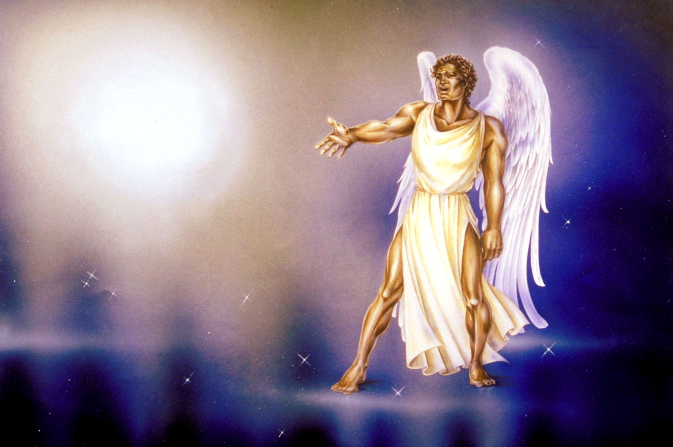
^{5:2} And I saw a strong angel proclaiming with a loud voice, “Who is worthy to open the scroll and break its seals?” (ESV)
Pat Marvenko Smith. Revelation Illustrated: An Artist's View of the Bible's Last Book (1982)

Slide 9
^{5:2} And I saw a strong angel proclaiming with a loud voice, “Who is worthy to open the scroll and break its seals?” (ESV)
Here a mighty angel then issues a challenge: “Who is worthy to open the scroll and break its seals?”.
The question is not merely who is strong enough, but who is worthy to “open the scroll and break its seals”.
This challenge must be understood in light of chapter 4.
The scroll rests in the hand of the holy and sovereign God who sits on the heavenly throne.
Who could possibly approach such a God, take the scroll, and bring his purposes to completion?

Slide 10
^{5:3} And no one in heaven or on earth or under the earth was able to open the scroll or to look into it, ⁴ and I began to weep loudly because no one was found worthy to open the scroll or to look into it. (ESV)
The answer is startling: “no one in heaven or on earth or under the earth was able to open the scroll” or even look inside it.
No angel, no human ruler, no spiritual being, and no power from the realm of the dead can do so.
This demonstrates the complete inability of all creation to solve humanity's deepest problem.
The solution cannot arise from within creation itself.
As a result, John begins to “weep loudly”.
His tears are not the disappointment of someone who cannot learn the future.
Rather, he weeps because if the scroll remains unopened, God's redemptive purposes will not come to fulfillment.
Will evil triumph? Will God's promises fail? John's tears reflect the desperation of a suffering church longing for God's kingdom to come.

Slide 11
^{5:5} And one of the elders said to me, “Weep no more; behold, the Lion of the tribe of Judah, the Root of David, has conquered, so that he can open the scroll and its seven seals.” (ESV)
Then one of the twenty-four elders speaks words of hope: “Weep no more; behold, the Lion of the tribe of Judah, the Root of David, has conquered”.
These titles are rich with Old Testament meaning. The “the Lion of the tribe of Judah” comes from Genesis 49:9–10, where Judah is associated with royal authority and the coming ruler.
The “Root of David” echoes Isaiah 11:1, 10 and God's promises of a coming Davidic king.
These titles identify Jesus as the long-awaited Messiah who fulfills God's covenant promises to David (2 Sam. 7; Isa. 11:1–10; Jer. 23:5; Ezek. 37:24).

Slide 12
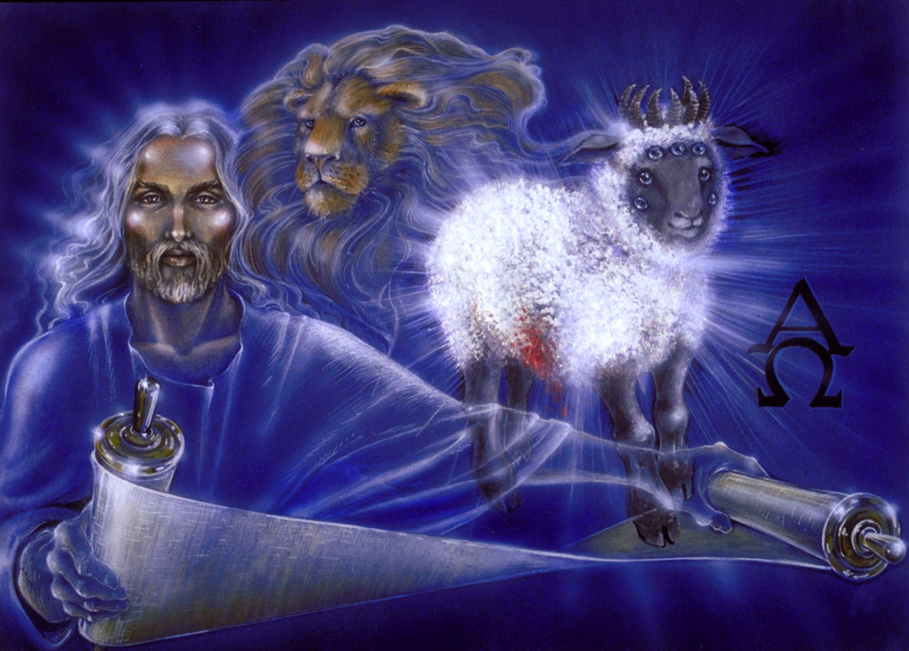
^{5:5b} …behold, the Lion of the tribe of Judah… ⁶ And between the throne and the four living creatures and among the elders I saw a Lamb standing, as though it had been slain, with seven horns and with seven eyes, which are the seven spirits of God sent out into all the earth. (ESV)
Pat Marvenko Smith. Revelation Illustrated: An Artist's View of the Bible's Last Book (1982)

Slide 13
^{5:5b} …behold, the Lion of the tribe of Judah… ⁶ And between the throne and the four living creatures and among the elders I saw a Lamb standing, as though it had been slain, with seven horns and with seven eyes, which are the seven spirits of God sent out into all the earth. (ESV)
The elder announces a conquering “Lion”. Yet when John turns to look, he does not see a lion. Instead, he sees “a Lamb standing, as though it had been slain”.
This is one of Revelation's most powerful surprises.
The “Lion” and the “Lamb” are not two different figures.
The “Lion” is the “Lamb”.
Jesus conquers not through military force but through his sacrificial death and victorious resurrection.
The Messiah wins by becoming the sacrifice.
The Lamb bears marks of slaughter, reminding readers of Isaiah 53:7, where the Suffering Servant prophesied there was to be “like a lamb that is led to the slaughter.”

Slide 14
^{5:6} And between the throne and the four living creatures and among the elders I saw a Lamb standing, as though it had been slain, with seven horns and with seven eyes, which are the seven spirits of God sent out into all the earth. (ESV)
This is probably a reference to the Passover lamb (Exodus 12), whose blood delivered God's people from judgment.
Thus, Christ's death is not merely an example of love; it is an atoning sacrifice that secures redemption.
The Lamb was “slain”, and yet he is “standing” – he is alive!
His death was not defeat but victory!
The resurrection proves that he has conquered.
The Lamb possesses “seven horns” and “seven eyes”.
Most commentators understand these symbols as representing perfect power and perfect knowledge.
Horns commonly symbolize kingly authority and strength, while eyes symbolize complete knowledge and perception (cf. Zech. 4:10; 2 Chron. 16:9).
The Lamb therefore possesses all authority and all wisdom.

Slide 15
^{5:7} And he went and took the scroll from the right hand of him who was seated on the throne. (ESV)
Finally, the Lamb approaches the throne and takes the scroll from God's hand.
This is a very significant moment.
The Lamb stands at the very center of the throne room and is able to do what no creature can do.
This points to Christ's divine identity.
He is distinct from the One seated on the throne, yet shares in God's authority and glory.
Both the Lamb's position at the center of the throne and the worship he receives throughout Revelation demonstrate that the Lamb if fully divine.

Slide 16
The Worship of the Lamb (5:8-14)
^{5:8} And when he had taken it, the four living creatures and the twenty-four elders fell down before the Lamb. Each one had a harp and they were holding golden bowls full of incense, which are the prayers of the saints. ⁹ And they sang a new song: “You are worthy to take the scroll and to open its seals, because you were slain, and with your blood you purchased men for God from every tribe and language and people and nation. ¹⁰ You have made them to be a kingdom and priests to serve our God, and they will reign on the earth.” ¹¹ Then I looked and heard the voice of many angels, numbering thousands upon thousands, and ten thousand times ten thousand. They encircled the throne and the living creatures and the elders. ¹² In a loud voice they sang: “Worthy is the Lamb, who was slain, to receive power and wealth and wisdom and strength and honor and glory and praise!” ¹³ Then I heard every creature in heaven and on earth and under the earth and on the sea, and all that is in them, singing: “To him who sits on the throne and to the Lamb be praise and honor and glory and power, for ever and ever!” ¹⁴ The four living creatures said, “Amen,” and the elders fell down and worshiped. (NIV)

Slide 17
^{5:8} And when he had taken the scroll, the four living creatures and the twenty-four elders fell down before the Lamb, each holding a harp, and golden bowls full of incense, which are the prayers of the saints. (ESV)
Revelation 5:8–14 is one of the most important worship scenes in the entire Bible.
It forms the climax of chapters 4–5 and explains why Jesus alone is worthy to open the scroll and carry out God's plan for history.
Without the Lamb taking the scroll and breaking its seals, none of the book's unfolding drama can occur.
The taking of the scroll is not merely a transfer of a document — it is the inauguration of God's redemptive and judicial purposes for history.

Slide 18
^{5:8} And when he had taken the scroll, the four living creatures and the twenty-four elders fell down before the Lamb, each holding a harp, and golden bowls full of incense, which are the prayers of the saints. (ESV)
When the Lamb takes the scroll from the hand of God, the heavenly court immediately falls before Him in worship.
This is striking because in chapter 4 these same beings worshiped God on the throne.
Now they worship the Lamb in the same way, demonstrating that Jesus shares God's divine status and is worthy of the same honor and adoration.
This is one of Revelation's clearest affirmations of Christ's deity.
As the vision progresses, the scene moves outward in expanding circles of praise:
  Here the “four living creatures” and “twenty-four elders” worship the Lamb.
  Next, we will see countless angels joining them (verses 11-12)
  Finally, we will see that all of creation joins the song (verses 13-14)

Slide 19
^{5:8} And when he had taken the scroll, the four living creatures and the twenty-four elders fell down before the Lamb, each holding a harp, and golden bowls full of incense, which are the prayers of the saints. (ESV)
Each of the elders holds a “harp” and “golden bowls full of incense”.
The “harp” was a musical instrument used for singing happy songs, maybe something like a banjo in our day, which is why the Jews “hung up” their harps when they were being taken into exile (Psalm 137:1-3).
Thus, the harps here represent the celebration and gladness in heaven as God's saving purposes are about to be accomplished.
The “golden bowls full of incense” are specifically identified as “the prayers of the saints”, echoing Psalm 141:2: “Let my prayer be counted as incense [i.e., a pleasant scent] before you.”
These prayers likely include the cries of God's suffering people for deliverance and justice (cf. Rev. 6:10).
The vision assures believers that their prayers have not been forgotten but are brought before God and play a role in the unfolding of His redemptive plan.

Slide 20
^{5:9} And they sang a new song, saying, “Worthy are you to take the scroll and to open its seals, for you were slain, and by your blood you ransomed people for God from every tribe and language and people and nation, ¹⁰ and you have made them a kingdom and priests to our God, and they shall reign on the earth.” (ESV)
The elders and living creatures erupt into a “new song”.
In Old Testament tradition, a “new song” is sung when God executes a fresh, historical act of deliverance. (Ps. 33:3; Isaiah 42:10)
Here, the “new song” celebrates the ultimate deliverance accomplished through the Lamb's sacrificial death and atonement.
The text provides four core dimensions of this atonement. It is a:
  Bloody Atonement:
  Broad Atonement:
  Purposeful Atonement:
  Triumphant Atonement:

Slide 21
^{5:9} And they sang a new song, saying, “Worthy are you to take the scroll and to open its seals, for you were slain, and by your blood you ransomed people for God from every tribe and language and people and nation, ¹⁰ and you have made them a kingdom and priests to our God, and they shall reign on the earth.” (ESV)
Bloody Atonement:
  The Lamb is worthy because He was slain, purchasing humanity “by your blood” .
  The biblical use of “blood” does not imply a mystical fluid, but rather denotes a life violently, sacrificially, and substitutionally ended in place of the guilty (Lev. 17:11) .
  This encompasses both liberation from the bondage of sin and appeasing God's wrath to grant forgiveness.
Broad Atonement:
  The Lamb’s sacrifice purchased people from “every tribe and language and people and nation”.
  This fourfold phrase occurs seven times in the book of Revelation, signifying global completeness.
  It also fulfills God's ancient covenant promise to Abraham that “all peoples on earth will be blessed” through him (Gen 12:3).

Slide 22
^{5:9} And they sang a new song, saying, “Worthy are you to take the scroll and to open its seals, for you were slain, and by your blood you ransomed people for God from every tribe and language and people and nation, ¹⁰ and you have made them a kingdom and priests to our God, and they shall reign on the earth.” (ESV)
Purposeful Atonement:
  Believers are not simply saved from sin; they are purchased “for God”.
  Redemption from sin doesn’t mean you can go on and do things your way, because if you’re still doing things your way, then you’re still in sin!
  The very nature of being redeemed from sin is that you’re redeemed “for God”.
  We are redeemed so that we can now serve God in the way that he requires.

Slide 23
^{5:9} And they sang a new song, saying, “Worthy are you to take the scroll and to open its seals, for you were slain, and by your blood you ransomed people for God from every tribe and language and people and nation, ¹⁰ and you have made them a kingdom and priests to our God, and they shall reign on the earth.” (ESV)
Triumphant Atonement:
  The redeemed are transformed into a “kingdom and priests to our God.” This is a fulfillment of Exodus 19:6.
  We’re all priests in the sense that we all take the message and truth and presence of God and mediate that to the world.
  Then we take the burdens, sins, concerns, passions, guilts, and fears of the world, and we bring them back in intercession to God.
  Furthermore, it says the redeemed “shall reign on the earth,” thus restoring humanity's original creation mandate to exercise righteous dominion over the earth (Gen. 1:26).

Slide 24
^{5:11} Then I looked, and I heard around the throne and the living creatures and the elders the voice of many angels, numbering myriads of myriads and thousands of thousands, ¹² saying with a loud voice, "Worthy is the Lamb who was slain, to receive power and wealth and wisdom and might and honor and glory and blessing!" (ESV)
The worship then expands dramatically.
Myriads of angels surround the throne and proclaim that the Lamb is worthy to receive “power and wealth and wisdom and might and honor and glory and blessing!”
This sevenfold doxology symbolizes complete and perfect praise.
The Lamb possesses all these qualities already; the angels are not giving them to Him but acknowledging His rightful possession of them.

Slide 25
^{5:13} And I heard every creature in heaven and on earth and under the earth and in the sea, and all that is in them, saying, “To him who sits on the throne and to the Lamb be blessing and honor and glory and might forever and ever!” (ESV)
Finally, the praise spreads to “every creature in heaven and on earth and under the earth and in the sea”.
All creation joins in worshiping both God and the Lamb.
This scene echoes Philippians 2:10–11, where every knee bows and every tongue confesses that Jesus Christ is Lord.
The entire created order, which currently groans under the effects of sin (Romans 8:19–22), anticipates the fulfillment of God's purposes in redemption and judgment.
The universe itself celebrates the coming of the new creation.

Slide 26
^{5:14} And the four living creatures said, “Amen!” and the elders fell down and worshiped. (ESV)
The vision concludes with the four living creatures saying “Amen!” and the elders falling down in worship.
The message for believers is clear: despite suffering, persecution, and apparent earthly defeat, the Lamb reigns.
History is under His control.
The cross is not a tragedy, but the center of God's victorious plan.
Therefore, the proper response of God's people is the same response found throughout heaven—worship, trust, and joyful obedience.
Jesus Christ, the slain Lamb, is fully worthy of divine worship because through His sacrificial death He redeemed a people for God and secured the fulfillment of God's purposes for all creation.

Slide 27
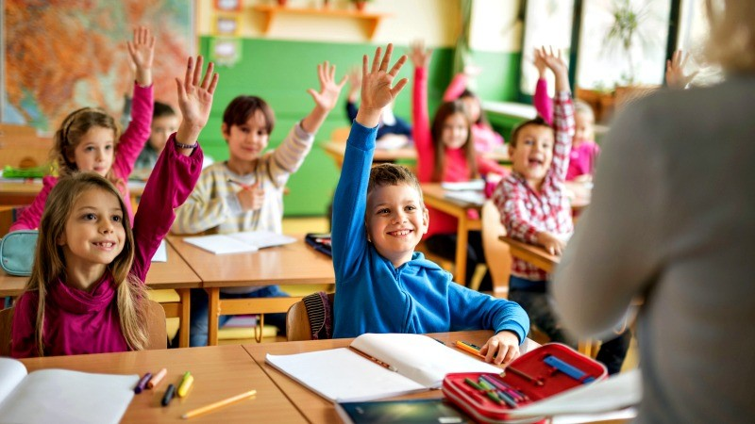
Class Discussion Time
Several weeks ago, I did a short lesson on passages that we could take Jehovah’s witnesses to when they come to our door to demonstrate the Deity of Christ (Ps 102:22-27 cf. Heb 1:8-12; John 12:38-41 cf. Isaiah 6:1-3, 8-10)
Do you think that Revelation 4 and 5 could be added to the list to demonstrate that Jesus (as the Lamb of God) receives the same worship as God the Father?

Slide 28
Class Discussion Time
Does it ever feel like your prayer time is not as valuable a part of your Christian service as other things that you do?
Our passage today describes the “prayers of the saints” are symbolized as “golden bowls full of incense”
I compared this to Psalm 141:2 in which David says, “Let my prayer be counted as incense before you.”
What do you think these two texts are telling us about the significance of our prayers in the eyes of God?

Slide 29
Class Discussion Time
Rev 5:9 tells us that when Christ ransomed us, he ransomed us “for God”.
What does that mean and what are the implications of that statement concerning how you should be living your Christian life?
Rev 5:10 tells us we are “a kingdom and priests to our God”.
What does that mean, and what are the implications of that statement concerning how you should be living your Christian life?

